Slide 1
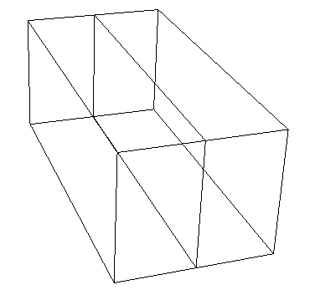
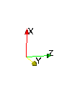
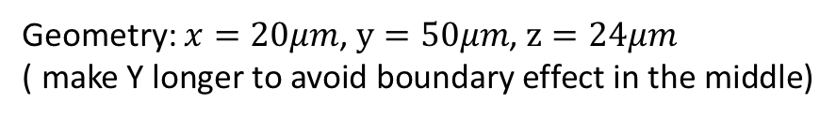
Bicrystal Model
Case 1: Rotate along X axis for 45 degrees;
Case 2: Rotate along X axis for 90 degrees
Case 2: Rotate along X axis for 135 degrees
X
X
Y
Z
Z
Y
Geometry: $x=20μm$, $y=50μm$, $z=24μm$
( make Y longer to avoid boundary effect in the middle)

Slide 2
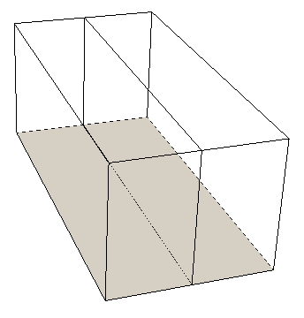
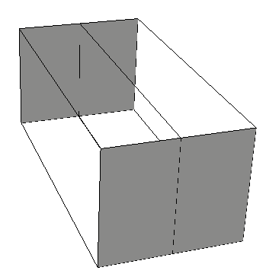
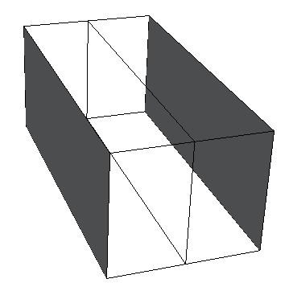
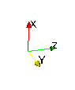
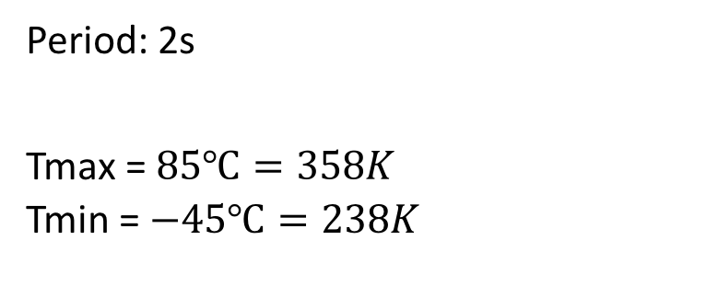
Boundary conditions:
Loading: thermal cycling
Constrain all the boundaries, free the top
Period: 2s
Tmax = $85℃=358K$
Tmin = $−45℃=238K$
Ux=0
Uy=0
Uz=0

Slide 3
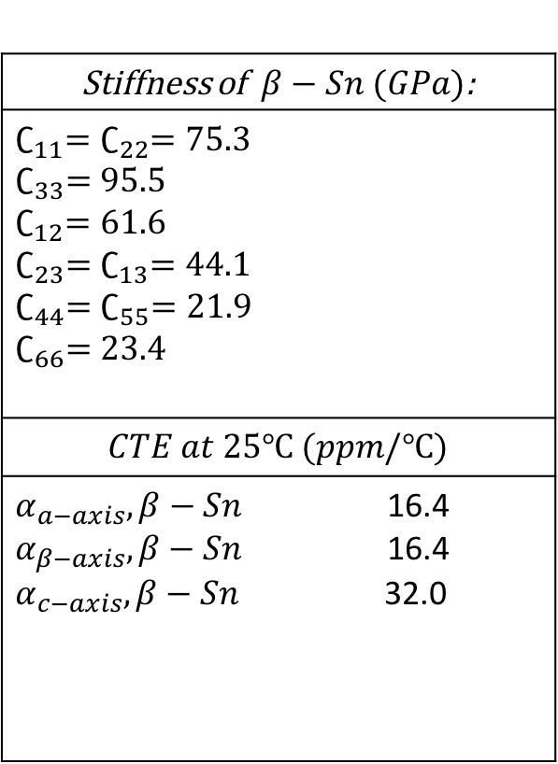
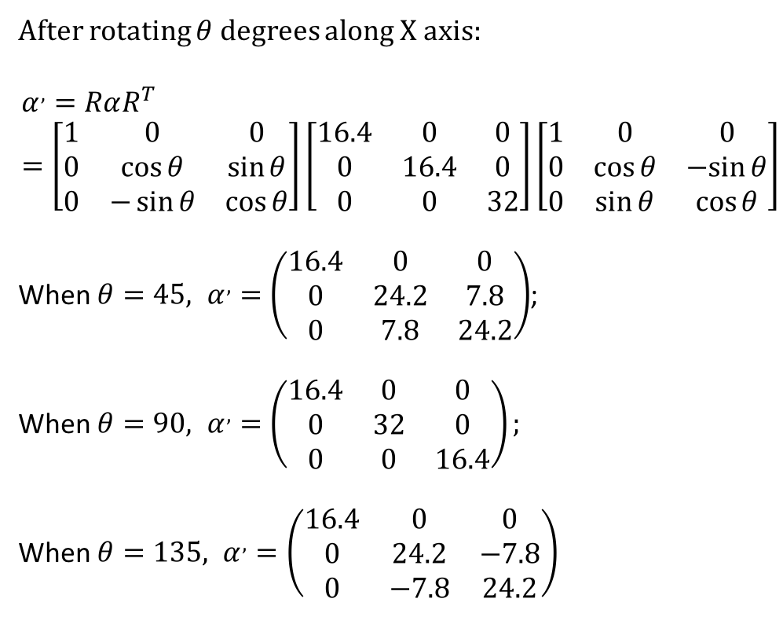

Material: $β−Sn$ (body-centered tetragonal)
Stiffness of$β−Sn (GPa)$:
$∁_{11}=∁_{22}=75.3$ $∁_{33}=95.5$ $∁_{12}=61.6$ $∁_{23}=∁_{13}=44.1$ $∁_{44}=∁_{55}=21.9$ $∁_{66}=23.4$
$$CTE at 25℃ (ppm/℃)$$
$α_{a−axis},β−Sn$ 16.4 $α_{β−axis},β−Sn$ 16.4 $α_{c−axis},β−Sn$ 32.0
After rotating $θ$ degrees along X axis:
$$α^{,}=RαR^{T}=\left[\begin{matrix}1 & 0 & 0 \\ 0 & \cos{θ} & \sin{θ} \\ 0 & −\sin{θ} & \cos{θ}\end{matrix}\right]\left[\begin{matrix}16.4 & 0 & 0 \\ 0 & 16.4 & 0 \\ 0 & 0 & 32\end{matrix}\right]\left[\begin{matrix}1 & 0 & 0 \\ 0 & \cos{θ} & −sin{θ} \\ 0 & \sin{θ} & \cos{θ}\end{matrix}\right]$$
When $θ=45, α^{,}=\left(\begin{matrix}16.4 & 0 & 0 \\ 0 & 24.2 & 7.8 \\ 0 & 7.8 & 24.2\end{matrix}\right)$;
When $θ=90, α^{,}=\left(\begin{matrix}16.4 & 0 & 0 \\ 0 & 32 & 0 \\ 0 & 0 & 16.4\end{matrix}\right);$
When $θ=135, α^{,}=\left(\begin{matrix}16.4 & 0 & 0 \\ 0 & 24.2 & −7.8 \\ 0 & −7.8 & 24.2\end{matrix}\right)$

Slide 4
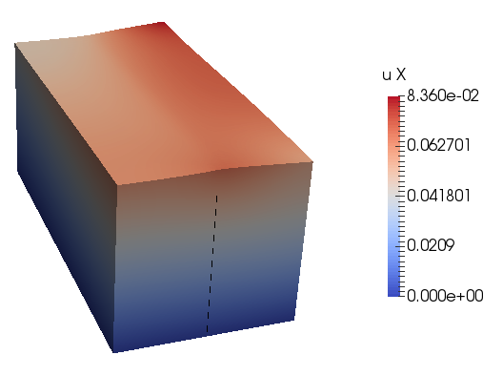
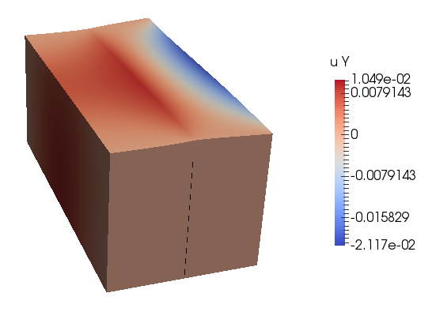
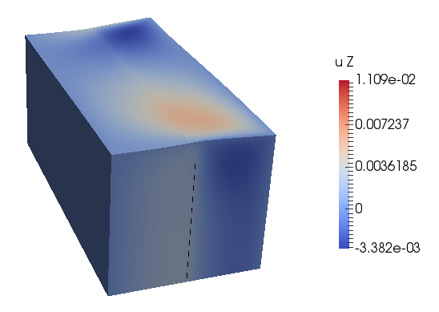
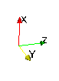
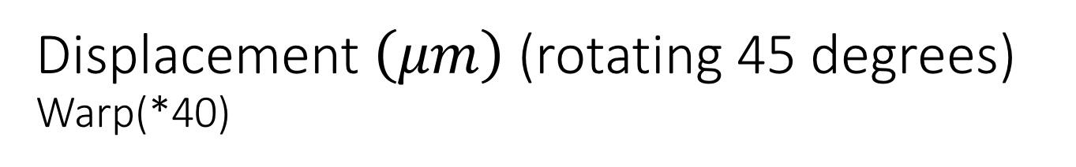
Displacement $\left(μm\right)$ (rotating 45 degrees)
Warp(*40)
Here are the displacements at max temperature

Slide 5
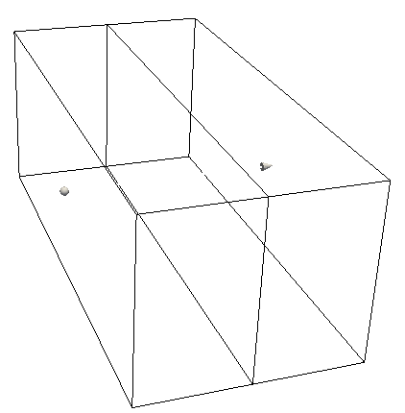
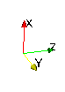
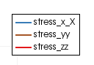
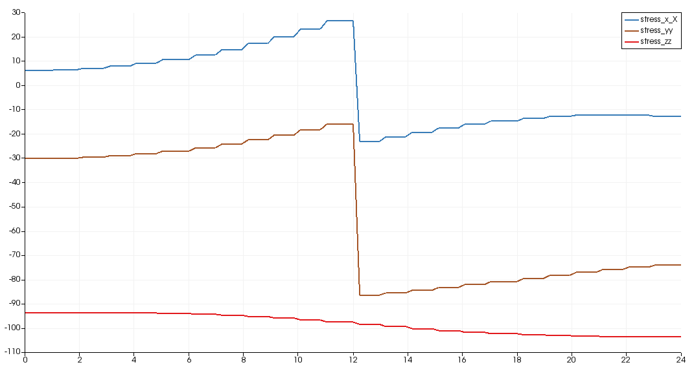
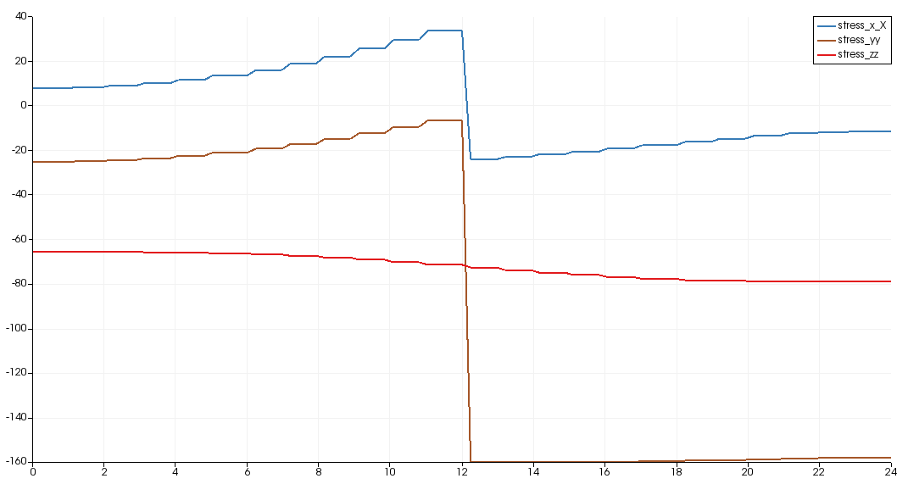
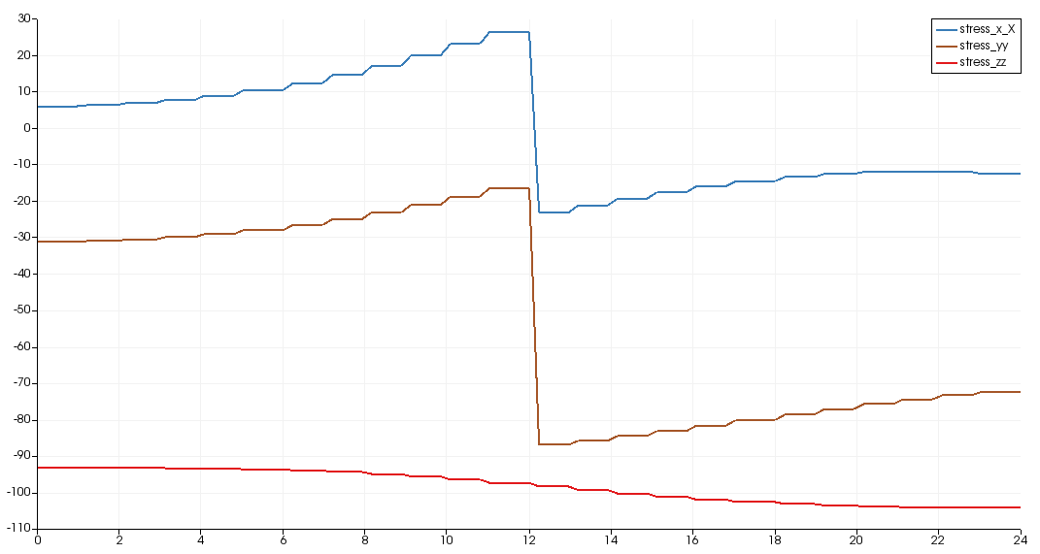
At max temperature
Stress (MPa)
Normal to grain boundary
Case 1:
rotate 45 degrees
Case 2:
rotate 90 degrees
Case 3:
rotate 135 degrees

Slide 6
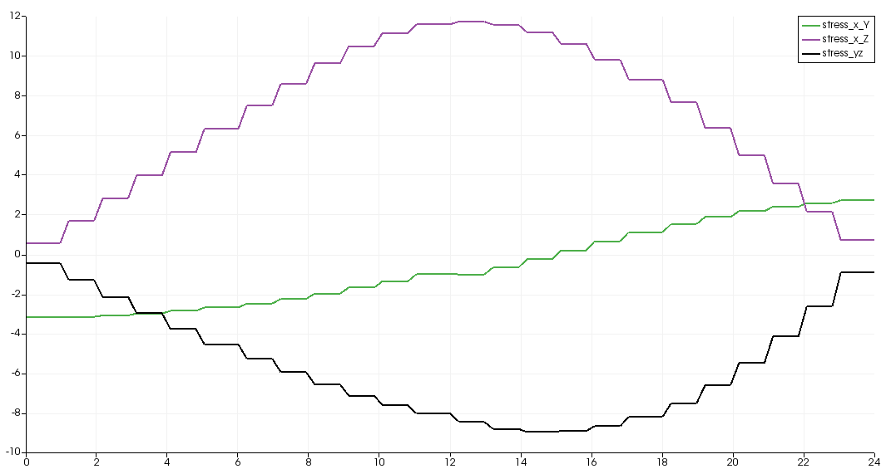
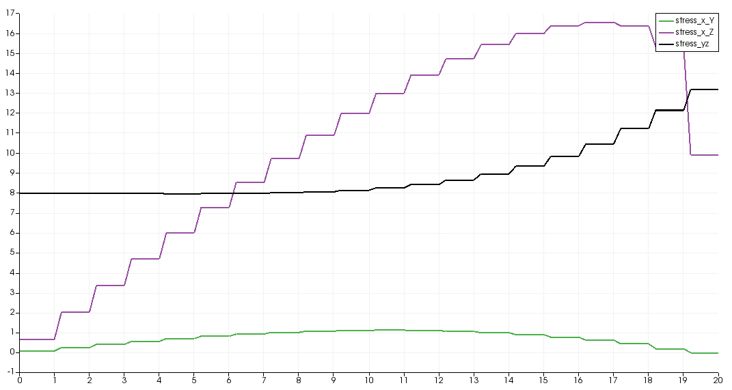
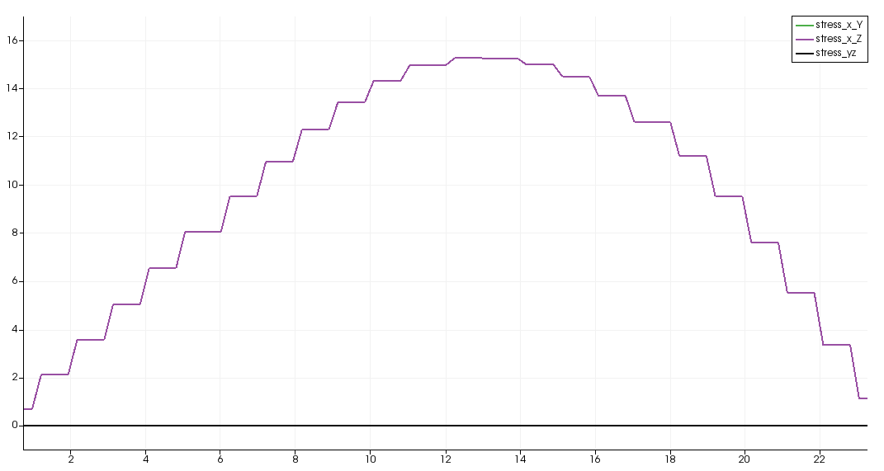
At max temperature
Stress (MPa)
Normal to grain boundary
Case 1:
Rotate 45 degrees
Case 2:
rotate 90 degrees
Case 3:
rotate 135 degrees

Slide 7
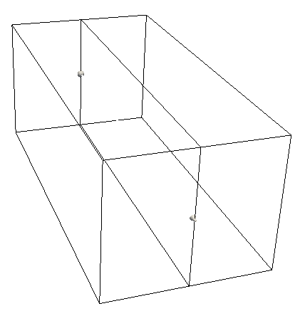
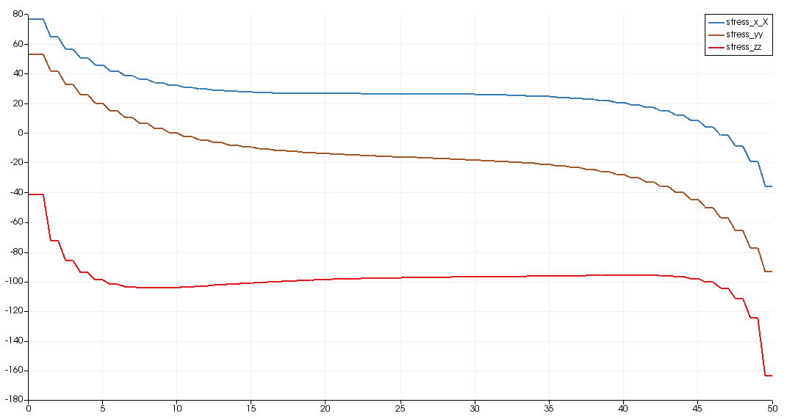
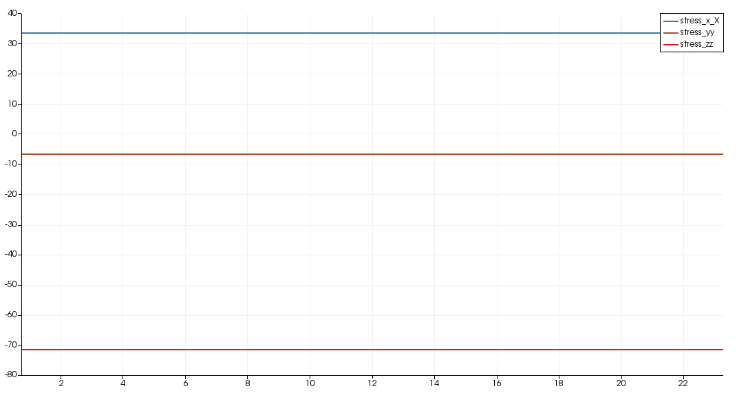
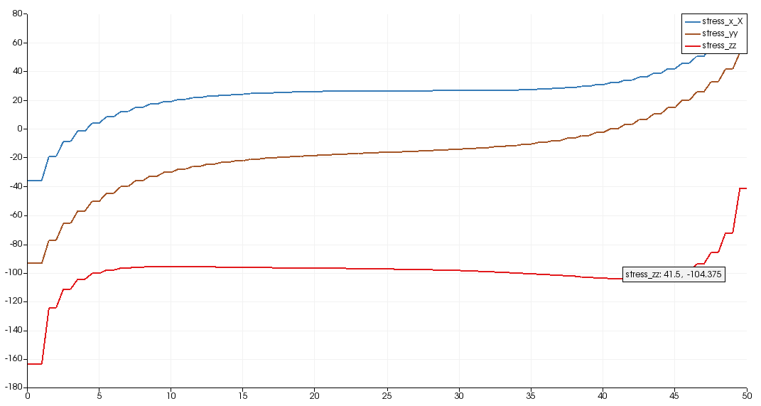
At max temperature
Stress (MPa)
Parallel to grain boundary
Case 1:
rotate 45 degrees
Case 2:
rotate 90 degrees
Case 3:
rotate 135 degrees

Slide 8
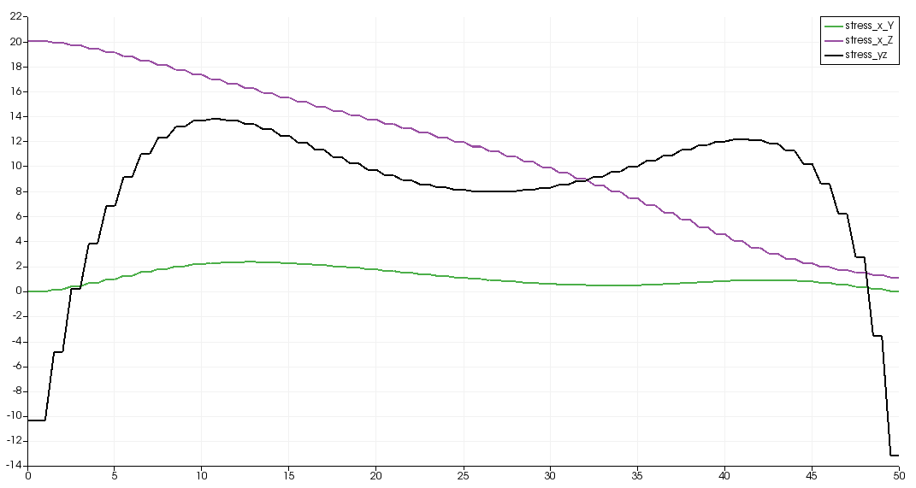
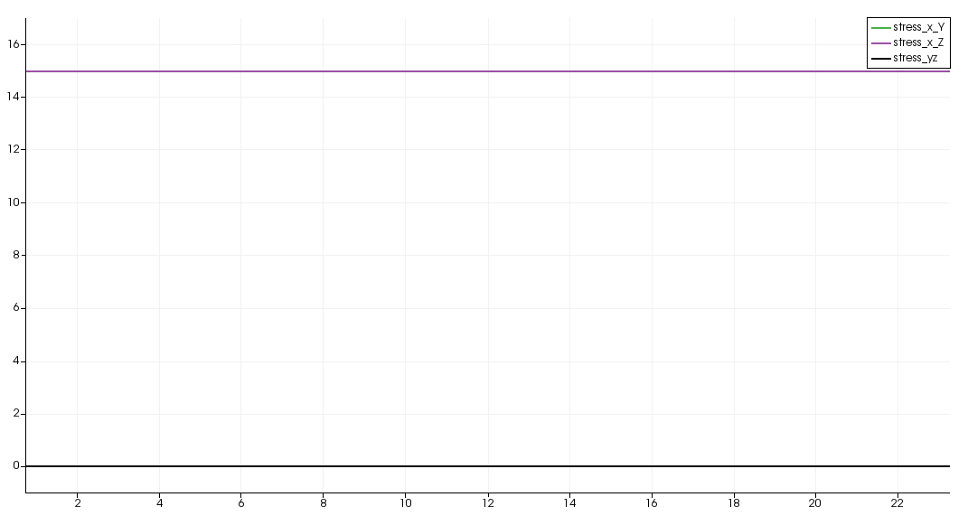
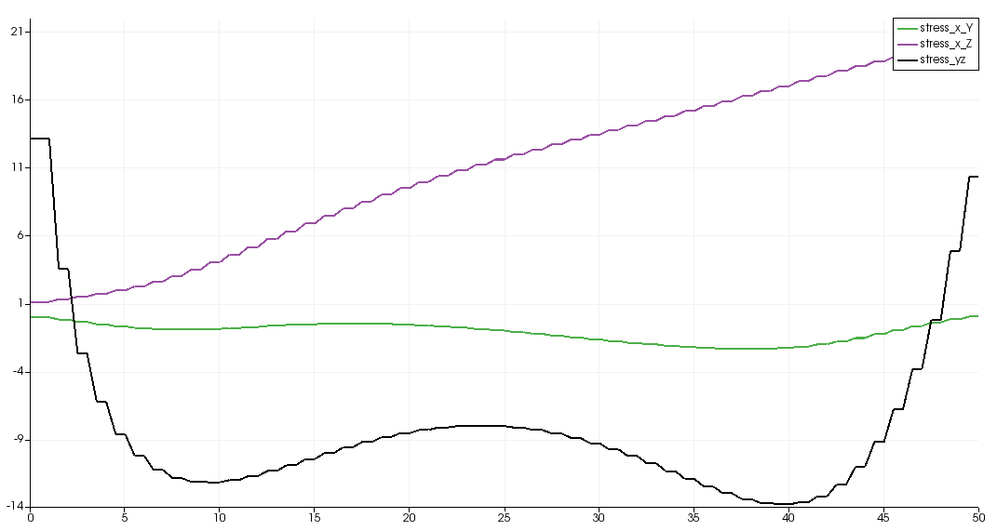
At max temperature
Stress (MPa)
Parallel to grain boundary
Case 1:
rotate 45 degrees
Case 2:
rotate 90 degrees
Case 3:
rotate 135 degrees

Slide 9

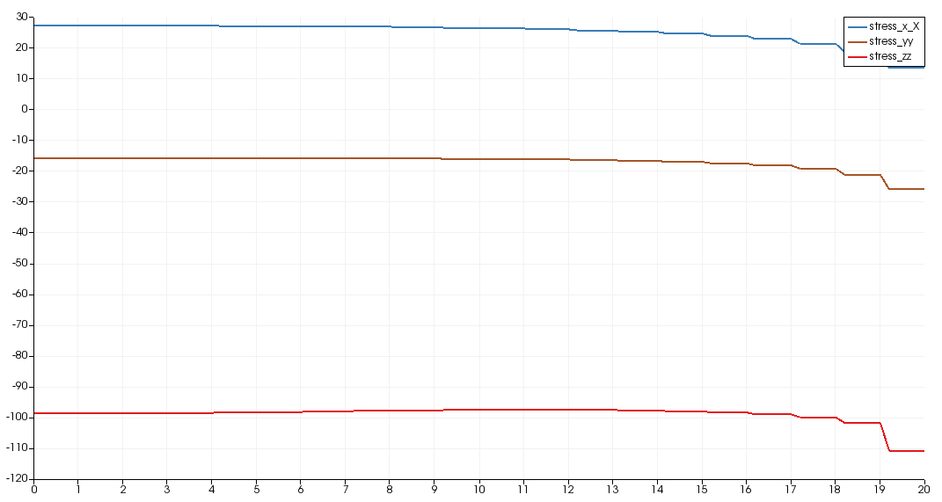
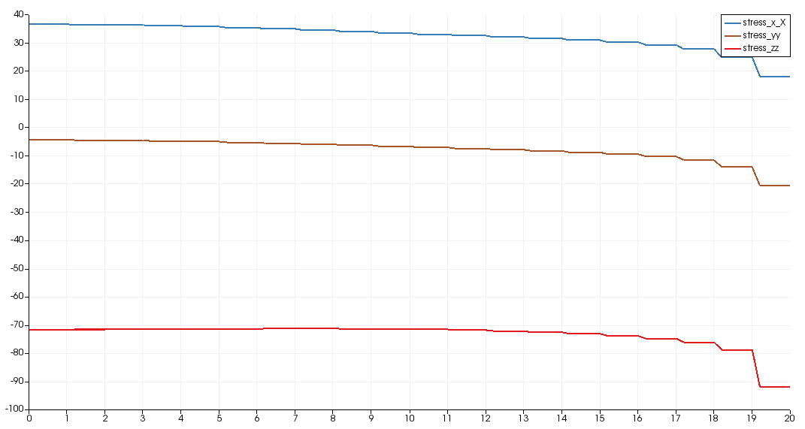
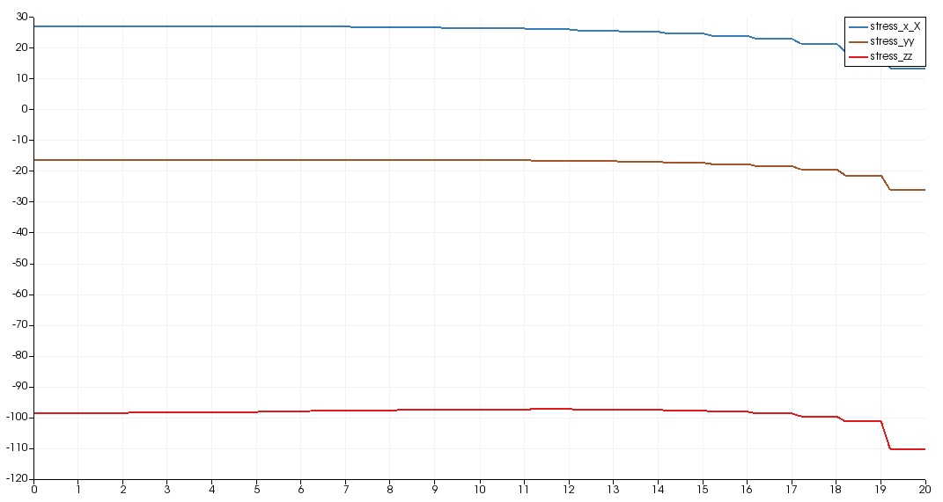
At max temperature
Stress (MPa)
Out of plane
Case 1:
rotate 45 degrees
Case 2:
rotate 90 degrees
Case 3:
rotate 135 degrees

Slide 10
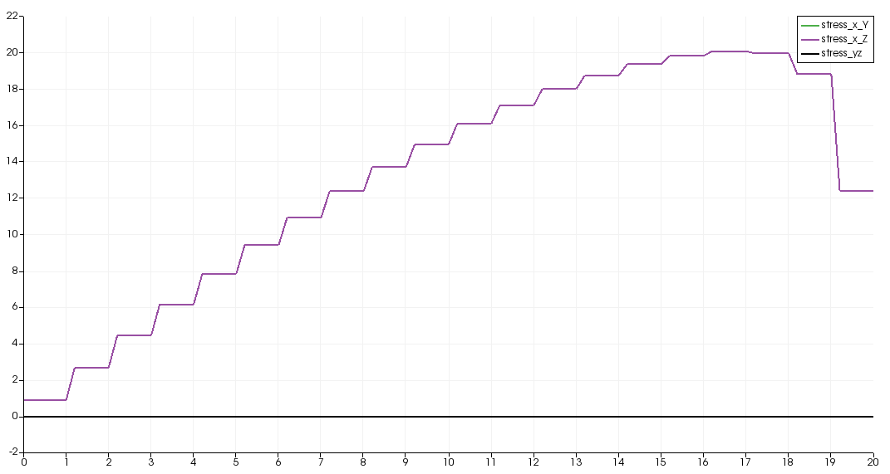
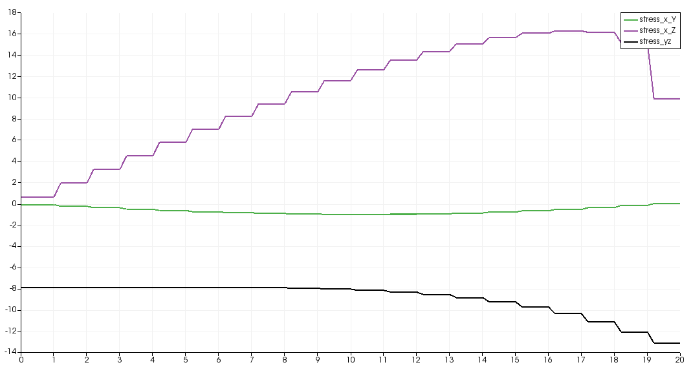
At max temperature
Stress (MPa)
Out of plane
Case 1:
rotate 45 degrees
Case 2:
rotate 90 degrees
Case 3:
rotate 135 degrees

