Slide 1


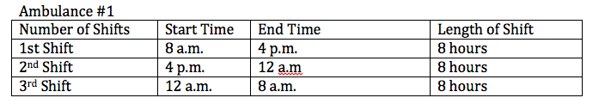
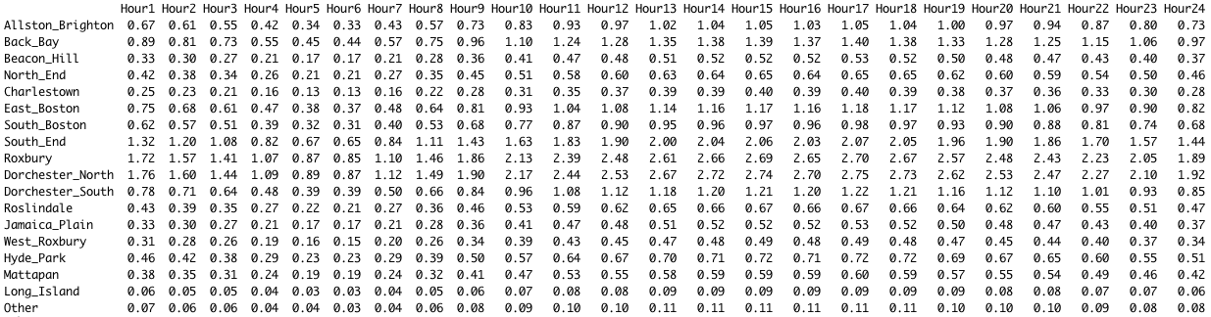
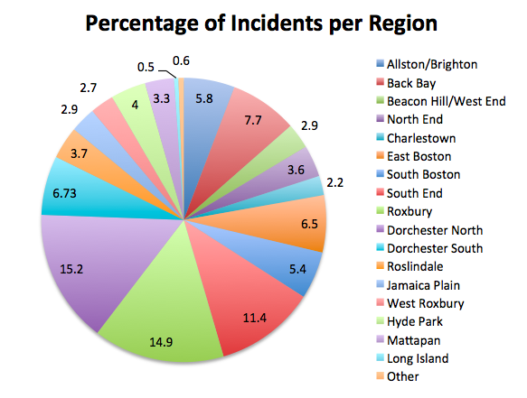
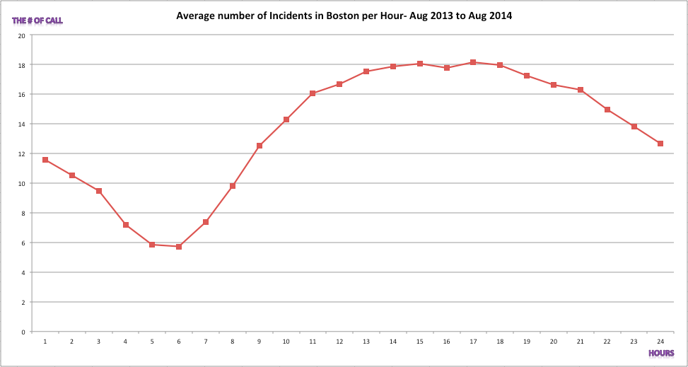
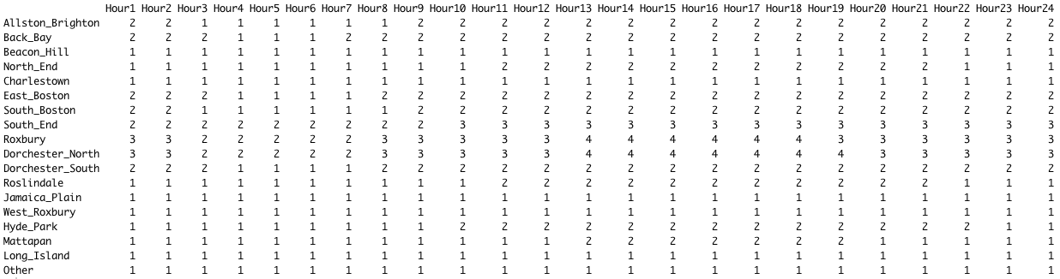

Optimizing Boston Emergency Medical Service Shifting Schedule Wesley Cai, Tam Nguyen
Objectives
Results
The goal is to minimize the number of ambulances needed per hour based on a region in Boston. Our model starts with our study area, Roxbury and then we expand the model to other regions in Boston.
The average number of calls/incidents occurring for each region per hour:
Abstract
We present a method to optimize a shift schedule for each region as well as finding the most optimal way to place ambulances at stations located in and around the Boston metropolitan area. The goal is to minimize the need for ambulances during a specific time period, given a certain expected coverage. Using data received from the Boston Emergency Services regarding the number of incidents per hour in a day, we generated a demand curve for our study area Roxbury. We plan to use the model of the study area to analyze other parts of Boston. Our results reveal that our model will minimize the costs because it uses the minimal number of ambulances based on the number of incidents in the region (Roxbury). Our model intakes the average calls per hour and each call represents the need for an ambulance. In order to minimize the number of ambulances, each ambulance has 20 minutes max to complete their “task” until they are assigned their next task.
Information & Data
The least number of ambulances needed to supply for each region each hour, given 95% requirement that a patient will be assigned an ambulance immediately :
Figure 2. This is the demand curve for the number of incidents per hour in Boston. We used this to estimate the number of incidents per region in Boston.
Figure 1. The pie chart represents the percentage of incidents or calls per region in Boston.
Assumption
The optimal shift schedule we found for Allston/Brighton is shown below:
The number of calls / incidents follows Poisson distribution
The moments of calls is uniformly distributed. Ex. P(a call at 11:05) = P(a call at 11:38)
The service time for an ambulance is fixed by 20 minutes. In other words, how long it takes an ambulance becomes available after heading out from ambulance station is 20 minutes.
Methods
Future Study & Conclusion
References
Our first task was to gather data on the Boston Emergency Medical Services regarding the call volume/number of incidents per hour. Figure 2. from above represents the call volume for the City of Boston. Using this demand curve, we used it to find the call volume per hour for Roxbury since they had a high number of incidents in 2013 and would be a good way to test our model. Our study area will then expand to other regions in Boston. We’re going to compare our model to the Paper Model, which assigns one ambulance to each incident/call. For multiple regions in Boston, we are assuming that ambulances closer to other regions can go take care of incidents in those regions. Ambulances are also prioritized based on the region that they are in, for example if there all the ambulances in Roxbury are occupied, then Roxbury will have to borrow an ambulance from a surrounding region that does not have a high call volume. The point is to not borrow an ambulance from a region that has a higher call volume during that time.
Our result is based on the simulation of 10,000 times for each hour and region. We may use Queueing Theorem as our approach to calculate the no-wait ratio and other values that represent the features of ambulance (queueing) system, such as the expected waiting time (minutes) on average, or the distribution of waiting time after calling 911.
In our model, the service time is fixed, which is not realistic. Therefore, the next step of this project is using a distribution to represent the service time that is not a fixed value. With this consideration, we believe than our model becomes more realistic and applicable.
City of Boston, Boston Emergency Medical Services, 2013 Vital Statistics.
D. Shiah, S. Chen. Ambulance allocation capacity model, (2007) 40-46.
H. Rajagopalan, C. Saydam, E. Sharer, and H. Setzler. Ambulance Deployment and Shift Scheduling: An Integrated Approach, Journal of Service Science and Management, (2011) 4, 66-78.
Kearney, Brendan. Superintendent in Chief of Boston Emergency Medical Services.
R. Church, P. Sorensen, and W. Corrigan, Manpower Deployment in Emergency Services, (2001) 1-16, 37, 219-234.

