Slide 1
LeetCode OJ Problems

Slide 2
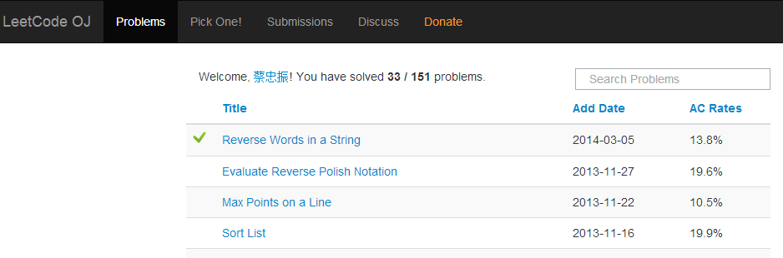
What I have done

Slide 3
1. Single Number
2. Linked List Cycle
3. Path Sum

Slide 4
Single Number
Total Accepted: 23003 Total Submissions: 51428
Given an array of integers, every element appears twice except for one. Find that single one.
Note: Your algorithm should have a linear runtime complexity. Could you implement it without using extra memory?
思路：题目要求线性的时间复杂度O(n)。采用直接排序或对比，复杂度要求一定不能满足题目。能采用的办法只有异或。

Slide 5
Single Number
异或运算的如下性质：
1.任意一个变量X与其自身进行异或运算，结果为0，即X^X=0
2.任意一个变量X与0进行异或运算，结果不变，即X^0=X
3.异或运算具有可结合性，即a^b^c=（a^b）^c=a^（b^c）
4.异或运算具有可交换性，即a^b=b^a

Slide 6
Single Number
举例
a^b^c^a^d^b^c = ?
= a^a^b^b^c^c^d
=d
好像知道这题该怎么做了。。

Slide 7
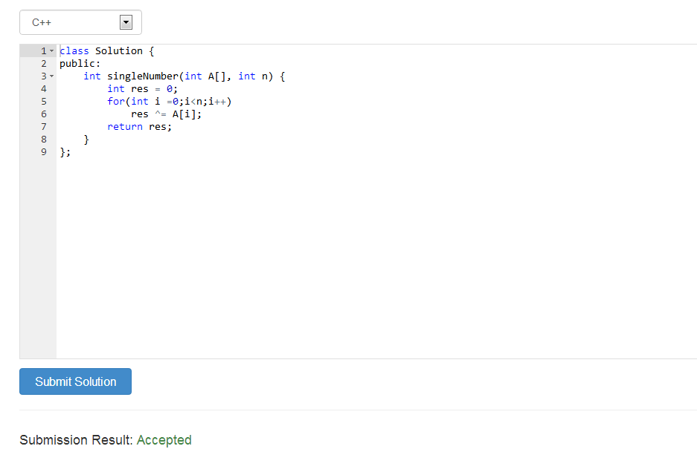
Single Number

Slide 8
Linked List Cycle
Total Accepted: 19380 Total Submissions: 55308
Given a linked list, determine if it has a cycle in it.
Follow up:
Can you solve it without using extra space?
思路：可以采用两个快慢指针来查检查链表是否含有环。让一个指针一次走一步，另一个一次走两步，如果链表中含有环，快的指针会再次和慢的指针相遇。

Slide 9
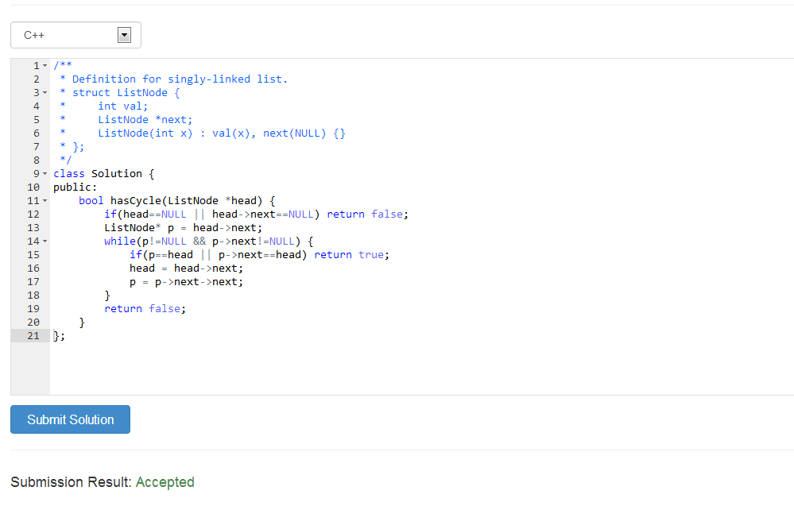
Linked List Cycle

Slide 10
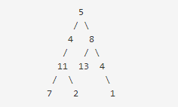
Path Sum
Total Accepted: 14061 Total Submissions: 46847
Given a binary tree and a sum, determine if the tree has a root-to-leaf path such that adding up all the values along the path equals the given sum.
For example:
Given the below binary tree and sum = 22,
return true, as there exist a root-to-leaf path 5->4->11->2 which sum is 22.

Slide 11
Path Sum
思路：
关于二叉树的题目，可以考虑递归的方法，这道题可以先看看递归方法。
如果到了叶节点，它的值和给定的值相等，那么就存在一条路径。然后遍历左右子树。
if(root->left == NULL && root->right == NULL && _sum == root->val)
return true;
search(left ,_sum - root-> val)||search(right ,_sum - root-> val)

Slide 12
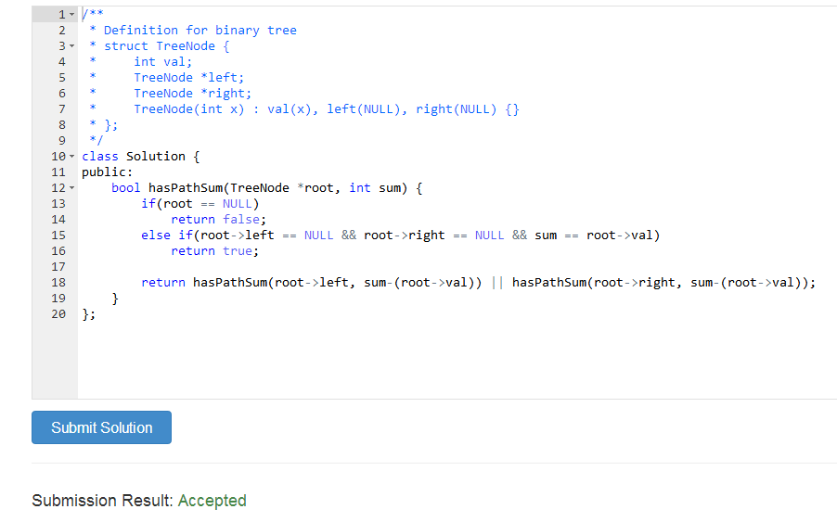
Path Sum

Slide 13
谢谢

