Slide 1
Admin View
Healthcare Appointment Scheduling System
Sprint 2: Database Implementation & UI-Based System Validation
Team: Caiden Sanders, Vsevolod Kovalev
Goal: prove data integrity, CRUD behavior, edge-case handling, and advanced query support.
Healthcare Appointment Scheduling System | Sprint 2 Demo

Slide 2
Sprint 2 Objectives
Implement the healthcare scheduling database in SQL.
Enforce primary keys, foreign keys, NOT NULL, UNIQUE, CHECK, and delete/update rules.
Demonstrate CRUD workflows and advanced JOIN queries through a live UI.
Show realistic failure handling for duplicate data, invalid references, unsafe deletes, and scheduling conflicts.
Healthcare Appointment Scheduling System | Sprint 2 Demo

Slide 3
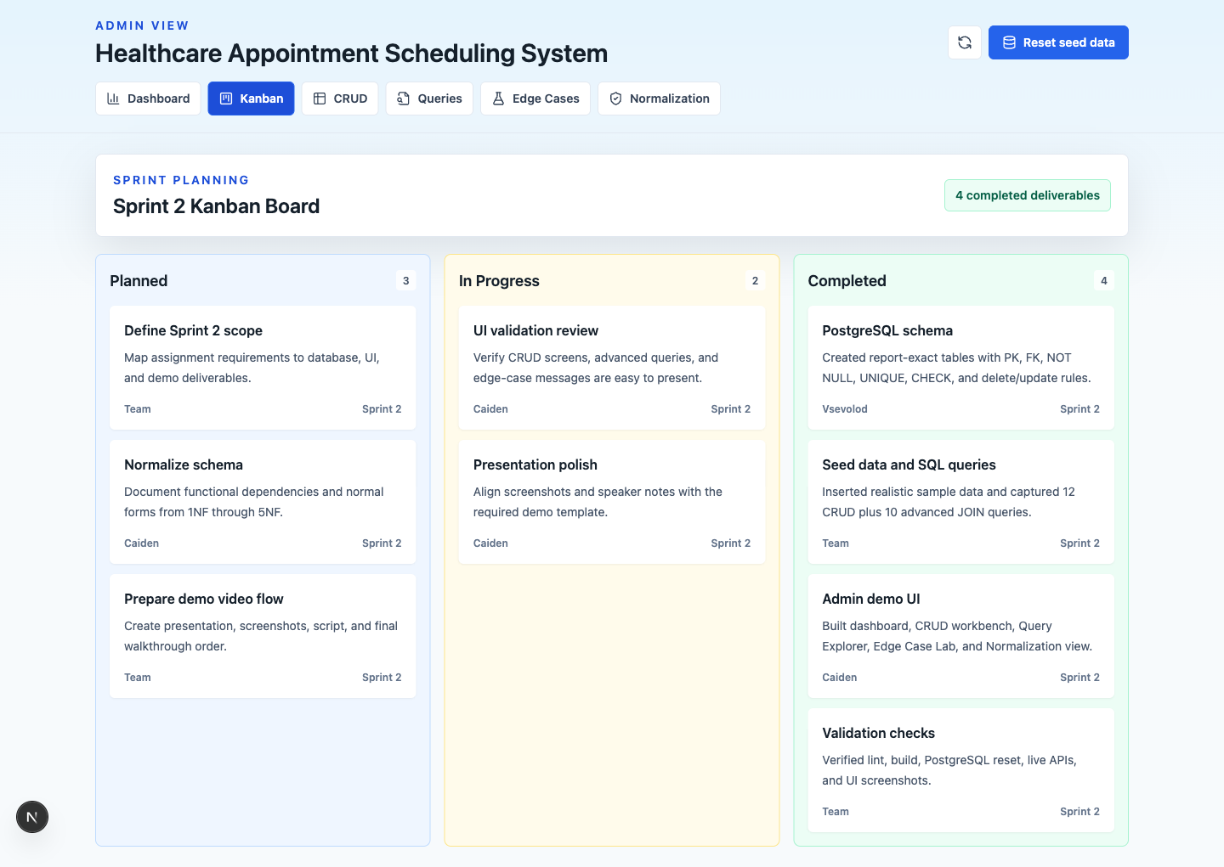
Kanban Board Walkthrough
The Kanban board summarizes planned, in-progress, and completed Sprint 2 work for the video walkthrough.
Healthcare Appointment Scheduling System | Sprint 2 Demo

Slide 4
Database Design
Core entities: USER, PATIENT, PROVIDER, DEPARTMENT, APPOINTMENT_STATUS, APPOINTMENT, PROVIDER_AVAILABILITY, APPOINTMENT_AUDIT_LOG.
USER stores shared account data; PATIENT and PROVIDER store role-specific data.
APPOINTMENT links patient, provider, department, and status through foreign keys.
Audit history and provider availability are separated to prevent update anomalies.
Healthcare Appointment Scheduling System | Sprint 2 Demo

Slide 5
Constraints and Business Rules
UNIQUE constraints protect natural identifiers like email and license number.
CHECK constraints enforce valid roles, gender values, day names, and time ordering.
ON DELETE CASCADE removes dependent patient records where appropriate.
ON DELETE RESTRICT blocks unsafe provider or department deletion when appointments or providers depend on them.
Healthcare Appointment Scheduling System | Sprint 2 Demo

Slide 6
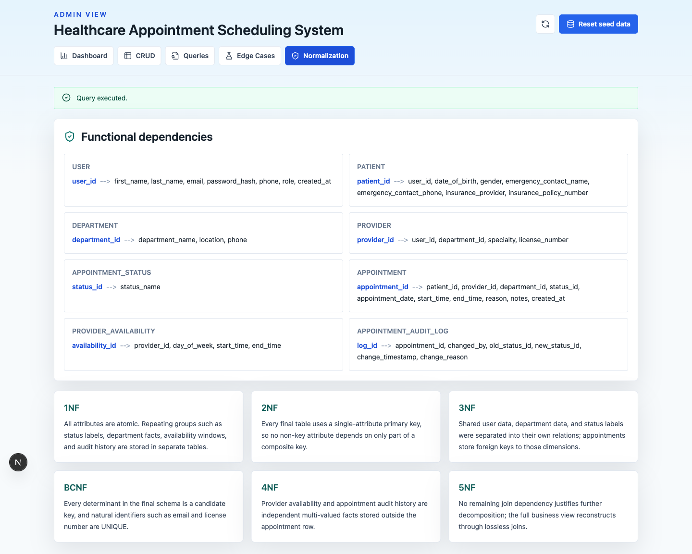
Normalization Validation
Functional dependencies and 1NF through 5NF analysis are presented directly in the UI.
Healthcare Appointment Scheduling System | Sprint 2 Demo

Slide 7
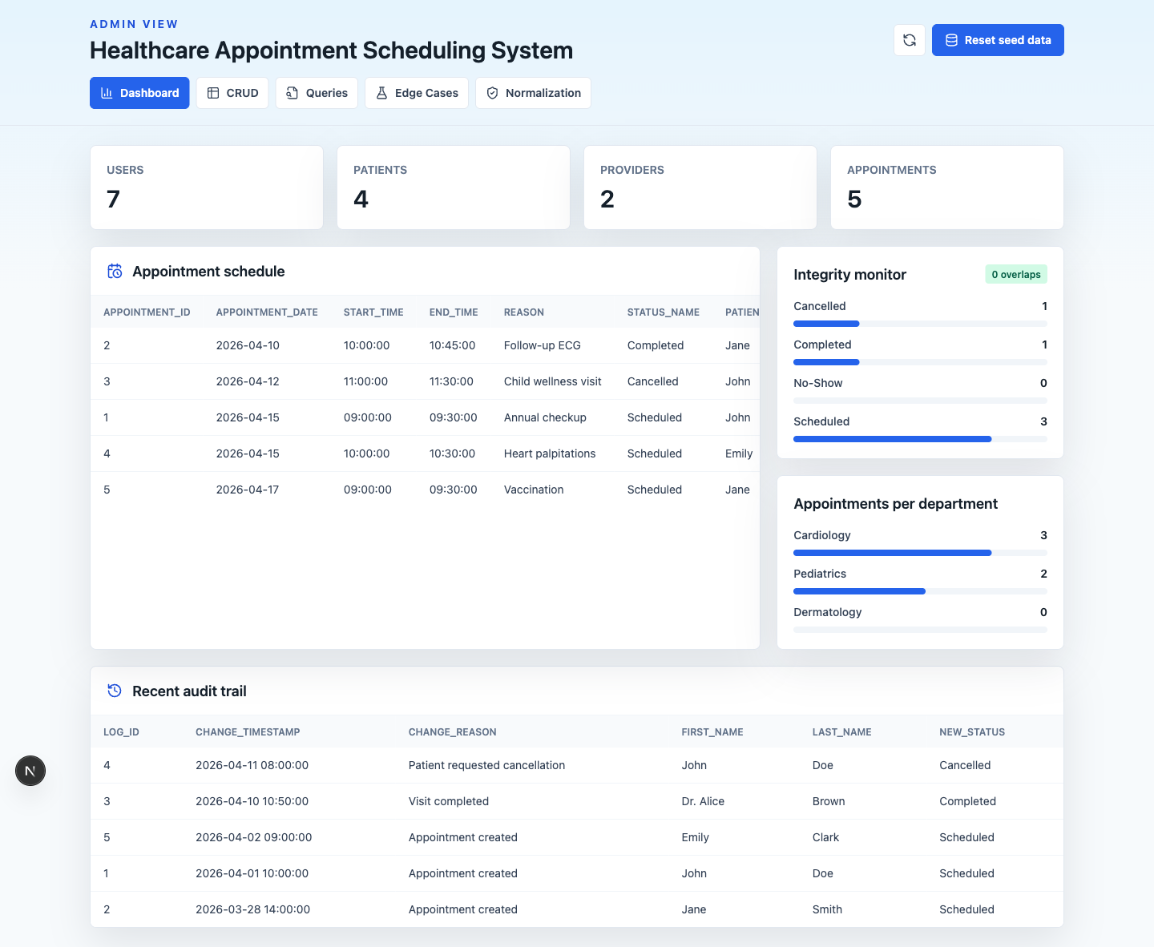
Live Admin Dashboard
The dashboard reads from PostgreSQL and summarizes counts, schedule rows, integrity status, and audit activity.
Healthcare Appointment Scheduling System | Sprint 2 Demo

Slide 8
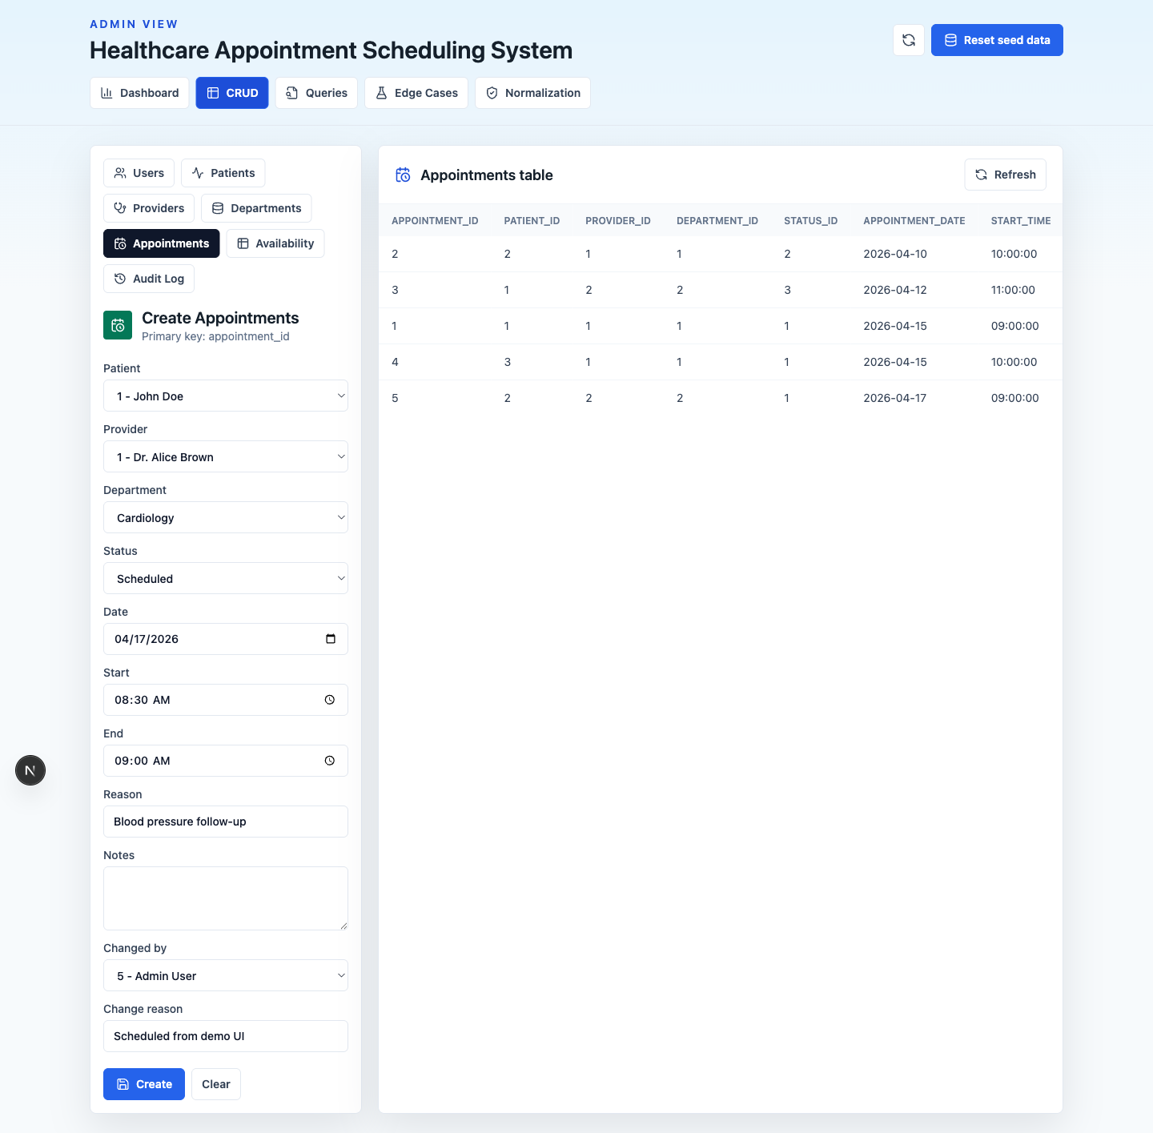
CRUD Demonstration
The CRUD workbench supports create, update, delete, and retrieve operations against the report schema.
Healthcare Appointment Scheduling System | Sprint 2 Demo

Slide 9
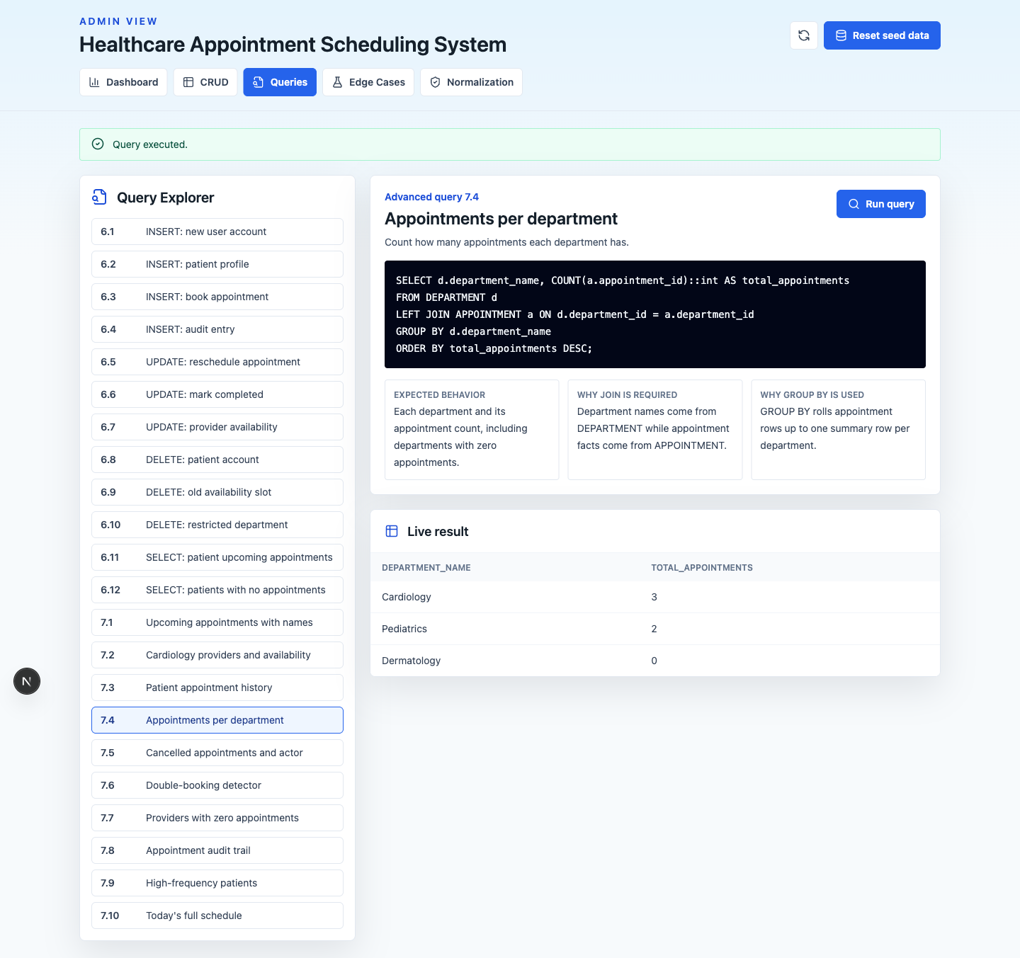
Advanced Retrieval Queries
The Query Explorer documents each scenario, SQL statement, JOIN/GROUP BY reasoning, and live output.
Healthcare Appointment Scheduling System | Sprint 2 Demo

Slide 10
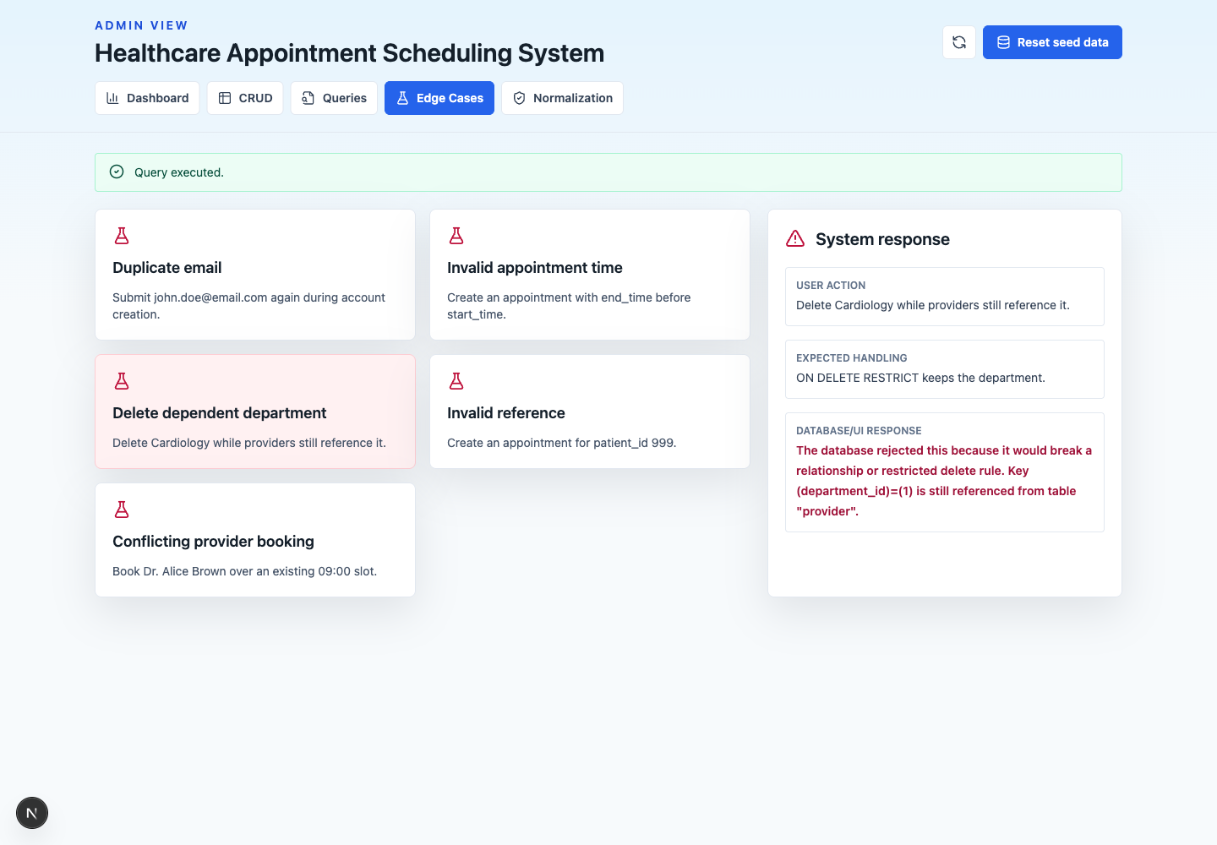
Edge-Case Handling
The UI shows the user action, expected handling, and database response when a rule is violated.
Healthcare Appointment Scheduling System | Sprint 2 Demo

Slide 11
Sprint Review & Retrospective
Outcome: the database and UI demonstrate report-exact schema behavior with live PostgreSQL.
What worked: separating report SQL, API routes, and UI sections made the demo easy to navigate.
Improvement: Sprint 3 can add authentication, calendar views, patient/provider portals, and more robust concurrency tests.
Risk reduced: edge cases are now visible instead of only described in the report.
Healthcare Appointment Scheduling System | Sprint 2 Demo

Slide 12
Conclusion and Sprint 3 Plan
Sprint 2 validates database integrity, normalization, CRUD operations, and advanced retrieval queries.
The UI is ready for a structured demo video with live interactions.
Sprint 3 should refine the user experience, add role-based workflows, and harden scheduling operations for production use.
Final deliverables: Sprint Report, demo video, and GitHub repository link.
Healthcare Appointment Scheduling System | Sprint 2 Demo

