Slide 1
Towards Ubiquitous Learning: A First Measurement of On-Device Training Performance
MobiSys 2021, 5th International Workshop on Embedded and Mobile Deep Learning (EMDL ’21)
Dongqi Cai¹, Qipeng Wang², Yuanqiang Liu², Yunxin Liu^{3, 4,} Shangguang Wang^{1, 5} and Mengwei Xu¹
1 Beijing University of Posts and Telecommunications
^{2 Peking University}
3 Institute for AI Industry Research (AIR)
^{4 Tsinghua University}
^{5 Shenzhen Research Institute}

Slide 2
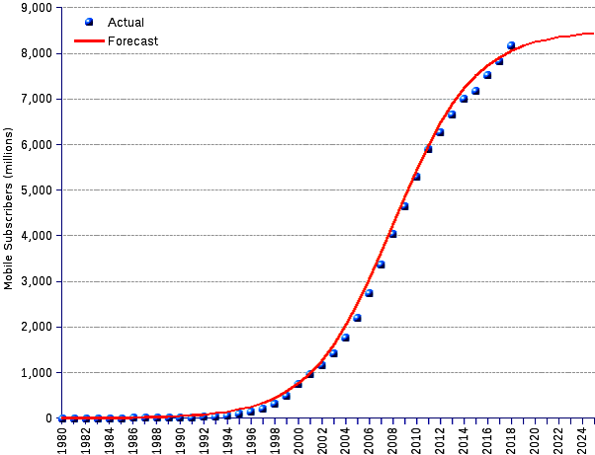


Background
MobiSys 2021, 5th International Workshop on Embedded and Mobile Deep Learning (EMDL ’21)
Galaxy S (Released in 2010)
RAM: 512MB
Storage: 16GB
Galaxy Note20 (Released in 2020)
RAM: 12GB
Storage: 512GB
(Source:https://stats.areppim.com/stats/stats_mobilex2019.htm)

Slide 3
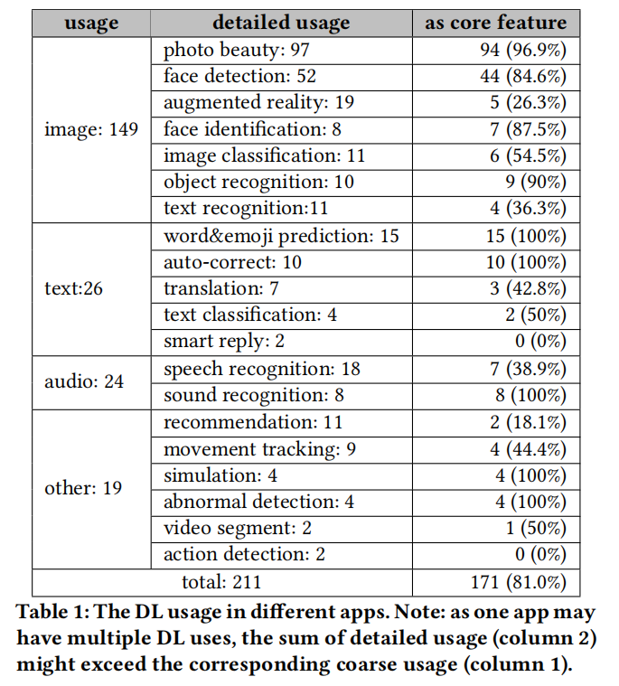
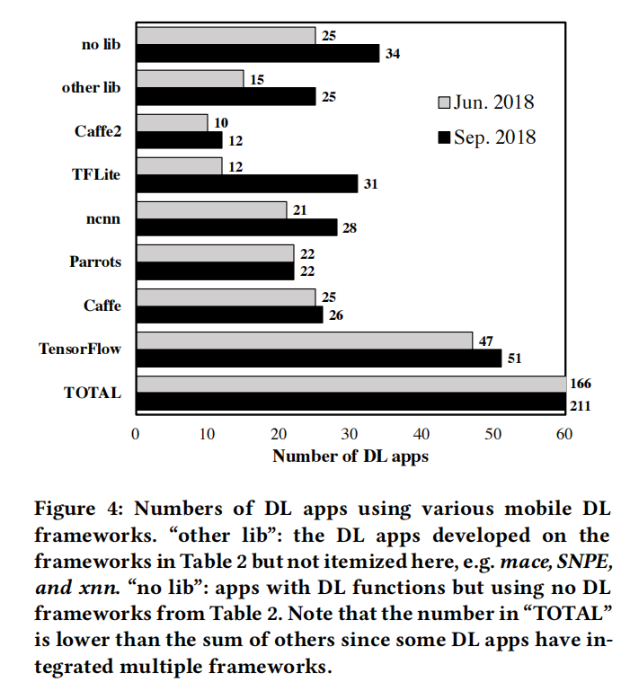
Deep Learning on edge devices
MobiSys 2021, 5th International Workshop on Embedded and Mobile Deep Learning (EMDL ’21)
Mengwei Xu, Jiawei Liu, Yuanqiang Liu, Felix Xiaozhu Lin, Yunxin Liu, and Xuanzhe Liu. A first look at deep learning apps on smartphones. In The World Wide Web Conference, pages 2125–2136, 2019.
Notes:
The inference (or prediction) stage of deep learning is known to happen on edge devices without cloud offloading.

Slide 4









Open Issue
MobiSys 2021, 5th International Workshop on Embedded and Mobile Deep Learning (EMDL ’21)
However, the training stage of deep learning is still commonly placed on data centers.
Notes:
for its tremendous demand of massive training data and computing resources.
Fueled by the increasingly powerful on-chip processors, the inference (or prediction) stage of deep learning is known to happen on edge devices without cloud offloading, making a case for low delay and data privacy protection

Slide 5
Ubiquitous Learning
MobiSys 2021, 5th International Workshop on Embedded and Mobile Deep Learning (EMDL ’21)
Methods: Federated Learning, Split Learning, Local Transfer Learning, etc.
Whether edge devices can really afford training modern NN models?
And if so, do current libraries efficiently support that?

Slide 6

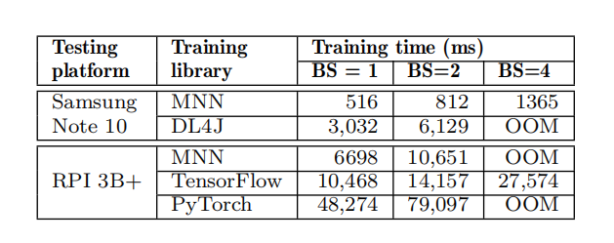
Mobile Neural Network (MNN)
MobiSys 2021, 5th International Workshop on Embedded and Mobile Deep Learning (EMDL ’21)
Lightweight
Versatility
High performance
Easy to use
https://github.com/alibaba/MNN
Notes:
training one batch of mobilenet-v2

Slide 7
Experiment Setups
MobiSys 2021, 5th International Workshop on Embedded and Mobile Deep Learning (EMDL ’21)
Devices
Models
Device | Specifications | Yr.
Redmi Note 9 Pro | Snapdragon 720G, 6GB RAM | 2020
Xiaomi MI 9 | Snapdragon 855, 6GB RAM | 2019
Huawei Mate 30 | Kirin 990, 8GB RAM | 2019
Meizu 16T | Snapdragon 855, 6GB RAM | 2019
Samsung S8 Plus | Snapdragon 835, 6GB RAM | 2017
Huawei Honor 8 | Kirin 950, 3GB RAM | 2016
Model | Convs | Parameter
LeNet | 2 | 3.2K
AlexNet | 5 | 61M
MoileNetv2 | 53 | 3.4M
SqueezeNet | 18 | 411.2K
GoogLenet | 22 | 6.8M
https://github.com/UbiquitousLearning/Benchmark-On-Device-Training

Slide 8
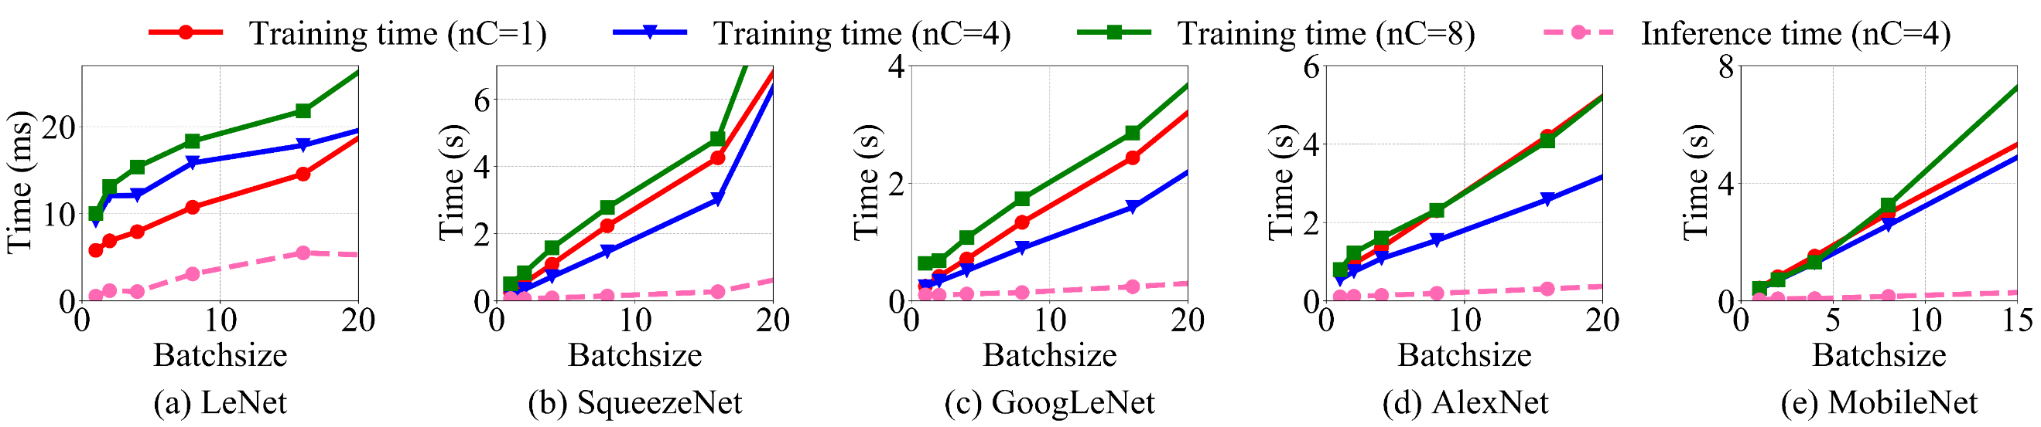



Overall Latency
MobiSys 2021, 5th International Workshop on Embedded and Mobile Deep Learning (EMDL ’21)
Training time >> Inference time (Up to 17.8× gap with MobileNet and Batchsize 16)
Setting the number of CPU core as 4 performs better

Slide 9
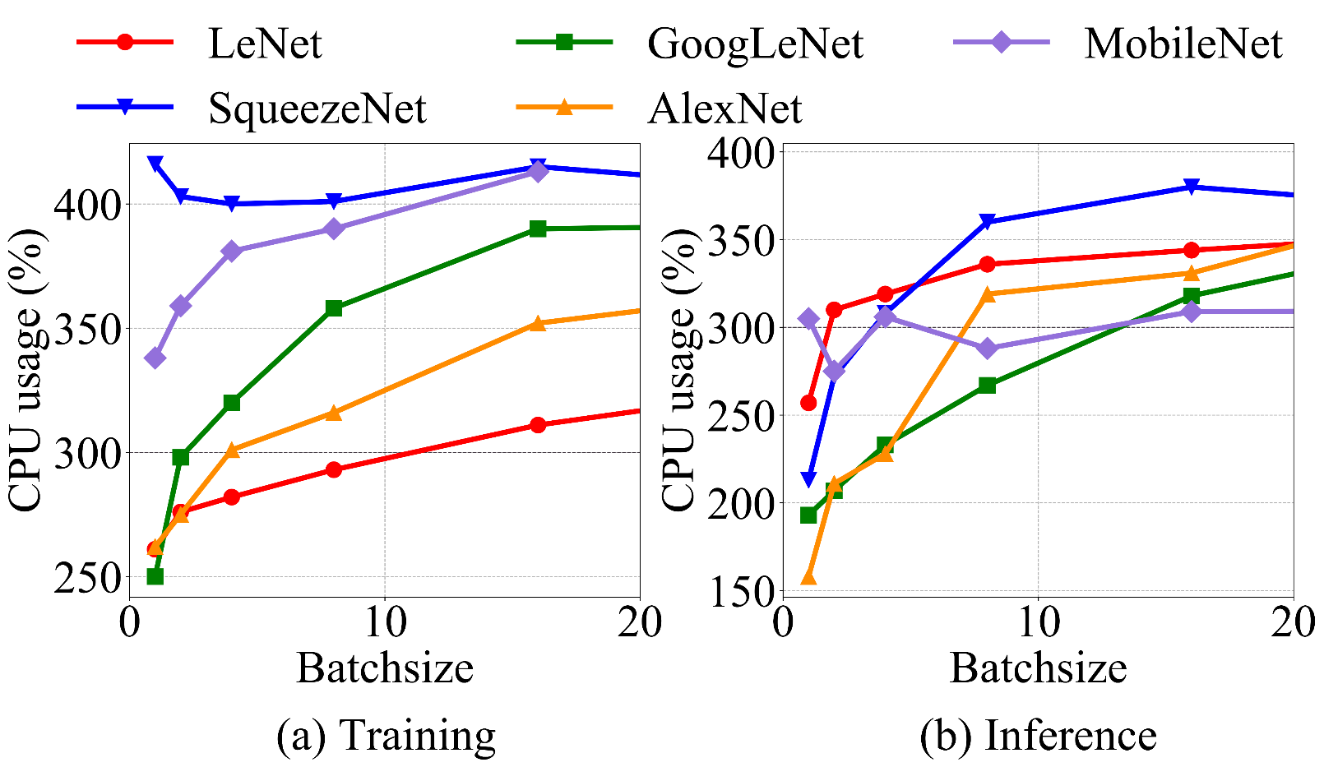
CPU Usage
MobiSys 2021, 5th International Workshop on Embedded and Mobile Deep Learning (EMDL ’21)
The CPU usage during training is already close to maximal with relatively small batchsize

Slide 10
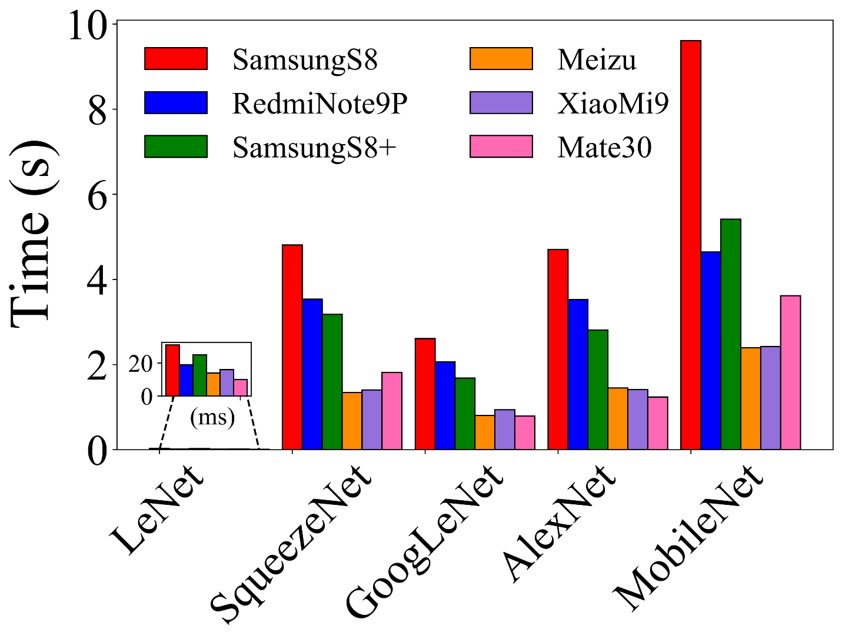
Cross-device Comparison
MobiSys 2021, 5th International Workshop on Embedded and Mobile Deep Learning (EMDL ’21)
Performance disparity
It is pervasive across devices and can be up to 4.0× (MobilenetV2 model among Meizu 16T and Samsung S8+)
Model affinity
SqueezeNet trains fastest on Meizu 16T while AlexNet trains fastest on Huawei Mate 30

Slide 11
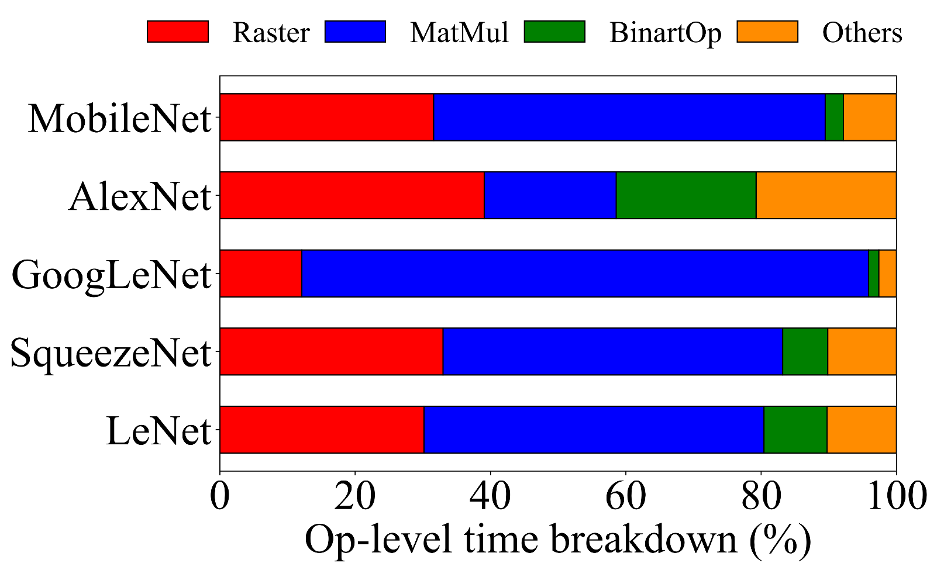
Latency Breakdown
MobiSys 2021, 5th International Workshop on Embedded and Mobile Deep Learning (EMDL ’21)
Raster operator is a unified implementation of all traditional operators that are related to tensor shape transformations, including slice, concat, reshape, broadcast, etc.
Convolution
Raster
MatMul
Raster
Raster

Slide 12
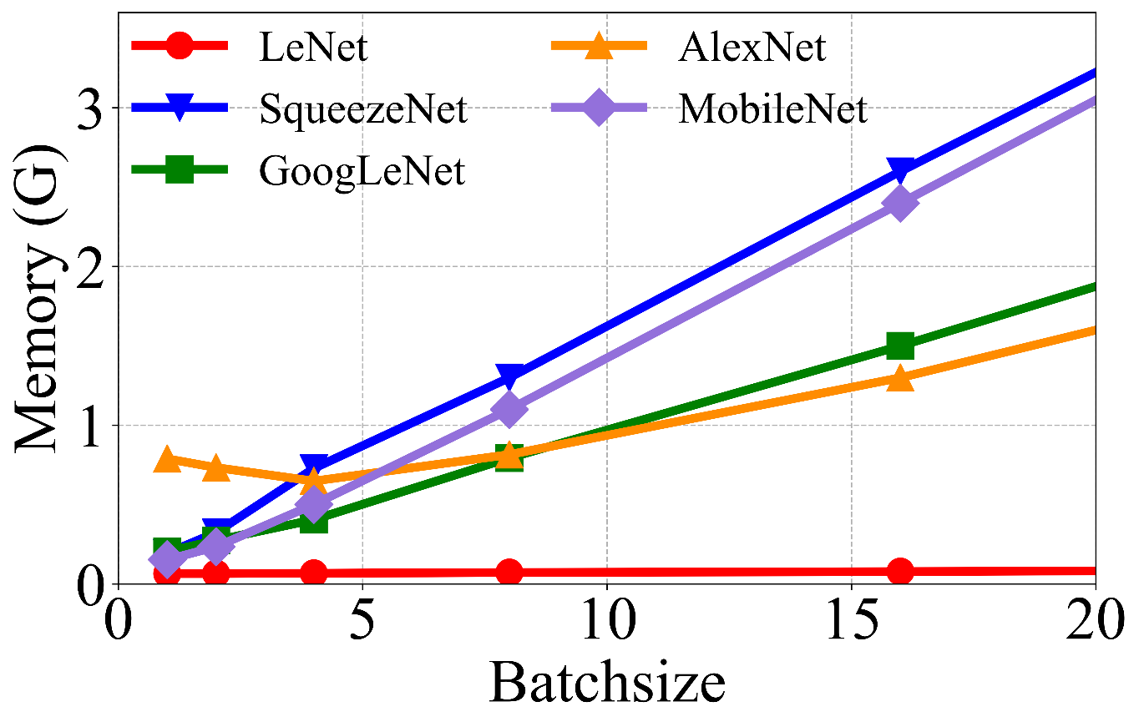
Memory footprint
MobiSys 2021, 5th International Workshop on Embedded and Mobile Deep Learning (EMDL ’21)
To keep the memory usage under 1GB, the upper bound of batchsize may be limited to 4!

Slide 13
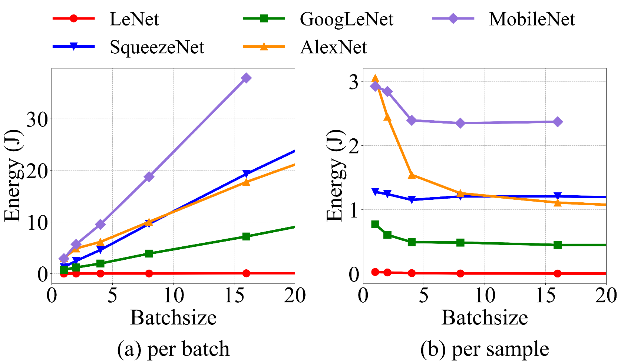
Energy consumption
MobiSys 2021, 5th International Workshop on Embedded and Mobile Deep Learning (EMDL ’21)
The training time doesn’t linearly scale with the batchsize since larger batchsize benefits the intra-operator parallelism.
Using larger batchsize can be more energy-efficient.

Slide 14
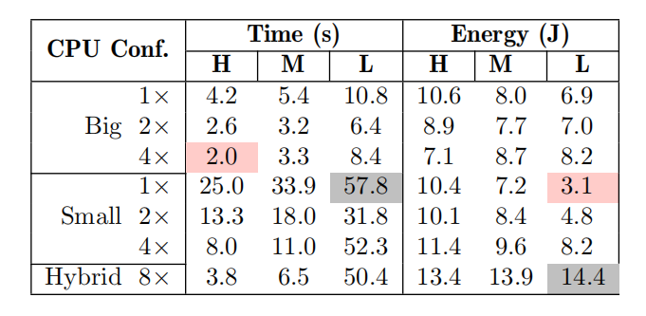
Impacts of CPU parameters
MobiSys 2021, 5th International Workshop on Embedded and Mobile Deep Learning (EMDL ’21)
Using 4 big cores with the highest frequency achieves the best performance.
Using only one small core with the lowest CPU frequency leads to the lowest usage of energy consumption. Its energy consumption is only 43.7% of the optimal case of training time, despite it runs 28.9× slower.

Slide 15
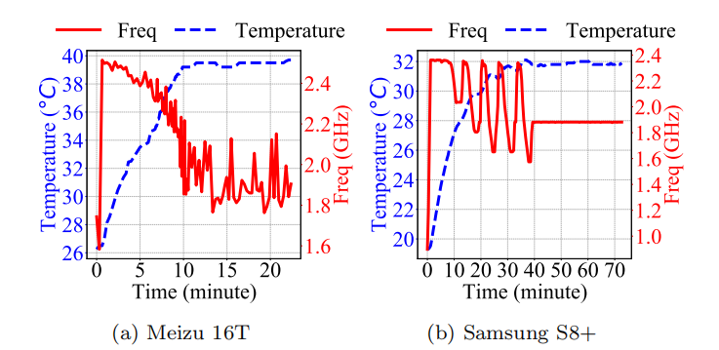
Thermal dynamics
MobiSys 2021, 5th International Workshop on Embedded and Mobile Deep Learning (EMDL ’21)
Such heterogeneous thermal dynamics may complicate the ubiquitous learning process, e.g., the device selection in federated learning.

Slide 16
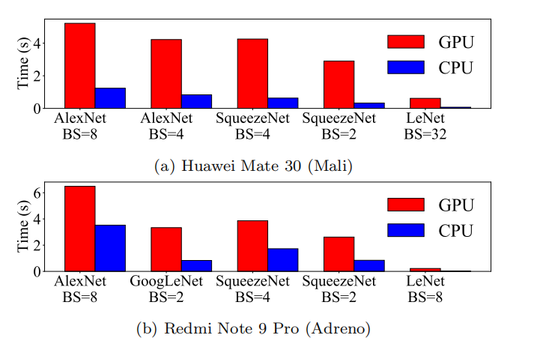
Mobile CPU vs. Mobile GPU
MobiSys 2021, 5th International Workshop on Embedded and Mobile Deep Learning (EMDL ’21)
Both GPU Mali and Adreno run much slower than CPU (1.8×–12.0×)

Slide 17
Conclusion
MobiSys 2021, 5th International Workshop on Embedded and Mobile Deep Learning (EMDL ’21)
Future Work
First measurement of on-device-training performance
At the dawn of “learning everywhere and anything”
Generating efficient operators
Memory optimizations
Tuning system parameters

Slide 18
Thank you
MobiSys 2021, 5th International Workshop on Embedded and Mobile Deep Learning (EMDL ’21)
https://github.com/UbiquitousLearning/Benchmark-On-Device-Training

