Slide 1
Supply, Demand and Policy in
New York's Ridehail Market
MIT 805 Big Data Semester Project | Parts 1 and 2
Gishon K Gwenzi (21731056) · Letsoba Savannah Mabe (20582995)
462 million trips · PySpark distributed processing · University of Pretoria
Notes:
Two parts. Part 1 was data collection, quality and exploratory analysis on 2025. Part 2 is distributed MapReduce processing across 2024 and 2025 to answer one question.

Slide 2
The dataset and why it needs distributed processing
Source
Why it is Big Data
No PII
NYC Taxi & Limousine Commission High Volume For-Hire Vehicle trip records — every Uber, Lyft, Via and Juno trip since Feb 2019. Monthly Parquet, NYC Open Data licence.
37 GB compressed across 88 files, roughly 364 GB uncompressed. A single month exceeds what a spreadsheet will open; one year requires distributed execution.
No rider, driver or vehicle identifiers. Location generalised to 265 taxi zones; GPS discontinued in 2016. Nothing identifying is redistributed.
Three reported scales, measured by HTTP HEAD across all 88 published files — no download required
Tier | Period | Files | Parquet | Uncompressed
Raw | 2019-02 to 2026-05 | 88 | 37.11 GB | ~364 GB
Working | 2024-01 to 2026-05 | 29 | 13.32 GB | ~131 GB
Processing (Part 1) | 2025 calendar year | 12 | 5.55 GB | 54.45 GB
243,589,684 records · 25 columns · Parquet compresses 9.8×, so disk size understates what Spark must hold in memory
Notes:
Raw 37 GB, working 13.3, processing 5.55 — all three measured, not estimated. We used HTTP HEAD requests to size the full archive without downloading it, which takes about a minute.

Slide 3
Data quality: auditing consistency, not trimming outliers
95.43%
26
1.15%
2 of 25
records retained after
scope restriction
duplicate records
in 243.6 million
pickup timestamped
before the request
columns containing
any null values
What we found
How we handled it
Only two fields carry nulls — one structurally inapplicable, one unevenly reported by operator
2.79 million records have a pickup before the request: clock drift, not corruption
531 records show negative driver pay against high fares — retrospective adjustments
Selective exclusion by analysis, not blanket deletion — clock-drift rows drop out of wait-time work only
Scope restriction cost 11.1M trips averaging 16.7 miles and $70 — we quantify the bias it introduces
Duplicates retained: 26 in 243.6M are coincidence, not error
Monetary fields represent a settled accounting position, not the amount transacted at the time of travel
Notes:
The key judgement: we audited internal consistency rather than removing extremes. A long trip is not necessarily wrong; a dropoff before its pickup certainly is.

Slide 4
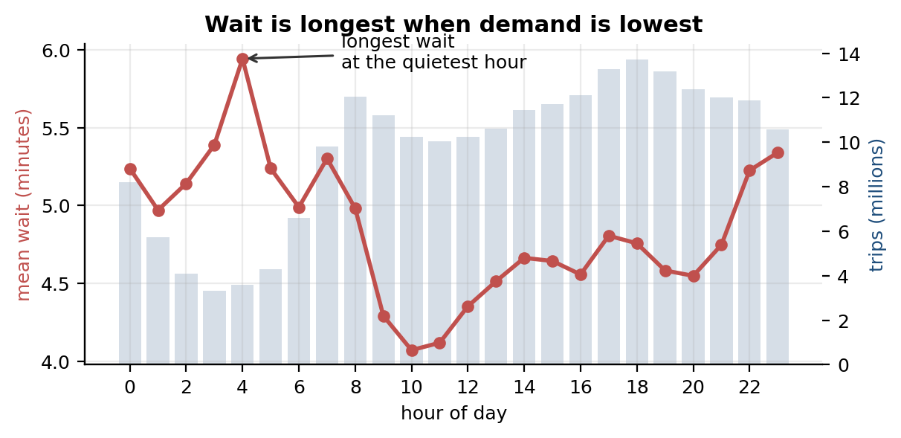
What the exploratory analysis revealed
Three findings that framed Part 2
A duopoly on paper only — Uber 72.2% to Lyft 27.8%, HHI 5,982, yet fares differ 8% and median wait by 16 seconds
Demand varies 9.3-fold across the week, and the morning commute rivals the Saturday-evening peak
Wait peaks at 04:00 and troughs at 10:00 — the inverse of demand, implying driver supply binds, not congestion
The question Part 2 had to answer: if waits are worst when the roads are emptiest, the constraint is supply — so where does supply fail, and did congestion pricing change it?
Notes:
This wait inversion is what drove the whole of Part 2. Longest waits at 4am, shortest at 10am. If road congestion were the constraint you would see the opposite.

Slide 5
Part 2 — MapReduce at scale across 462 million trips
Where, when and for whom does the market fail to match supply to demand — and did congestion pricing change that?
Notes:
One question, three threads: congestion pricing, supply-side failure, and demand patterns.

Slide 6
Architecture: one distributed pass, then everything else is cheap
1
24 monthly Parquet files
2
Clean + derive
3
One shuffle
4
Shared aggregate
2024-01 to 2025-12
11.1 GB compressed
~107 GB in memory
→
Part 1 rules, plus wait_s,
hour, and an empirically
derived CBD zone flag
→
Group by zone, DO zone,
year, month, day, hour —
storing sums, not means
→
73,973,527 rows
Every later result reads
this, both authors
The charged zone set was derived from the data, not hard-coded
In 2025 the cbd_congestion_fee column records which trips were charged. Grouping by destination zone gives the empirical charge rate per zone — a map-shuffle-reduce in itself. The distribution is strongly bimodal: 178 zones below 0.2, 38 above 0.8, only 29 in between. Those 38 zones were then applied backwards to 2024 to label trips that would have been charged, which is what makes a before-and-after comparison possible at all.
Notes:
Pre-aggregation is the practical core. 462 million rows reduce to 74 million, which fits comfortably in memory. Savannah read the same file for her demand work so we never ran the expensive shuffle twice.

Slide 7
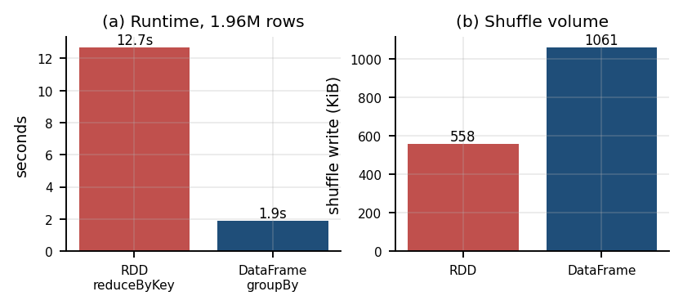
The same aggregation, written twice
RDD — explicit Map → Shuffle → Reduce
DataFrame — Catalyst optimised
.map(((zone, hour), (1, wait)))
.reduceByKey(sum counts, sum waits)
.map(partial sums → mean)
.groupBy("PULocationID", hour)
.agg(count("*"), avg("wait_s"))
reduceByKey combines locally before shuffling — exactly what a Hadoop Combiner does, but built in.
Catalyst inserts a partial HashAggregate before the Exchange and a final one after — automatic combining.
Both produced 6,143 identical keys — zero difference
The RDD path shuffled LESS data (558 KiB vs 1,061 KiB) yet ran 6.56× slower. So the gap is not shuffle volume — it is the JVM-to-Python process boundary. Every row must be serialised out to a Python worker and back; DataFrame operations compile to JVM bytecode and never leave.
Notes:
This is the cleanest demonstration we have. Same answer, same data, two execution models. The RDD version moved less data across the network and was still six and a half times slower.

Slide 8
Distributed execution evidence
849
120.5 GiB
7.2 GiB
30 of 80
306×
tasks completed
zero failures
total input
read from disk
shuffled —
just 6% of input
stages skipped
via reuse
shuffle reduction
from combining
Captured from the Spark UI
What Hadoop would have cost
DAG visualisation and stage timeline across 8 cores
Exchange hashpartitioning as the single shuffle boundary
Adaptive query execution coalesced 256 partitions to 96 at runtime
Cached frame: 26.1 GiB on disk, 0 B in memory — spilled rather than failed
Hadoop MapReduce writes every stage boundary to HDFS, replicated three times by default, then reads it back. Our 7.2 GiB of shuffle would become roughly 21.6 GiB of extra write traffic — none of which Spark incurs, because it pipelines in memory and only spills under pressure.
The 30 skipped stages have no Hadoop equivalent at all — a chained pipeline recomputes from input every time.
Notes:
849 tasks, zero failures, 44 minutes of cumulative task time across 8 cores in 39 minutes wall clock. Event logging was on so the History Server can replay all of this.

Slide 9
Spark's DAG versus the Map → Shuffle → Reduce model
 | Hadoop MapReduce | Spark (observed in this run)
Execution unit | One fixed Map → Shuffle → Reduce per job | Arbitrary DAG of stages; boundaries only at shuffles
Between stages | Written to HDFS, re-read, 3× replicated | Pipelined in memory; spills to disk only under pressure
Combining | Combiner must be written by hand | Catalyst inserts partial/final HashAggregate automatically
Joins | Always a full shuffle of both inputs | 265-row zone lookup broadcast; large side never shuffled
Planning | Eager, fixed at submission | Lazy; AQE re-planned 256 partitions to 96 mid-flight
Every row of this table is evidenced from our own execution plans and stage metrics — not quoted from documentation
Notes:
We argued each contrast from the plan we actually produced. The Exchange node, the broadcast join, the skipped stages, the AQE coalescing.

Slide 10
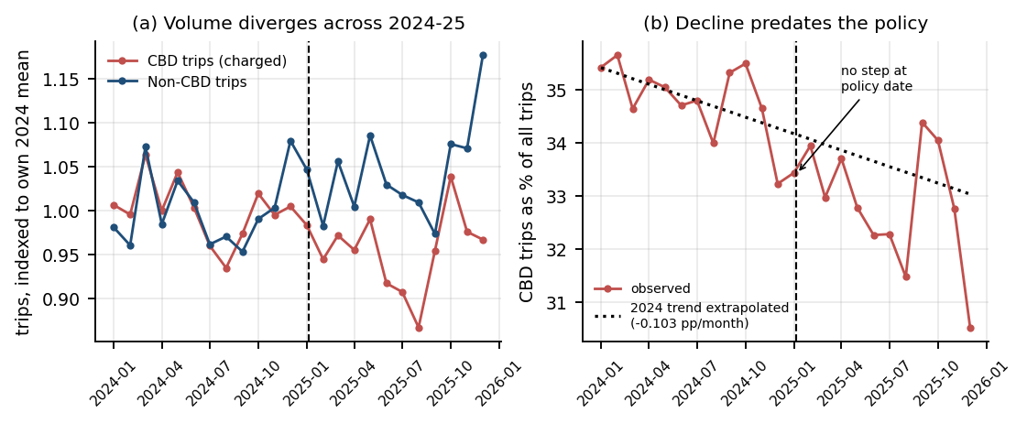
Thread A: congestion pricing did less than the headline suggests
The naive read
CBD trips fell 4.39% while non-CBD rose 4.40% — a difference of 8.79 percentage points. Dramatic, and misleading.
The honest read
The share was already falling at 0.103 pp/month through 2024. No step at the policy date. Residual: 0.72 pp.
+0.21 pp
−0.72 pp
$117.1M
+7.5%
share CHANGE from Dec 2024
to Jan 2025 — it rose
residual once the 2024
trend is extrapolated
revenue raised in
the first year
CBD mean fare rise;
non-CBD fares flat
Conclusion: the fee raised revenue and was passed to riders — $1.50 accounts for 64% of the $2.33 fare increase — but produced no volume reduction distinguishable from the pre-existing trend. Boundary zones grew 0.79% against 5.26% for outer zones, so riders did not stop short of the cordon either.
Notes:
This is the finding we did not expect. We set out to measure a policy effect and found the decline predates the policy. Reporting that honestly is stronger than claiming an effect that does not survive the pre-trend check.

Slide 11
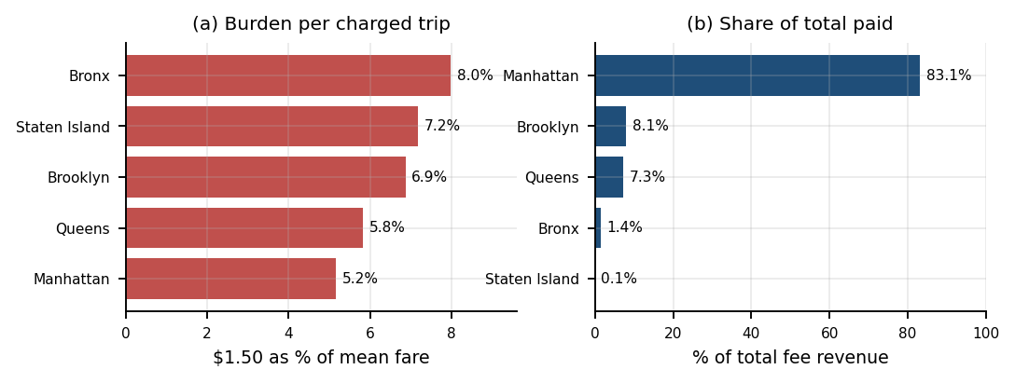
Who paid: a flat fee has unequal incidence
Two true statements
Per charged trip the $1.50 is 7.98% of a Bronx fare but 5.17% of a Manhattan one — a 1.54× spread falling hardest on the lowest fares.
In aggregate Manhattan pickups generated 83.1% of all fee revenue, because 76.3% of its trips are charged against 3.7% of the Bronx's.
Why this matters for policy
Manhattan funds the scheme, but an outer-borough rider who does cross the cordon pays half again as much of their fare for the privilege. Part 1 showed those same outer-borough zones behave as transit substitution rather than discretionary travel — short, cheap, frequent trips where rail coverage is weakest. The flat structure therefore bears hardest on the riders least able to substitute away from it. A fee scaled to fare, or a rebate for trips originating in the identified zones, would raise comparable revenue with materially less regressivity — and this dataset makes that trade-off directly computable.
Notes:
Both readings are true and they answer different questions. Do not let anyone collapse them into one.

Slide 12
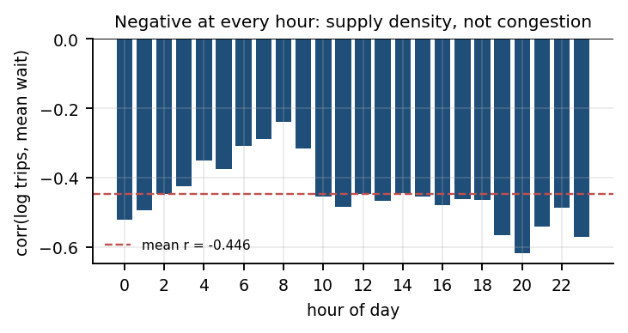
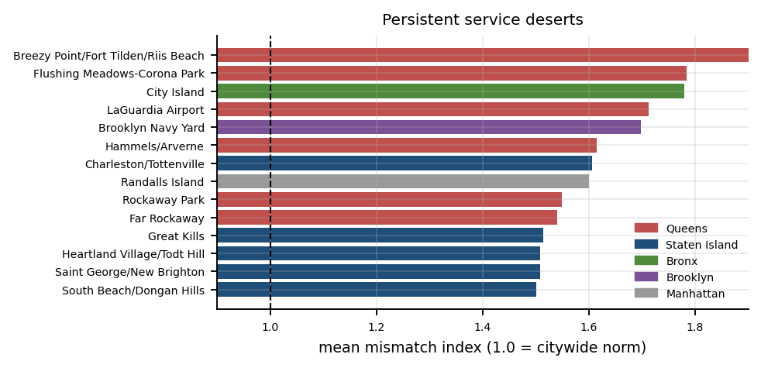
Thread B: service quality is a function of supply density
Negative at every one of the 24 hours
From −0.24 at 08:00 to −0.617 at 20:00, overall r = −0.472. Busier zones are served faster, at all times of day. If road congestion were the binding constraint the sign would invert at peak hours — it never does. This confirms Part 1's inference directly.
74 persistent service deserts
Ranked by severity above; four zones are above threshold in all 24 hours. Overwhelmingly peripheral — 23 in Queens, 18 in Staten Island, 18 in Brooklyn. Hammels/Arverne is the most persistent of these, at 61% above the city norm every hour.
Notes:
The mismatch index normalises by hour — wait in a zone-hour divided by the citywide mean for that same hour. Without normalising we would just rediscover that 4am is slow everywhere.

Slide 13
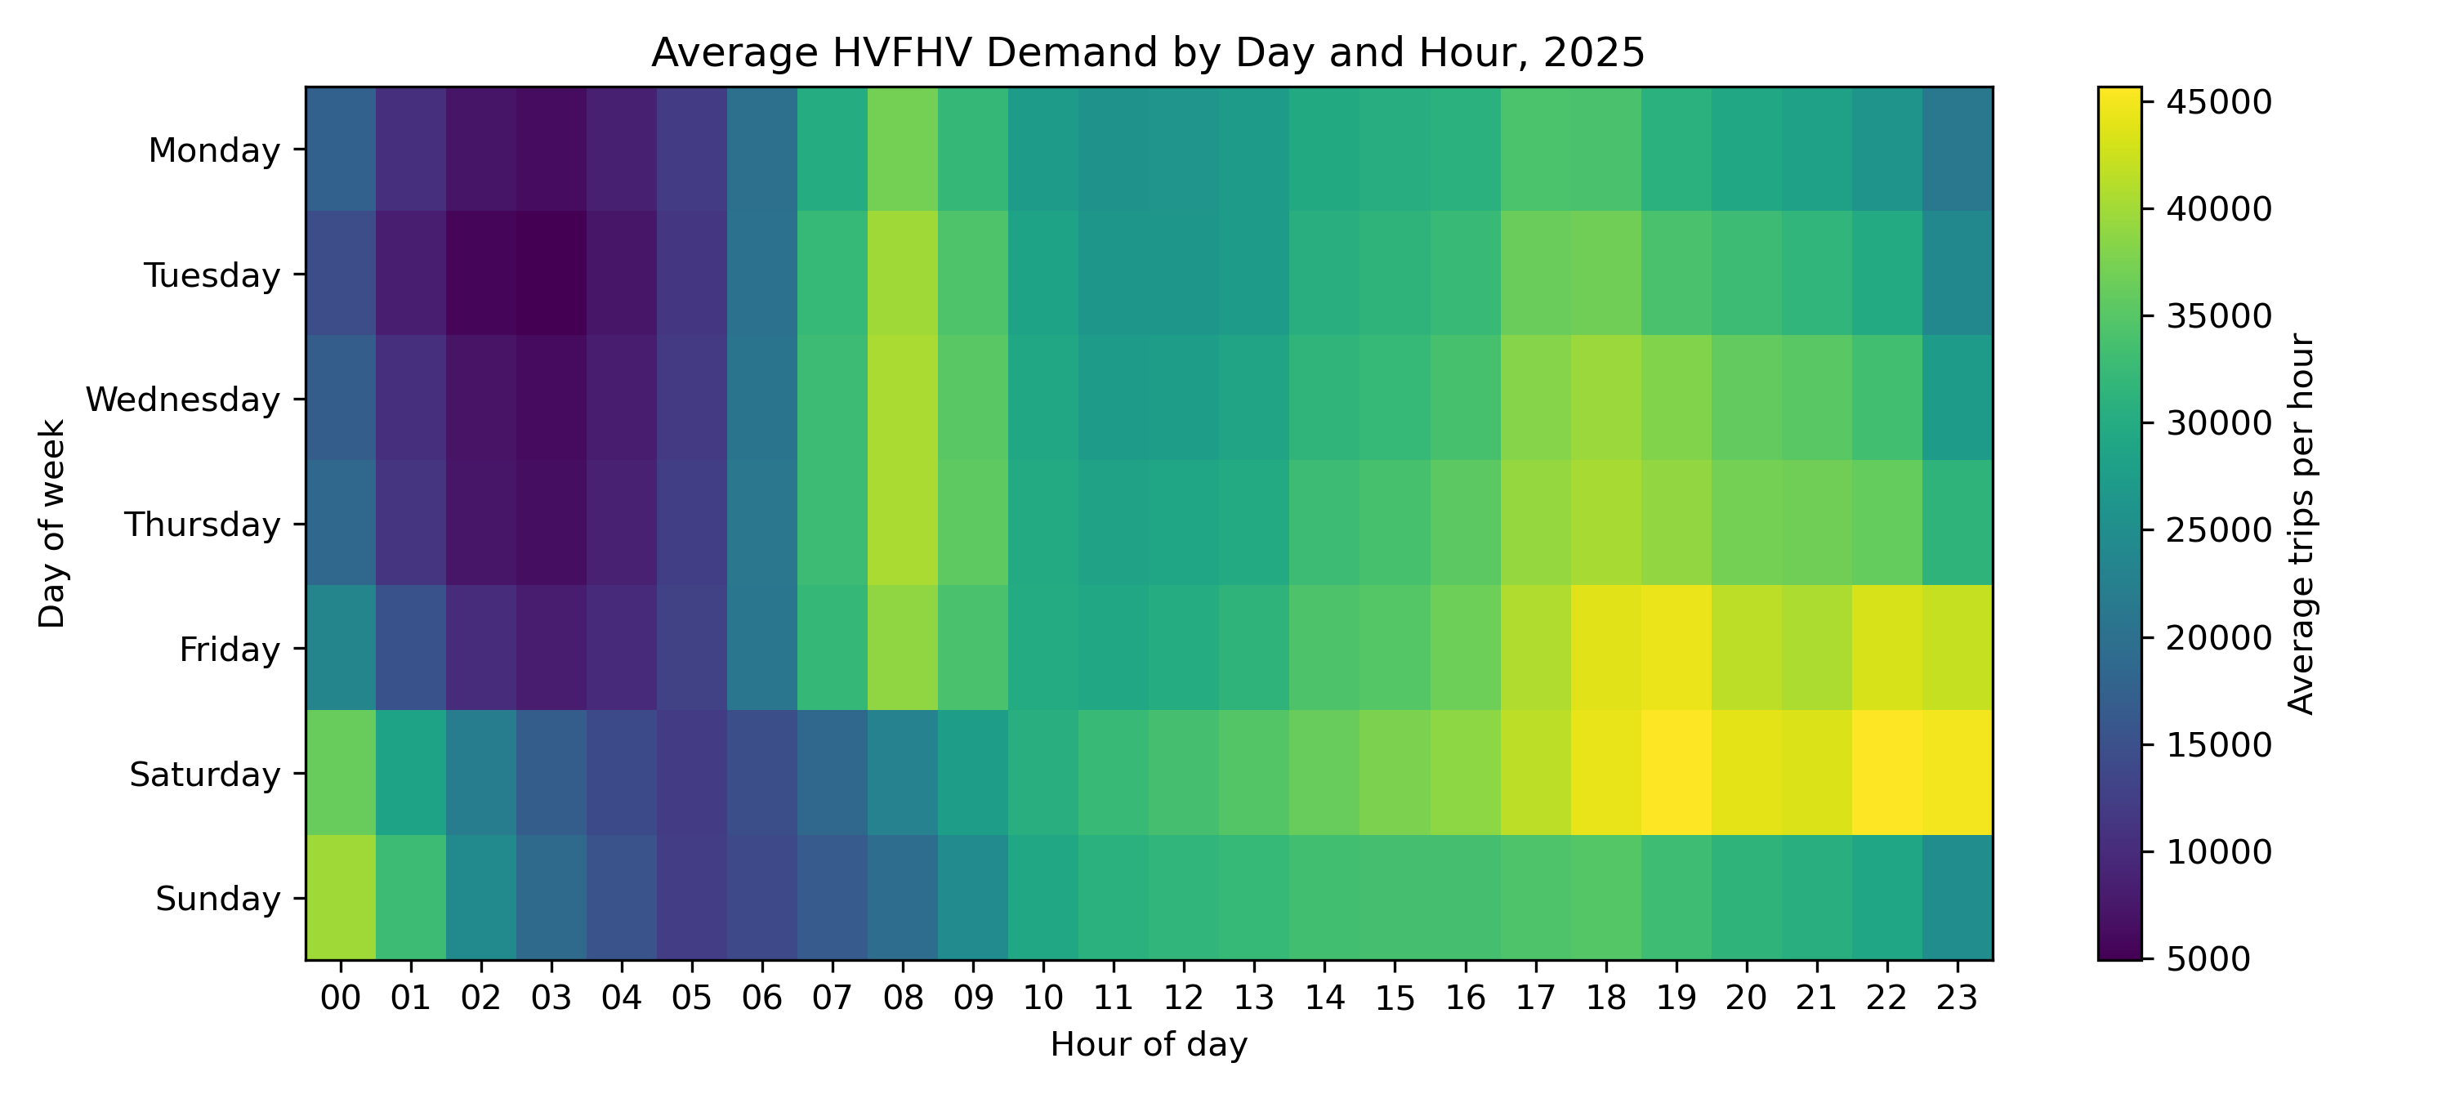
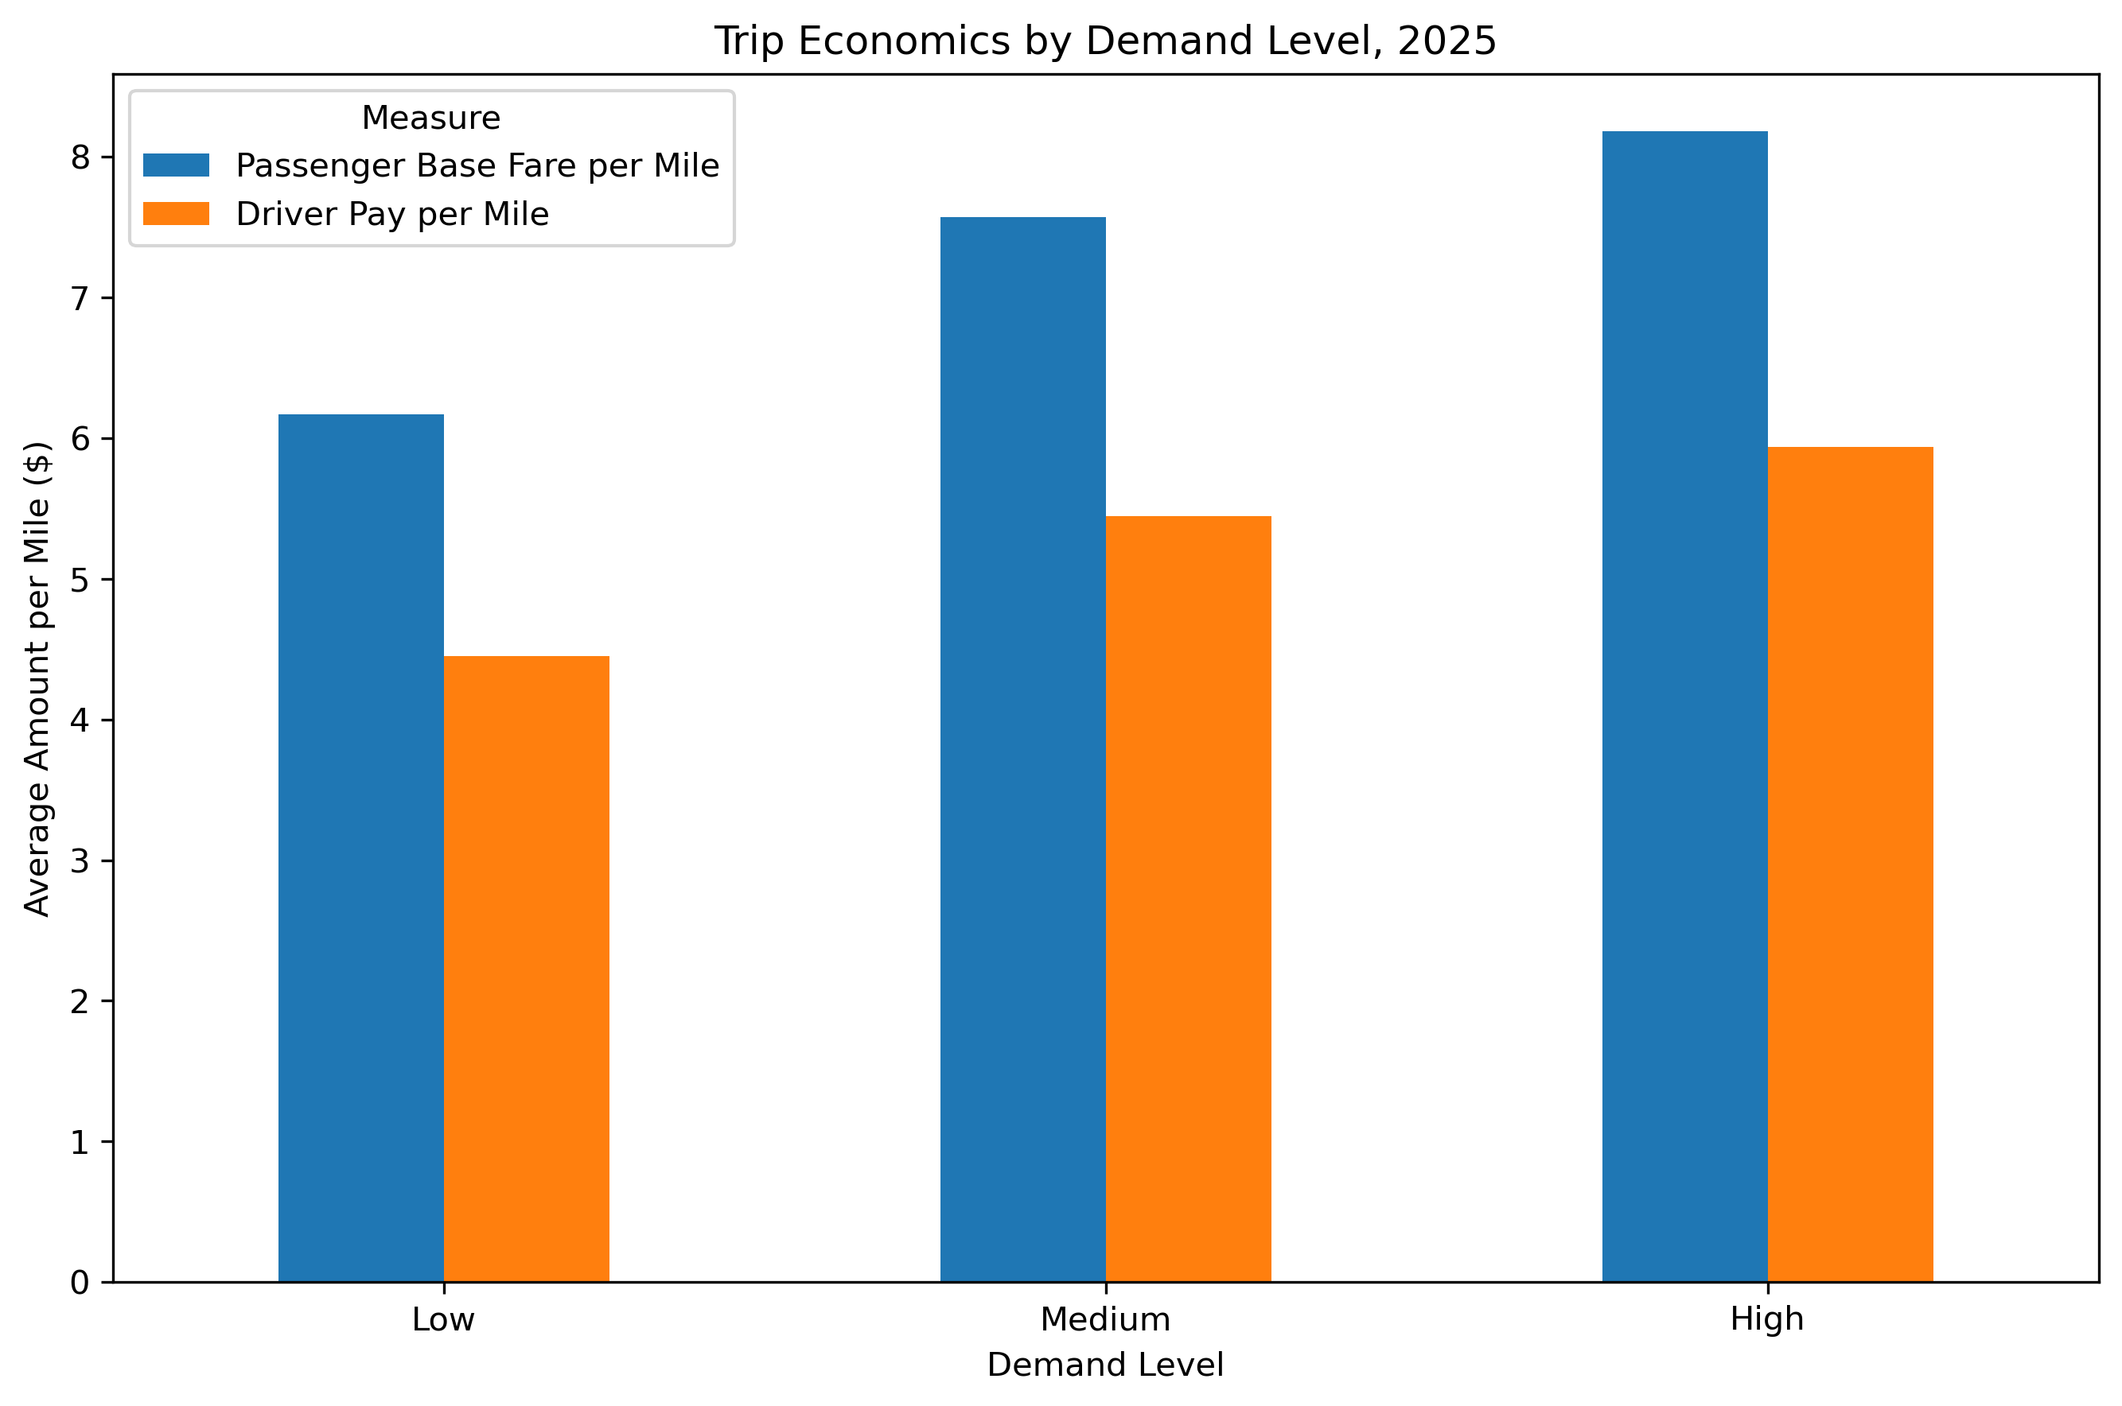
Demand patterns and trip economics
Per-mile economics rise with demand
Realised demand
Total fares stay near $27 and driver pay near $21 across all three levels — but fare per mile climbs $6.17 → $8.18 and driver pay per mile $4.45 → $5.94. High demand means shorter, slower trips. Not profitability: the data has no operating costs.
8,760 date-hours split into terciles. Volume runs from ~9,699 trips/hour at 03:00 to ~39,127 at 18:00. Saturday highest, Monday lowest.
Notes:
Savannah's thread. Manhattan's share of pickups rises from 34.5% at low demand to 38.1% at high, while Queens falls — so demand growth concentrates rather than spreading.

Slide 14
Where the threads meet
Inside the cordon
Everywhere else
272.0 s → 269.2 s
281.0 s → 294.1 s
mean wait improved 1.0% between 2024 and 2025
mean wait deteriorated 4.7% over the same period
Congestion pricing did not remove trips from the cordon. It appears to have redistributed driver supply — and because service quality tracks supply density at every hour of the day, a marginal gain inside the zone came with a loss four times larger outside it, borne by the same peripheral zones already identified as service deserts.
Limitations we state plainly
Identification — 2024 and 2025 differ in many ways besides the fee; we report association with a pre-trend adjustment, not causation
Survivorship — only matched, completed trips are recorded, so a service desert cannot be distinguished from suppressed demand
No entity identifiers — without driver or vehicle keys, the supply redistribution we infer cannot be confirmed directly
Notes:
This is the sentence the whole project builds to. Service quality is a supply problem, and the one major policy intervention of 2025 made the gap slightly worse for the people already worst served.

Slide 15
What the data supports
The fee raised $117.1M and was passed to riders, with no volume effect beyond the pre-existing trend.
Service quality is governed by driver supply density, not road congestion — at every hour.
74 peripheral zones are persistently under-served, and they are where waits worsened most.
github.com/caie007/savannahgishon
Notes:
Close on the three claims the evidence actually supports, and point at the repo.

