Slide 1

Open Access and
Institutional Research Impact
PA 397C Data Management and Research Life Cycle | Spring 2019
Caifan Du
School of Information, The University of Texas at Austin

Slide 2
What is Open Access (OA)?
Open Access (OA) literature: “digital, online, free of charge, free of most copyright and licensing restrictions” (Suber, 2012)
Reduces access barriers (price & copyright)
Claimed benefits: Increased visibility of research work & larger audience

Slide 3
How can OA work out?
Existing research indicates that journals turning to open access have a rise in their citation impact.
Researchers produce academic work for impact instead of financial rewards.
However, many academics are still not familiar with their OA options.

Slide 4
OA Mandates and Policies
Policy-makers:
funding agencies and higher education institutions
2 OA options:
Gold OA (journals) & Green OA (repositories)

Slide 5
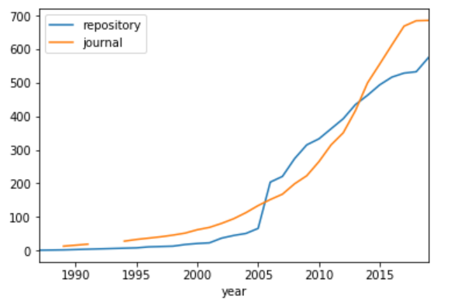
Gold OA & Green OA

Slide 6
OA Mandates and Policies
Mandates as requirement:
Only works for Green OA
(As only about ¼ of peer-reviewed journals are OA)
Institutions also host their own OA repositories
For knowledge management, digital preservation, and research impact, and so on

Slide 7
Research Question
Do institution-hosted OA repositories and their OA policies have an effect on institutional research impact?
IV: 1) age of institution-hosted OA repositories
2) # of years since institutional OA policies become effective
DV: institutional research impact
Notes:
Impact of institutional OA efforts

Slide 8
Data Sources
Directory of Open Access Repositories (DOAR) (self-reported)
Institution, year_established
Registry of Open Access Mandates & Policies (self-reported)
Institution, policy_effective
Ranking Web of Universities (Cybermetrics Lab, Spanish National Research Council)
Institution, citation_impact
The Center for World University Rankings (CWUR) (for validation)
Intitution, citation_impact

Slide 9
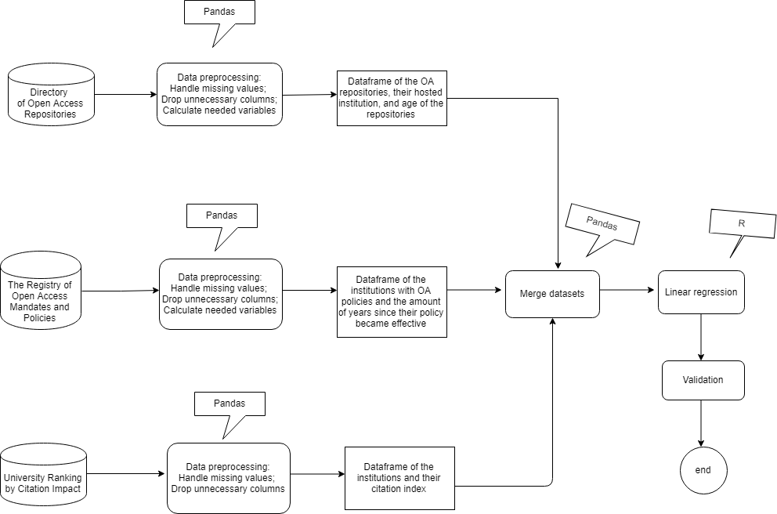
Workflow

Slide 10
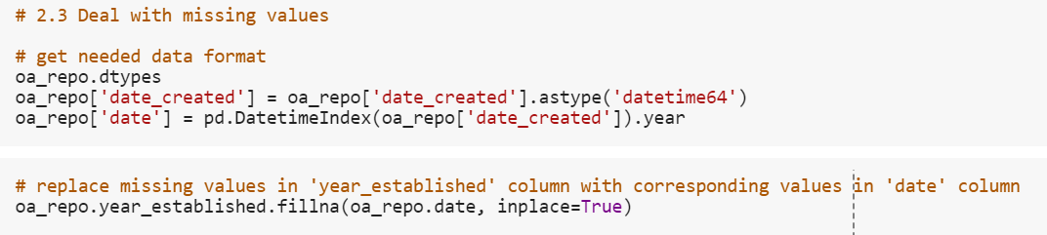
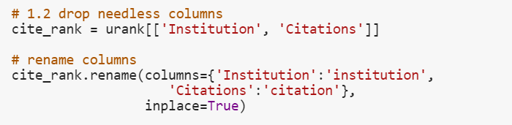
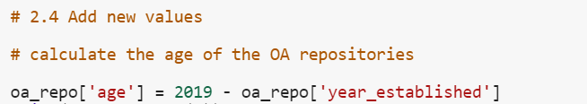
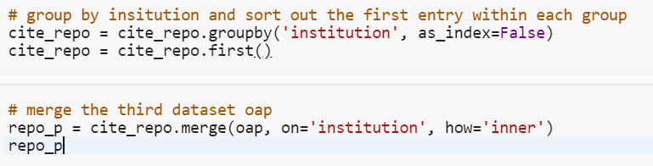
Data Preprocessing

Slide 11
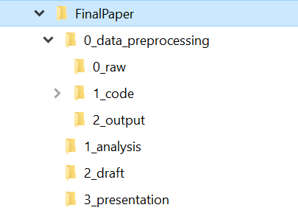
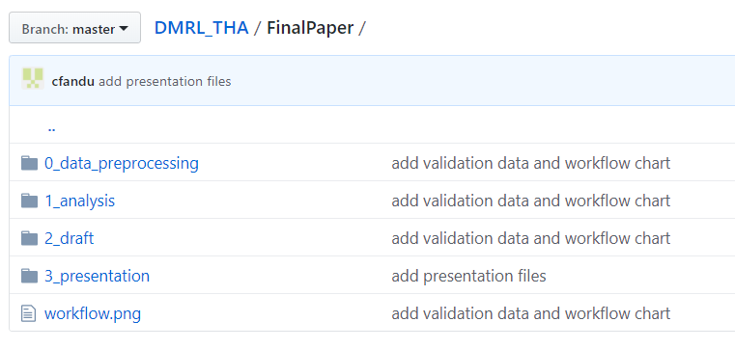
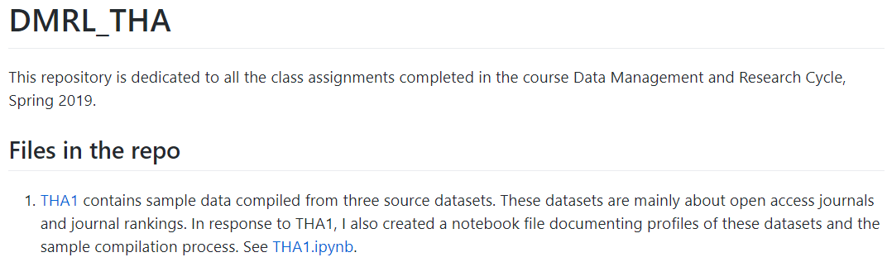
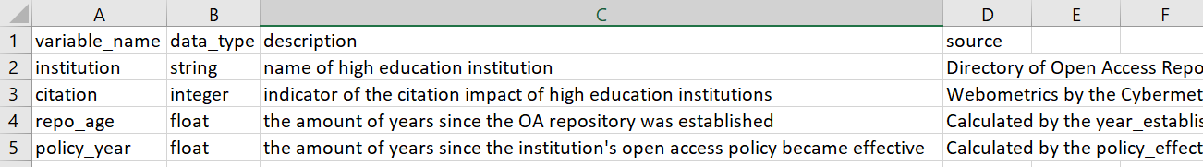
Data Management
File Organization &
Naming Conventions
Back-up & Syncing
Documentation & Data Dictionaries

Slide 12
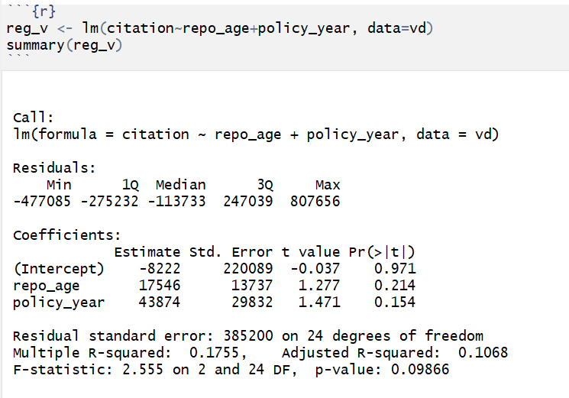
Data Analysis

Slide 13
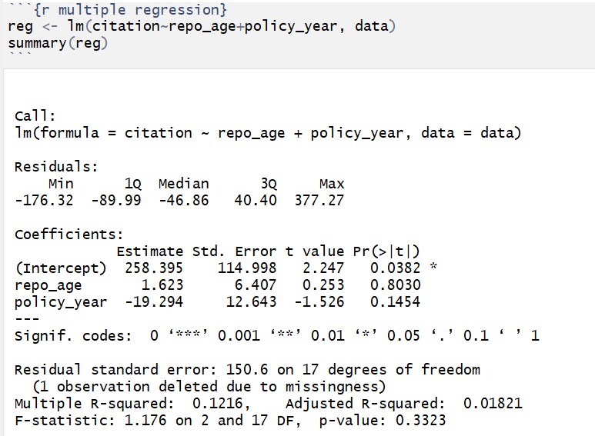
Validation
Note: Even though the validation result seems imply the better dataset is being used, in the two compared datasets, citation impact is computed in different ways

Slide 14
Reflections
Challenge 1 (operationalization):
How to find the empirical counterpart to your conceptualization?
How to find the conceptual counterpart of your empirical evidence?
Challenge 2 (technical):
String matching is a pain!

Slide 15
Reflections
Challenge 3 (data management):
The concern about quality and methodological transparency of online data sources
Positive side:
Data management habits are built bit by bit
For my research questions…

Slide 16
Thank you!
Notes:
Better categorization
Solutions: technological, social

