Slide 1

Online Resource Allocation for Edge Intelligence with Colocated Model Retraining and Inference
Huaiguang Cai, Zhi Zhou, Qianyi Huang
Sun Yat-Sen University
Presenter: Zhiwei Zhai
Notes:
Hi everyone, my name is Zhiwei Zhai from Sun Yat-Sen University, I'm here to present the paper 'Online Resource Allocation for Edge Intelligence with Colocated Model Retraining and Inference' on behalf of the authors.

Slide 2
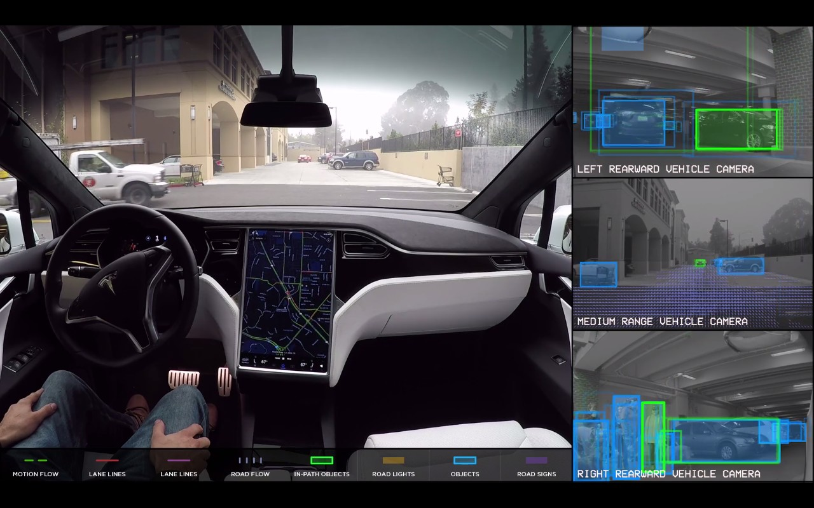
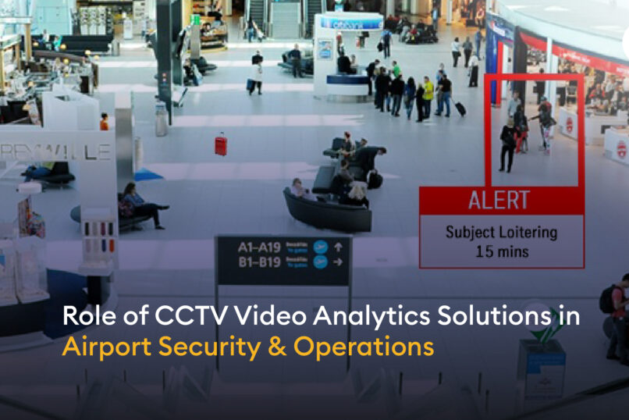

The Killer App for Edge Computing: Video Analytics[1]
Self-driving and smart cars
Surveillance and security
Augmented reality
Potential benefits of edge computing for video analytics:
Providing low-latency, energy-efficient, and privacy-protecting services to users.
Credit: Google images
[1] "Real-Time Video Analytics: The Killer App for Edge Computing", in Computer, 2017.
Notes:
Video analytics, the killer app for edge computing, can drive a wide range of applications with great potential to impact society, such as Self-driving, Surveillance and Augmented reality.
[click]
Generally speaking, edge intelligence can provide low-latency, energy-efficient, and privacy-protecting services to users.

Slide 3
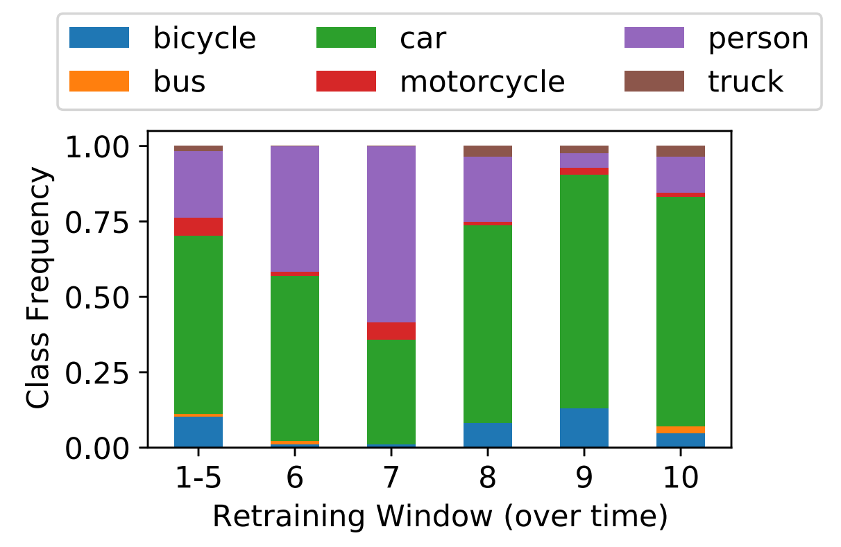
The Model's Accuracy Suffers from Various Drifts
Data drift: A shift in the distribution of features or labels.
Model drift: Compressed models have less generalization ability compared to the original models.
Task drift: The deployed model may be applied to perform unseen tasks (e.g., fine tuning, transfer learning, embodied AI).
What can we do?
Retrain the model!
Example: Class Distribution Shifts[2]
[2] “Ekya: Continuous Learning of Video Analytics Models on Edge Compute Servers”, in NSDI, 2022.
Notes:
However, the model's accuracy suffers from various drifts. The most common drift is Data drift, it means a shift in the distribution of features or labels. Such as label shift, concept drift, domain adaptation, or test time adaptation. Here is an example of class distribution shifts. In different time periods throughout the day, the proportion of pedestrians, cars, and bicycles may vary.
[click]
We also notice some other differences between the model training phase and the inference phase, such as model drift and task drift.
[click]
What can we do?
[click]
A uniform solution is model retraining.

Slide 4
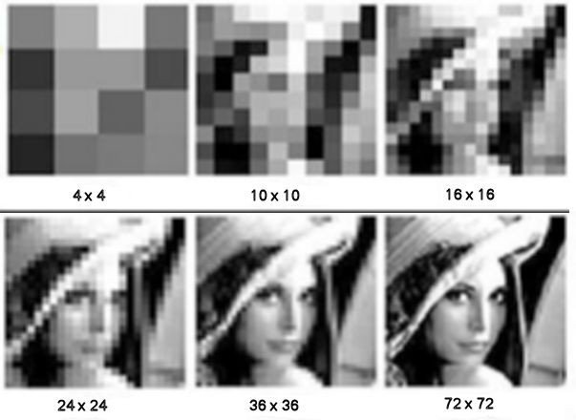


Model Retraining Can Handle Drifts
Retraining configuration adaption
Inference configuration adaption
$f(x)$: Vali$datio$n accuracy
Drifts
Where do the additional computing resources for model retraining come from?
Model Retraining
Downgrade the inference configuration!
$x$: Epochs, training data size, etc.
Example: Lower input resolution leads to reduced inference accuracy and resource consumption.
Credit: Google images
[3] “Speeding up automatic hyperparameter optimization of deep neural networks by extrapolation of learning curves”, in IJCAI, 2015.
Notes:
[click]
When drifts happen, the model’s accuray will go down. But model retraining can handle drifts.
[click]
For model retraining, the configuration refers to the hyperparameters of the training, such as the number of epochs, training data size. For these hyperparameters, a larger value typically results in higher accuracy, but also with a higher resource demand.
[click]
Where do the additional computing resources for model retraining come from?
[click]
We can downgrade the inference configuration! For example: Lower input resolution leads to reduced inference accuracy and resource consumption.

Slide 5
Retraining vs. Inference: Competitive Dynamics
55%
40%
Time slot 0
65%
32%
Resource allocation on edge.
Time slot 1
55%
40%
Computing resources allocated to
model retraining.
Time slot T-1
15%
80%
Time slot T
100%
Computing resources allocated to model Inference.
Example: A typical resource allocation process for model retraining and inference across T time slots.
Notes:
When colocating model retraining and inference serving at the edge server, they may compete for the limited computational resources such as CPU and GPU.
For example, if we allocate more resource to model retraining to improve its accuracy, the accuracy of the current model inference would diminish due to reduced resource allocation. But if we take away resource from model retraining to inference serving, the current inference accuracy would increase, but the subsequent inference may decrease due to the reduced accuracy of the retrained model.
[click]
Here is a typical resource allocation process for model retraining and inference across T time slots. Usually, we should allocate more resources to model retraining initially, and then gradually allocate more resources to model inference as time goes on.

Slide 6
Model Retraining and Inference Co-location Paradigm
Notes:
Following the pilot effort of Ekya, we adopt a general system architecture as illustrated.
In this architecture, at each time slot, a group of device clients first upload their inference requests to the edge server.
After receiving the data, a scheduler determines the configuration for model retraining and inference.
Afterward, a student model will immediately return predictions of all inference requests to the clients.

Slide 7
Model Retraining and Inference Co-location Paradigm
Notes:
Next, some uniformly random-chosen data according to the retraining configuration, will be sent to the teacher model to get the corresponding high-credit labels.
Then the student model updates its weight by retraining the model according to the labels.

Slide 8
Summary Thus Far
AI models are increasingly pushed to the edge to serve users.
The model's accuracy suffers from various drifts.
Model retraining can handle drifts.
Competitive relationship between model retraining and inference.
Notes:
Now, let's summarize what we have covered so far.
AI models are increasingly pushed to the edge to serve users. The model's accuracy suffers from various drifts. And model retraining can handle drifts. However, there’s a competitive relationship between model retraining and model inference.
[click]
Then a central question arises: How can resources be credibly allocated for model retraining and inference co-location to optimize long-term model performance under various drifts?

Slide 9
Summary Thus Far
Central question:
How can resources be credibly allocated for model retraining and inference co-location to optimize long-term model performance under various drifts?
AI models are increasingly pushed to the edge to serve users.
The model's accuracy suffers from various drifts.
Model retraining can handle drifts.
Competitive relationship between model retraining and inference.
Notes:
Now, let's summarize what we have covered so far.
AI models are increasingly pushed to the edge to serve users. The model's accuracy suffers from various drifts. And model retraining can handle drifts. However, there’s a competitive relationship between model retraining and model inference.
[click]
Then a central question arises: How can resources be credibly allocated for model retraining and inference co-location to optimize long-term model performance under various drifts?

Slide 10
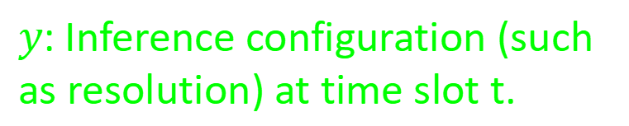
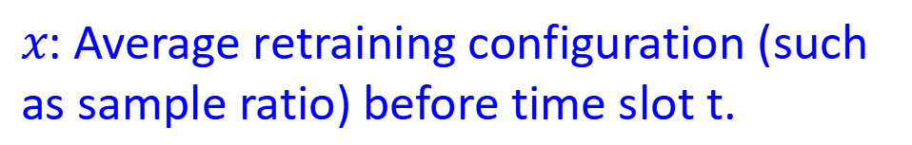
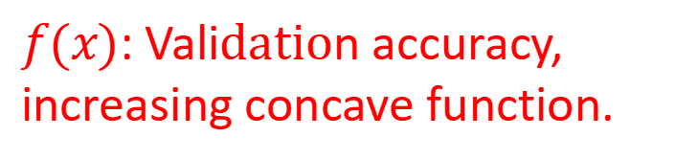
Long-term Accuracy Model and Resource Allocation Model
Objective : Optimize long-term accuracy.
Constraint (1): Limited resource on edge.
$f(x)$: Vali$datio$n accuracy, increasing concave function.
55%
40%
Resource allocation on edge.
Constraint (2-4): Each time slot, select only one retraining and inference configuration.
$x$: Average retraining configuration (such as sample ratio) before time slot t.
$y$: Inference configuration (such as resolution) at time slot t.
Notes:
Differing from prior works using heuristic algorithms, in this work, we try to design a more rational, explainable, and theoretically-guaranteed algorithm.
Formally modeling the model retraining and inference co-location paradigm can help us gain a deeper understanding of it.
Our objective is to optimize long-term model accuracy. This function represent our modeling of model accuracy when drifts happens.
[click]
f(x) is an increasing concave function that maps the average retraining configuration before time slot t to the current model accuracy.
[click]
And model accuracy at time slot t is also directly proportional to the inference configuration used at that time.
[click]
The constraint is, model retraining and model inference may compete for the limited computational resource. Additionally, in each time slot, we can only select one retraining and inference configuration.

Slide 11
Challenges of the Original Problem
(P)
s.t.
Challenges:
Time-coupled decision making.
Non-convex objective function.
Problem (P) is integer programming problem, NP-hard.
Analytical formula for f is commonly unknown in practice.
Notes:
This problem is particularly difficult for several reasons.
First, decision variables are heavily coupled and time-coupled.
Second, although f is concave, but the objective function is nonconvex.
Third, This problem is actually an integer programming problem, which is known NP-hard.
Finally, The analytical formula for f is commonly unknown in practice.

Slide 12
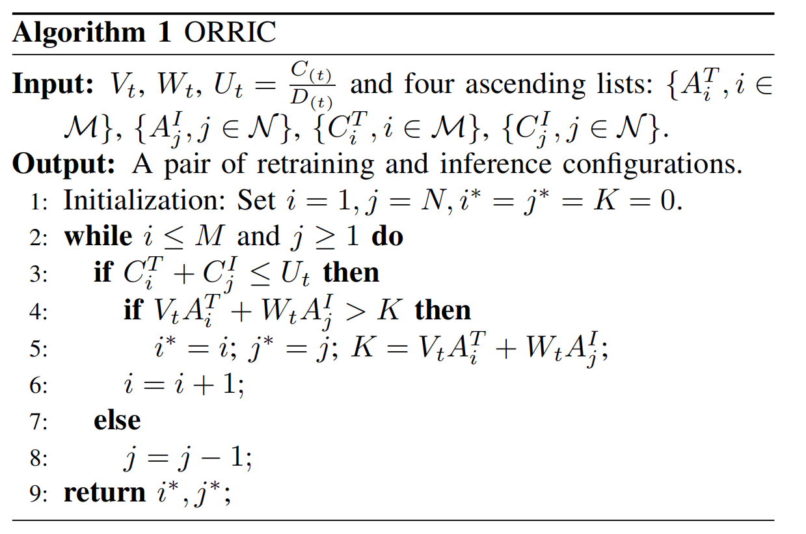
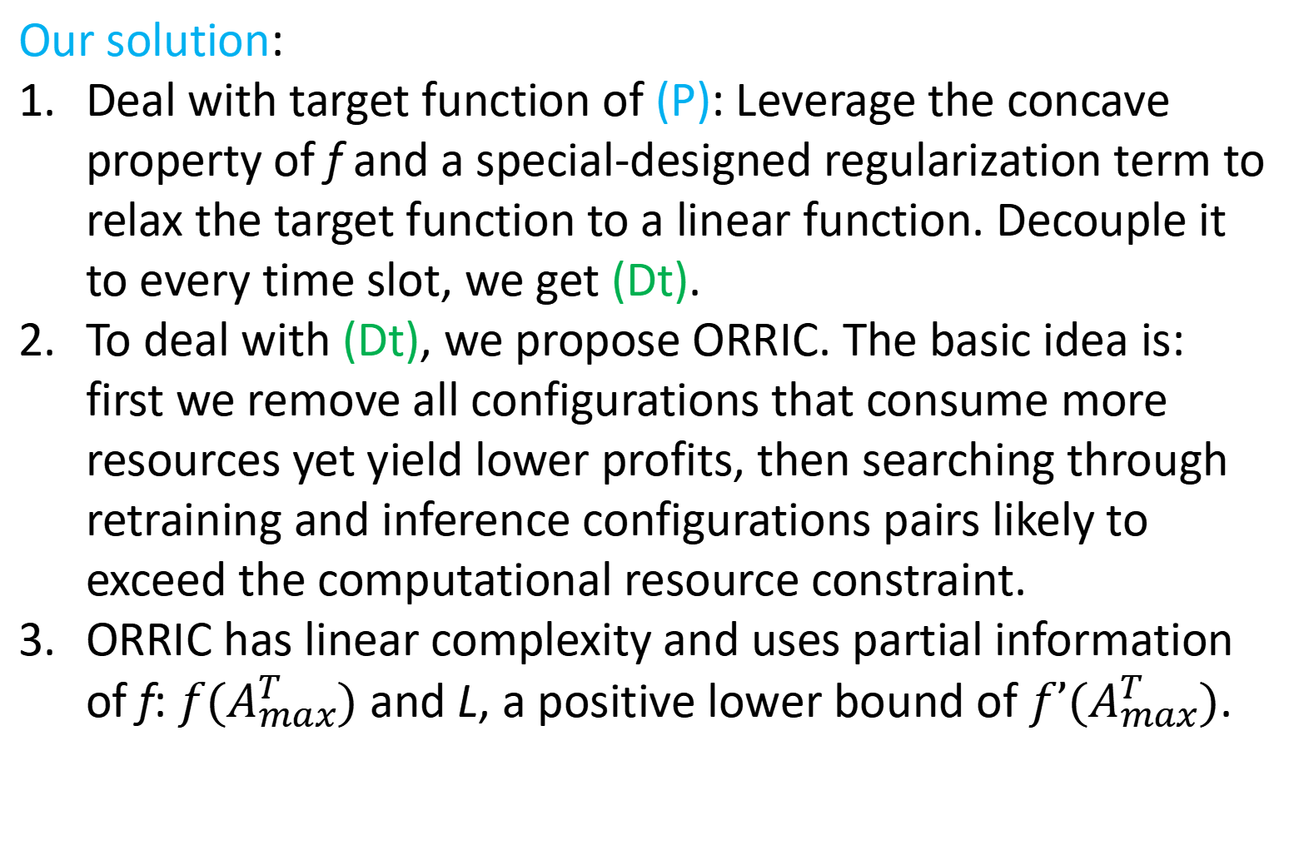
Our Solution
(P)
relaxation
(Dt)
Our solution:
Deal with target function of (P): Leverage the concave property of f and a special-designed regularization term to relax the target function to a linear function. Decouple it to every time slot, we get (Dt).
To deal with (Dt), we propose ORRIC. The basic idea is: first we remove all configurations that consume more resources yet yield lower profits, then searching through retraining and inference configurations pairs likely to exceed the computational resource constraint.
ORRIC has linear complexity and uses partial information of f: $f(A_{max}^{T})$ and L, a positive lower bound of $f’(A_{max}^{T})$.
Notes:
Our solution is mainly focusing on the target function of (P), we first leverage the concave property of f and a special-designed regularization term to relax the target nonconvex function to a linear function. Decouple it to every time slot, we get (Dt).
To deal with (Dt), we propose ORRIC. The basic idea is: first we remove all configurations that consume more resources yet yield lower profits, then searching through retraining and inference configurations pairs likely to exceed the computational resource constraint.
ORRIC has linear complexity and uses partial information of f，more precisely, (f A T sub max)(直接这样单个词读就行) and L, a positive lower bound of the derivative of f at A T sub max.

Slide 13
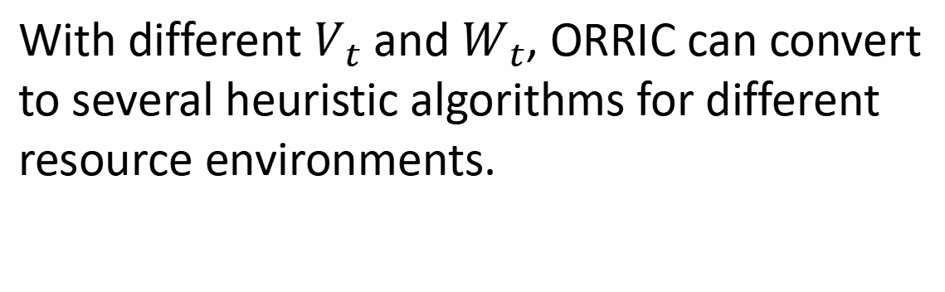
Insights from ORRIC
Resources | T is Large | T is Small
Sufficient | Knowledge-Distillation
Limited | Focus-Shift | Inference-Greedy
Scarce | Inference-Only
With different $V_{t}$ and $W_{t}$, ORRIC can convert to several heuristic algorithms for different resource environments.
1) Knowledge-Distillation: The teacher model imparts knowledge to the student model without considering resource consumption.
2) Inference-Greedy: Prioritize using a higher configuration for inference and utilize the remaining resources for retraining.
3) Focus-Shift: Shift the focus from retraining to inference as time passes.
4) Inference-Only: This algorithm is actually the traditional computing paradigm that deploys a trained model and then performs inference.
(Dt)
Notes:
With different Vt and Wt, ORRIC can convert to several heuristic algorithms for different resource environments.
When the computational resources are sufficient, which means we can use the best inference and retraining configuration, ORRIC converts to Knowledge-Distillation because Vt and Wt are larger than zero.
When resources are really scarce, ORRIC converts to Inference-Only, which is actually the traditional computing paradigm that, deploys a trained model and then performs inference.
When resources are limited and T is large, ORRIC converts to Focus-Shift, and Inference-Greedy when T is samll.

Slide 14
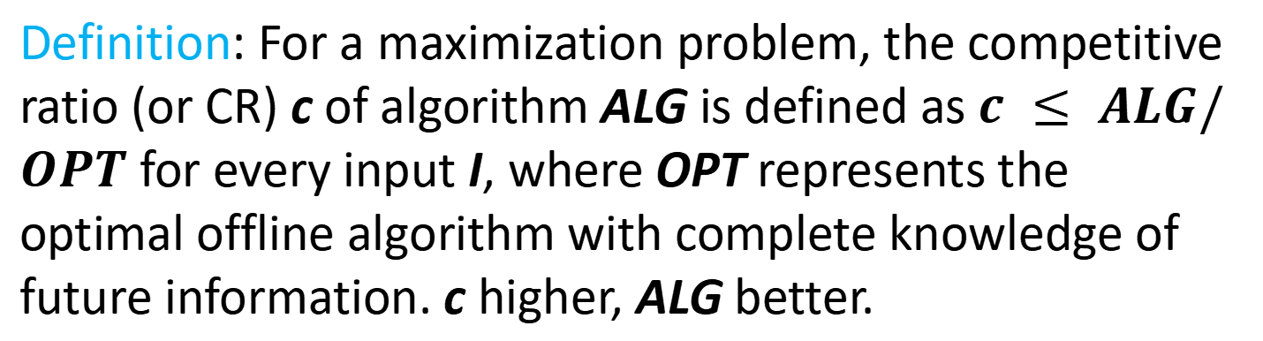
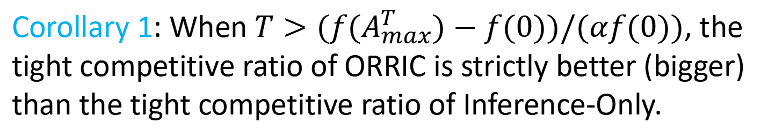
Insights from Compititive Results
Definition: For a maximization problem, the competitive ratio (or CR) c of algorithm ALG is defined as $c ≤ ALG/OPT$ for every input I, where OPT represents the optimal offline algorithm with complete knowledge of future information. c higher, ALG better.
Corollary 1: When $T>(f(A_{max}^{T})−f(0))/(αf(0))$, the tight competitive ratio of ORRIC is strictly better (bigger) than the tight competitive ratio of Inference-Only.
Insights: When drift occurs for a sufficiently lengthy time, the worst-case performance of the Model Retraining and Inference Co-location paradigm is strictly better than that of the traditional Inference-Only paradigm.
Notes:
We also give some competitive results about our ORRIC algorithm and Inference-Only algorithm. The latter one actually represent the traditional computing paradigm that, deploys a trained model and then performs inference.
Due to the rough approximation to the original objective function, ORRIC may not fully represent the potentiality of model retraining and inference co-location paradigm. However, the tight competitive ratio of ORRIC is still larger than that of Inference-Only, when drift occurs for a sufficiently lengthy time. This implies that, in such scenarios, the worst-case performance of the model retraining and inference co-location paradigm is strictly better than that of the traditional Inference-Only paradigm.

Slide 15
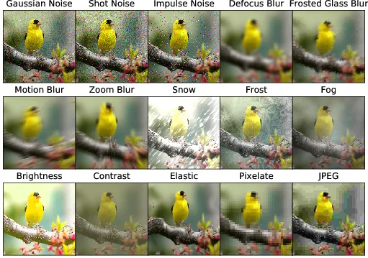
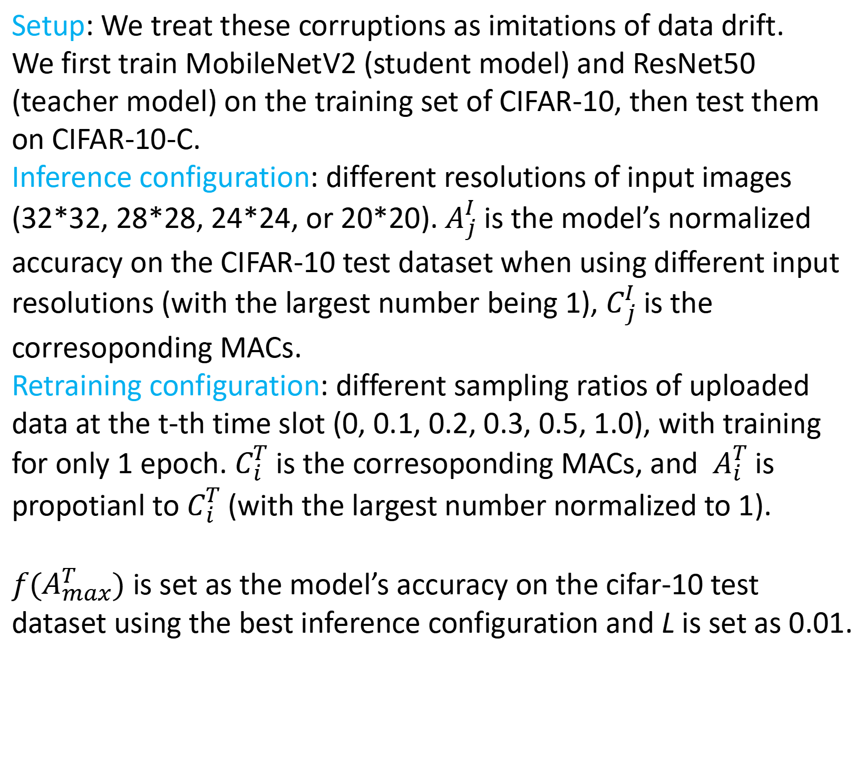
Evaluation Setup
Setup: We treat these corruptions as imitations of data drift.
We first train MobileNetV2 (student model) and ResNet50 (teacher model) on the training set of CIFAR-10, then test them on CIFAR-10-C.
Inference configuration: different resolutions of input images (32*32, 28*28, 24*24, or 20*20).$A_{j}^{I}$ is the model’s normalized accuracy on the CIFAR-10 test dataset when using different input resolutions (with the largest number being 1),$C_{j}^{I}$ is the corresoponding MACs.
Retraining configuration: different sampling ratios of uploaded data at the t-th time slot (0, 0.1, 0.2, 0.3, 0.5, 1.0), with training for only 1 epoch. $C_{i}^{T}$ is the corresoponding MACs, and $A_{i}^{T}$ is propotianl to $C_{i}^{T}$ (with the largest number normalized to 1).
$f(A_{max}^{T})$ is set as the model’s accuracy on the cifar-10 test dataset using the best inference configuration and L is set as 0.01.
Dataset: CIFAR-10-C
Our Code: https://github.com/caihuaiguang/ORRIC.
Notes:
For evaluation, our dataset is CIFAR-ten-C, that is generated by adding nighteen corruptions to the test dataset of CIFAR-ten, is typically used in experiments of out- of-distribution generalization or continual test-time adaptation in computer vision. We treat these corruptions as imitations of data drift.
We first train MobileNetV-two and ResNet-fifty on the training set of CIFAR-ten, then test them on CIFAR-ten-C.
Inference configuration involves different resolutions of input images.
Retraining configuration involves different sampling ratios of uploaded data at the t-th time slot.
(f A T sub max) is set as the model’s accuracy on the cifar-ten test dataset using the best inference configuration and L is set as zero point zero one.

Slide 16
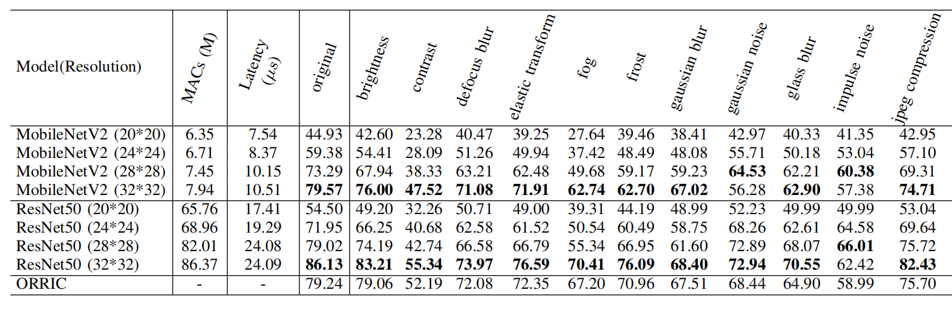

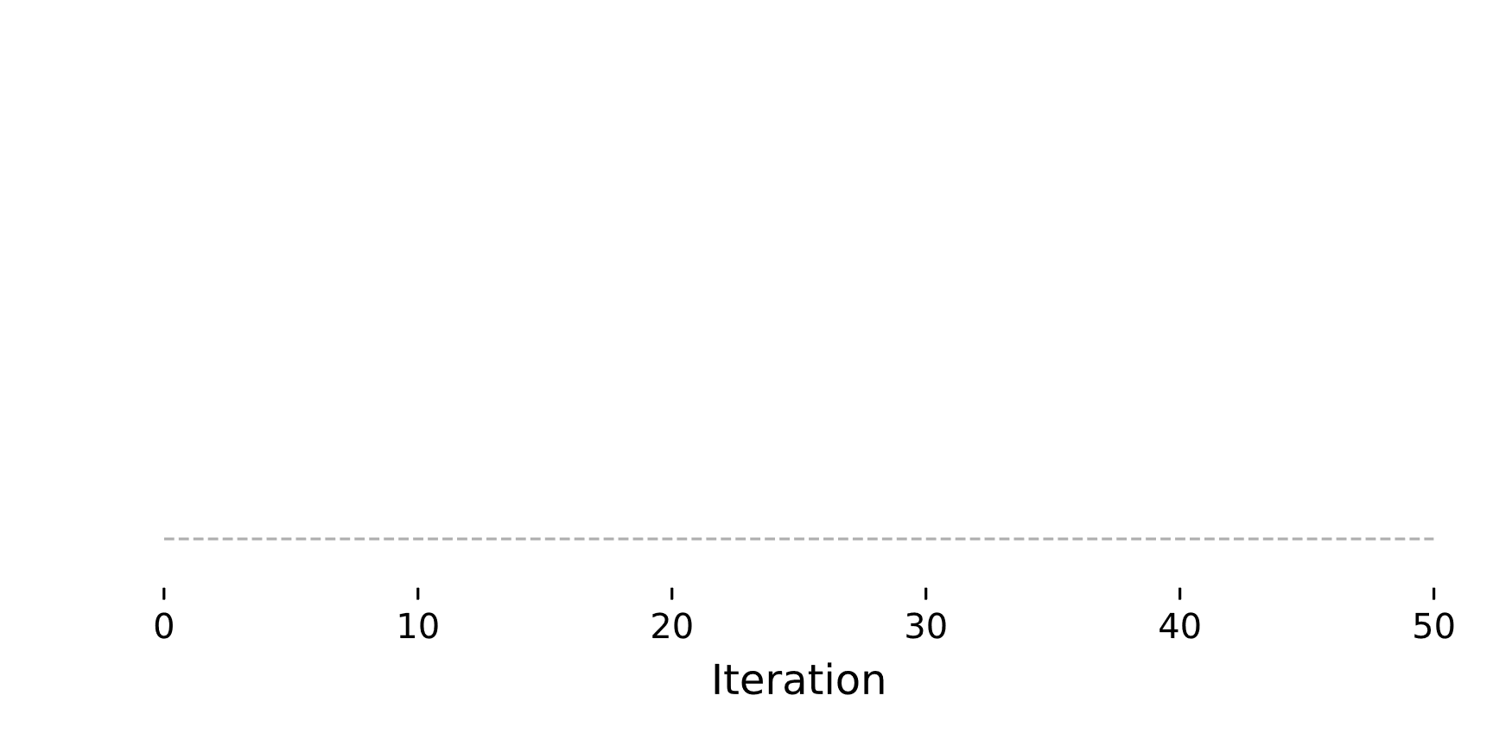
Evaluation Results
Severity level of corruption are becoming higher.
Accuracy-Cost-Latency trade-off comparison.
Notes:
We compare three methods in our setting, ORRIC, Teacher Only, and Student Only.
The left picture shows the results on the 'fog' corruption dataset. Each type of corruption in CIFAR-ten-C has five severity levels, causing the accuracy of all three methods to drop suddenly and periodically. However, the curve for ORRIC is almost always higher than that of Student Only, demonstrating the benefit of model retraining.
The right picture shows the Accuracy-Cost-Latency trade-off of these three methods while normalizing the maximum value of each axis to one.
In general, the model retraining and inference co-location paradigm can utilize idle available resources to improve model accuracy while maintaining low latency, thereby alleviating the negative impact of drift on accuracy.

Slide 17
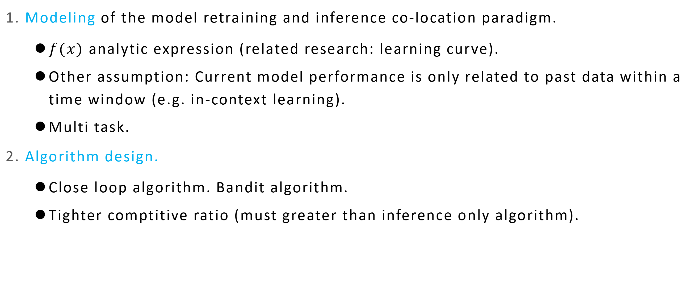
Future Direction: Modeling and Algorithm Design
1. Modeling of the model retraining and inference co-location paradigm.
$f(x)$ analytic expression (related research: learning curve).
Other assumption: Current model performance is only related to past data within a time window (e.g. in-context learning).
Multi task.
2. Algorithm design.
Close loop algorithm. Bandit algorithm.
Tighter comptitive ratio (must greater than inference only algorithm).
Notes:
There are several future works that can be done, specifically from the perspectives of modeling and algorithm design.
For modeling,
first, knowing the analytic expression of f(x) may help designing more effictive algorithm.
Second, in our modeling, every previously used retraining configuration has the same effect on current model performance. Other assumptions about the relationship between retraining configuration and model performance may be reasonable as well. For expample, in in-context learning the current model performance is only related to past data within a time window.
Third, in this work, we only consider the single-task scenario and do not address the multi-task scenario as in Ekya.
And for algorithm design, our algorithm does not leverage feedback from the system, and our competitive results are far from optimal, indicating significant room for improvement.

Slide 18
Future Direction: On-device Model Retraining and Inference Co-location
Exiting researches on model retraining and inference co-location typically deploy the model on edge or cloud.
Model retraining and inference co-location on devices holds promise for enhanced privacy protection, reduced bandwidth usage and personalized AI models.
Famous works like TensorFlow Lite, PyTorch Mobile and MNN mainly focus on model inference on devices, and there is little code available for model retraining and inference co-location.
Notes:
Another future direction is on-device Model Retraining and Inference Co-location.
Existing researches on model retraining and inference co-location typically deploy the model on edge or cloud.
Model retraining and inference co-location on devices holds promise for enhanced privacy protection, reduced bandwidth usage and personalized AI models.
Famous works like TensorFlow Lite, PyTorch Mobile and MNN mainly focus on model inference on devices, and there is little code available for model retraining and inference co-location, and some lack regular maintenance. We call for further efforts in this direction.

Slide 19
Thank you!
Our Code: https://github.com/caihuaiguang/ORRIC.

