Slide 1
CVPR 21 SCF-Net: Learning Spatial Contextual Features for Large-Scale Point Cloud Segmentation
汇报者：蔡怀广 自动化所 202228014628021

Slide 2
目录
01.
作者
CONTENTS
02.
任务
03.
方法
04.
结论

Slide 3

作者介绍
一作Siqi Fan，他的第三篇文章
自动化所王飞跃团队

Slide 4
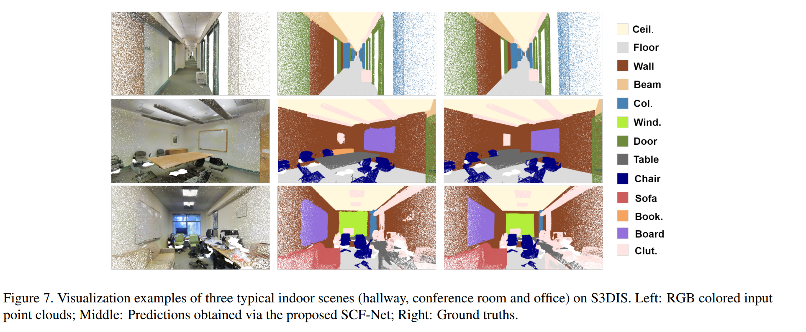
任务、相关工作
目的： learn effective features from large-scale point clouds for semantic segmentation
语义分割（semantic segmentation） : 像素级别的分类任务。
输入： 3D点云：每个3D点有空间信息（x,y,z坐标）和特征（颜色等）；输出： 每个3D点的类别
难点：large-scale point clouds, 3D point clouds are generally unstructured and unordered
已有方案分类：projection-based( project 3D point clouds into 2D images and then process 2D semantic segmentation, then project back the intermediate segmentation results to the point clouds. computationally expensive, the information loss of the details), discretization-based ( convert the point cloud into a discrete representation, such as voxel, and then feed to a NN for voxel-wise segmentation. computationally expensive, sensitive to the granularity of the voxels), and point-based methods(some of them could not deal with the large-scale point clouds.RandLA-Net [13] utilized random sampling to achieve high efficiency and leveraged local feature aggregation module to learn and preserve geometric patterns)

Slide 5
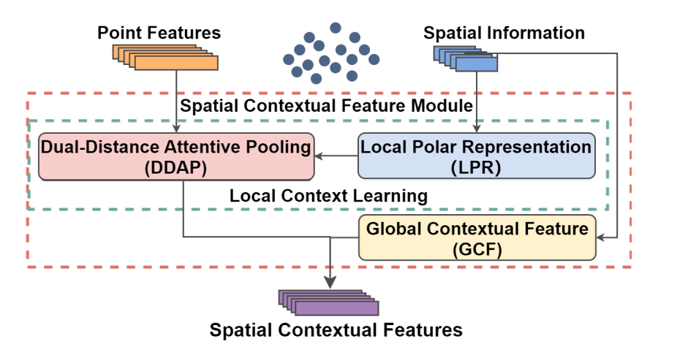
方法：SCF(Spatial Contextual Features)
目的：SCF: a learnable module that learns Spatial Contextual Features from large-scale point clouds
mainly consists of three blocks
和大部分神经网络上的小修小改一样，利用了人的先验知识，但却无法刻画能力边界，也没有一套严格的理论解释各部分作用。当然性能提升了，也是很有价值的探索。

Slide 6
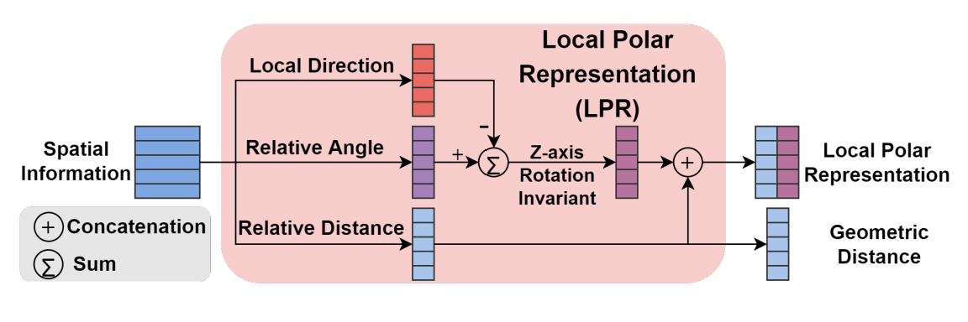
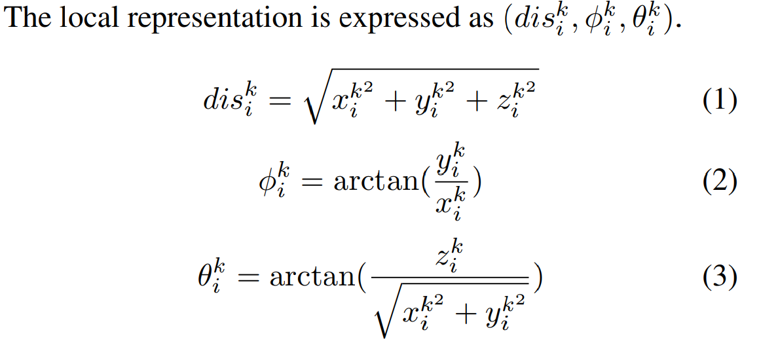
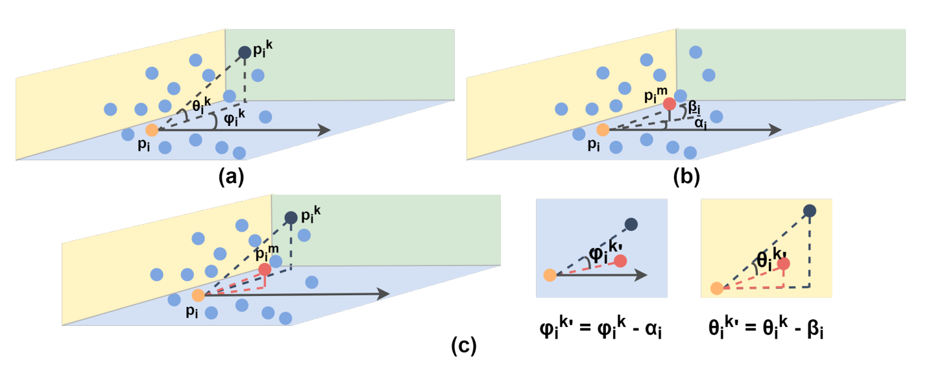
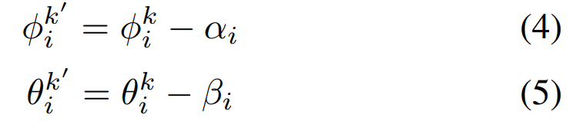
SCF：局部极坐标表示块(LPR)
目的：the local polar representation block is firstly explored to construct a spatial representation that is invariant to the z-axis rotation
the features directly learnt from the input 3D points are orientation-sensitive：每个点为原点的极坐标系
方法：
Constructing initial local representation
Calculating the local direction
Updating
why z-axis?
why rotation?

Slide 7


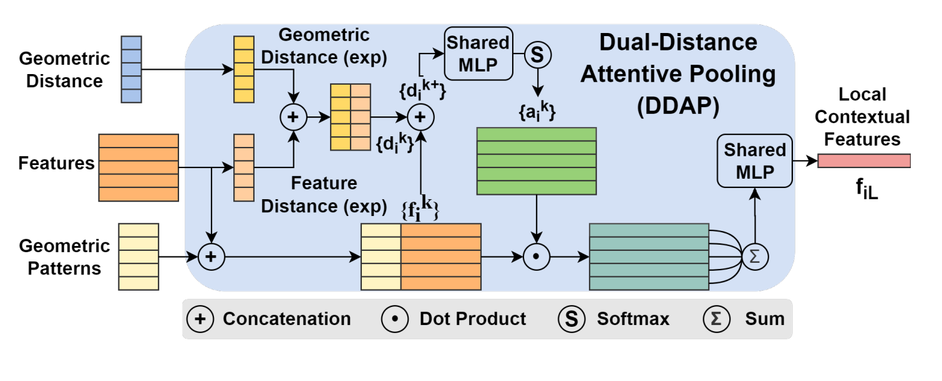


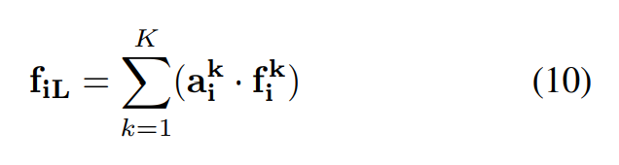
SCF：双距离注意力池块(DDAP)
目的：dual-distance attentive pooling: utilize the representations of its neighbors for learning local features according to both the geometric and feature distances
geometric patterns, the local representation output
by the LPR are concatenated with the absolute coordinates

Slide 8
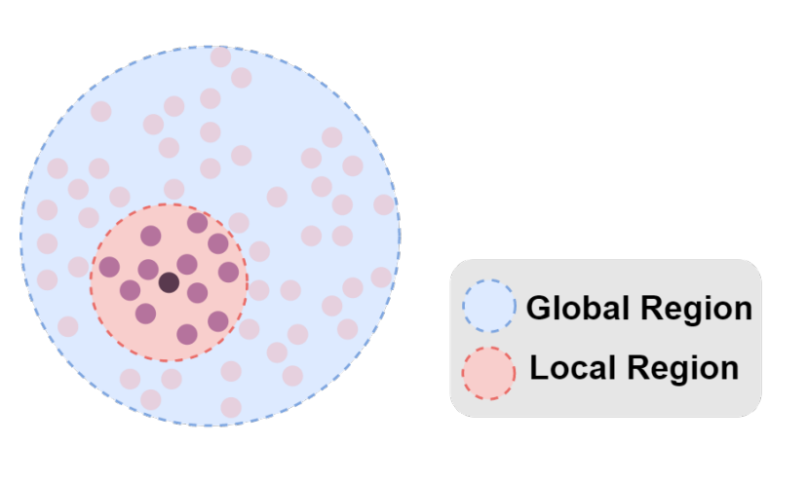
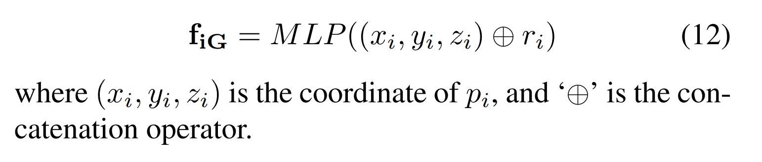
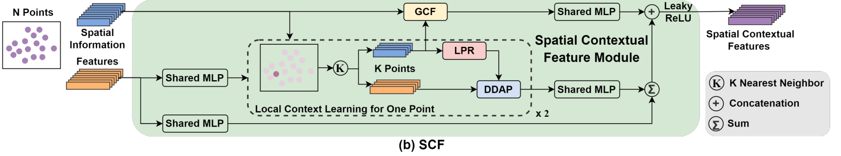
SCF：全局上下文特征(GCF)
目的： the global contextual feature block is designed to learn a global context for each 3D point by utilizing its spatial location and the volume ratio of the neighborhood to the global point cloud.
这就实现Global了? 有点粗糙

Slide 9
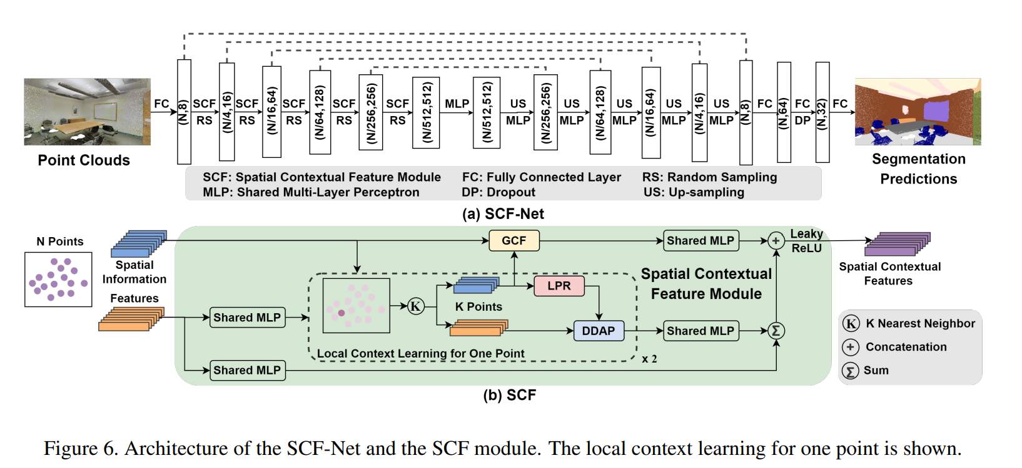
方法：SCF-Net
设计思想：如何实现SCF的模块化？
SCF模块嵌入到一个标准的编码器-解码器架构中，从而产生了新的分割网络，SCF-net。

Slide 10
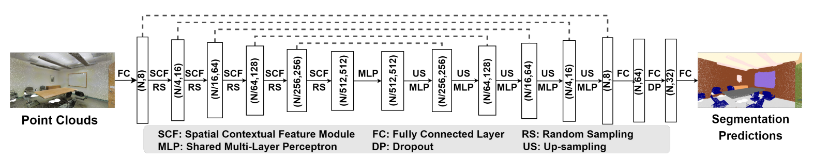
方法：SCF-Net
网络的输入为N×d的点云，N为点的个数，d为输入的特征维数。
首先通过一个全连通层，然后五层encoder，其中，采用随机采样对点云进行下采样，并嵌入SCF模块学习空间上下文特征。在这个过程中，点数逐渐减少，特征维度逐渐增大。
接下来又是五个解码器（decoder）堆叠，并通过最近邻插值进行上采样。输出维度相同的层之间进行skip link。最后是三个连续的全连接层。
输出N×c，N是点数，c是类的数量。

Slide 11
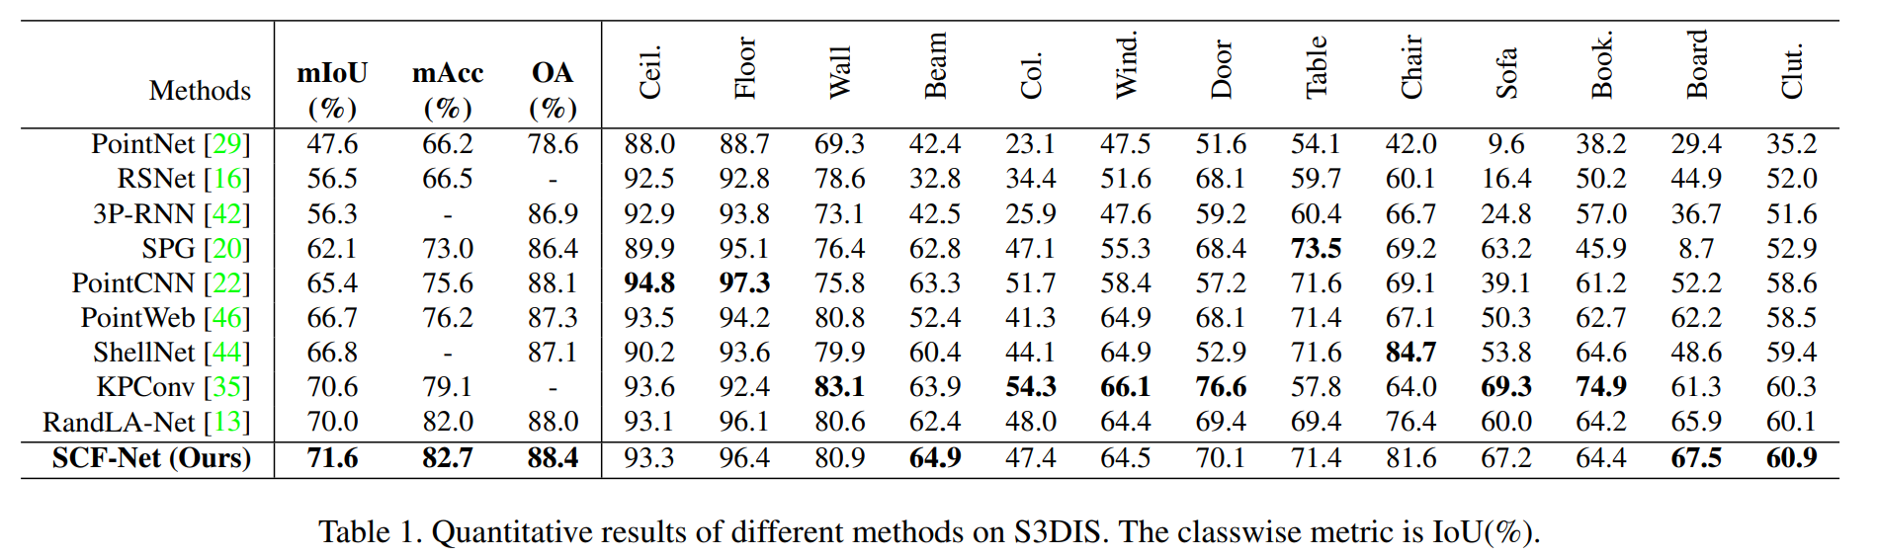
结论：实验结果
SCF-Net performs better than several state-of-the-art methods in most cases, evaluate on two typical large-scale point cloud benchmarks
Intersection-over-Union(mIoU), mean class Accuracy (mAcc) and Overall Accuracy (OA) are used as standard metrics

Slide 12
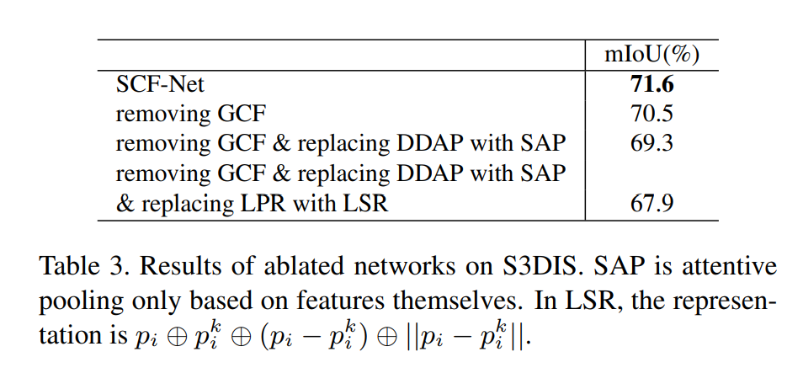
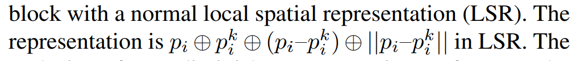
结论：消融实验
Ablation Study on SCF
SAP: Only neighboring point features are taken into consideration while learning the pooling weights.
LSR: In LSR, it is represented in Cartesian coordinates, while it is represented as the relative angle to thelocal direction in LPR, which is not sensitive to the rotationaround the z-axis.

Slide 13
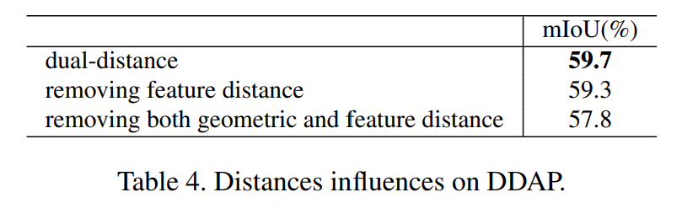
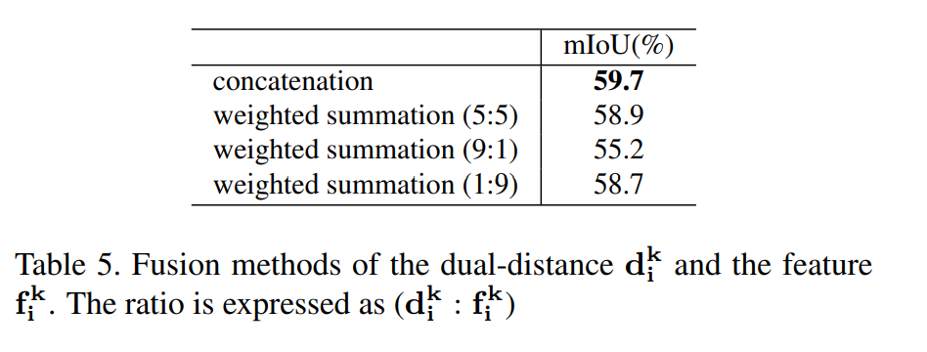
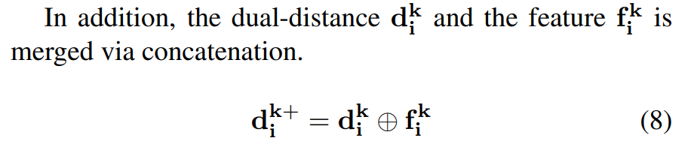
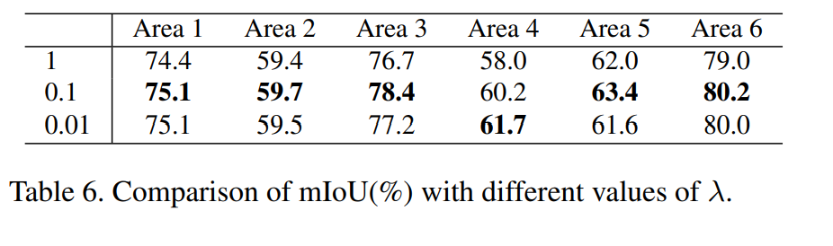
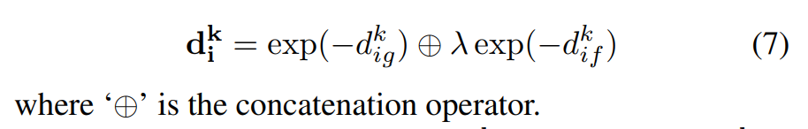
结论：消融实验
Ablation Study on DDAP
the improvement benefited from the geometric distance is greater
both are effective
It can be seen that 0.1 is a better choice, which achieves the best performanceon five of the six areas

Slide 14
结论：总结
They propose the learnable module SCF to learn effective features from large-scale point clouds for semantic segmentation. The proposed module mainly consists of three blocks, including the local polar representation block, the dual-distance attentive pooling block, and the global contextual feature block. The LPR and DDAP blocks are used for learning discriminative local contextual features, while the GCF block is proposed to learn the global contextual features.
SCF could be easily embedded into various network architectures for point cloud segmentation, and we embed it into an encoder-decoder architecture, resulting in the SCF-Net in this work. Extensive experimental results on S3DIS and Semantic3D demonstratethat the proposed method achieves state-of-the-art performances on both indoor and outdoor scenes.

Slide 15
结论：评价
和大部分神经网络上的小修小改一样，利用了人的先验知识（比如说语义分割应该使得对物体方向不敏感、欧式空间中临近的点可能是同一个物体，注意局部信息的同时也要注意全局信息），但却无法刻画能力边界，也没有一套严格的理论解释各部分作用。当然性能提升了，也是很有价值的探索。
SCF-module的设计思想非常棒！和Resnet一样，设计出一个模块，然后就可以应用于各种网络了。
局部极坐标表示块（LPR）利用极坐标克服达到沿Z轴的旋转不变性，这个思想挺好的，但作者既没有说明Z轴是哪个，也没有示意图告诉我为何旋转了还保持不变（写作瑕疵）。双距离注意力池块(DDAP)哪儿太多术语了搞不清，公式还可以写得更加详细一点。感觉是类似于局部注意力的方式，本可以描述得更加清楚一点的，这样方便形式化然后理论研究。全局上下文特征(GCF)只考虑全局的几何信息，而且就一个（坐标，体积比率）设计有一点粗糙，不考虑全局的特征信息，可以进一步研究。
消融实验、SCF-Net的实验做得很充分，令人信服。
优点：网络设计高明、实验充分、写作清楚、代码开源。
瑕疵：写作稍有交代不清楚的地方（作者英语水平和我差不多，所以读起来快于一般情况），缺少理论和insight的思考和启发。

