Slide 1
DESKTOP PET
by Irene Cai

Slide 2
Dreams

Slide 3
v
M
C
Pet
Food
Toys
Listeners
Timers
Frame
Label
(picture/text)
Panel
(buttons)

Slide 4
MODEL
PET
HashMap <toy : int> int : hunger/health/happy List<String> : dreams
+ eat / play / process dream + lose XXX while time pass + say something
Timers ......
Toy Box
List<Toy>
+ provide toy
Food Box
List<Food>
+ provide food
toy
???
+ produce other toys
Food
Int : value / spoil Rate
+ spoil while time pass

Slide 5
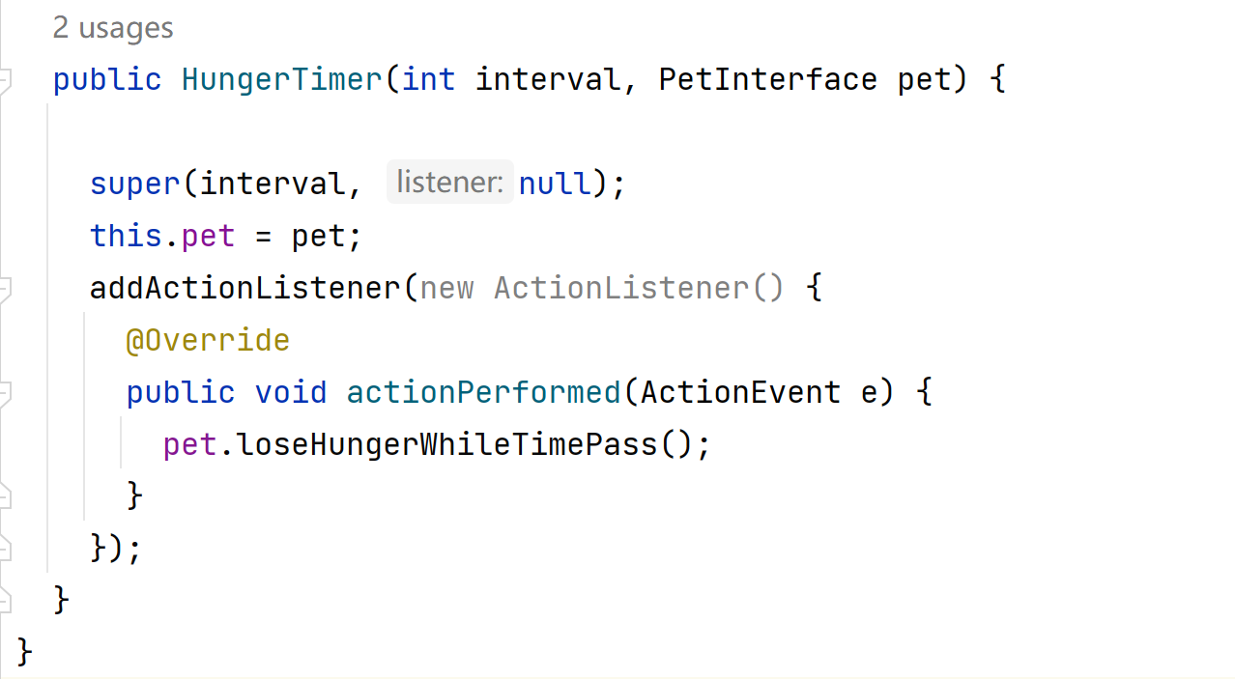
Time to repeat
Action to repeat

Slide 6
CONTROLLER
Happiness Timer
pet
+ make pet loss happiness
Central Controller
Listeners: · Action listener · Property Change listener Timers: · for Pet Fields · for Food
+ Reactions to Listeners: · Start or Stop timers · Generate Panel (foodPanel)
Food Generator Timer
Food Box
+ add food to box
Health Timer
pet
+ make pet loss health
Food Timer
+ make food spoil
Hunger Timer
pet
+ make pet loss hunger

Slide 7
VIEW
Speaking Label (text)
+ change text method
dynamic
Food
Panel
(buttons)
*be listened
Frame
Pet Label
(GIF)
+ change gif method
Basic Panel (buttons) *be listened

Slide 8
How to make a panel Dynamic?
How to make a Normal panel:
1. Create buttons
2. Add them onto panel
3. Add listener to controller
How to make a Dynamic panel:
Need parameters
Need a dynamic list, and For-loop
Create new Listeners (helicopter objects) instead of using the Centre controller

Slide 9
What was hard/easy?

Slide 10
Know how to do == Easy
Don’t know how to do == Hard

Slide 11

But anyway, pet loves you...

Slide 12
Reference:
DALL·E 2
https://openai.com/product/dall-e-2

