Slide 1

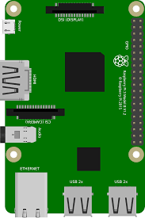
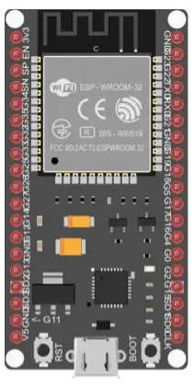


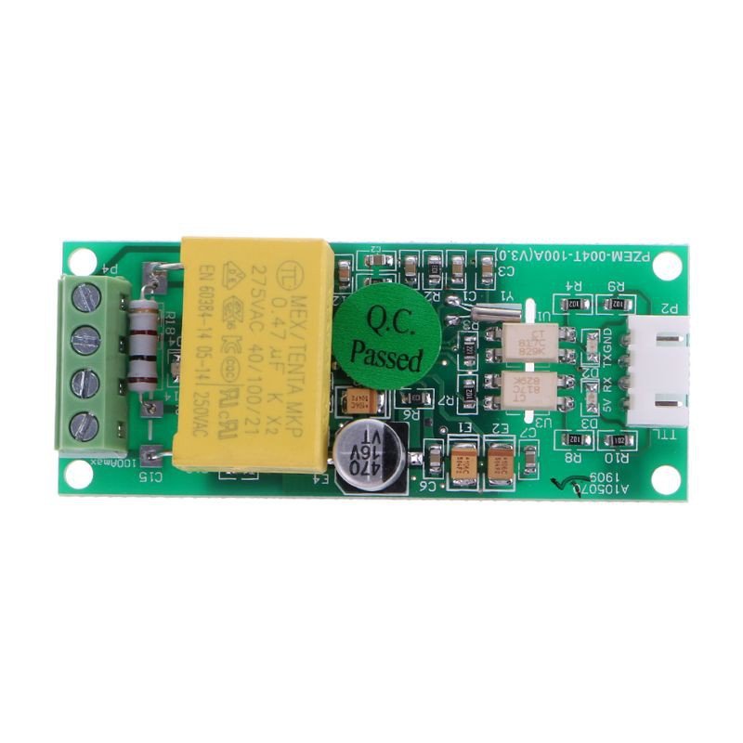
Mosquitto
Broker on RPi
MQTT Client
Publish in:
esp32/voltage,
current, power,
energy, freq, pf
Publish in:
esp32_01/voltage,
current, power,
energy, freq, pf
UART
Generator
Subscribe to:
esp32/voltage,
current, power,
energy, freq, pf
RPi
esp-32
pzem-004t
MQTT Client
Publish in:
Esp32_02/voltage,
current, power,
energy, freq, pf
UART
Load
esp-32
pzem-004t

Slide 2
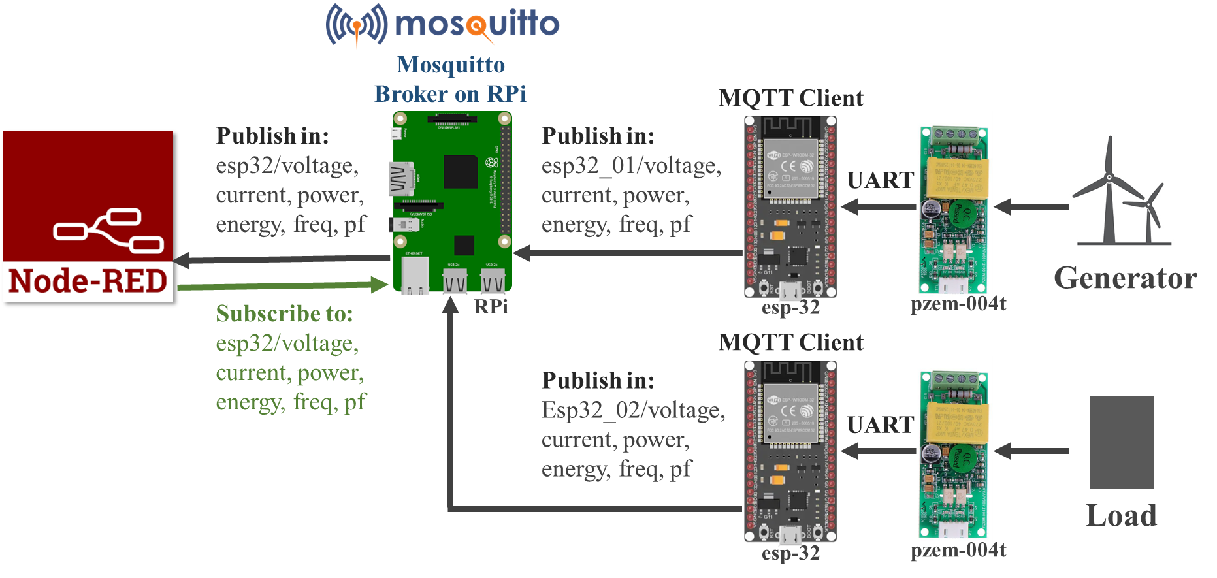

Slide 3
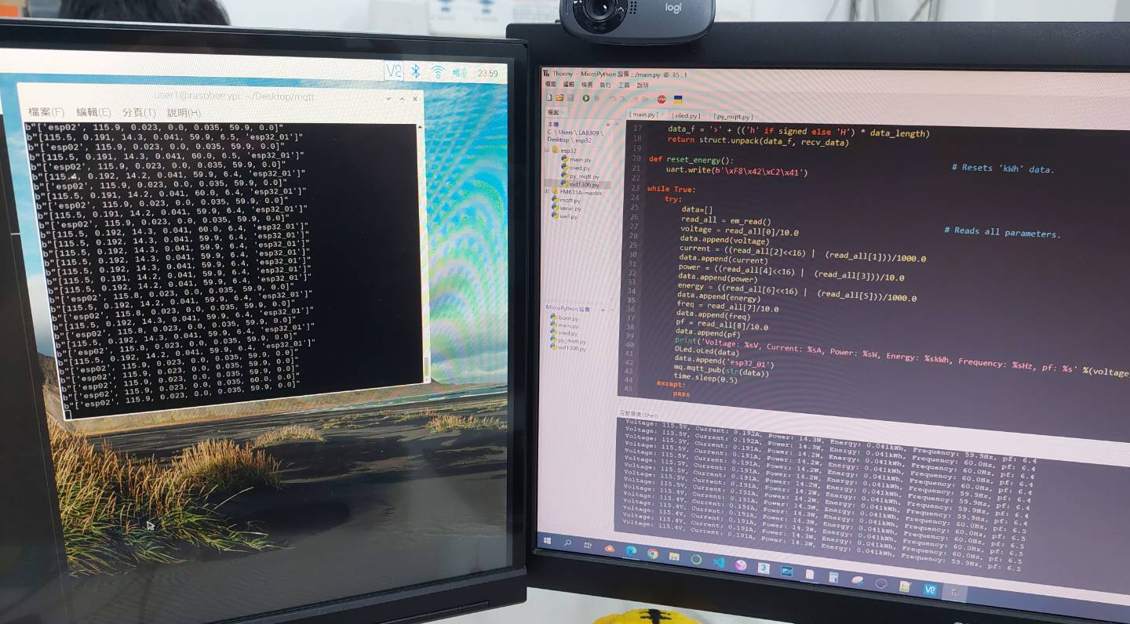
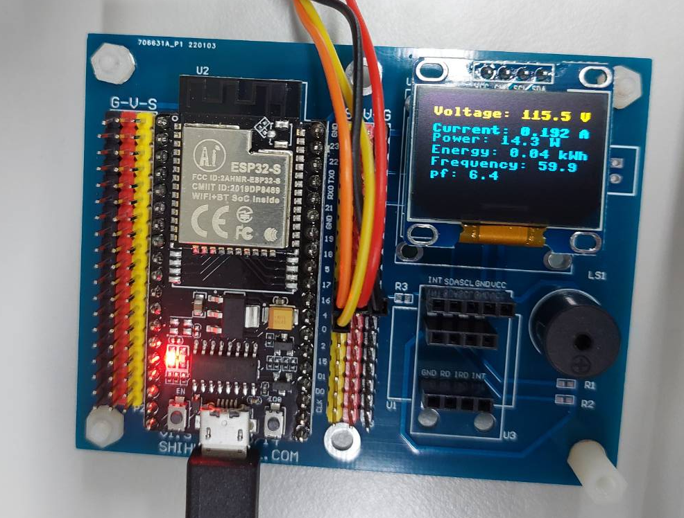
Esp-32
RPi
Esp-32

