Slide 1
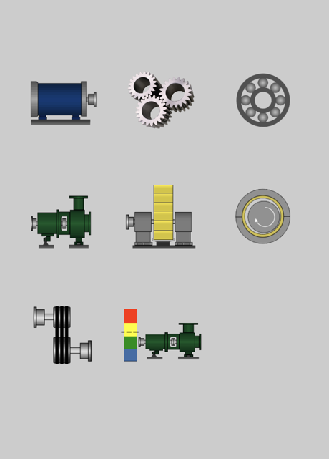

>>
设备振动频率计算
电机
齿轮
滚动轴承
泵
风机风扇
滑动轴承
传动带
振动参照

Slide 2
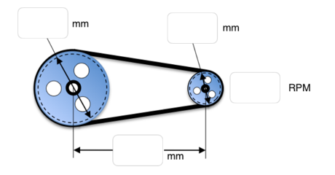
返回
>>
传动带
传动比(Transmission Ratio) = 0.00
皮带长(Belt Length) = 0.00 mm
带速度(Belt Velocity) =0.00 mm/min
滑轮驱动器转速(Driver Pulley RPM) = 0.00
从动皮带轮转速(Driven Pulley RPM) = 0.00
皮带速度(Belt RPM) =0.00
RPM | Hz | 输入转速 | 输出转速 | 皮带速度
1X |  | 0.00 | 0.00 | 0.00
2X |  | 0.00 | 0.00 | 0.00
3X |  | 0.00 | 0.00 | 0.00
4X |  | 0.00 | 0.00 | 0.00

Slide 3
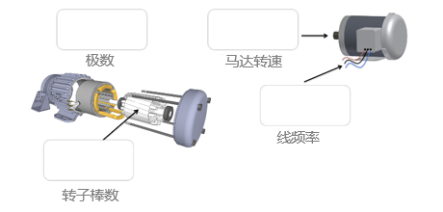
返回
>>
电机
马达转速(RPM) = 0.00
同步速度(CPM) = 0.00
Slip(CPM) =0.00
Slip(%) =0.00
PPF(CPM) =0.00
RBPF(CPM) =0.00
RPM | Hz | RPM | PPF | RBPF
1X |  | 0.00 | 0.00 | 0.00
2X |  | 0.00 | 0.00 | 0.00
3X |  | 0.00 | 0.00 | 0.00
4X |  | 0.00 | 0.00 | 0.00

Slide 4
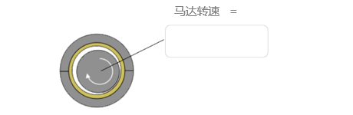
返回
>>
滑动轴承
RPM | Hz | Rotor Sync. | 输出转速 | 皮带转速
1X |  | 0.00 | 0.00 | 0.00
1.5X |  | 0.00 | 0.00 | 0.00
2X |  | 0.00 | 0.00 | 0.00
3X |  | 0.00 | 0.00 | 0.00
4X |  | 0.00 | 0.00 | 0.00
5X |  | 0.00 | 0.00 | 0.00
6X |  | 0.00 | 0.00 | 0.00
7X |  | 0.00 | 0.00 | 0.00
0.4-0.48X |  | 0.00 | 0.00 | 0.00

Slide 5
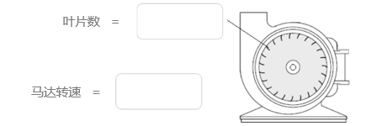
返回
>>
风扇/鼓风机
RPM | Hz | Rotor Sync. | 输出转速 | 皮带转速
f.r |  | 0.00 | 0.00 | 0.00
1X |  | 0.00 | 0.00 | 0.00
2X |  | 0.00 | 0.00 | 0.00
3X |  | 0.00 | 0.00 | 0.00
4X |  | 0.00 | 0.00 | 0.00

Slide 6
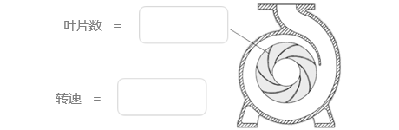
返回
>>
泵
RPM | Hz | Rotor Speed | Vane Pass
f.R. |  | 0.00 | 0.00
1X |  | 0.00 | 0.00
2X |  | 0.00 | 0.00
3X |  | 0.00 | 0.00
4X |  | 0.00 | 0.00

Slide 7
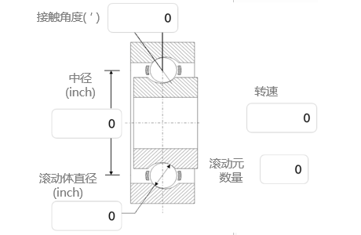
返回
>>
滚动轴承
RPM | Hz | X | 1X | 2X | 3X | 4X
RPM |  | 0.00 | 0.00 | 0.00 | 0.00 | 0.00
BPFI |  | 0.00 | 0.00 | 0.00 | 0.00 | 0.00
BPFO |  | 0.00 | 0.00 | 0.00 | 0.00 | 0.00
BSF |  | 0.00 | 0.00 | 0.00 | 0.00 | 0.00
FTF |  | 0.00 | 0.00 | 0.00 | 0.00 | 0.00

Slide 8
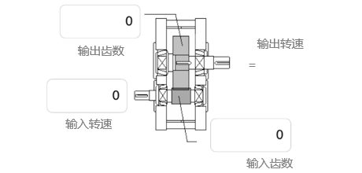
返回
>>
齿轮
输入速度(Input Speed) = 0.00
输出速度(Input Speed) = 0.00
输入齿数(Input# of Teeth) =0.00
输出齿数(Onput# of Teeth) =0.00
RPM | Hz | 1X |  | 2X
INPUT GEAR GMF -1xSB +1xSB -2xSB +2xSB |  | 0.00 |  | 0.00
 |  | 0.00 | 0.00 | 0.00 | 0.00
 |  | 0.00 | 0.00 | 0.00 | 0.00
OUPUT GEAR GMF -1xSB +1xSB -2xSB +2xSB |  | 0.00 |  | 0.00
 |  | 0.00 | 0.00 | 0.00 | 0.00
 |  | 0.00 | 0.00 | 0.00 | 0.00

Slide 9
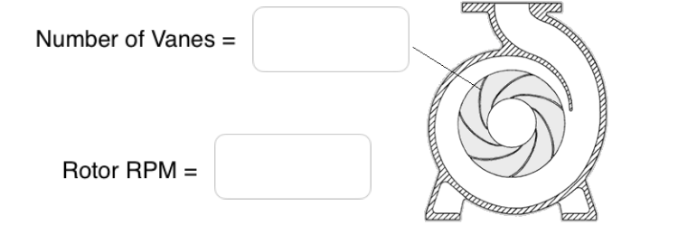
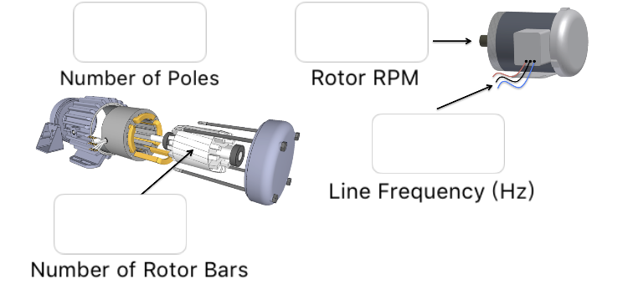
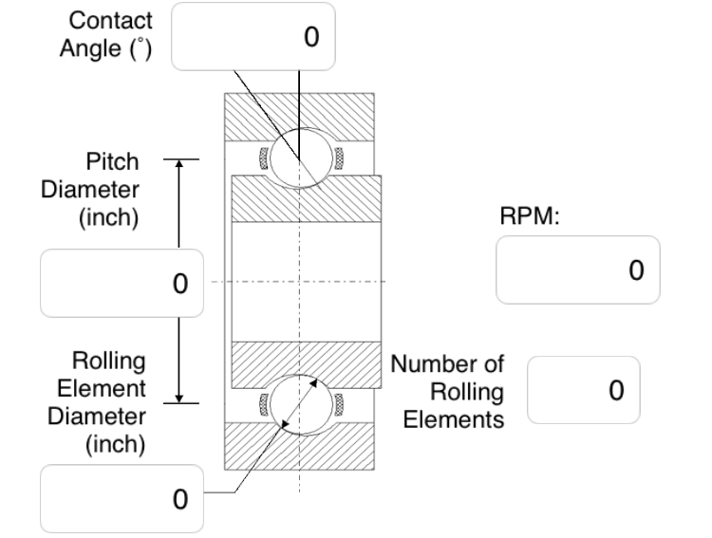
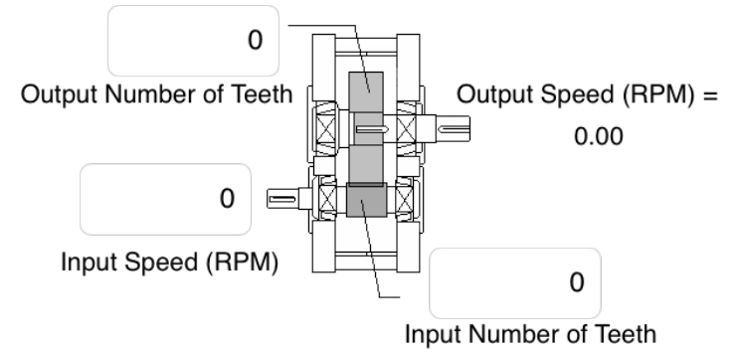
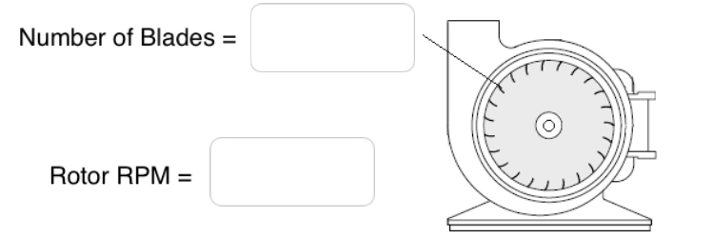
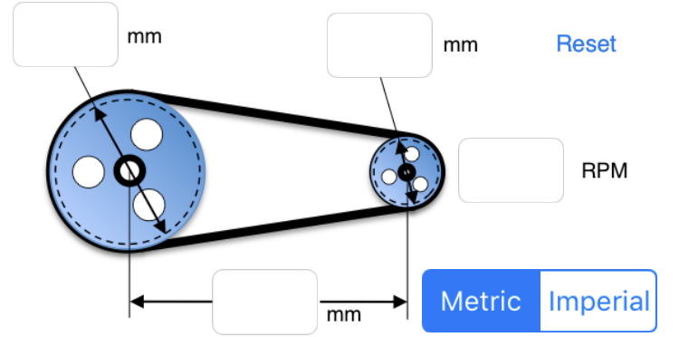
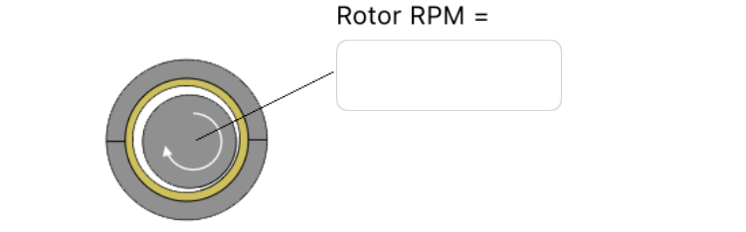
叶片数 =
接触角度( ′ )
极数
马达转速
中径
(inch)
转速 =
转速
线频率
转子棒数
滚动体直径
(inch)
滚动元
数量
输出齿数
输出转速
=
叶片数 =
输入转速
输入齿数
马达转速 =
马达转速 =

