Slide 1
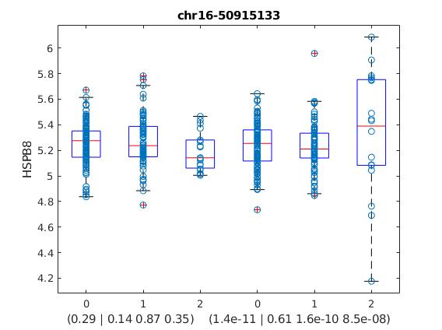

Slide 2
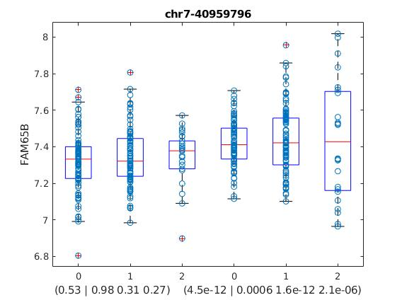

Slide 3
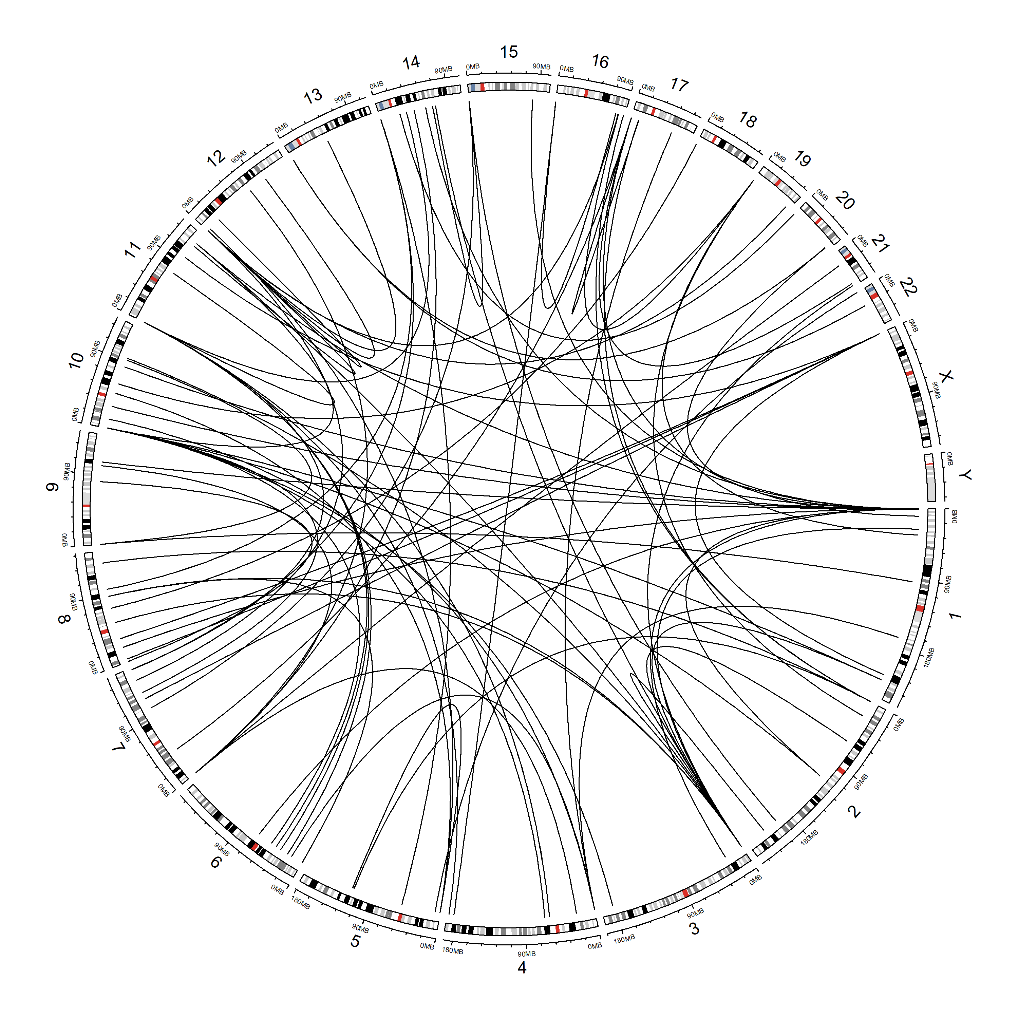
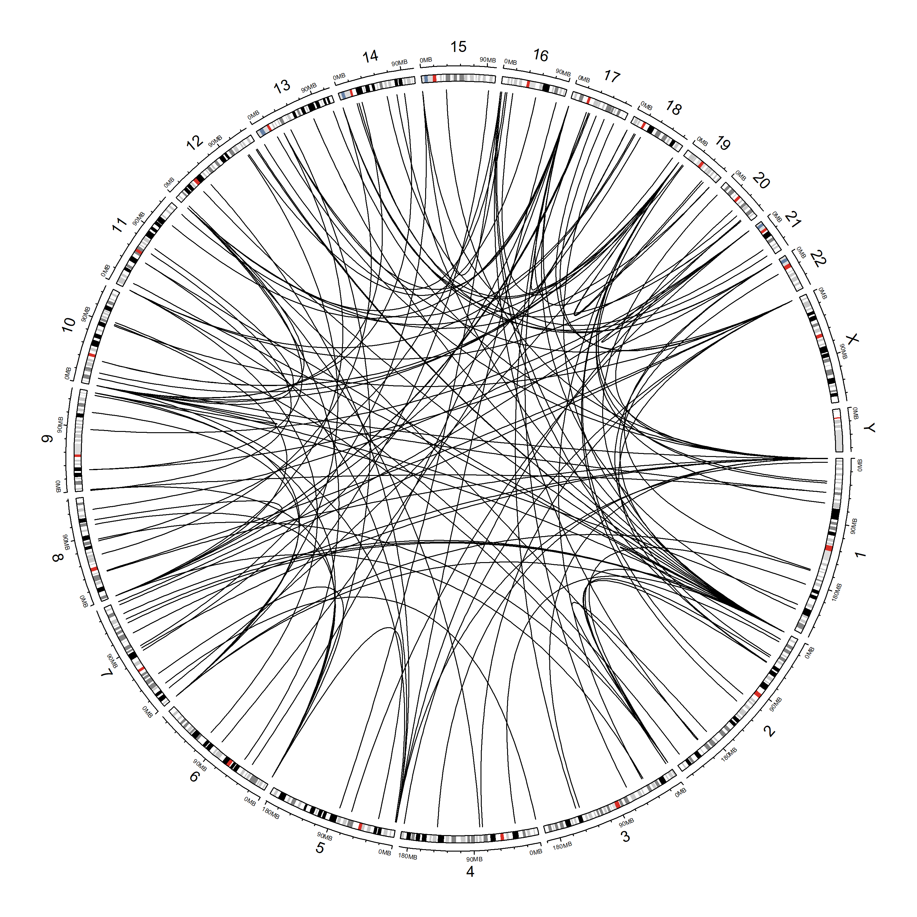
CTL
SCZ

Slide 4
15
14
13
12
11
-log10(P) SCZ
10
9
8
7
6
5
6
7
8
9
10
11
12
-log10(P) CTL

Slide 5
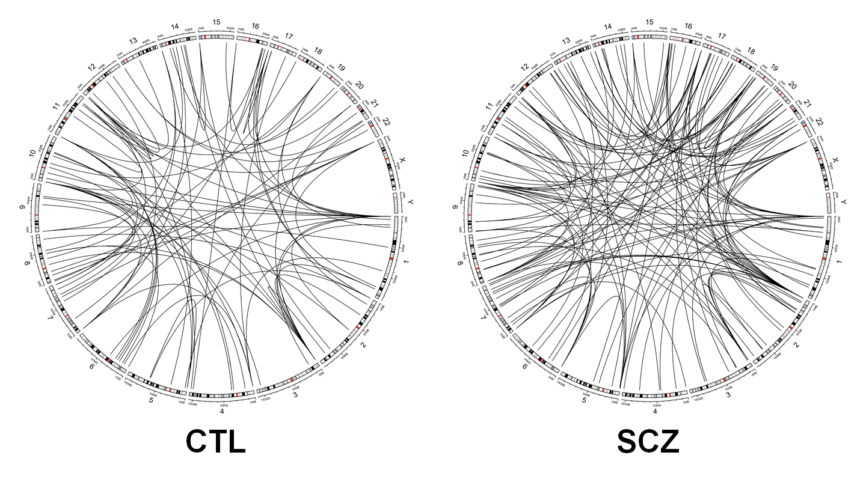
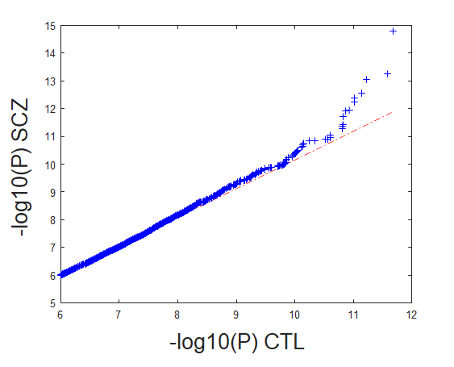

A
B
C

