Slide 1
PCA (Principal Component Analysis)
This présentation was collected from many othe presentations.
Prepared By : Alaa Tharwat
engalaatharwat@hotmail.com
HICIT – Egypt.
Prophet mohammed said [ALLAH will help any one helped his/her brother/sister] PBUH
Notes:
1

Slide 2
Idea of PCA
Introduced by Pearson (1901) and Hotelling (1933) to describe the variation in a set of multivariate data in terms of a set of uncorrelated variables
We typically have a data matrix of n observations on p correlated variables x₁,x₂,…x_{p}
PCA looks for a transformation of the x_{i} into p new variables y_{i} that are uncorrelated
Notes:
2

Slide 3
Principal Component Analysis (PCA)
Principal component analysis (PCA), or Karhunen-Loeve transformation, is a data-reduction method that finds an alternative set of parameters for a set of raw data (or features) such that most of the variability in the data is compressed down to the first few parameters
Principal component analysis mathematically is an orthogonal linear transformation that changes the data into a new coordinate system such that the variance is put in order from the greatest to the least.
Because of the decreasing variance property, much of the variance (information in the original set of p variables) tends to be concentrated in the first few PCs. This implies that we can drop the last few PCs without losing much information. PCA is therefore considered as a dimension-reduction technique.
The transformed PCA parameters are orthogonal
The PCA diagonalizes the covariance matrix, and the resulting diagonal elements are the variances of the transformed PCA parameters
Major application: Correlated variables are transformed into uncorrelated variables
The coefficients of these principal components are chosen to meet three criteria
What are the three criteria?

Slide 4
What are Principal Components?
The three criteria:
There are exactly p principal components (PCs), each being a linear combination of the observed variables.
The PCs are mutually orthogonal (i.e., perpendicular and uncorrelated);
The components are extracted in order of decreasing variance.
Y = b₁X₁ + b₂ X₂ + … b_{n} X_{n}

Slide 5
Principal Component Analysis
PCA identifies an m dimensional explanation of n dimensional data where m < n.
Originated as a statistical analysis technique.
PCA attempts to minimize the reconstruction error under the following restrictions
Linear Reconstruction
Orthogonal Factors
Equivalently, PCA attempts to maximize variance.
building new variables (components) from combinations of observed variables

Slide 6
What Are Principal Components?
Each variance Is the eigenvalue of the covariance matrix and has an eigenvector (or characteristic vector) associated with it.
Principal components are a new set of variables, which are linear combinations of the observed ones, with these properties:
Because PCs are orthogonal, they can be used instead of the original variables in situations where having orthogonal variables is desirable (e.g., regression).
“hyperspace graphing” is not available to visualize data
This is can be seen as a tool for image compression with no loss of information

Slide 7
Basic Definitions

Slide 8
Expected Values and Its Properties

Slide 9
Standard Deviation and Variance

Slide 10
Joint Density Function

Slide 11
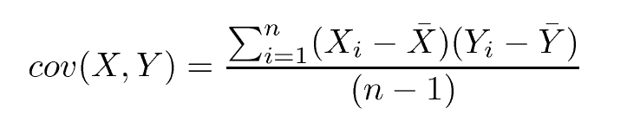

Covariance Matrix
How much do the dimensions vary from the mean with respect to each other ?
The covariance matrix is symmetric

Slide 12
Correlation Matrix

Slide 13
Algebraic derivation of PCs
To find that maximizes subject to
Let λ be a Lagrange multiplier
therefore
is an eigenvector of S
corresponding to the largest eigenvalue

Slide 14
Algebraic derivation of PCs
To find the next coefficient vector maximizing
uncorrelated
subject to
and to
First note that
then let λ and φ be Lagrange multipliers, and maximize

Slide 15
Algebraic derivation of PCs

Slide 16




Symmetric Matrix
Let be a square matrix of size nxn. The matrix A is symmetric, if
for all
Notes:
16

Slide 17
Orthogonality/Orthonormality
<v1,v2> = <(1 0),(0 1)>
= 0
1.5
1
0.5
0.5 1.0 1.5
Two vectors v1 and v2 for which <v1,v2>=0 holds are said to be orthogonal
Unit vectors which are orthogonal are said to be orthonormal.

Slide 18



Eigenvalues/Eigenvectors
Let A be an nxn square matrix and x an nx1 column vector. Then a (right) eigenvector of A is a nonzero vector x such that:
For some scalar
Eigenvalue
Eigenvector
Procedure:
Finding the eigenvalues
=0
Finding lambdas
Notes:
18

Slide 19
The Eigenvalue Problem
The covariance matrix.
The Eigenvalue is the set of values that satisfy this condition.
The resulting eigenvalues (There are n eigenvalues for n variables). The sum of eigenvalues is equal to the sum of variances in the covariance matrix.
Finding the eigenvalues and eigenvectors is called an eigenvalue problem (or a characteristic value problem).

Slide 20
Get the Eigenvectors
An eigenvector is a vector (x) that satisfies the following condition: A x = λx
In our case A is a variance-covariance matrix of the order of 2, and a vector x is a vector specified by x₁ and x₂.

Slide 21
Get the Eigenvectors
We want to find an eigenvector of unit length, i.e., x₁² + x₂² = 1
We therefore have
From Previous Slide
Solve x₁
The first eigenvector is one associated with the largest eigenvalue.

Slide 22
Get the PC Scores
First PC score
Original data (x and y)
Eigenvectors
Second PC score
The original data in a two dimensional space is reduced to one dimension..

Slide 23
Principle Component Analysis
Let X denote an m-dimensional random vector representing the environment of interest. We assume that the random vector X has zero mean:
Let q denote a unit vector also of dimension m, onto which the vector X is to be projected. This projection is defined by the inner product of the vectors X and q, as shown by
subject to the constraint

Slide 24
Principle Component Analysis
Under the assumption that the random vector X has zero mean, it follows that the mean value of the projection A is zero too:
The variance of A is therefore the same as its mean-square value, and so we may write

Slide 25
Principle Component Analysis
1
Variance
2
3
=zero
4
5

Slide 26
Principle Component Analysis
So, q and q^{T} are orthogonal
6
Eigen values(λ) and eigen vectors (q)

Slide 27
PCA: Terminology
jth principal component is jth eigenvector of correlation/covariance matrix
coefficients, a_{jk}, are elements of eigenvectors and relate original variables (standardized if using correlation matrix) to components
scores are values of units on components (produced using coefficients)
amount of variance accounted for by component is given by eigenvalue, λ_{j}
proportion of variance accounted for by component is given by λ_{j} / Σ λ_{j}
loading of kth original variable on jth component is given by a_{jk√}λ_{j} --correlation between variable and component
Adapted from http://myweb.dal.ca/~hwhitehe/BIOL4062/pca.ppt

Slide 28
Principal Component Analysis (PCA)
Steps in PCA: #1 Calculate Adjusted Data Set
Adjusted Data Set: A
Data Set: D
Mean values: M
M_{i} is calculated by taking the mean of the values in dimension i
…
n
dims
…
-
=
data samples

Slide 29

Principal Component Analysis (PCA)
Steps in PCA: #2 Calculate Co-variance matrix, C, from Adjusted Data Set, A
Co-variance Matrix: C
n
Note: Since the means of the dimensions in the adjusted data set, A, are 0, the covariance matrix can simply be written as:
C = A A^{T}/(n-1)
n
C_{ij} = cov(i,j)

Slide 30
Principal Component Analysis (PCA)
Steps in PCA: #3 Calculate eigenvectors and eigenvalues of C
Matrix E
Matrix E
Eigenvalues
Eigenvalues
x
x
Eigenvectors
Eigenvectors
If some eigenvalues are 0 or very small, we can essentially discard those eigenvalues and the corresponding eigenvectors, hence reducing the dimensionality of the new basis.

Slide 31
Principal Component Analysis (PCA)
Steps in PCA: #4 Transforming data set to the new basis
F = E^{T}A
where:
F is the transformed data set
E^{T} is the transpose of the E matrix containing the eigenvectors
A is the adjusted data set
Note that the dimensions of the new dataset, F, are less than the data set A
To recover A from F:
(E^{T})⁻¹F = (E^{T})⁻¹E^{T}A
(E^{T})^{T}F = A
EF = A
* E is orthogonal, therefore E⁻¹ = E^{T}

Slide 32
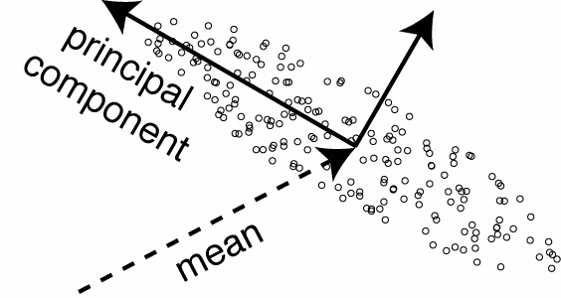
Principal component in 2d

Slide 33
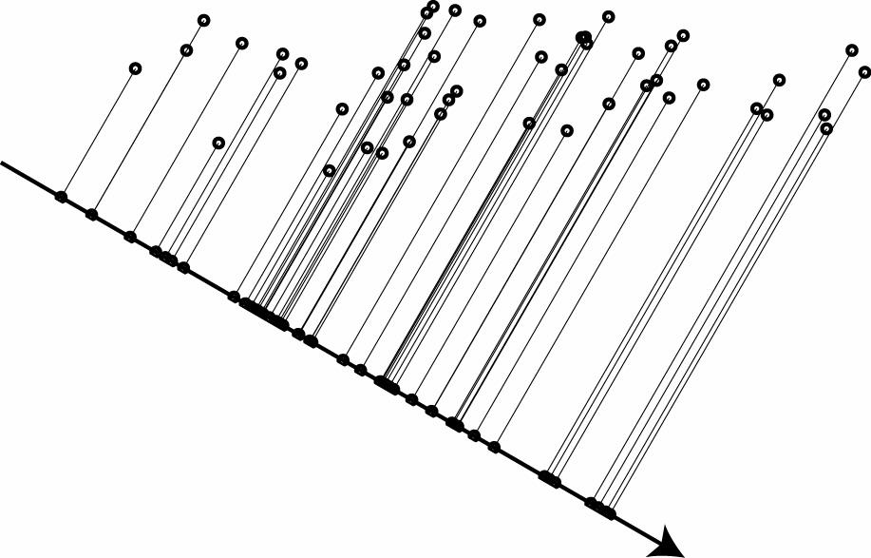
One-dimensional projection
Notes:
\begin{align*}
\langle(w^Tx)^2\rangle -\langle w^Tx\rangle^2 &= w^TCw\\
&= \sum_{ij} w_i C_{ij} w_j
\end{align*}

Slide 34
PCA Scores
x_{i2}
y_{i,1}
y_{i,2}
x_{i1}

Slide 35
Principal Components Analysis: Eigenvalues
λ₂
λ₁
Adapted from http://myweb.dal.ca/~hwhitehe/BIOL4062/pca.ppt

Slide 36
SVD
A = USV^{T}
A (m by n) is any rectangular matrix (m rows and n columns)
U (m by n) is an “orthogonal” matrix
S (n by n) is a diagonal matrix
V (n by n) is another orthogonal matrix
Such decomposition always exists
All matrices are real; m ≥ n

Slide 37
A = USV^{T}
A is any rectangular matrix (m ≥ n)
Row space: vector subspace generated by the row vectors of A
Column space: vector subspace generated by the column vectors of A
The dimension of the row & column space is the rank of the matrix A: r (≤ n)
A is a linear transformation that maps vector x in row space into vector Ax in column space

Slide 38
A = USV^{T}
U is an “orthogonal” matrix (m ≥ n)
Column vectors of U form an orthonormal basis for the column space of A: U^{T}U=I
u₁, …, u_{n} in U are eigenvectors of AA^{T}
AA^{T} =USV^{T} VSU^{T} =US² U^{T}
“Left singular vectors”

Slide 39
A = USV^{T}
V is an orthogonal matrix (n by n)
Column vectors of V form an orthonormal basis for the row space of A: V^{T}V=VV^{T}=I
v₁, …, v_{n} in V are eigenvectors of A^{T}A
A^{T}A =VSU^{T} USV^{T} =VS² V^{T}
“Right singular vectors”

Slide 40
A = USV^{T}
S is a diagonal matrix (n by n) of non-negative singular values
Typically sorted from largest to smallest
Singular values are the non-negative square root of corresponding eigenvalues of A^{T}A and AA^{T}

Slide 41
AV = US
Means each Av_{i} = s_{i}u_{i}
Remember A is a linear map from row space to column space
Here, A maps an orthonormal basis {v_{i}} in row space into an orthonormal basis {u_{i}} in column space
Each component of u_{i} is the projection of a row onto the vector v_{i}

Slide 42
Full SVD
We can complete U to a full orthogonal matrix and pad S by zeros accordingly
=

Slide 43
Reduced SVD
For rectangular matrices, we have two forms of SVD. The reduced SVD looks like this:
The columns of U are orthonormal
Cheaper form for computation and storage
=

Slide 44
PCA using SVD
Recall: In PCA we basically try to find eigenvalues and eigenvectors of the covariance matrix, C. We showed that C = (AA^{T}) / (n-1), and thus finding the eigenvalues and eigenvectors of C is the same as finding the eigenvalues and eigenvectors of AA^{T}
Recall: In SVD, we decomposed a matrix A as follows:
A = U S V^{T}
and we showed that:
AA^{T} = U S² U^{T}
where the columns of U contain the eigenvectors of AA^{T} and the eigenvalues of AA^{T} are the squares of the singular values in S
Thus SVD gives us the eigenvectors and eigenvalues that we need for PCA

Slide 45
Notes on SVD
SVD is the “absolute high point of linear algebra”
SVD is difficult to compute; but once we have it, we have many things
SVD finds the best approximating subspace, using linear transformation
Simple SVD cannot handle translation, non-linear transformation, separation of labeled data, etc.
Good for exploratory analysis; but once we know what we look for, use appropriate tools and model the structure of data explicitly!

Slide 46
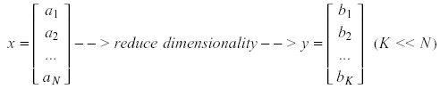
Dimensionality Reduction
One approach to deal with high dimensional data is by reducing their dimensionality.
Project high dimensional data onto a lower dimensional sub-space using linear or non-linear transformations.

Slide 47
Dimensionality Reduction
Linear transformations are simple to compute and tractable.
Classical –linear- approaches:
Principal Component Analysis (PCA)
Fisher Discriminant Analysis (FDA)
k x 1 k x d d x 1 (k<<d)

Slide 48
Principal Component Analysis (PCA)
Find a basis in a low dimensional sub-space:
Approximate vectors by projecting them in a low dimensional
sub-space:
(1) Original space representation:
(2) Lower-dimensional sub-space representation:
Note: if K=N, then

Slide 49
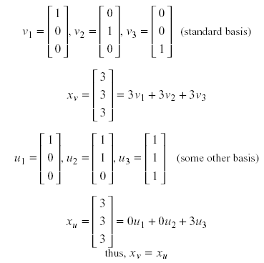
Principal Component Analysis (PCA)
Example (K=N):

Slide 50
Principal Component Analysis (PCA)
Information loss
Dimensionality reduction implies information loss !!
PCA preserves as much information as possible:
What is the “best” lower dimensional sub-space?
The “best” low-dimensional space is centered at the sample mean and has directions determined by the “best” eigenvectors of the covariance matrix of the data x.
By “best” eigenvectors we mean those corresponding to the largest eigenvalues ( i.e., “principal components”).
Since the covariance matrix is real and symmetric, these eigenvectors are orthogonal and form a set of basis vectors.
(see pp. 114-117 in textbook for a proof)

Slide 51
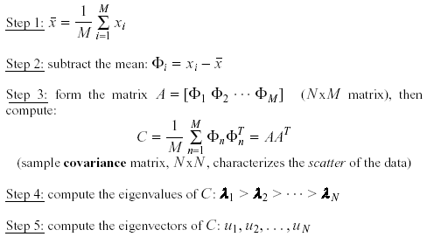
Principal Component Analysis (PCA)
Methodology
Suppose x₁, x₂, ..., x_{M} are N x 1 vectors

Slide 52
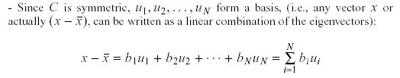
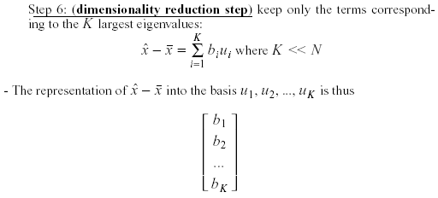
Principal Component Analysis (PCA)
Methodology – cont.

Slide 53
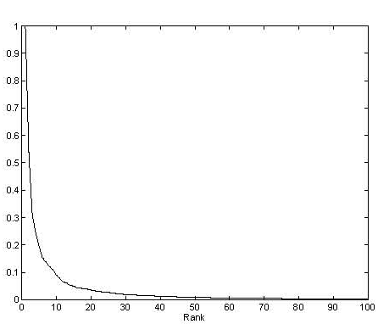
Principal Component Analysis (PCA)
Eigenvalue spectrum
λ_{N}
K
λ_{i}

Slide 54
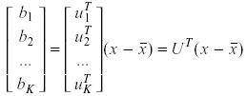
Principal Component Analysis (PCA)
Linear transformation implied by PCA
The linear transformation R^{N} → R^{K} that performs the dimensionality reduction is:

Slide 55
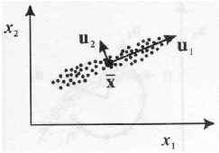
Principal Component Analysis (PCA)
Geometric interpretation
PCA projects the data along the directions where the data varies the most.
These directions are determined by the eigenvectors of the covariance matrix corresponding to the largest eigenvalues.
The magnitude of the eigenvalues corresponds to the variance of the data along the eigenvector directions.

Slide 56

Principal Component Analysis (PCA)
How many principal components to keep?
To choose K, you can use the following criterion:

Slide 57


Principal Component Analysis (PCA)
What is the error due to dimensionality reduction?
It can be shown that the average error due to dimensionality reduction is equal to:
__

Slide 58

Principal Component Analysis (PCA)
Standardization
The principal components are dependent on the units used to measure the original variables as well as on the range of values they assume.
We should always standardize the data prior to using PCA.
A common standardization method is to transform all the data to have zero mean and unit standard deviation:

Slide 59
Principal Component Analysis (PCA)
Case Study: Eigenfaces for Face Detection/Recognition
M. Turk, A. Pentland, "Eigenfaces for Recognition", Journal of Cognitive Neuroscience, vol. 3, no. 1, pp. 71-86, 1991.
Face Recognition
The simplest approach is to think of it as a template matching problem
Problems arise when performing recognition in a high-dimensional space.
Significant improvements can be achieved by first mapping the data into a lower dimensionality space.
How to find this lower-dimensional space?

Slide 60
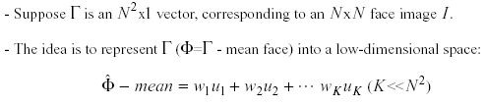
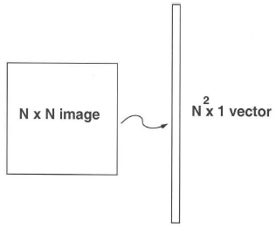
Principal Component Analysis (PCA)
Main idea behind eigenfaces
average face
Ψ
Φ - Ψ

Slide 61
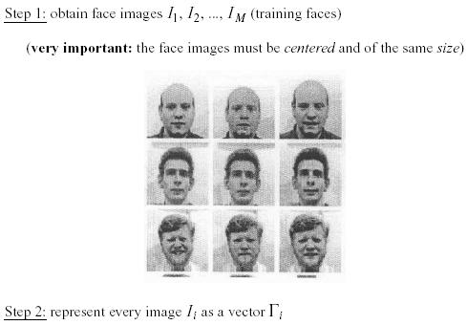
Principal Component Analysis (PCA)
Computation of the eigenfaces

Slide 62
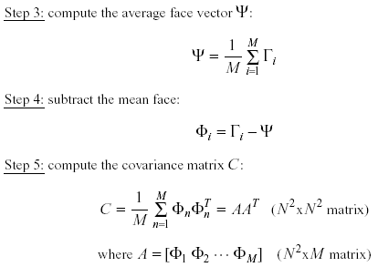
Principal Component Analysis (PCA)
Computation of the eigenfaces – cont.

Slide 63
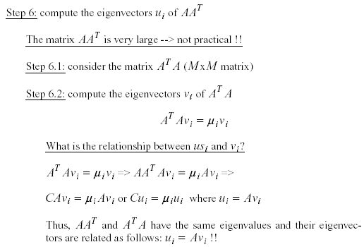
Principal Component Analysis (PCA)
Computation of the eigenfaces – cont.

Slide 64
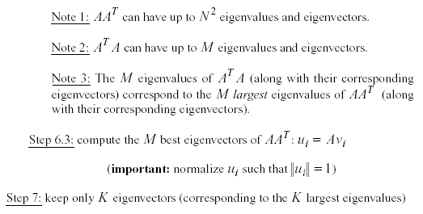
Principal Component Analysis (PCA)
Computation of the eigenfaces – cont.

Slide 65
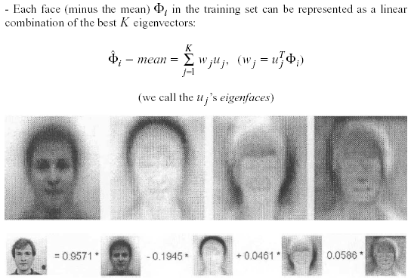
Principal Component Analysis (PCA)
Representing faces onto this basis

Slide 66
Principal Component Analysis (PCA)
Eigenvalue spectrum
λ_{N}
K
λ_{i}
M

Slide 67
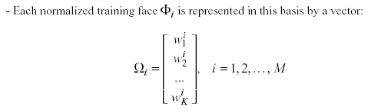
Principal Component Analysis (PCA)
Representing faces onto this basis – cont.

Slide 68
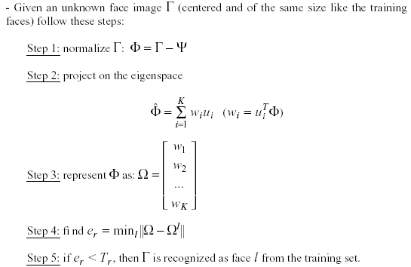
Principal Component Analysis (PCA)
Face Recognition Using Eigenfaces

Slide 69

Principal Component Analysis (PCA)
Face Recognition Using Eigenfaces – cont.
The distance e_{r} is called distance within the face space (difs)
Comment: we can use the common Euclidean distance to compute e_{r}, however, it has been reported that the Mahalanobis distance performs better:

Slide 70
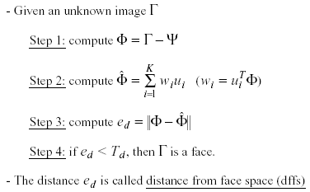
Principal Component Analysis (PCA)
Face Detection Using Eigenfaces

Slide 71
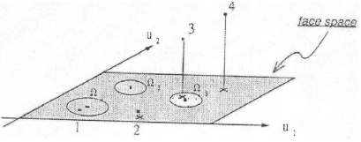
Principal Component Analysis (PCA)
Face Detection Using Eigenfaces – cont.

Slide 72

Principal Component Analysis (PCA)
Reconstruction of faces and non-faces

Slide 73
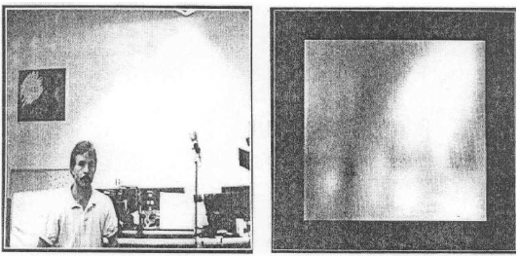
Principal Component Analysis (PCA)
Applications
Face detection, tracking, and recognition

Slide 74
Principal Component Analysis (PCA)
Problems in face recognition:
Background (de-emphasize the outside of the face – e.g., by multiplying the input image by a 2D Gaussian window centered on the face)
Lighting conditions (performance degrades with light changes)
Scale (performance decreases quickly with changes to head size)
multi-scale eigenspaces
scale input image to multiple sizes
Orientation (performance decreases but not as fast as with scale changes)
plane rotations can be handled
out-of-plane rotations are more difficult to handle

Slide 75
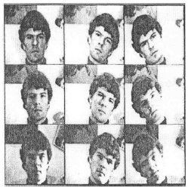
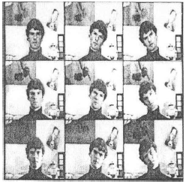
Principal Component Analysis (PCA)
Dataset
16 subjects
3 orientations, 3 sizes
3 lighting conditions, 6 resolutions (512x512 ... 16x16)
Total number of images: 2,592

Slide 76
Principal Component Analysis (PCA)
Experiment 1
Used various sets of 16 images for training
One image/person, taken under the same conditions
Classify the rest images as one of the 16 individuals
7 eigenfaces were used
No rejections (i.e., no threshold on difs)
Performed a large number of experiments and averaged the results:
96% correct averaged over light variation
85% correct averaged over orientation variation
64% correct averaged over size variation

Slide 77

Principal Component Analysis (PCA)
Experiment 2
Considered rejections (i.e., by thresholding difs)
There is a tradeoff between correct recognition and rejections.
Adjusting the threshold to achieve 100% recognition accuracy resulted in:
19% rejections while varying lighting
39% rejections while varying orientation
60% rejections while varying size
Experiment 3
Reconstruction using partial information

Slide 78
Principal Component Analysis (PCA)
PCA and classification
PCA is not always an optimal dimensionality-reduction procedure for classification purposes.
Multiple classes and PCA
Suppose there are C classes in the training data.
PCA is based on the sample covariance which characterizes the scatter of the entire data set, irrespective of class-membership.
The projection axes chosen by PCA might not provide good discrimination power.

Slide 79
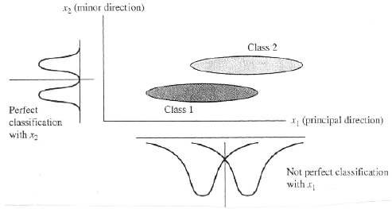
Principal Component Analysis (PCA)
PCA and classification (cont’d)

Slide 80
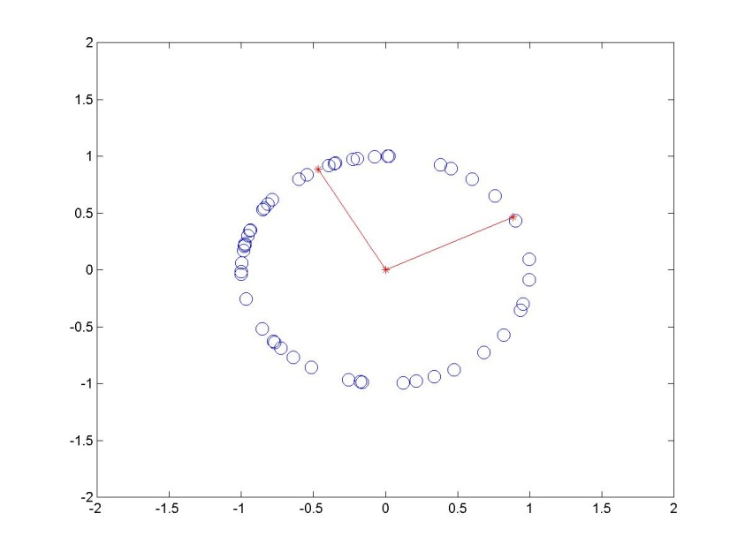
Cases when PCA fail (1)
PCA projects data onto a set of orthogonal vectors (principle components). This restricts the new input components to be the linear combination of old ones.
In cases, however, when the intrinsic freedom of data can not be expressed as a linear combination of input components, PCA will overestimate the input dimensionality (matlab demo).
PCA can not find out the non-linear intrinsic dimension of data, like the angle θ in this
example; Instead it will find out two components with equal importance.

Slide 81
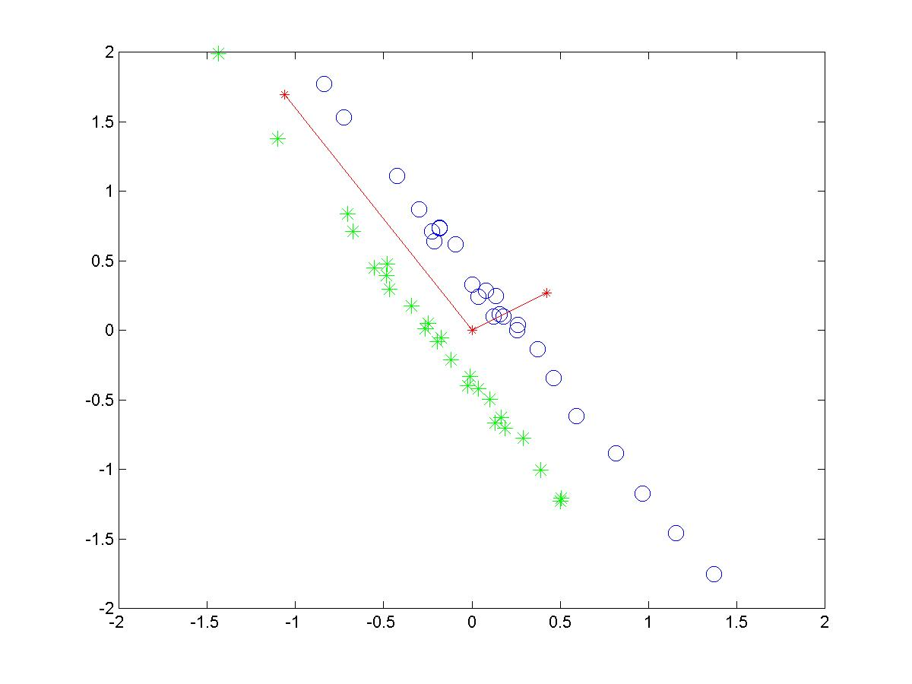
Cases when PCA fail (2)
In cases when components with small variability really matter,
PCA will make mistakes due to the unsupervised nature.
In this example, if we only consider the projections of two classes of data
as input, the two classes become indistinguishable.

Slide 82
Geometric Rationale of PCA
objective of PCA is to rigidly rotate the axes of this p-dimensional space to new positions (principal axes) that have the following properties:
ordered such that principal axis 1 has the highest variance, axis 2 has the next highest variance, .... , and axis p has the lowest variance
covariance among each pair of the principal axes is zero (the principal axes are uncorrelated).

Slide 83
The Algebra of PCA
the eigenvalues, λ₁, λ₂, ... λ_{p} are the variances of the coordinates on each principal component axis
the sum of all p eigenvalues equals the trace of S (the sum of the variances of the original variables).
 | X₁ | X₂
X₁ | 6.6707 | 3.4170
X₂ | 3.4170 | 6.2384
λ₁ = 9.8783
λ₂ = 3.0308 Note: λ₁+λ₂ =12.9091
Trace = 12.9091

Slide 84
The Algebra of PCA
each eigenvector consists of p values which represent the “contribution” of each variable to the principal component axis
eigenvectors are uncorrelated (orthogonal)
their cross-products are zero.
Eigenvectors
 | u₁ | u₂
X₁ | 0.7291 | -0.6844
X₂ | 0.6844 | 0.7291
0.7291*(-0.6844) + 0.6844*0.7291 = 0

Slide 85
The Algebra of PCA
variance of the scores on each PC axis is equal to the corresponding eigenvalue for that axis
the eigenvalue represents the variance displayed (“explained” or “extracted”) by the k^{th} axis
the sum of the first k eigenvalues is the variance explained by the k-dimensional ordination.

Slide 86
PCA: Potential Problems
Lack of Independence
NO PROBLEM
Lack of Normality
Normality desirable but not essential
Lack of Precision
Precision desirable but not essential
Many Zeroes in Data Matrix
Problem (use Correspondence Analysis)
Adapted from http://myweb.dal.ca/~hwhitehe/BIOL4062/pca.ppt

Slide 87
A 2D Numerical Example

Slide 88
PCA Example –STEP 1
Subtract the mean
from each of the data dimensions. All the x values have x subtracted and y values have y subtracted from them. This produces a data set whose mean is zero.
Subtracting the mean makes variance and covariance calculation easier by simplifying their equations. The variance and co-variance values are not affected by the mean value.

Slide 89
Covariance matrix

Slide 90
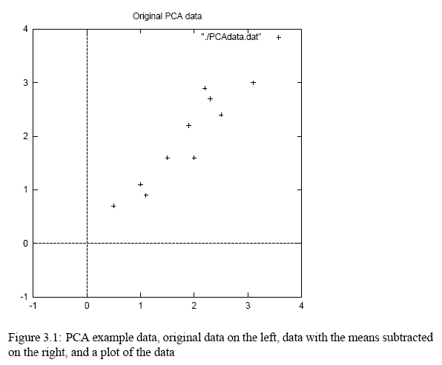
PCA Example –STEP 1
http://kybele.psych.cornell.edu/~edelman/Psych-465-Spring-2003/PCA-tutorial.pdf

Slide 91
PCA Example –STEP 2
Calculate the covariance matrix
cov = .616555556 .615444444
.615444444 .716555556
since the non-diagonal elements in this covariance matrix are positive, we should expect that both the x and y variable increase together.

Slide 92
PCA Example –STEP 3
Calculate the eigenvectors and eigenvalues of the covariance matrix
eigenvalues = .0490833989
1.28402771
eigenvectors = -.735178656 -.677873399
.677873399 -.735178656

Slide 93
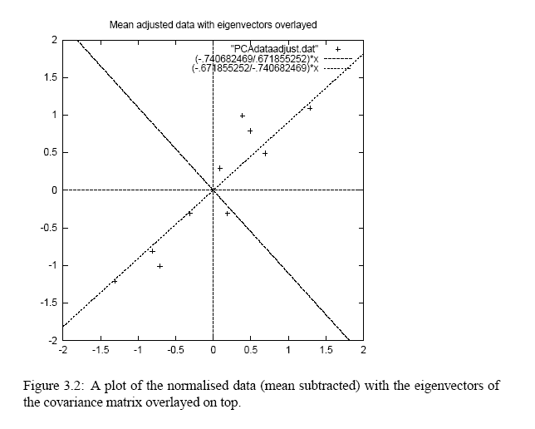
PCA Example –STEP 3
http://kybele.psych.cornell.edu/~edelman/Psych-465-Spring-2003/PCA-tutorial.pdf
eigenvectors are plotted as diagonal dotted lines on the plot.
Note they are perpendicular to each other.
Note one of the eigenvectors goes through the middle of the points, like drawing a line of best fit.
The second eigenvector gives us the other, less important, pattern in the data, that all the points follow the main line, but are off to the side of the main line by some amount.

Slide 94
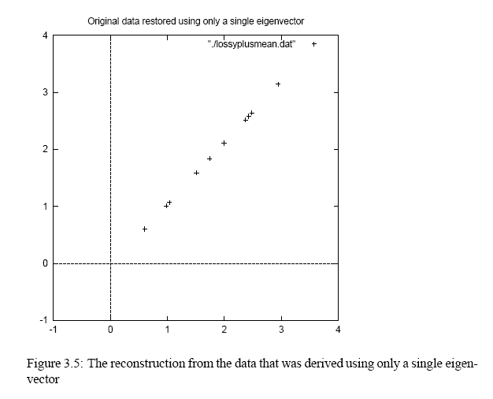
Reconstruction of original Data
http://kybele.psych.cornell.edu/~edelman/Psych-465-Spring-2003/PCA-tutorial.pdf
x
-.827970186
1.77758033
-.992197494
-.274210416
-1.67580142
-.912949103
.0991094375
1.14457216
.438046137
1.22382056

Slide 95
Order eigenvectors by eigenvalue, highest to lowest.
In general, you get n components. To reduce dimensionality to p, ignore n−p components at the bottom of the list.

Slide 96
Construct new feature vector.
Feature vector = (v₁, v₂, ...v_{p})

Slide 97
Derive the new data set.
TransformedData = RowFeatureVector × RowDataAdjust
This gives original data in terms of chosen components (eigenvectors)—that is, along these axes.

Slide 98
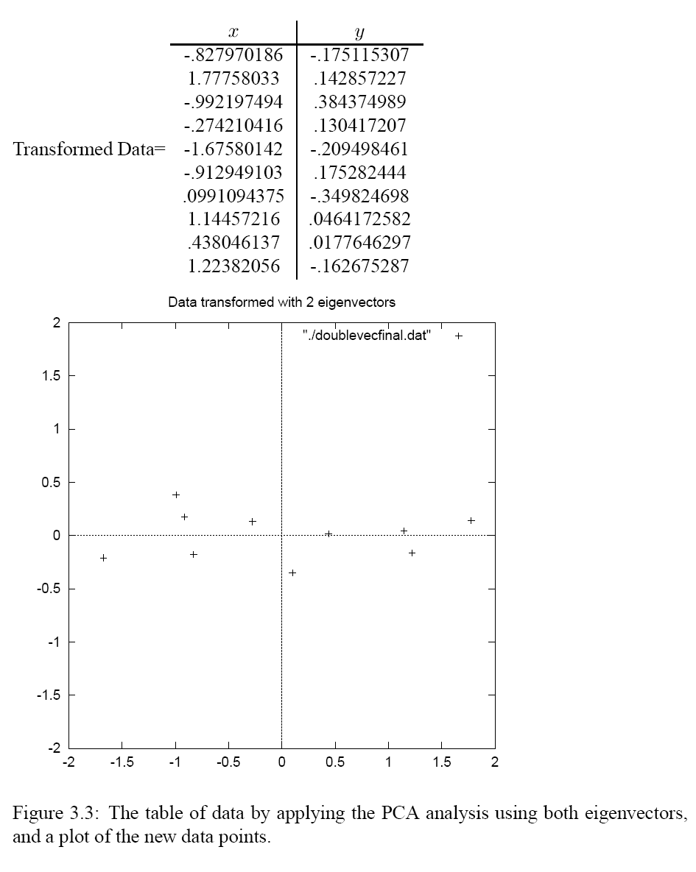

Slide 99
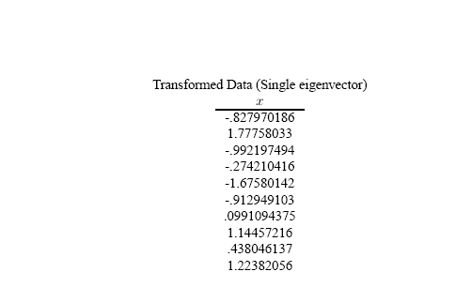
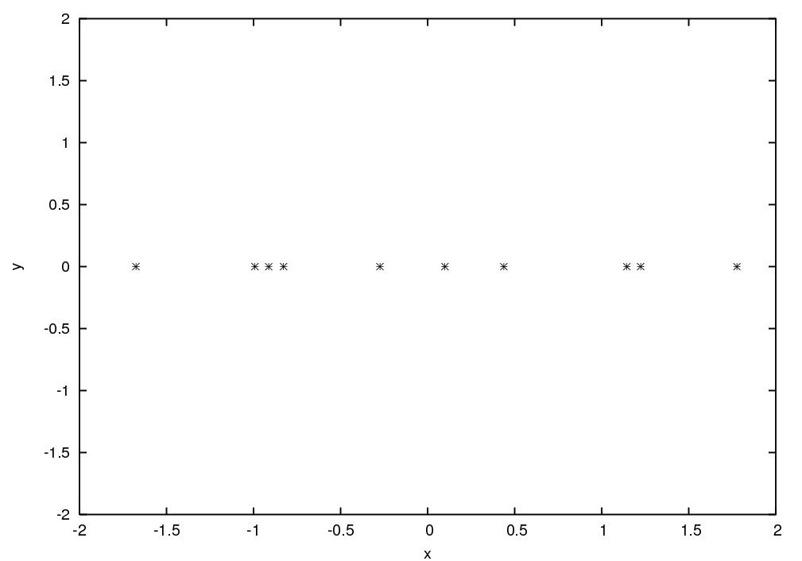

Slide 100
