Slide 1
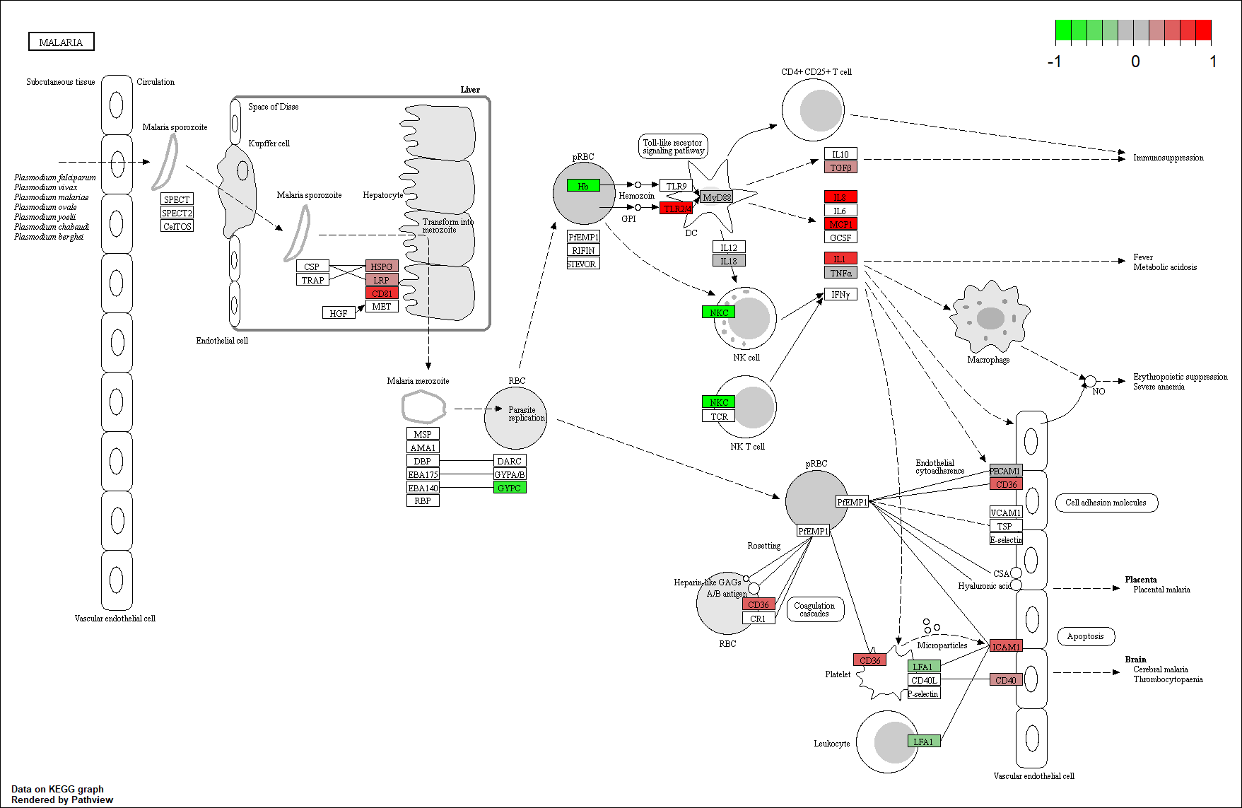
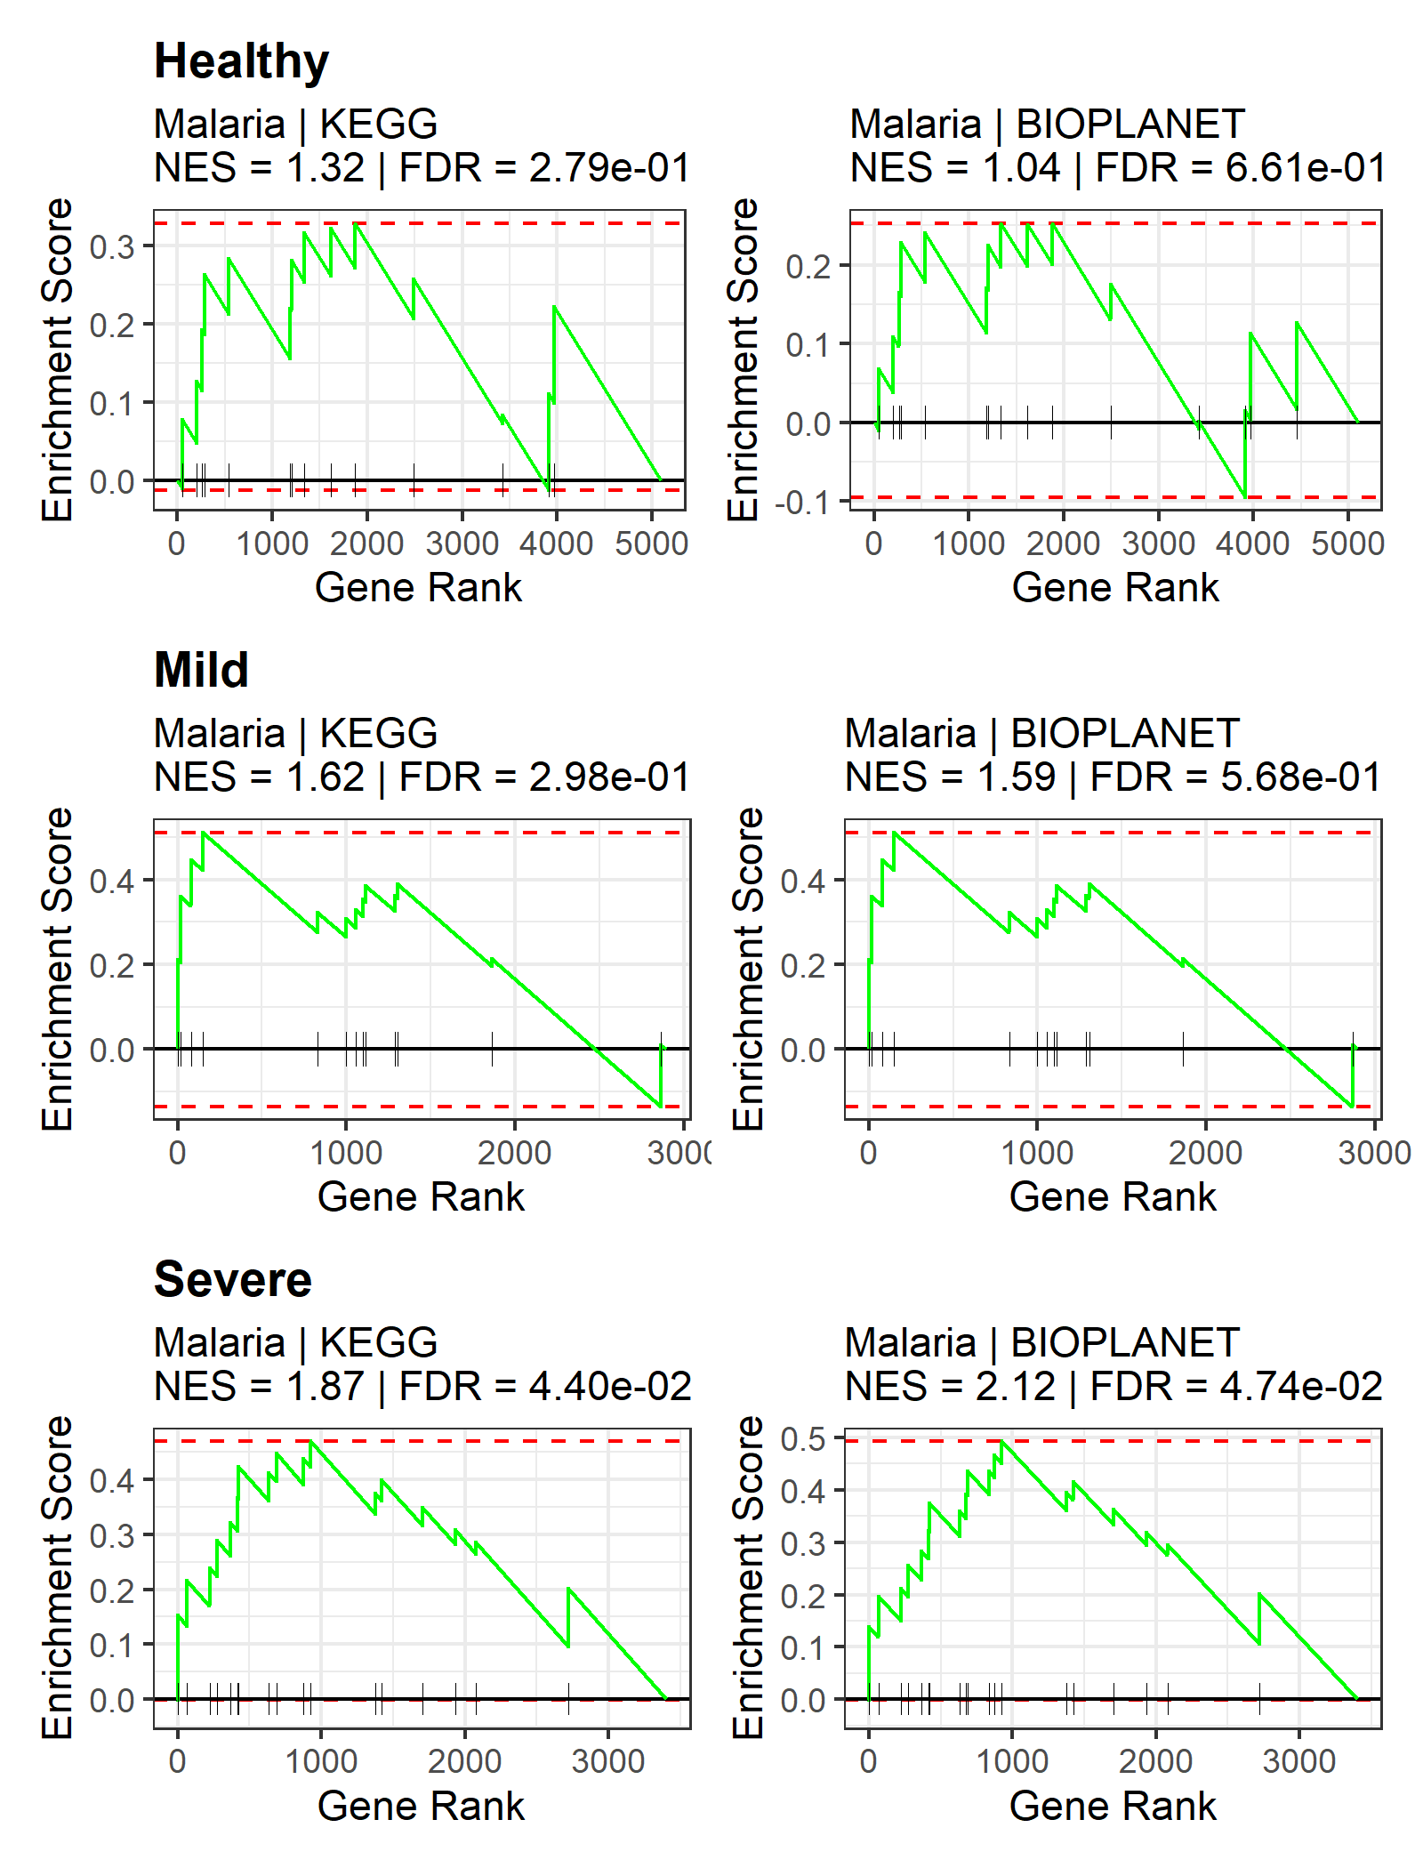
a
b
c
(3)
d
Random or pseudotime-guided
Adjacency matrices (n×n×t)
Denoised adjacency matrices
(n×n×t)
Denoised weight-
averaged network
(n×m’, m’<m)
CANDECOMP/PARAFAC (CP)
Network construction
t networks
tensor decomposition
(n×n)
scRNA-seq data
cell subsampling
t subsamples
c₂
t networks
PC regression
c₁
c_{r}
+
+…+
(1)
(2)
b₁
b₂
b_{r}
(n×m gene-cell matrix)
a₁
a₂
a_{r}
(2n×k_{m})
(4)
f
List of genes ranked by distance
Nonlinear
d₁
d₂
manifold alignment
d₃
.
.
.
differential regulation test
d_{n}
(5)
TGFB
enrichment analyses
Aligned network manifold
Distance between each gene’s two projections on the manifold
GO, GSEA, KEGG, enrichr
CXCL8
e
IL1A
MCP1
Malaria | KEGG
NES = 1.87 | FDR = 2.0E-02
TLR2/4
MALARIA

Slide 2
a
b
c
(3)
d
Random or pseudotime-guided
Adjacency matrices (n×n×t)
Denoised adjacency matrices
(n×n×t)
Denoised weight-
averaged network
(n×m’, m’<m)
CANDECOMP/PARAFAC (CP)
Network construction
t networks
tensor decomposition
(n×n)
scRNA-seq data
cell subsampling
t subsamples
c₂
t networks
PC regression
c₁
c_{r}
+
+…+
(1)
(2)
b₁
b₂
b_{r}
(n×m gene-cell matrix)
a₁
a₂
a_{r}
(2n×k_{m})
(4)
f
List of genes ranked by distance
Nonlinear
d₁
d₂
manifold alignment
d₃
.
.
.
differential regulation test
d_{n}
(5)
TGFB
enrichment analyses
Aligned network manifold
Distance between each gene’s two projections on the manifold
GO, GSEA, KEGG, enrichr
CXCL8
e
IL1A
MCP1
Malaria | KEGG
NES = 1.87 | FDR = 2.0E-02
TLR2/4
MALARIA

Slide 3
a
b
c
d
Random or pseudotime-guided
Adjacency matrices (n×n×t)
Denoised adjacency matrices
(n×n×t)
Denoised weight-
averaged network
(n×m’, m’<m)
CANDECOMP/PARAFAC (CP)
Network construction
t networks
tensor decomposition
(n×n)
scRNA-seq data
cell subsampling
t subsamples
c₂
t networks
PC regression
c₁
c_{r}
+
+…+
b₁
b₂
b_{r}
(n×m gene-cell matrix)
a₁
a₂
a_{r}
e
(2n×k_{m})
g
List of genes ranked by distance
Nonlinear
d₁
d₂
manifold alignment
d₃
.
.
.
differential regulation test
d_{n}
enrichment analyses
TGFB
Aligned network manifold
Distance between each gene’s two projections on the manifold
GO, GSEA, KEGG, enrichr
CXCL8
f
IL1A
MCP1
TLR2/4
MALARIA

Slide 4
A
B
C
Random or pseudotime-guided
Adjacency matrices (n×n×t)
Denoised adjacency matrices
(n×n×t)
Denoised weight-
averaged network
(n×m’, m’<m)
CANDECOMP/PARAFAC (CP)
Network construction
t networks
tensor decomposition
(n×n)
scRNA-seq data
cell subsampling
t subsamples
c₂
t networks
(n×n)
(2n×k_{m})
PC regression
c₁
c_{r}
+
+…+
List of genes ranked by distance
b₁
b₂
b_{r}
Nonlinear
d₁
d₂
(n×m gene-cell matrix)
manifold alignment
d₃
.
.
.
differential regulation test
a₁
a₂
a_{r}
d_{n}
enrichment analyses
Aligned network manifold
Distance between each gene’s two projections on the manifold
GO, GSEA, KEGG, enrichr
TGFB
CXCL8
IL1A
MCP1
TLR2/4

Slide 5
A
B
Random or pseudotime-guided
Adjacency matrices (n×n×t)
Denoised adjacency matrices
(n×n×t)
Denoised weight-
averaged network
(n×m’, m’<m)
CANDECOMP/PARAFAC (CP)
Network construction
t networks
tensor decomposition
(n×n)
scRNA-seq data
cell subsampling
t subsamples
c₂
t networks
PC regression
c₁
c_{r}
+
+…+
b₁
b₂
b_{r}
(n×m gene-cell matrix)
a₁
a₂
a_{r}
(n×n)
(2n×k_{m})
Nonlinear
d₁
d₂
differential regulation test
manifold alignment
d₃
.
.
.
enrichment analyses
d_{n}
List of genes ranked by distance
GO, GSEA, KEGG, enrichr
Aligned network manifold
Distance between each gene’s two projections on the manifold

Slide 6
TGFB
IL8
MCP1
IL1
TLR2/4

