Slide 1
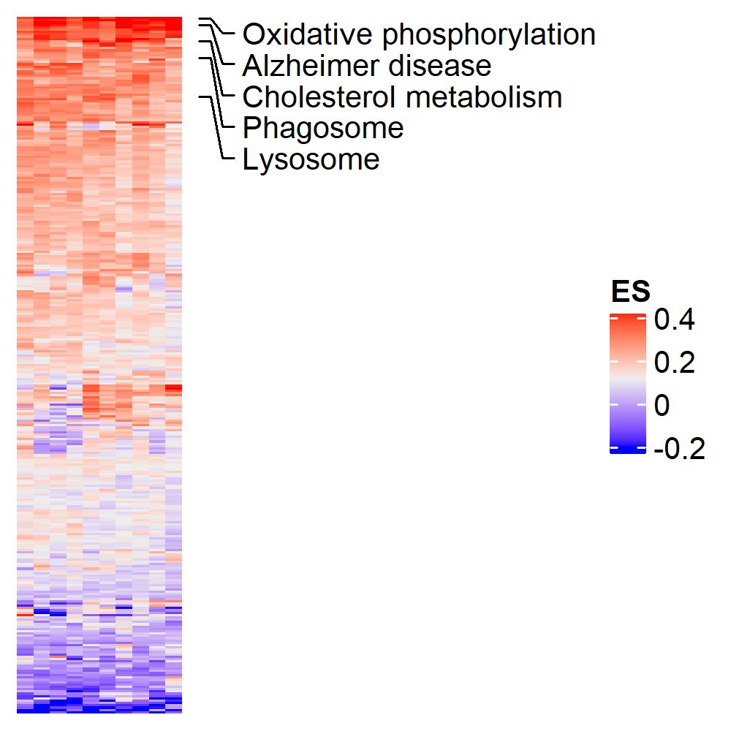
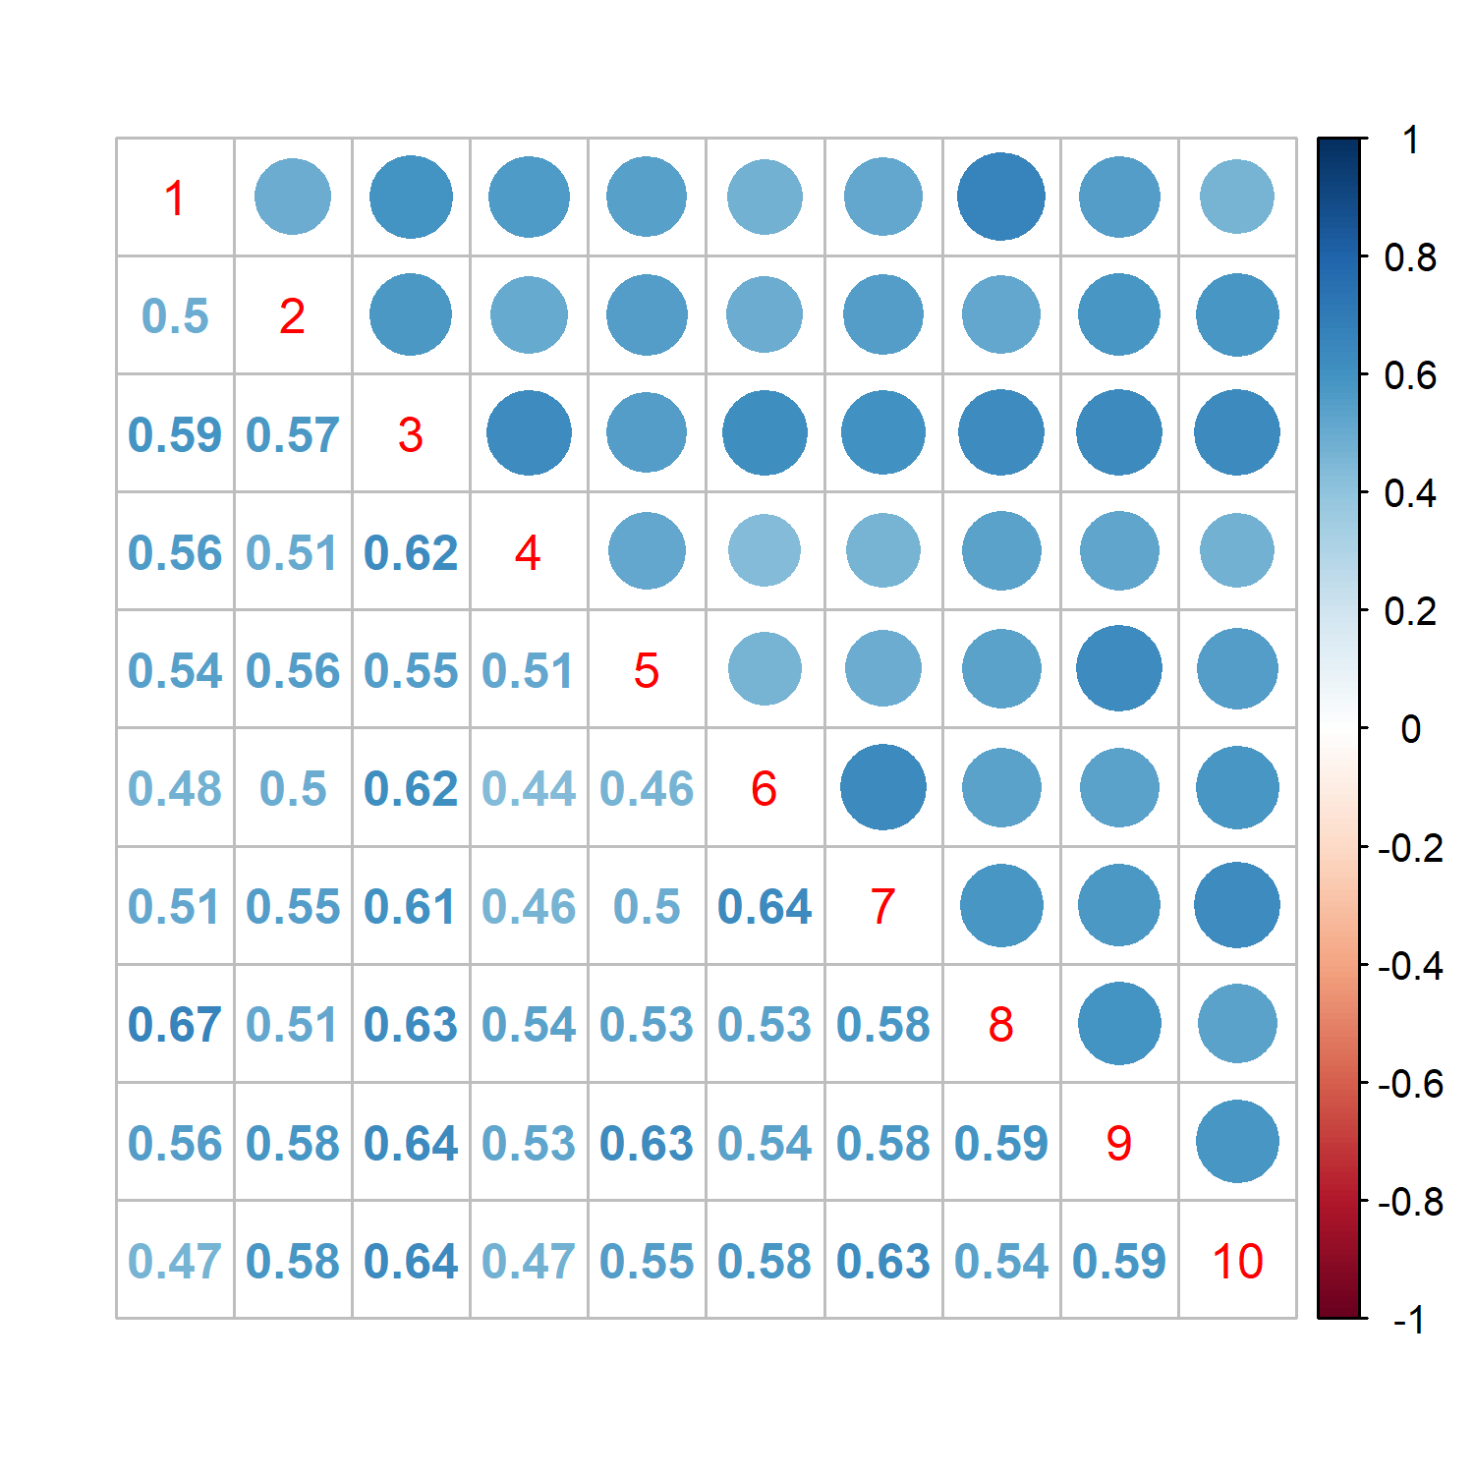
10 Experiments, 500 random sampled cells each time
Spearman correlation coefficient: 0.55 ± 0.06

