Slide 1
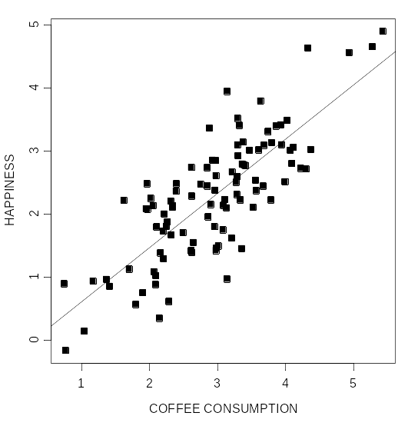

Covariance and Correlation
Questions:
What does it mean to say that two variables are associated with one another?
How can we mathematically formalize the concept of association?

Slide 2
Limitation of covariance
One limitation of the covariance is that the size of the covariance depends on the variability of the variables.
As a consequence, it can be difficult to evaluate the magnitude of the covariation between two variables.
  If the amount of variability is small, then the highest possible value of the covariance will also be small. If there is a large amount of variability, the maximum covariance can be large.

Slide 3
Limitations of covariance
Ideally, we would like to evaluate the magnitude of the covariance relative to maximum possible covariance
How can we determine the maximum possible covariance?

Slide 4
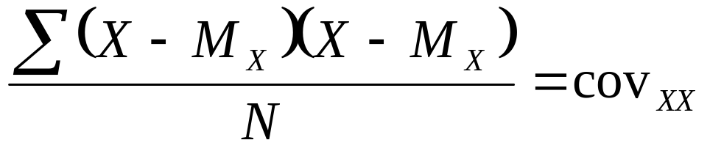
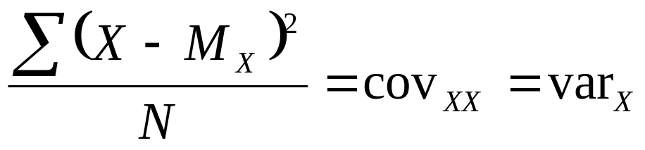
Go vary with yourself
Let’s first note that, of all the variables a variable may covary with, it will covary with itself most strongly
In fact, the “covariance of a variable with itself” is an alternative way to define variance:

Slide 5
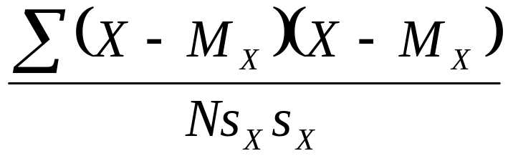
Go vary with yourself
Thus, if we were to divide the covariance of a variable with itself by the variance of the variable, we would obtain a value of 1. This will give us a standard for evaluating the magnitude of the covariance.
Note: I’ve written the variance of X as s_{X} × s_{X} because the variance is the SD squared

Slide 6
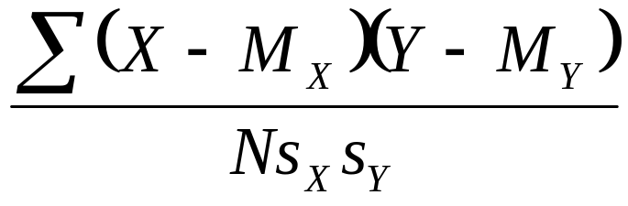
Go vary with yourself
However, we are interested in evaluating the covariance of a variable with another variable (not with itself), so we must derive a maximum possible covariance for these situations too.
By extension, the covariance between two variables cannot be any greater than the product of the SD’s for the two variables.
Thus, if we divide by s_{x}s_{y}, we can evaluate the magnitude of the covariance relative to 1.

Slide 7
Spine-tingling moment
Important: What we’ve done is taken the covariance and “standardized” it. It will never be greater than 1 (or smaller than –1). The larger the absolute value of this index, the stronger the association between two variables.

Slide 8
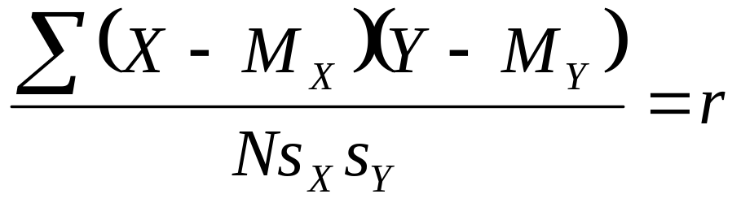
Spine-tingling moment
When expressed this way, the covariance is called a correlation
The correlation is defined as a standardized covariance.

Slide 9
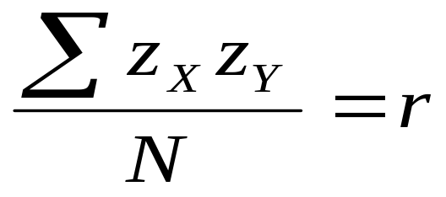
Correlation
It can also be defined as the average product of z-scores because the two equations are identical.
The correlation, r, is a quantitative index of the association between two variables. It is the average of the products of the z-scores.
When this average is positive, there is a positive correlation; when negative, a negative correlation

Slide 10
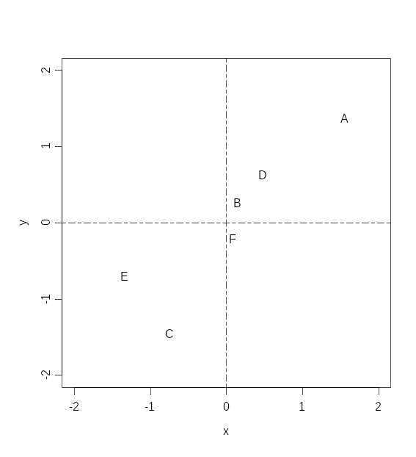
Mean of each variable is zero
A, D, & B are above the mean on both variables
E & C are below the mean on both variables
F is above the mean on x, but below the mean on y

Slide 11
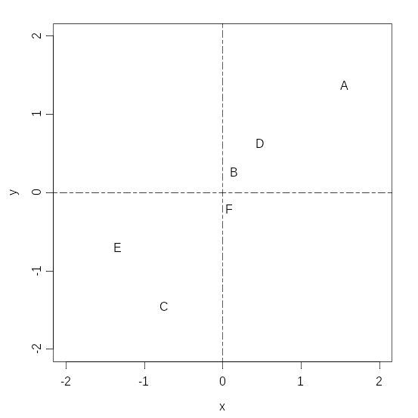
− × + = −
+ × + = +
− × − = +
+ × − = −

Slide 12
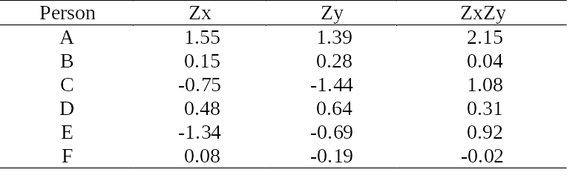
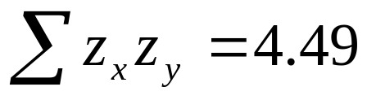
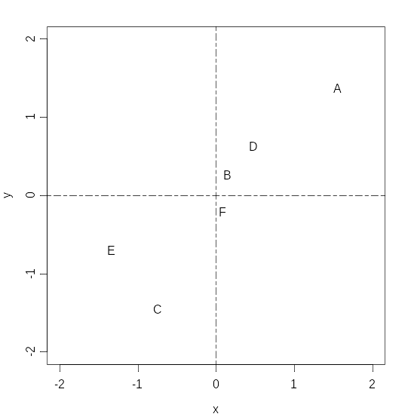
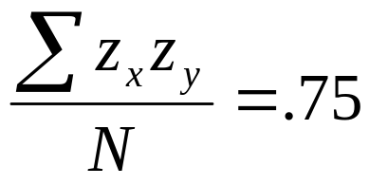
Correlation

Slide 13
Correlation
The value of r can range between -1 and + 1.
If r = 0, then there is no correlation between the two variables.
If r = 1 (or -1), then there is a perfect positive (or negative) relationship between the two variables.

Slide 14
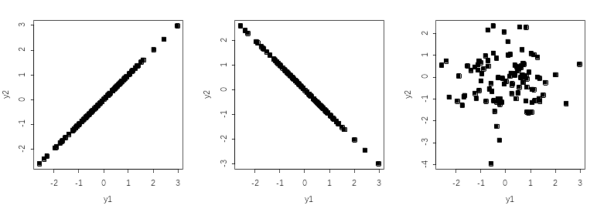
r = + 1
r = - 1
r = 0

Slide 15
Correlation
The absolute size of the correlation corresponds to the magnitude or strength of the relationship
When a correlation is strong (e.g., r = .90), then people above the mean on x are substantially more likely to be above the mean on y than they would be if the correlation was weak (e.g., r = .10).

Slide 16
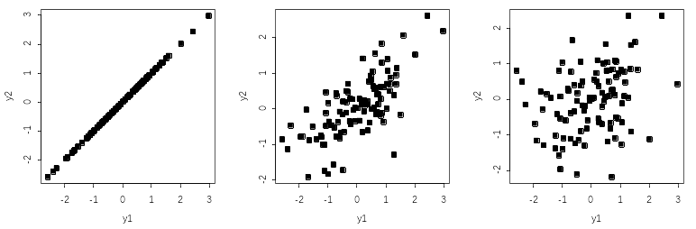
r = + 1
r = + .70
r = + .30

Slide 17
Correlation
Advantages and uses of the correlation coefficient
  Provides an easy way to quantify the association between two variables
  Employs z-scores, so the variances of each variable are standardized & = 1
  Foundation for many statistical applications

