Slide 1
Modeling the Rotational Kinematics of HD 100546’s Circumstellar Disk
Cail Daley
Supervisors: Catherine Walsh & Paola Pinilla

Slide 2
Background
Should I assume that my audience has any knowledge of disks? NO
ALMA introduction– disks are cold & in sub-mm, where molecular lines are→CO(3-2), second most abundant molecules, most bright
Start with formation/evolution of circumstellar disks
Motivation for studying disks
Transitions disks? Does HD 100546 count?

Slide 3
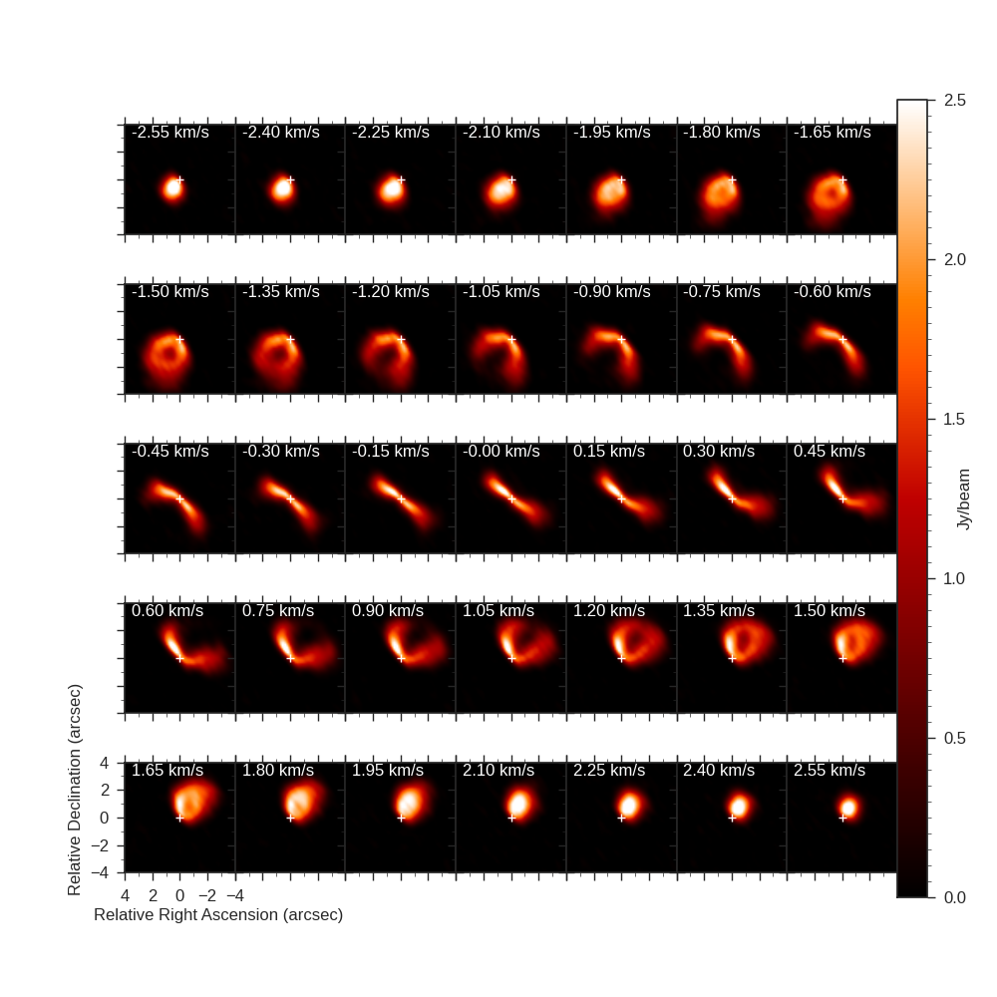
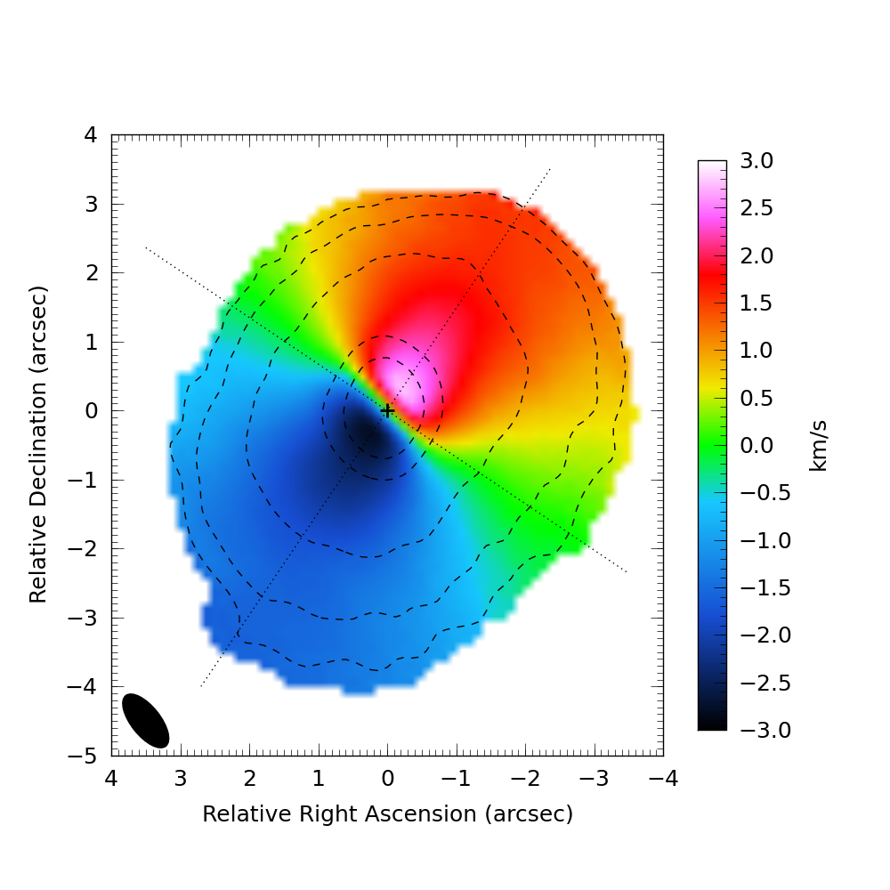
HD 100546 Background
Talk about planetary companions, etc.
Mention dust, two rings
Scattered light (both papers)
Close, bright,

Slide 4
Effects of Planets On Disks
Warps, spiral rings, etc.

Slide 5
Alma cycle 0 data
Show first moment map (redshifted/blueshifted)
Line profile
Channel map video frame by fram--> full channel map

Slide 6
Flatness of 12CO(3-2)
First job was to assess flatness of disk
Gridding suggests it to be flat, but Meeus (2002) and 2012 data suggests that it is flared
Show mirrored maps with isovleocity
Compare Hd 163296 De-gregorio-monsalvo 2013 to show how un-flared it is
No fit plots

Slide 7
warp
Grid parameter space, best fit, cartoon, best fit parameters (in difference from outer disk)
What could this be? Warp, spiral arm
Spiral arm would probably effect more than just inner disk, probably couldn’t increase velocity enough
Panic et al 2010

Slide 8
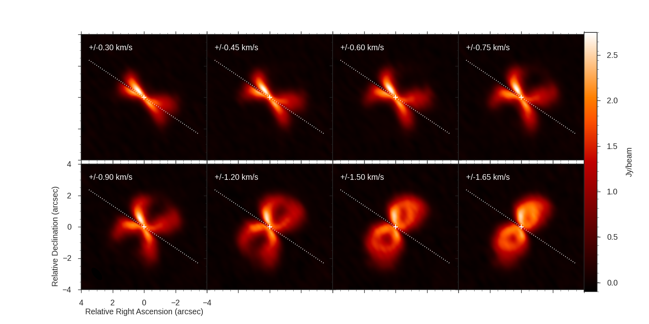
Motivation for numerical modeling
Non-axisymmetry → “how badly does a keplerian model fit”

Slide 9
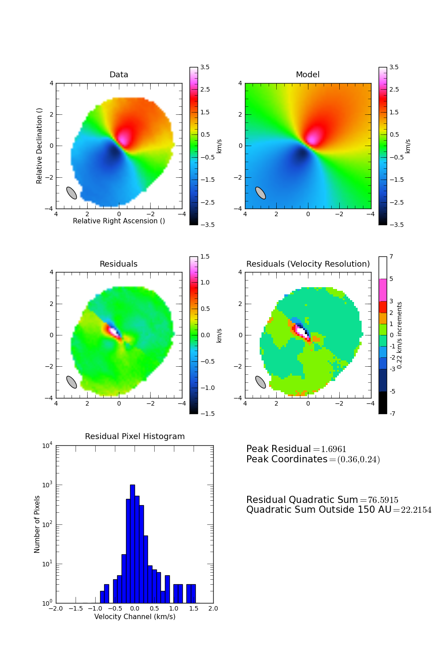
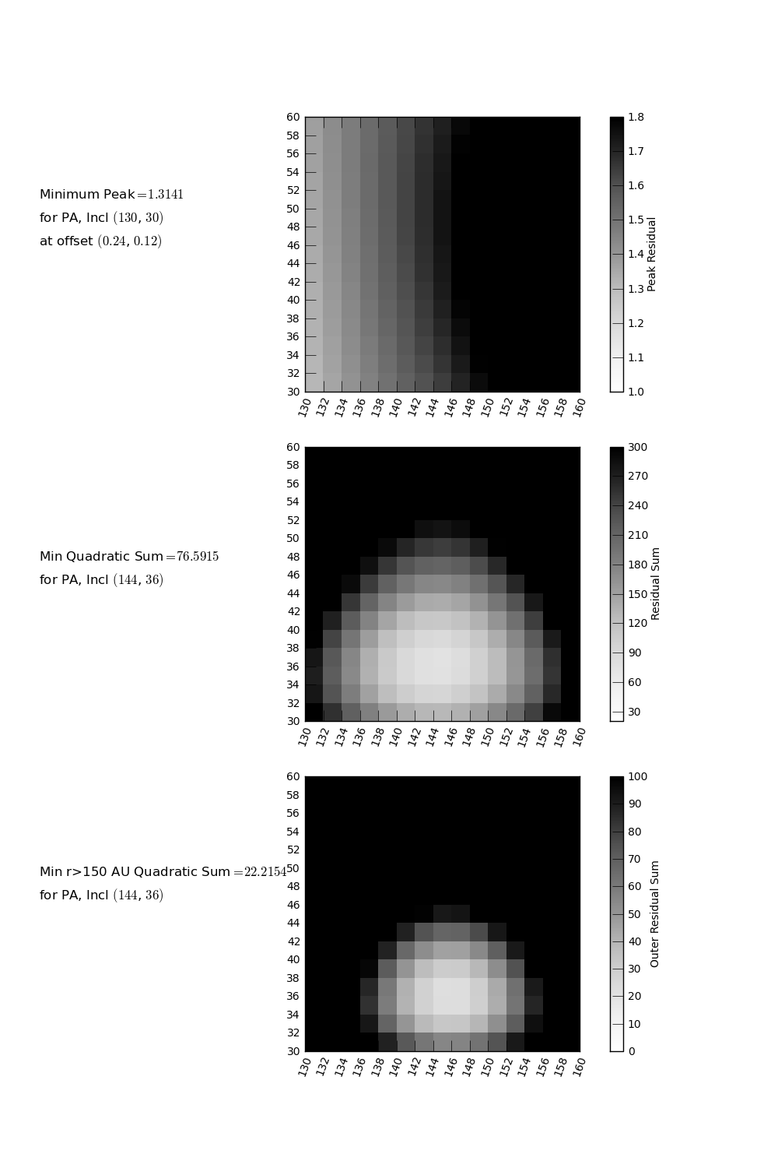
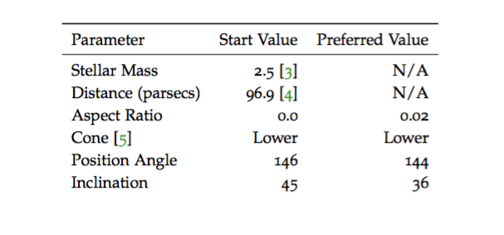
Modeling
Go through model/grid creation: keplerian velocity grid, explain translation from image radius to “real” disk radius
Stick to flat disk for simplicity? (“there is no significant difference between best-fit aspect ratio and flat disk”)
Can I skip explaining cone stuff?

Slide 10
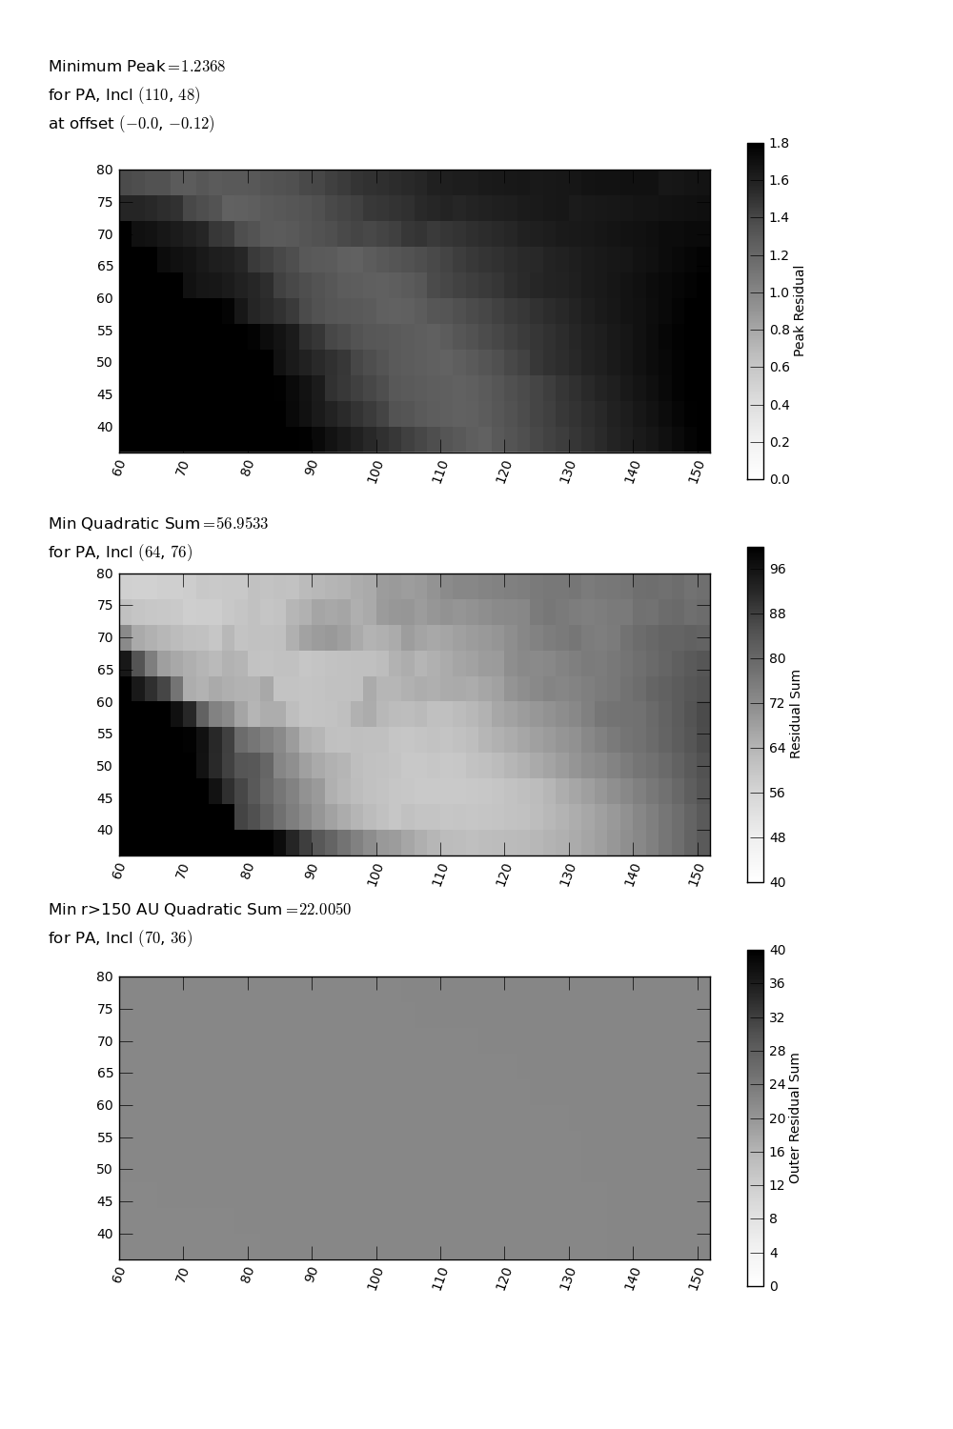
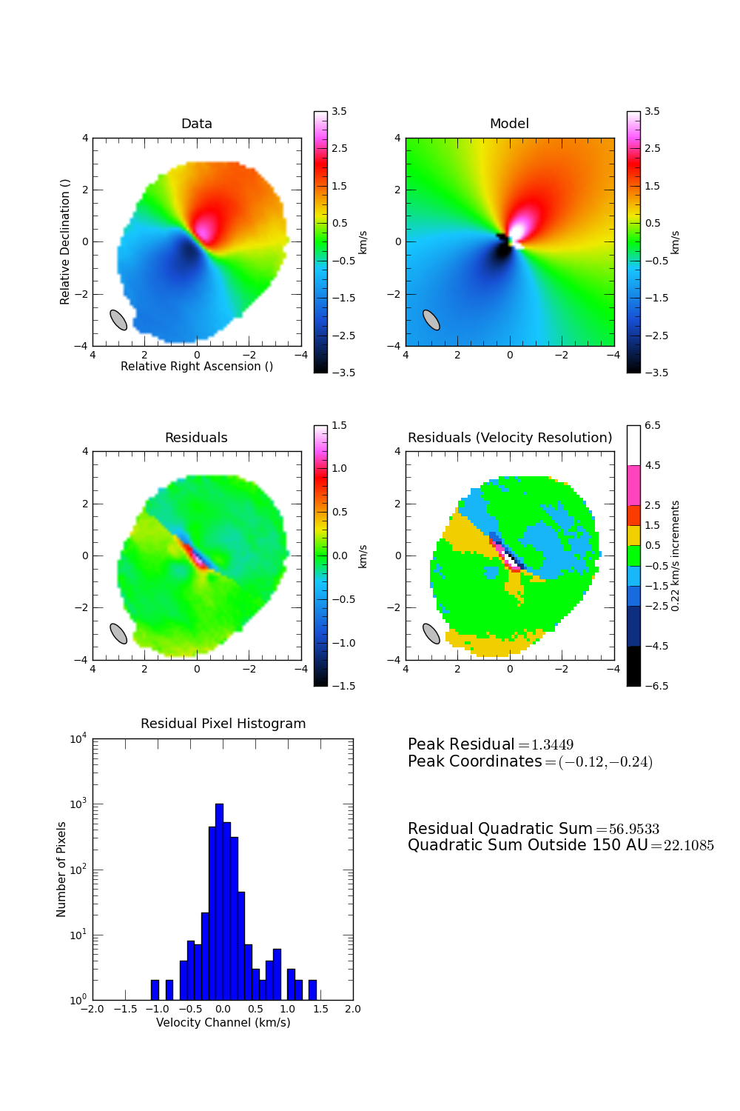

Warp
Include both unconvolved and convolved model images?
Explain why axisymmetric warp won’t fit

Slide 11
Blob
Let’s assume instead of a warp, asymmetric contribution on one side of the disk→ parameter space, best fit etc.
Once you have your best fit model, explain physical motivations

Slide 12
Circumplanetary Disk
Motivation/Explanation
Cartoon?
Do velocities match?

Slide 13
Conclusions
Structure cannot be explained by keplerian emission
Warp fits better
Excess emission could be from a planet, etc.?
Conclusion: we need better data

