Slide 1
leetcode17

Slide 2
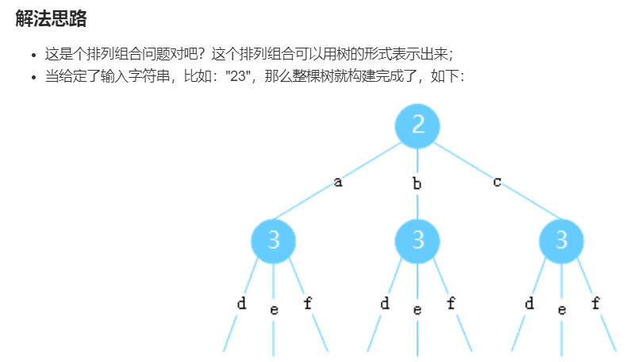

Slide 3
建立字母与vector索引的映射
vector<string> map = {"", "", "abc", "def", "ghi", "jkl",
"mno", "pqrs", "tuv", "wxyz"};
string curr_str = map[digits[depth] - '0'];
depth=0
digits是输入，如”23”
depth是树的深度，对应digits字母的索引
depth为0时，digits[depth]为’2’
depth=1
digits[depth] - ‘0’得到整型的数字2
map[digits[depth] - ‘0’]得到当前数字2对于的字符串
比如”abc”

Slide 4
if (depth == digits.size()) {
res.push_back(combination);
return;
}
for (int i = 0; i < curr_str.size(); ++i) {
combination.push_back(curr_str[i]);
dfs(digits, map, res, depth + 1, combination);
combination.pop_back();
}
return
combination最初是个空字符串，通过push_back增加字符，pop_back删去末尾字符。是每次循环用于
组合字符串用的。
假设digits = “23”,
当前depth == 1
combination == “a”
curr_str == “def”
进入for循环
push_back -> combination == “ad”
dfs 中depth == 2
pop_back -> combination == “a”
push_back -> combination == “ae”
dfs 中depth == 2
pop_back -> combination == “a”
for循环完成后，函数返回，进入digits==0的那一层
开始combination以’b’开头的情况

