Slide 1
Welcome to SLU!
Group 2 TA: Miao Cai

Slide 2



About me
2010 Freshman
2014 Undergraduate
2017 Master
2nd year doctoral student in biostatistics
Bayesian statistics
Traffic safety
Biostatistician at
Department of Veteran Affairs
Clinical epidemiology
Health policy

Slide 3
About you
Who are you?
Major in school
Why did you choose to come to this program?
What do you hope to do in St. Louis before leaving?
What is something special about you?

Slide 4
Guidelines
Feel safe and comfortable to share, ask questions, learn, develop skills, and grow as students.
Most importantly, enjoy yourself!
Respect
Patience
Understanding
Listening
Being prepared for class
Taking care of ourselves
https://github.com/caimiao0714

Slide 5
Schedules
Every day:
Check-in
Discuss class topics
Discuss how things are going in St. Louis
Discuss any problems, questions, concerns
Lab activities
Topics:
Global health
Communication of health information
Understanding and conducting research
Activities:
Storyboard
Public Service Announcements
Group projects

Slide 6
St. Louis
Things to do in St. Louis
Great places in St. Louis
St. Louis Zoo
Getting around St. Louis

Slide 7
Tomorrow
For lab, please bring 4 items that represent YOU!
This can be an object, a picture, a photo, a word, a concept…….anything!

Slide 8

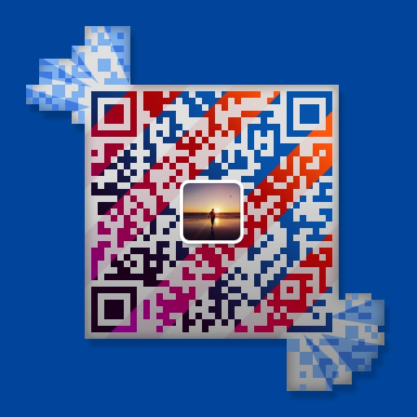
Contact me for any reason
My wechat
miao.cai@slu.edu
+1(314)326-8418
Salus center 484
caimiao0714.com

Slide 9
Questions, comments, concerns?

