Slide 1
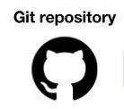










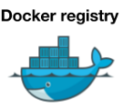


Springboot, Restful, Dhtmlx, Jquery, Swagger, JPA, H2DB
EC2, EDS, Docker, CodeDeploy, S3
JPA
H2DB
Docker
Remote
Api

