Slide 1
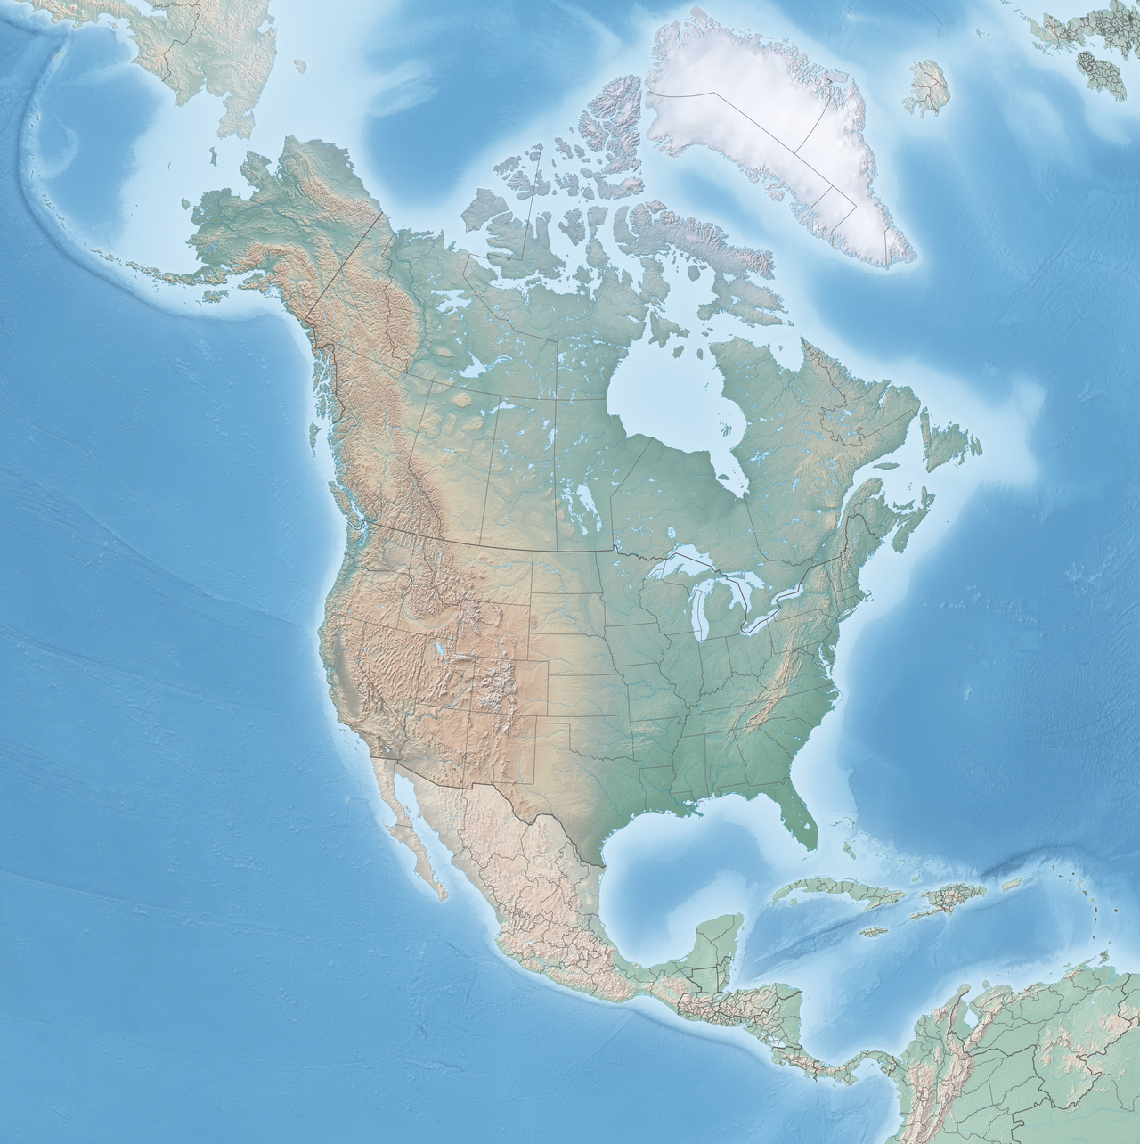
The United States of America (USA)
Country overview: name, currency and location on the map
Key facts
▪ Country name: United States of America (USA / U.S.)
▪ Capital: Washington, D.C.
▪ Currency: United States Dollar (USD, symbol $)
▪ Location: North America, between Canada (north) and Mexico (south)
▪ Language: English (de facto national language)
▪ States: 50 states and several territories
The United States is a federal republic located in North America. Its official currency is the dollar (USD), one of the most traded currencies in the world, and the country stretches from the Atlantic Ocean to the Pacific Ocean.

Slide 2
Culture and Typical Clothing
A melting pot of traditions, fashion and everyday style
Culture
Typical clothing
▪ Melting pot: cultures from immigrants all over the world
▪ Global influence: Hollywood movies, TV series and music
▪ Sports culture: baseball, basketball and American football
▪ Values: freedom, individualism and entrepreneurship
▪ Landmarks: Statue of Liberty, Golden Gate Bridge, Grand Canyon
▪ Everyday style: jeans, T-shirts, sneakers and baseball caps
▪ Cowboy culture: wide-brim hats, boots and denim in the West
▪ Native American: colorful regalia worn at ceremonies and powwows
▪ Workwear: denim jackets, flannel shirts and work boots
▪ Note: there is no single national costume — style is regional and casual
American culture is one of the most influential in the world, blending Indigenous, European, African, Latin American and Asian traditions. Because of this diversity, typical clothing is mostly casual and regional: jeans and sneakers are iconic nationwide, while cowboy hats and boots represent the ranching heritage of the West.

Slide 3
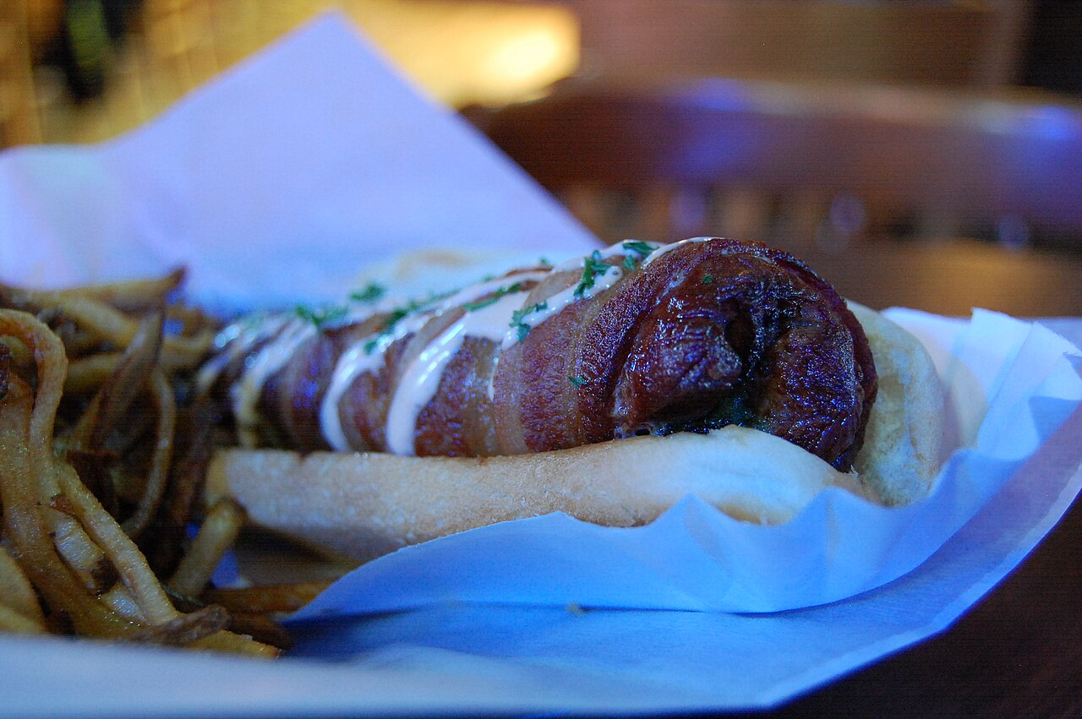
Gastronomy — The Hot Dog
Dish: Hot Dog • Local: New York City, NY
The dish
Ingredients
▪ Name: Hot Dog (frankfurter / wiener served in a bun)
▪ Local: New York — street carts and Nathan's Famous, Coney Island
▪ Since: popular in NYC since the late 19th century
▪ Beef and/or pork sausage (frankfurter)
▪ Soft sliced bun (bread roll)
▪ Yellow mustard and ketchup
▪ Chopped onions and relish
▪ Sauerkraut and pickles (optional)
Utensils used to prepare and serve
▪ Grill or hot dog roller grill
▪ Tongs and a long fork (to turn the sausages)
▪ Knife and cutting board (to slice toppings)
▪ Serving tray, buns, napkins and condiment squeeze bottles
The hot dog is a fast-food icon of New York City, sold from carts on almost every corner. It is quick, cheap and delicious — a true symbol of American street food.
Photo: Hot dog with mustard — Wikimedia Commons (CC BY-SA 2.0)

Slide 4
Dance and Music
From jazz and blues to hip-hop — rhythm was born in the USA
Music
Dance
▪ Jazz and blues: born in New Orleans in the early 1900s
▪ Rock 'n' roll: 1950s, with Elvis Presley and Chuck Berry
▪ Hip-hop: born in the Bronx, New York City, in the 1970s
▪ Country: from the rural South and Nashville
▪ Pop: global hits by Michael Jackson, Madonna and Beyoncé
▪ Swing / Lindy Hop: energetic partner dance of the jazz era
▪ Hip-hop dance: breakdance, popping and locking
▪ Broadway: choreographed musical theatre in New York
▪ Square dance: traditional folk dance of the country west
▪ Tap dance: percussive shoes, a classic American art form
The United States gave the world some of the most popular music genres in history. Jazz, blues, rock, country and hip-hop all started on American soil, and dances like swing, tap and breakdance spread around the globe. New York City remains the capital of Broadway, hip-hop and musical innovation.

Slide 5
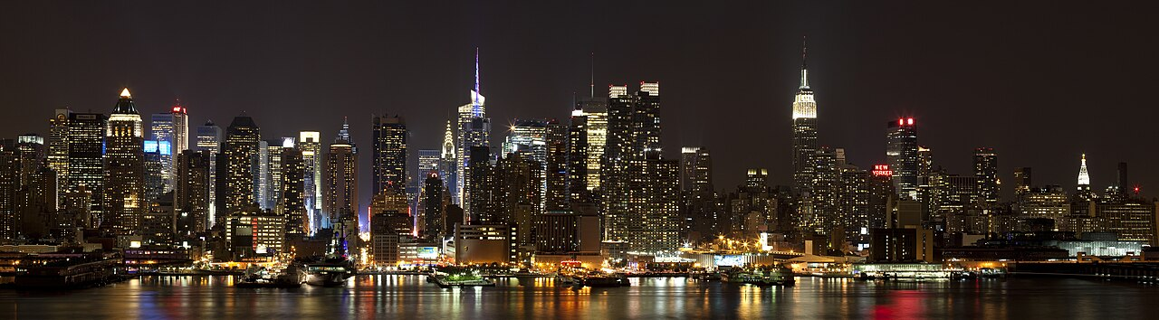
Popular Parties and Festivities
Celebrations that bring the whole country together
Most popular parties
▪ Independence Day (July 4): fireworks, parades and barbecues
▪ Thanksgiving (November): family dinner with turkey and pumpkin pie
▪ Halloween (October 31): costumes, candy and trick-or-treat
▪ New Year's Eve: the famous ball drop in Times Square, NYC
▪ Super Bowl Sunday: big game, snacks and parties at home
▪ Mardi Gras: colorful parades and carnival in New Orleans
New York City is the stage for some of the biggest celebrations in the country. On New Year's Eve, over a million people gather in Times Square to watch the crystal ball drop at midnight, while the Macy's Thanksgiving Day Parade fills the streets with giant balloons and floats every November.
Photo: Manhattan skyline at night — Wikimedia Commons (CC BY-SA 2.0)

Slide 6
Curiosities and Wrap-Up
Fun facts about the United States
Did you know?
▪ The Statue of Liberty was a gift from France in 1886 and stands in New York Harbor.
▪ The flag has 50 stars (one for each state) and 13 stripes (the original colonies).
▪ The hot dog was made famous by street vendors in New York City over 100 years ago.
▪ There is no official language at the federal level, but English is spoken by the vast majority.
▪ The U.S. is the 3rd largest country in the world by area and population.
To wrap up: the United States of America is a vast country in North America whose currency is the United States Dollar. Its culture is a mix of peoples from all over the world, reflected in casual clothing such as jeans, in musical genres like jazz, rock and hip-hop, and in dances such as swing and breakdance. Popular parties range from Independence Day and Thanksgiving to Halloween and the Times Square New Year's Eve ball drop. And when it comes to gastronomy, nothing is more New York than a hot dog from a street cart — a beef frankfurter in a soft bun with mustard, onions and relish, prepared on the grill and served on a tray.
Images: Wikimedia Commons — North America relief map (CC BY-SA 4.0), hot dog (CC BY-SA 2.0), Manhattan skyline (CC BY-SA 2.0)

