Slide 1
GDG CONF 2015

Slide 2
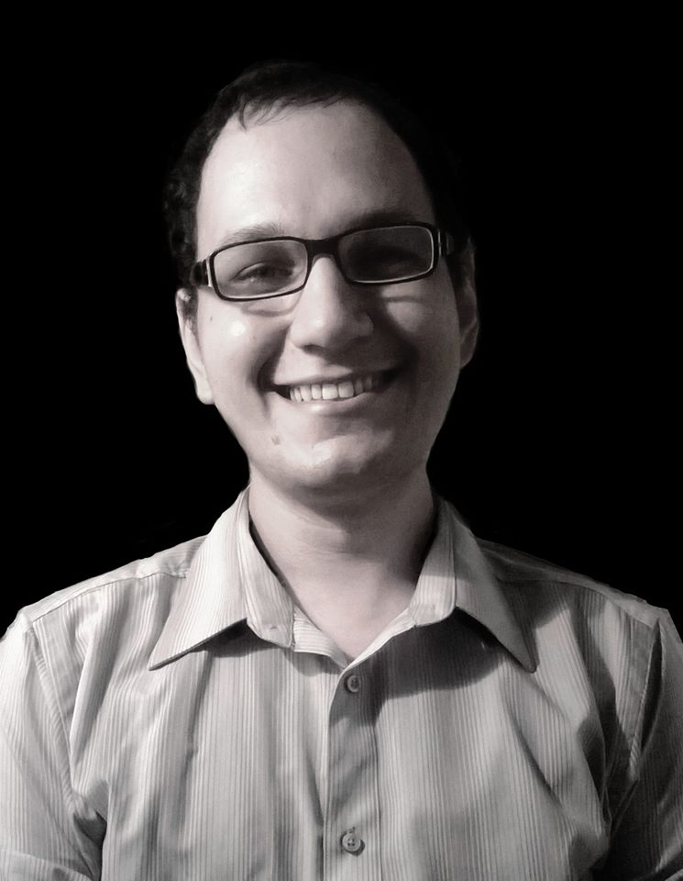
Hello, world!

Slide 3
Hello, world!
Caio Cutrim
http://github.com/caiocutrim
http://facebook.com/caio.cutrim.3
http://twitter.com/CaioCutrim1989
Programador web e entusiasta Node JS

Slide 4
Let's start!

Slide 5
What the hell is

Slide 6

What the hell is
?

Slide 7
NON-BLOCKING-THREAD

