Slide 1
Diagnosis of thyroid cancer
The thyroid is an organ in the neck
In case a node is felt, a puncture is performed
Follicular cytology
- benign
- suspicious
- follicular lesion

Slide 2
Current practice
After a test result “follicular lesion” :
Technetiumscan (Tc scan)
Results on Tc scan
- cold: operate
- hot: follow-up
Problems
- Tc scan has a low specificity (82% false-positives)
- 5% experiences damage by operating

Slide 3
Diagnosis of thyroid cancer
damage
p(damage | cancer,cold)
U=0.6
cancer
p(cancer | cold)
No damage
cold
operate
U=0.9
damage
U=0.7
p(damage | cancer,cold)
No cancer
Patient with follicular lesion
p(no cancer | cold)
Healthy
U=1
cancer
p(cancer | hot)
U=0.5
hot
Missed cancer
Follow-up
No cancer
p(no cancer | hot)
U=1
Healthy

Slide 4
Diagnosis of thyroid cancer
Damage
p(damage | cancer,cold)
U=0.6
Tc cold
Operate
=0.05
p(cold| cancer)
No damage
cancer
0.98
0.95
U=0.9
0.15
Tc hot
Follow-up
Missed cancer
Patient with follicular lesion
p(hot| cancer)
1
U=0.5
0.02
damage
U=0.7
Tc cold
p(damage | cancer,cold)
Operate
=0.05
p(cold| no cancer)
Healthy
0.95
U=1
No cancer
0.82
0. 85
Tc hot
Follow-up
Healthy
p(hot| no cancer)
U=1
1
0.18

Slide 5
Decision problem
Does there exist a diagnostic strategy that limits damage to the vocal cords and that limits costs without increasing the number of missed cancer cases?
Period of evaluation: 1 year

Slide 6
Biomarker Galectine-3
2 new strategies in addition to current practice (strategy A)
strategy B: No Tc-scan but Galectine-3
(Gal-3) colouring
+: operate; –: follow-up
strategy C: Gal-3 colouring and Tc-scan
Gal-3 +: operate
–: Tc scan
Tc scan cold: operate
hot: follow-up

Slide 7
Sensitivities and specificities
Determine the diagnostic accuracy on the basis of published studies
Check for heterogeniety between studies
Deville WL et al. BMC Med Res Methodol. 2002 3;2:9.
In absence of heterogeniety, pool the data and
calculate sensitivity and specificity

Slide 8
Sensitivity and specificity
Gal-3 kleuring
Study Correct pos False pos False neg Correct neg
I 31 11 4 33
II 21 7 3 23
III 7 3 1 9
______________________________________________
Total 59 21 8 65
No heterogeneity (Q-test p =0.47)
Sensitivity: 59/67 = 88% (correct pos/ (correct pos + false neg)
Specificity: 65/86 = 76% (false pos/ (false pos + correct neg)

Slide 9
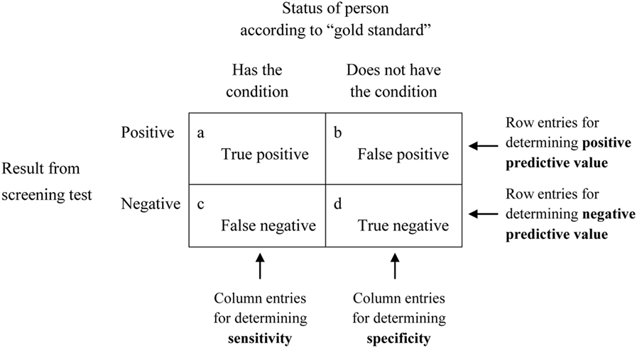

Sensitivity & Especificity
Robert Trevethan
Notes:
Reference: https://www.frontiersin.org/articles/10.3389/fpubh.2017.00307/full

Slide 10
Medical costs
Tc scan € 154
Gal3 colouring € 174
Follow-up € 147
Operation (no malignancy) € 3000
Operation (malignancy) € 5000

Slide 11
Base-case results
Strategy | Se | Sp | Operations without cancer | Outcome for cohort of 1,000 patients with follicular cytology
 |  |  |  | costs (million €) | Missed cancers | Damage and no cancer
A | 98% | 18% | 83% | €3.0 | 3 | 35
B | 88% | 76% | 61% | €1.6 | 18 | 10
C | 100% | 14% | 83% | €3.2 | 0.4 | 37

Slide 12
Base-case results
Strategy | Costs per patient | Expected utility per patient | Incremental costs per utility
A | €3,018 | 0.9711
B | €1,633 | 0.9728 | < 0
C | €3,245 | 0.9716 | €454,000

Slide 13
Conclusions
Replacement of the Tc-scan by Gal-3 colouring
cost-effective but increase in number of missed cancer cases
Use of Tc scan after Gal-3 colouring more expensive than current practice and only small increase in utility

