Slide 1
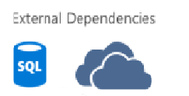
User Interface
Controllers
Application
Domain
Entities
Services
Infrastructure
Repositories
Identity

