Slide 1
Mission 4
Due May 13th Sunday 11:59pm
1. Use the provided mission 4 template.
3. Submit a single source code file.
4. Observe the Programming Suggestions.
Submit your files via email to baek@snu.ac.kr
Please make sure to use the following header.
[전산학2018] Mission4
[생물정보학2018] Mission4
Please make sure to include your name in the file names that you submit.
Mission4_DBaek_백대현.xlsx
Mission4_DBaek_백대현.py

Slide 2
Mission 4: Finding Overrepresented Motifs
Using the provided log2(fold-change) values, discover the motifs that are significantly enriched in the highly downregulated genes after miR-1 transfection into HeLa cell.
Use (1) the Fisher’s exact test for the 2x2 contingency table shown below,
(2) a fold-change cutoff of -0.50 to decide the highly downregulated genes (not including -0.50), and
(3) a motif size of 7, which means that we will iterate the test 4**7=16,384 times and pick the most significantly enriched motifs.
Motif NotMotif
HighlyDownregulated
NotHighlyDownregulated
n1 | n2
n3 | n4

Slide 3
Relative risk vs. Odds ratio
Disease Not Disease
Exposure
Unexposure
A = n1 / (n1+n2)
B = n3 / (n3+n4)
Relative risk: A / B
Odds in favor of disease in exposed group: C = n1 / n2
Odds in favor of disease in unexposed group: D = n3 / n4
Disease odds ratio: C / D = n1 / n2 / (n3 / n4) = n1n4 / n2n3
Odds ratio > 1: a greater likelihood of disease among the exposed.
Odds ratio < 1: a greater likelihood of disease among the unexposed.
n1 | n2
n3 | n4

Slide 4
Relative Risk vs. Odds Ratio
Compute the fraction of genes that include the motif in highly downregulated genes (A) and the fraction of genes that include the motif in those that are not highly downregulated (B).
A = n1 / (n1+n2)
B = n3 / (n3+n4)
A/B: relative risk
Then, the enrichment of the motif is A/B, and we will pick the motifs that have A/B > 1.0.
Report the 10 most significantly enriched motifs in the highly downregulated genes, in the ascending order of P values using the provided template file.

Slide 5
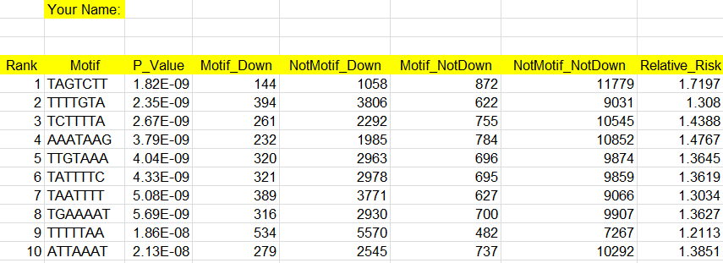
Mission 4: Finding Overrepresented Motifs

Slide 6
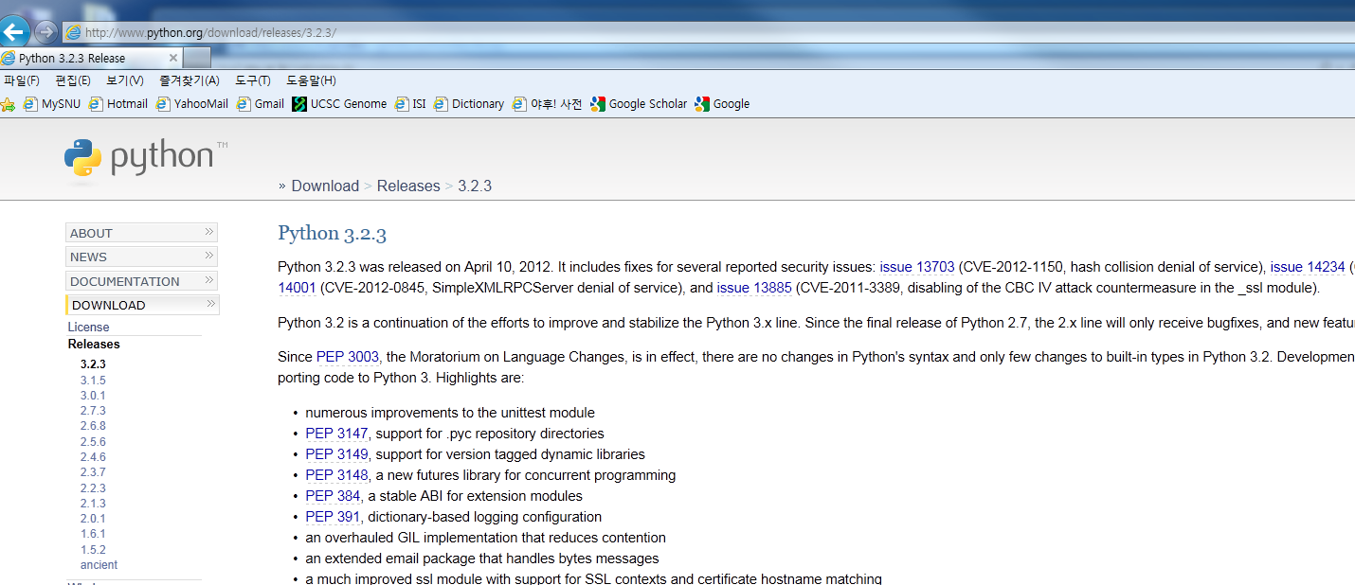
Python 3.2, Numpy, and Scipy

Slide 7
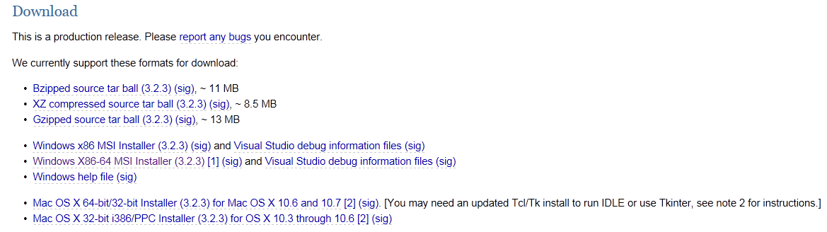
Python 3.2, Numpy, and Scipy

Slide 8
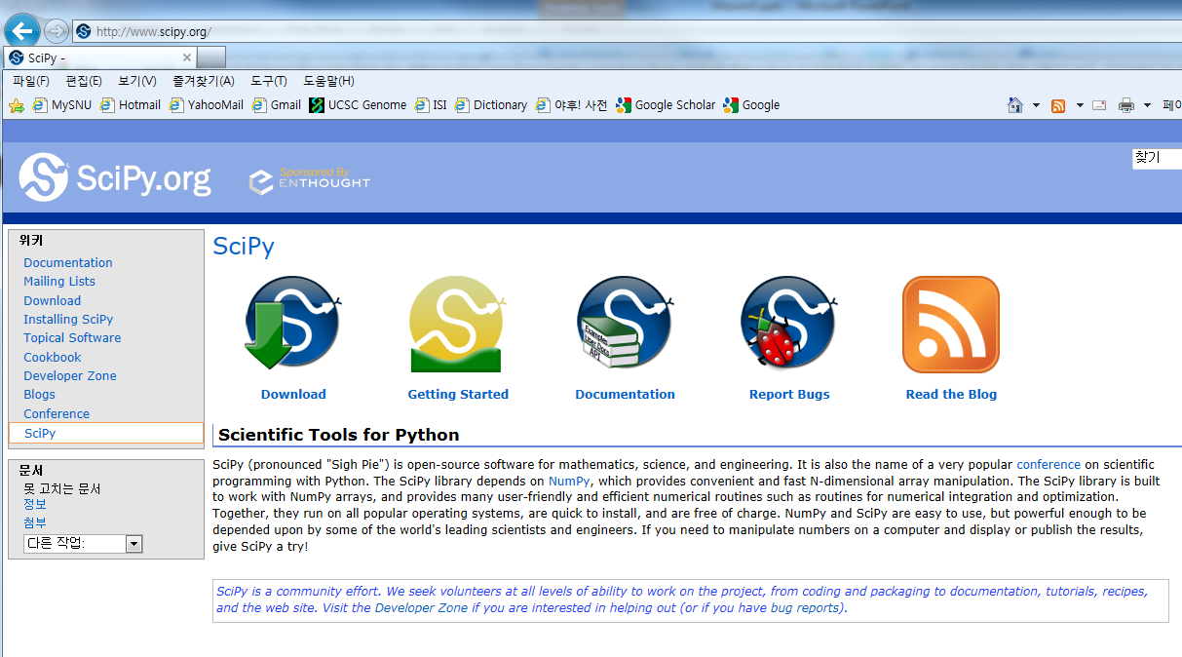
Python 3.2, Numpy, and Scipy

Slide 9
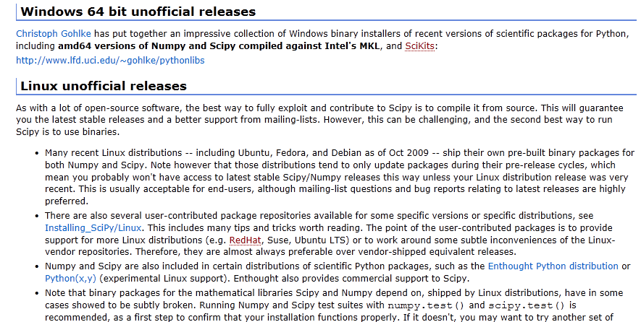
Python 3.2, Numpy, and Scipy

Slide 10
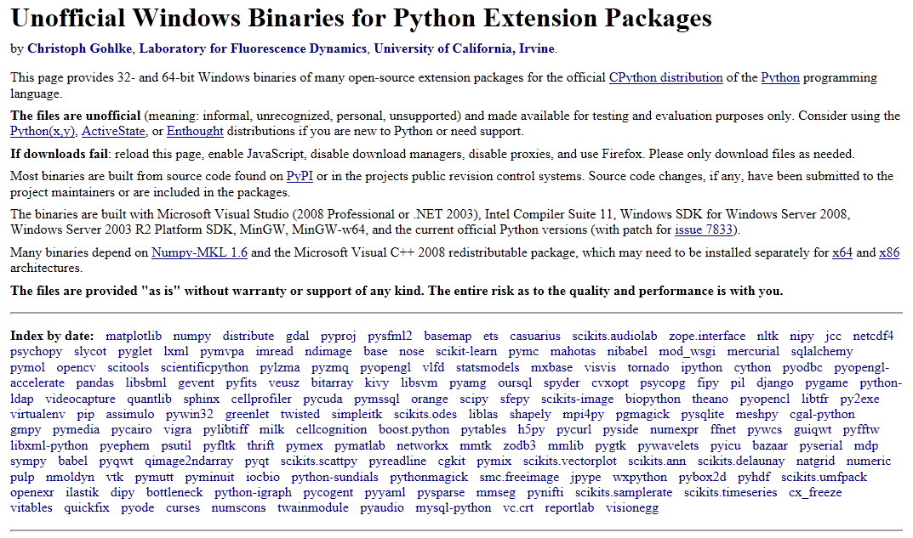
Python 3.2, Numpy, and Scipy

Slide 11
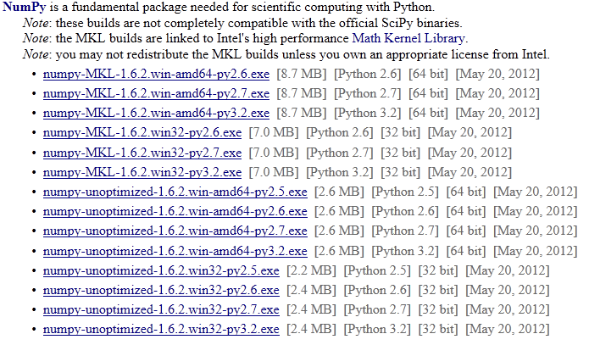
Python 3.2, Numpy, and Scipy

Slide 12
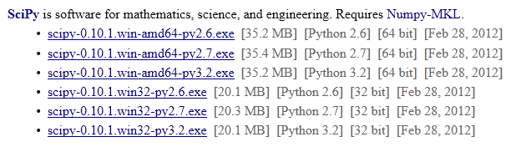
Python 3.2, Numpy, and Scipy

Slide 13
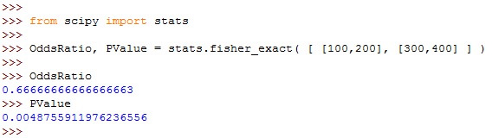
Fisher’s Exact Test Using Scipy

Slide 14
Useful Tips: Pseudo Count
global PSEUDO_COUNT = 0.0000001
fFraction = f1 / ( f1 + f2 )
Instead, use the following to avoid dividing by zero.
fFraction = ( f1 + PSEUDO_COUNT ) / ( f1 + f2 + PSEUDO_COUNT )
Estimated run time: <10 mins

