Slide 1
Mission 5
Due May 27th Sunday 11:59pm
1. Use the provided mission 5 template.
3. Submit a single source code file.
4. Observe the Programming Suggestions.
Submit your files via email to baek@snu.ac.kr
Please make sure to use the following header.
[전산학2018] Mission5
[생물정보학2018] Mission5
Please make sure to include your name in the file names that you submit.
Mission5_DBaek_백대현.xlsx
Mission5_DBaek_백대현.py

Slide 2
Mission 5: Predicting the Overexpressed miRNAs
Repeat the analysis given in Mission 4 for each the provided 3 transcriptome data. The analyses are identical to those in Mission 4 except for the following changes:
Correct your P values by using the bonferonni correction. When counting the number of tests for the bonferonni correction, only consider Fisher’s exact tests whose relative risk are bigger than 1.0 (A/B>1.0).
Report the 5 most significantly enriched motifs in the highly downregulated genes, in the ascending order of P values.
For those highly associated motifs, report whether they are 7mer-m8 or 7mer-A1 sites of known human miRNAs.
Report your results in the provided Mission5_template.
Repeat the above analyses for ORF 7mers, and discuss about your results in comparison with 3’UTR results and about possible methodological improvements.
Estimated run time: <60 mins

Slide 3
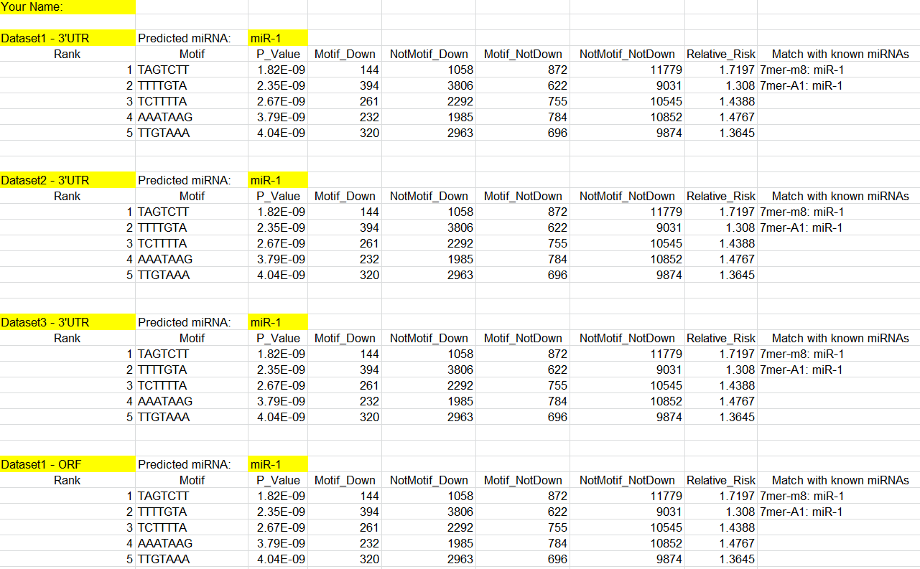
Mission 5: Predicting the Overexpressed miRNAs

Slide 4
Types of miRNA Target Sites
6mer
ORF
................NNNNNN................Poly(A)
ACUGAC
3’-CCCCAUAAACUGUUUGACUGU-5’ miR-223
7
6
5
3
2
4
Seed
7,8mers
ORF
................AACUGAC................Poly(A)
7mer-m8
.................ACUGACA..............
7mer-A1
...............AACUGACA..............
8mer
3’-CCCCAUAAACUGUUUGACUGU-5’ miR-223
7
6
3
2
5
4
Seed

Slide 5
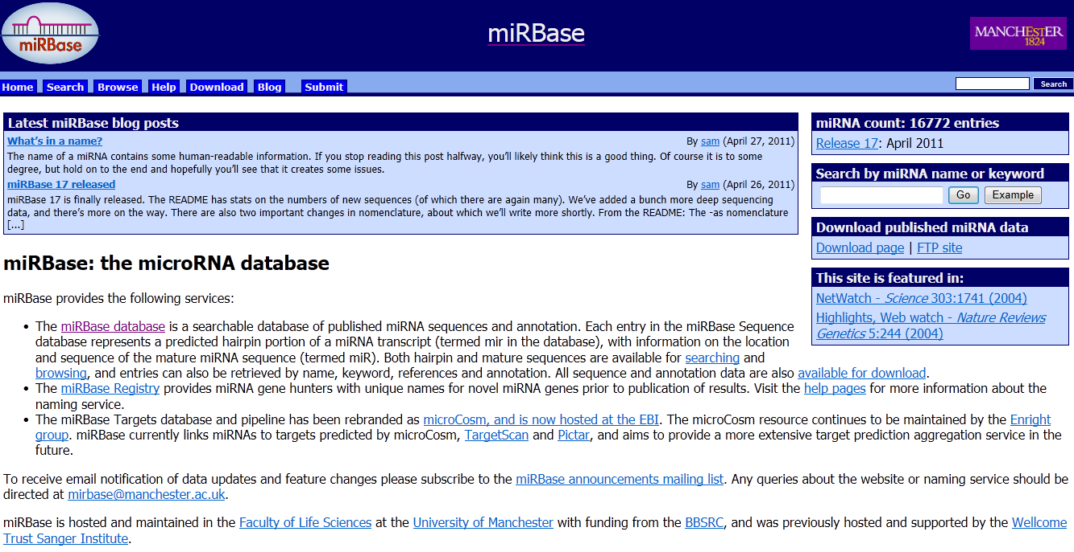
miRBase

Slide 6
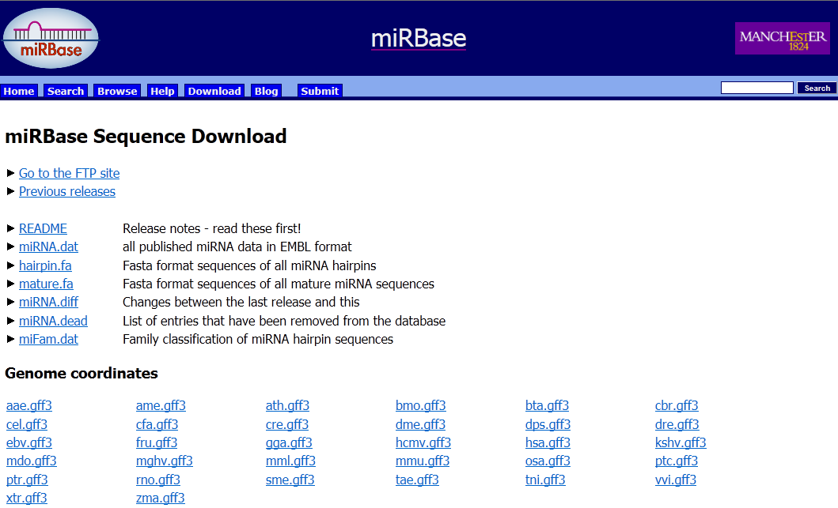
miRBase

Slide 7
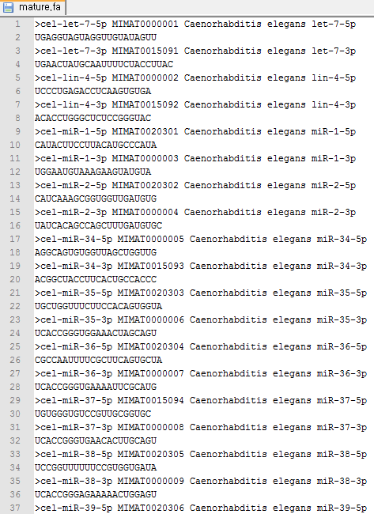
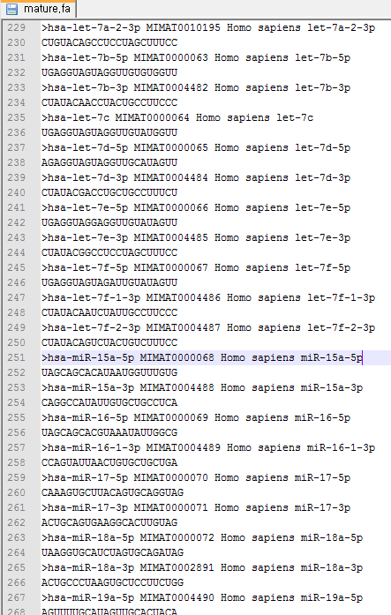
miRBase

