Slide 1


Adding New Search Engines to Chrome ‘Omnibox’
September 18, 2018
Camille Mathieu

Slide 2
Discussion Questions
What are some websites you visit regularly (not including social media)?
Consider: Why might you search WorldCat instead of Amazon, or Amazon instead of WorldCat?

Slide 3

What is ‘Omnibox’?
Web browser address bar that also acts as a search engine ^{[1]}
Example: Chrome browser
Search multiple search engines from a single search bar
Why? Supports all kinds of searches with less steps

Slide 4
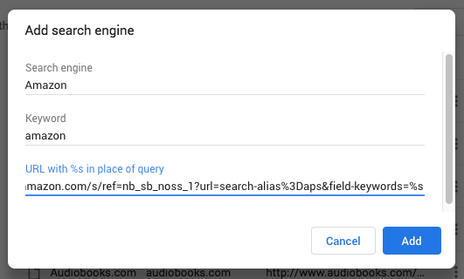
How to Set a New Search Engine ^{[2]}
Open Chrome, and enter ‘chrome://settings/’ into the omnibox
Under Search engine heading, click Manage search engines
Select the ‘Add’ button next to Other search engines
Fill out the form, and click ‘Add’
Search engine name + keyword
Search URL, substitute “%s” for keyword

Slide 5
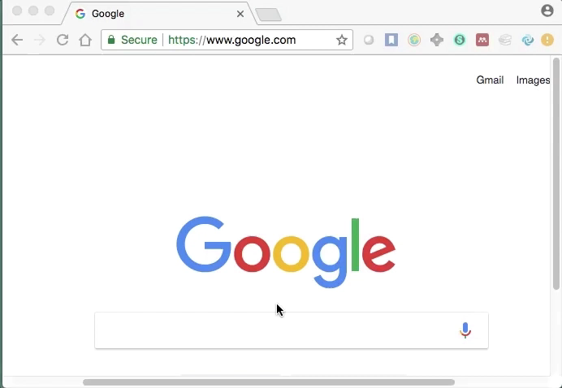
Using your New Search Engine
Type keyword into omnibox
Hit space bar
Enter query as normal

Slide 6
Let’s try it!
Add the PCC library search to your Chrome omnibox – here’s a URL to get us started:
https://pasadenacc.on.worldcat.org/search?format=all&queryString=little+women&wcsbtn2w=Search

Slide 7
Reflection
What is an omnibox?
Do you think omniboxes are useful? Why or why not?

Slide 8
References
“Omnibox.” https://www.computerhope.com/jargon/o/omnibox.htm
“Set your default search engine.” https://support.google.com/chrome/answer/95426?hl=en&co=GENIE.Platform%3DDesktop
Slides and notes available at cemathieu42.github.io

