Slide 1

Keyword Searching vs. Subject Searching
September 18, 2018
Camille Mathieu

Slide 2
Discussion Questions
What are some websites you visit regularly to “look up” information?
What factors help you determine how you will construct your query?

Slide 3
Types of Searching
Keyword search
Looks for query terms anywhere in the full text of a resource or its record
Use when looking for any information on a very specific topic
Subject search
Looks for query terms only in the subject field of a resource’s record
Use when looking for information on a topic or in a particular domain

Slide 4
Types of Searching
Keyword search
Looks for query terms anywhere in the full text of a resource or its record
Use when looking for any information on a very specific topic
Free text
Subject search
Looks for query terms only in the subject field of a resource’s record
Use when looking for information on a topic or in a particular domain
Controlled vocabulary (taxonomy)

Slide 5
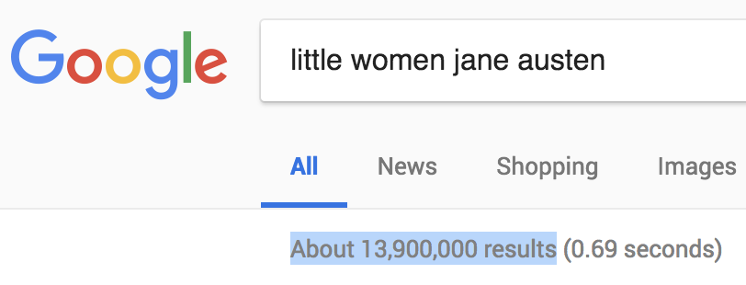
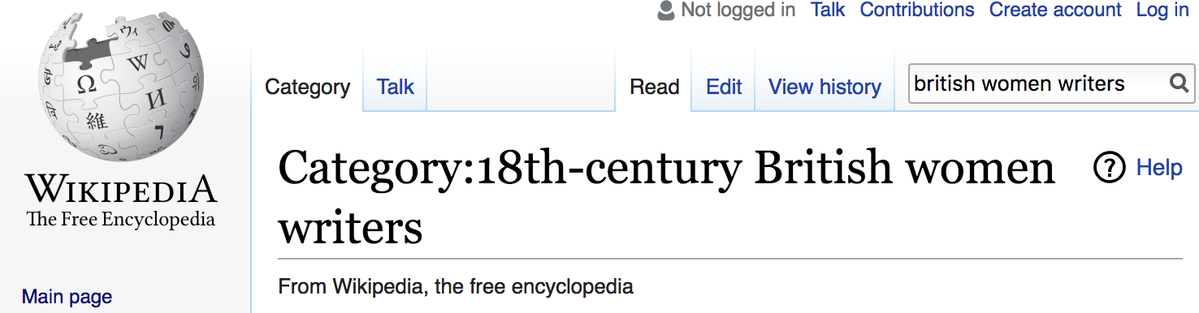
Keyword vs. Subject Search
Keyword
Subject
High recall, low relevancy
High relevancy, low recall

Slide 6
Scenario 1: Doggie Drama
Yikes! Your friend’s new puppy got out of her crate and ate a bowl of cat food. Your friend is worried the puppy will be sick. How would you go about finding more information for your friend?

Slide 7
Scenario 2: Finals Frenzy
You are working the reference desk when a flustered student comes up to you. The student just realized he needs more sources on common sports injuries received by basketball players for a paper due in two days. How do you go about finding library resources for the student?

Slide 8
Scenario 3: Wedding Wares
Your mom’s best friend is getting married, and has asked that your mom and all other bridesmaids wear red, velvet, ¾ length sleeve dresses to the wedding. Your mom has a coupon for Macy’s. How do you go about helping her find a dress?

Slide 9
Scenario 4: Required Reading
You are working the reference desk when a tired-but-excited student comes up to you. She explains she has been up all night reading Harry Potter and the Philosopher’s Stone and she NEEDS to know if you have The Chamber of Secrets. How do you help this student find the book?

Slide 10
Reflection
What are some key differences between keyword searching and subject searching?
Describe one time you had to change your search strategy because you weren’t finding what you were looking for.

Slide 11
References
“Keyword vs. Subject Searching.” http://gethelp.library.upenn.edu/PORT/locating/keywordvssubject.html
Slides and notes available at cemathieu42.github.io

