Slide 1
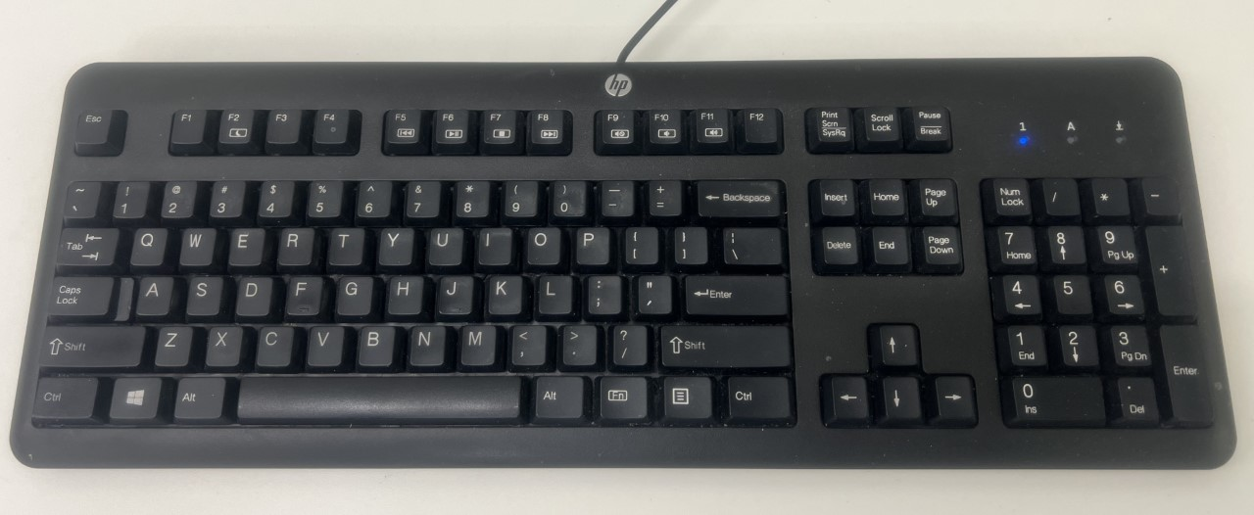
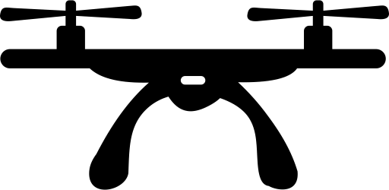
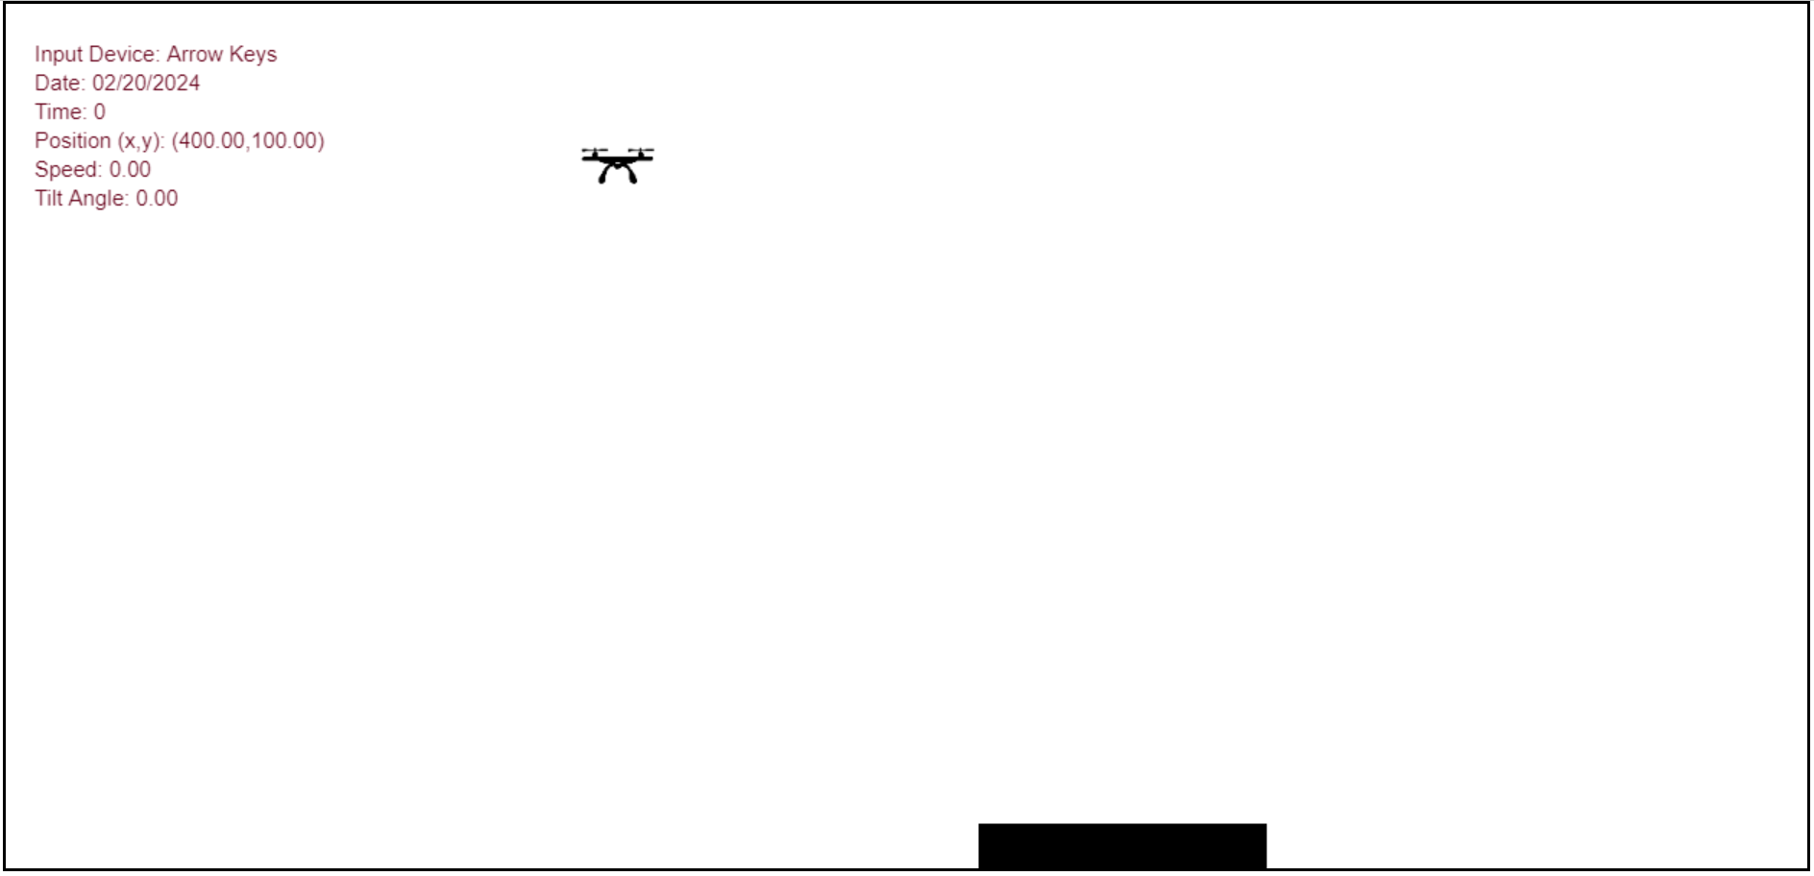

Slide 3
Starting Point
Landing Pad

Slide 4
W & S
control thrust force
Left & Right
control tilt angle

Slide 5
Thrust

Slide 6
Tilt angle

