Slide 1

BestElectronics4U
Find the Best Tech Deals Near You
Team Member:Ahmed Hamouda, Olufem Adeonigbagbe, Brandon Bedoya, Minning Liu, Cai Rong Li, Yulin Ding
Fauget Inc.

Slide 2
Customer Survey
Key findings from the 2025 Consumer Electronics Ecommerce Market Research Report:
91.24%
69.66%
Store Accessibility
Customer Satisfaction
Percentage of respondents with easy access to electronics stores
Percentage of respondents satisfied with their local electronics shopping options
The survey reveals high accessibility to electronics stores, but customer satisfaction with local options could be improved.

Slide 3
Problem
01
02
No Central Price Comparison
Significant Time Commitment
Shoppers lack a unified platform to efficiently compare prices from local electronics retailers.
Manually comparing prices across different stores consumes hours of valuable time.

Slide 4



Current Choice
Amazon
Store Apps
Google Maps
Excludes local stores, showing only online prices.
Limited data; each app only shows its own prices.
Lacks price comparison; provides only location info.

Slide 5
Our Solution:
BestElectronics4U
Fauget Inc.

Slide 6

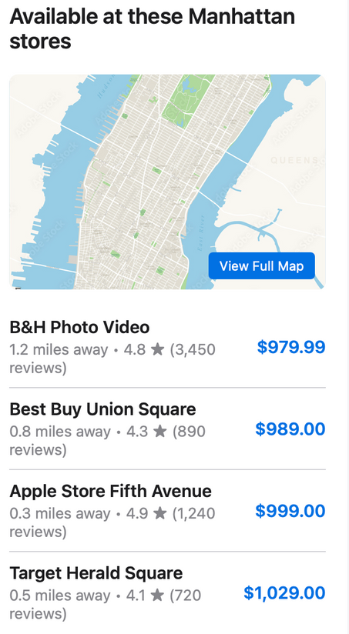
Search Products
01
Find electronics you're interested in by name, category, or features.
Compare Prices
02
See prices across different stores near you, sortable by price or distance.
Get Directions
03
View store locations on a map and get directions to the best deal.
BestElectronics4U

Slide 7
Revenue
We will generate revenue through a hybrid revenue model:
$2
$100
Ads
Monthly Subscription
Lifetime Subscription
Sell Advertising
for users who need short-term access, such as those shopping for a one-time purchase or comparing prices for seasonal sales.
for frequent shoppers or tech enthusiasts who regularly compare electronics prices.
for users who prefer not to subscribe to paid services.
Fauget Inc.

Slide 8
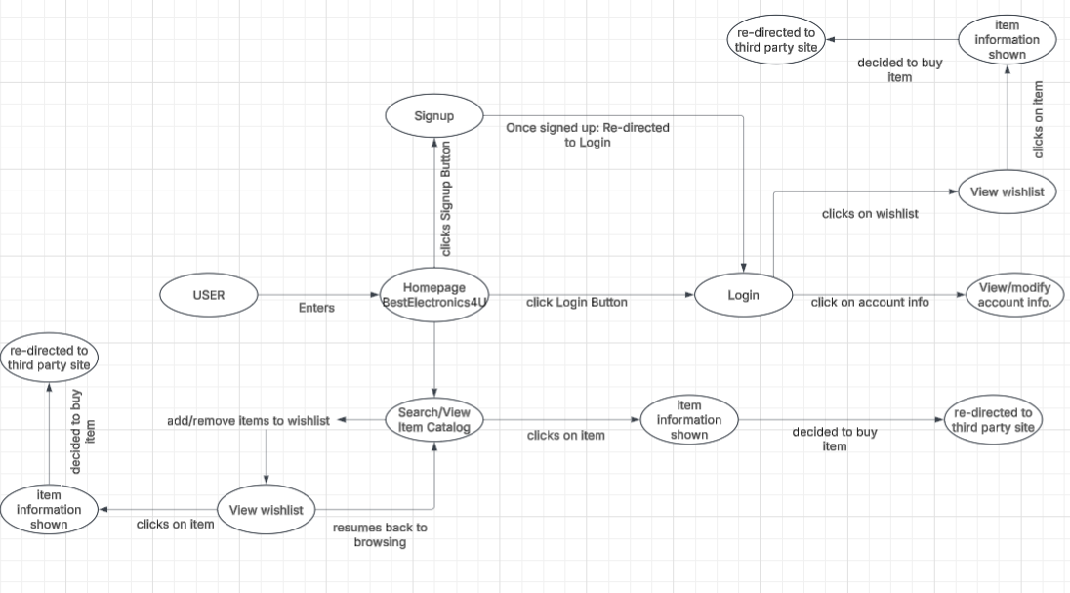
User Journey Diagram

Slide 9
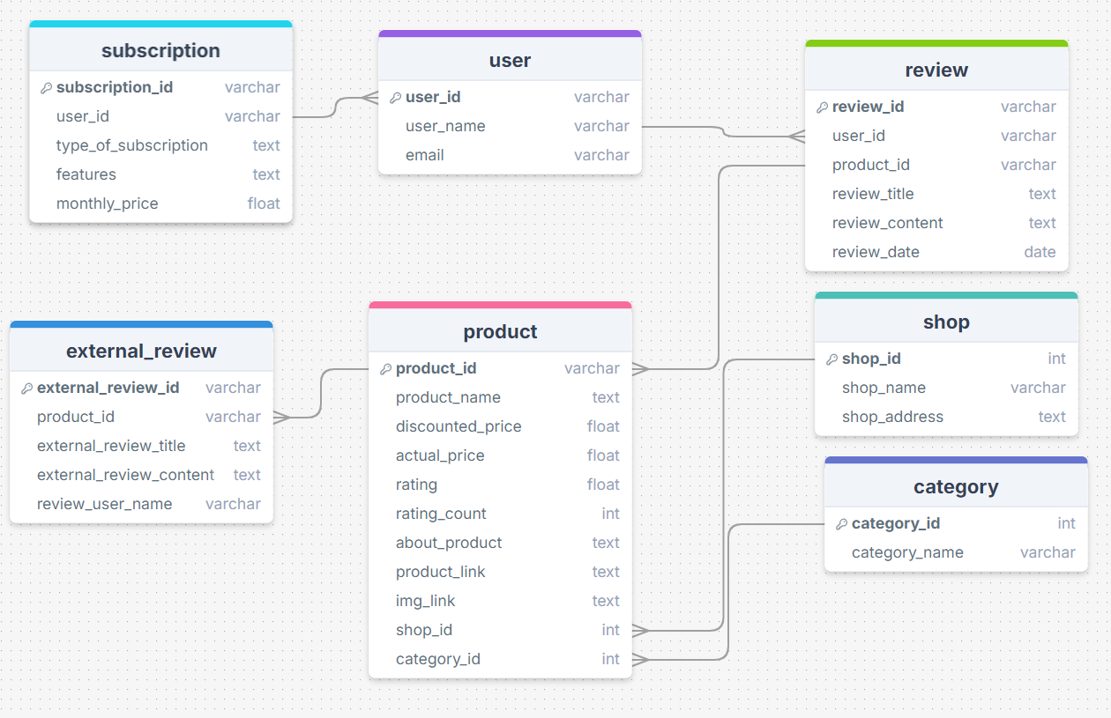
Data Model

Slide 10
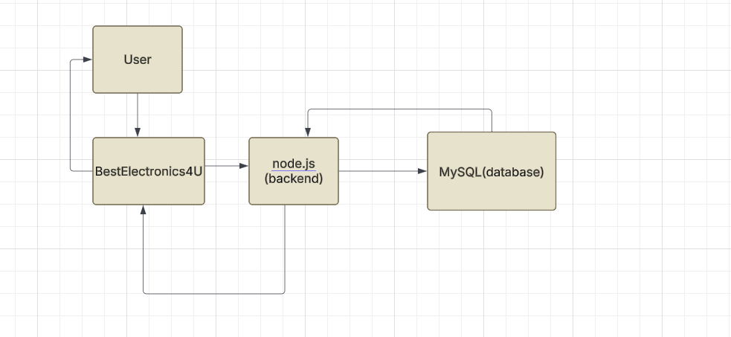
System Design Diagram

Slide 11








Tech Stack
Front End
Deployment
Back End
React.js | HTML | Tailwind CSS
Vercel | Docker | Render
Javascript | Node.js | MySQL
Fauget Inc.
Fauget Inc.

Slide 12
Member Role
Ahmed Hamouda | Backend Software Engineer (Js|node.js|mySQL)
Olufemi Adeonigbagbe | Backend Software Engineer (Js|node.js|mySQL)
Brandon Bedoya | Backend Software Engineer (Js|node.js|mySQL)
Minning Liu | Front End Software Engineer (React.js|HTML| tailwind CSS)
Cai Rong Li | Front End Software Engineer (React.js|HTML| tailwind CSS)
Yulin Ding | Front End Software Engineer (React.js|HTML| tailwind CSS)

Slide 13
Thank You
FOR YOUR TIME
Fauget Inc.

