Slide 1







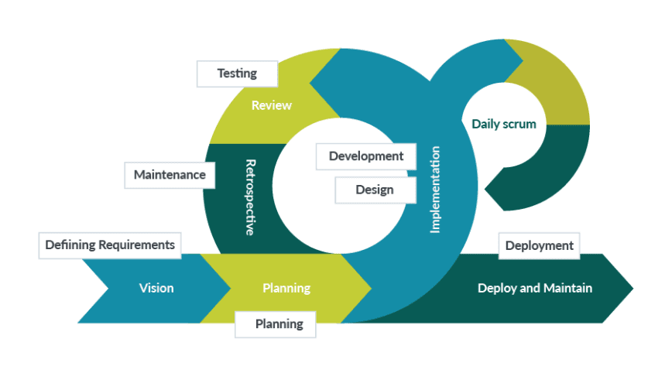
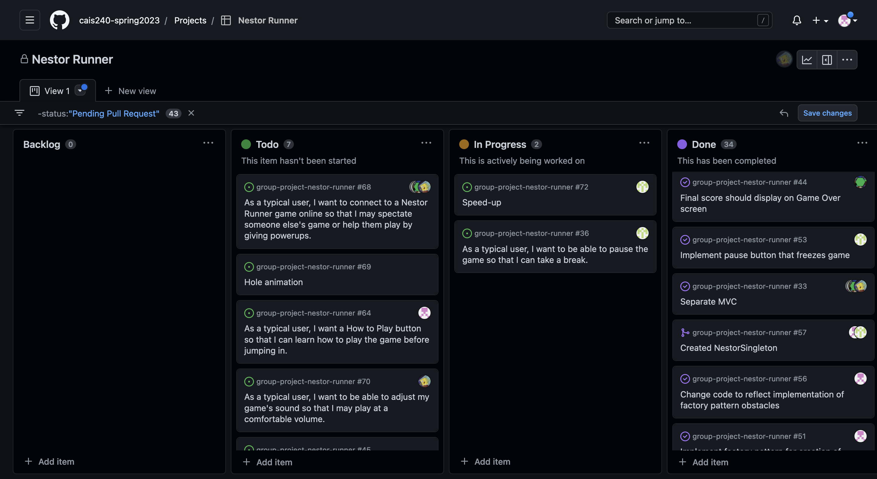
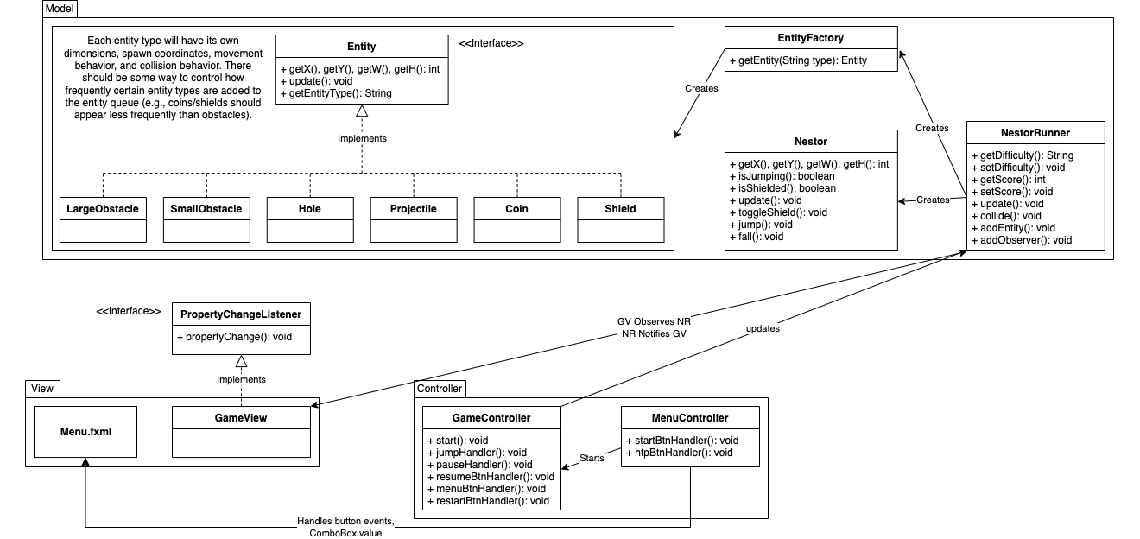
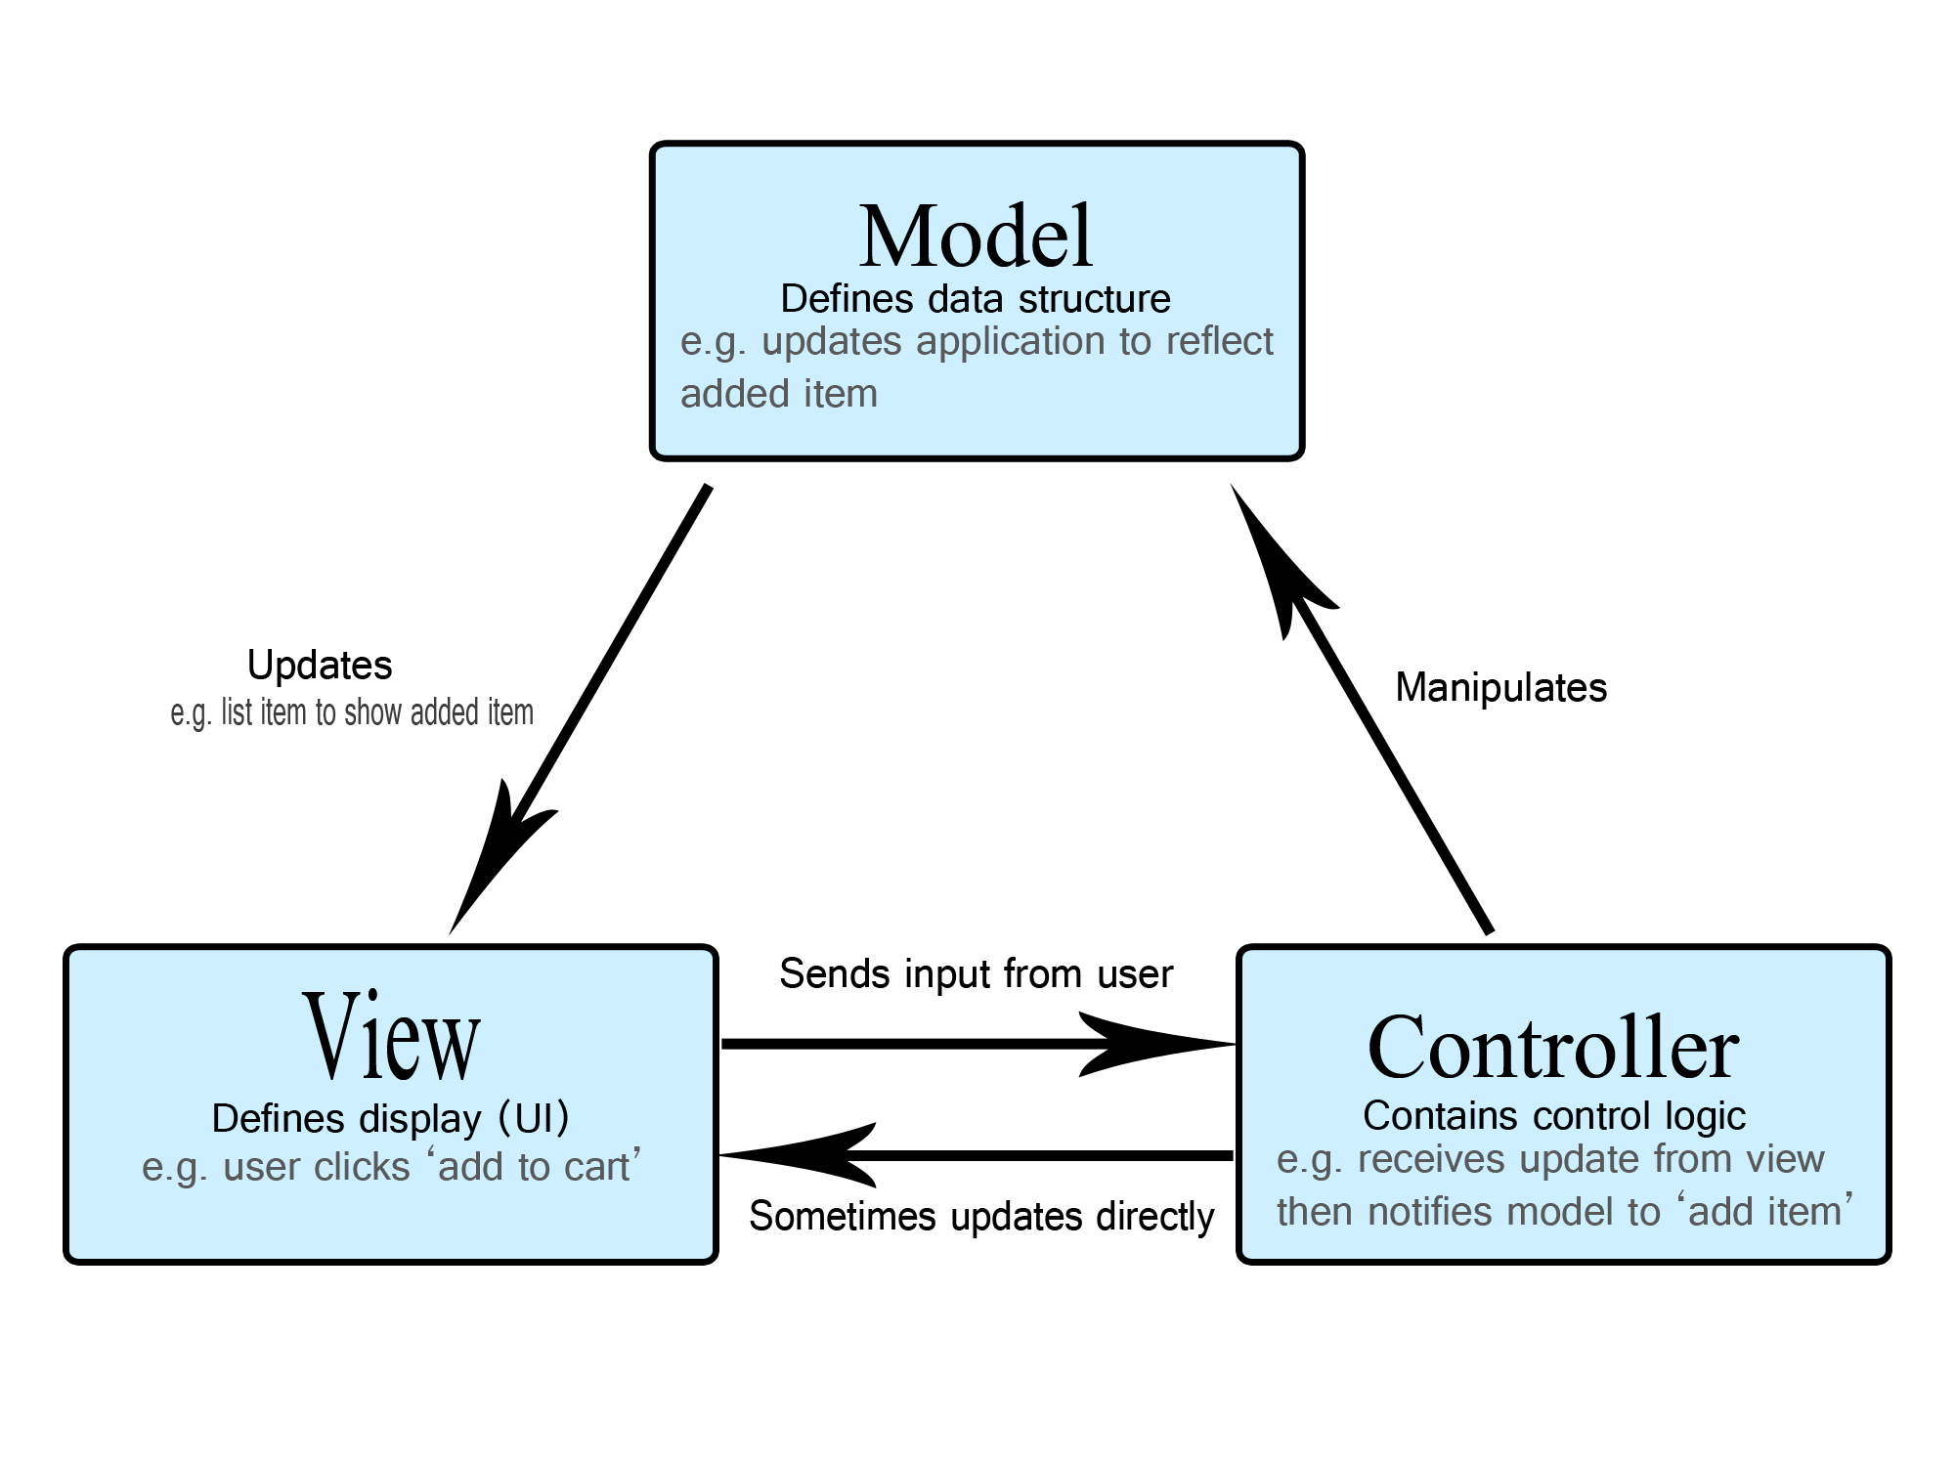
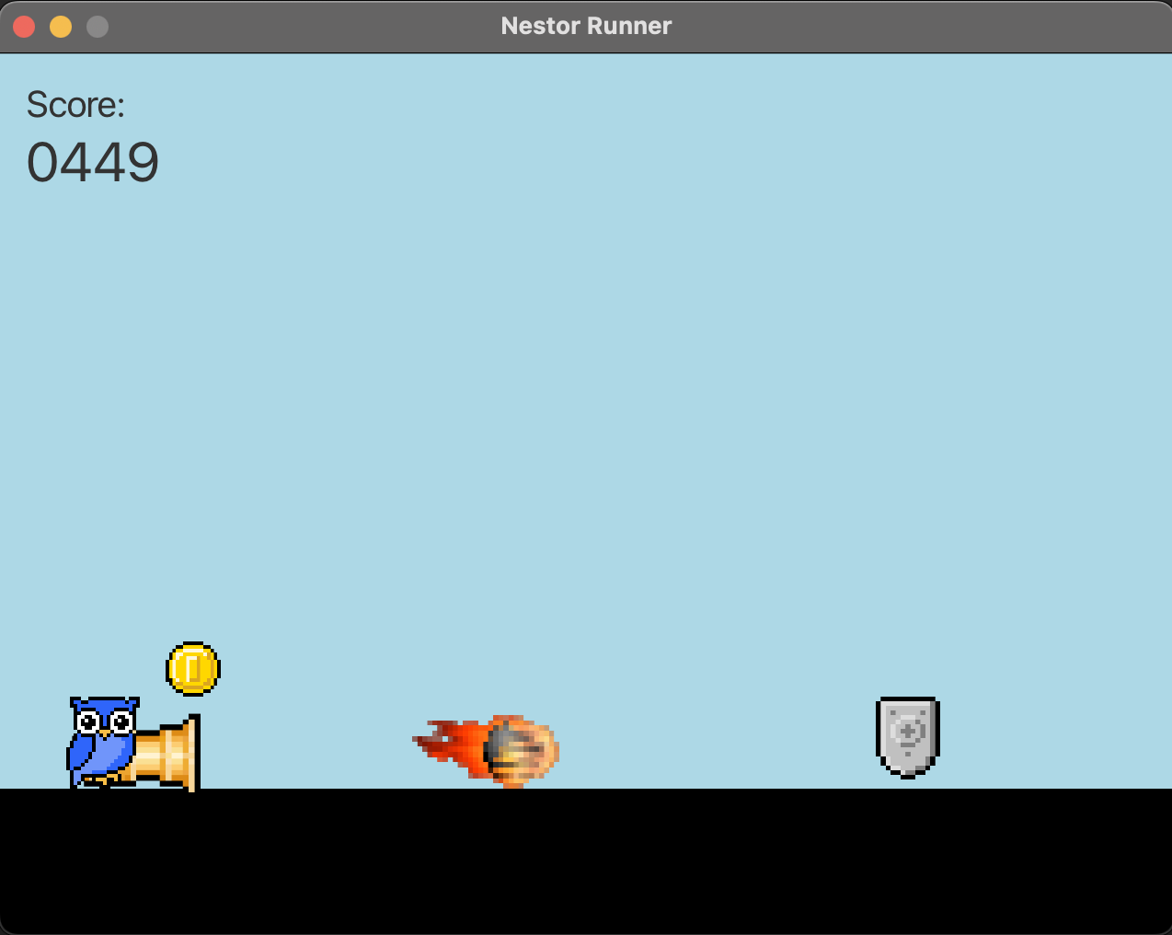
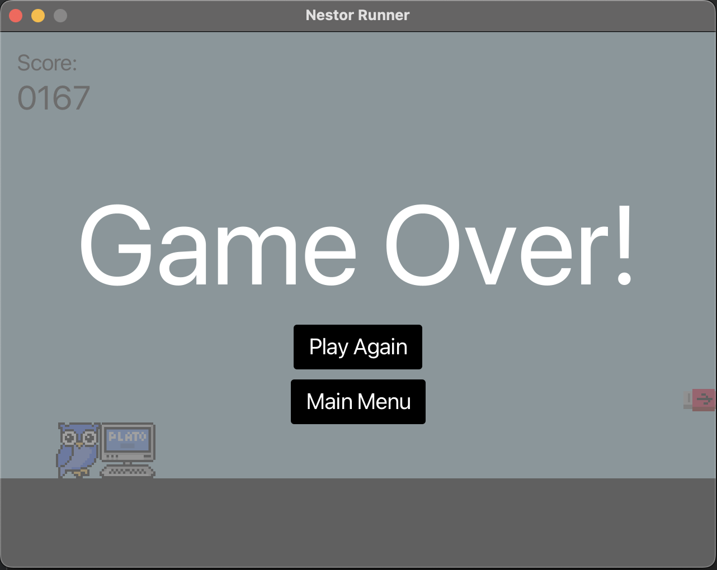
Scrum Methodology for Game Development
Noah Kelly, Glenn Lane, James Summa, Jacob York
Department of Computer and Information Science
Score:
1312
Introduction
Process
Discussion
For our Software Engineering course, we teamed up with the goal of making a game using standard industry practices. Our team employed the Scrum framework to facilitate project management, the Model-View-Controller architecture for the project’s overall structure, and several design patterns for the project’s implementation.
The game itself – Nestor Runner – is a scrolling game in which the player controls Nestor the owl and tries to earn points, coins, and power-ups for as long as possible while avoiding treacherous obstacles. Players can choose their difficulty, and there is even a remote spectate mode in which someone on another computer can watch a friend play.
Scrum Framework/Agile Methodology
Unified Modeling Language (UML) Diagram
Gameplay
Some of the motivating factors for this project included the opportunity to learn new concepts, the challenge of its development, the boost it would add to our portfolios, and, most importantly, the fun of creating something we enjoyed!
Utilizing the various industry standards was among the most difficult aspect of this project, particularly maintaining MVC separation. Working as a development team, with each of us taking a turn as Scrum Master, provided insight into real-world scenarios in which our coding skills will be just as important as our ability to collaborate and work in group settings. Communication, testing, and code review proved to be essential to maintaining a properly functioning, shared code repository.
We hoped to be able to implement a networked component to this project, in which more than one computer could be involved in the gameplay. However, due to time restrictions, we may have to limit such a feature to only allow someone on another computer to spectate the player’s game.
Figure 1: Scrum lifecycle
Figure 2: Sprint board
Design
Model-View-Controller Architecture
Design Patterns
Factory Method Pattern: Used to create instances of the obstacles and power-ups, all of which share a common interface. A “factory” is responsible for generating them from a central point, hiding the creation logic from the client.
Observer Pattern: Used to link the model and view. The view ”observes” any changes to an instance of the model and updates itself to reflect those changes.
Singleton Pattern: Used to ensure that only one instance of the model was being references by the controller and view.
Future Enhancements
Our design and implementation of this project allows for a large amount of growth and features in the future. With the addition of network spectate, we could implement a multiplayer feature. The design also allows for an easy addition of new obstacles, powerups, and collectables. Another idea we had is that we could easily rework the game to be a platform game like Super Mario
References
Rubin, K. S. (2013). Essential Scrum: A practical guide to the most popular Agile process. Addison-Wesley.
Freeman, E. et al. (2021). Head First Design Patterns, 2nd Edition. O’Reilly Media, Inc.
Liang, Y. D. (2017). Introduction to Java Programming and Data Structures, Comprehensive Version, 11th Edition. Pearson.

