Slide 1

c++ app
c++ module
python app
interpreter
python
interpreter
custom frontend
GL
osg
vtk
omegalib core
Equalizer
SAGE
Fullscreen render
Windowed render

Slide 2

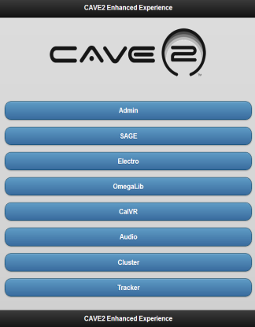
application
MC server
> mcsend “pythonCommand()”
IPad Interface
Console

Slide 3
application 1
application 2
MC server
MC client

Slide 4

application 1
application 2
MC client
MC client
MC server
> mcsend “pythonCommand()”

Slide 5
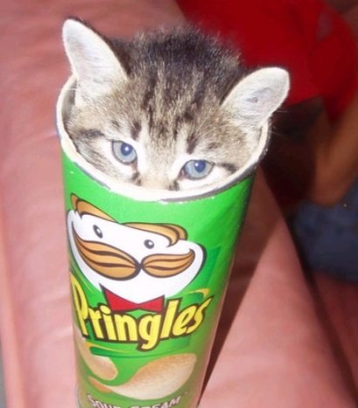
Internet
1
urlretrieve(…)
3
master
broadcastCommand(…)
slave
2
storage server
4
Kitteh.jpg

Slide 6


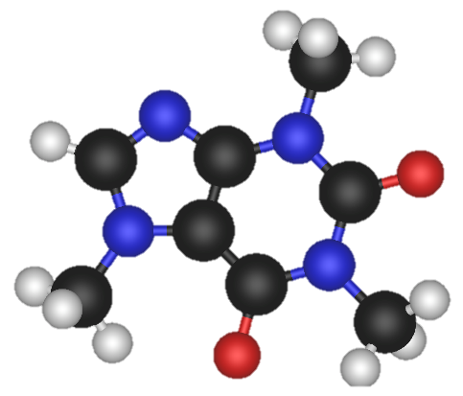



Slide 7

Reference Tile
Reference Offset
(center of reference tile)
Head Offset
Camera Position
World Origin

