Slide 1
Demand Simulator
2025-11-05

Slide 2
Overview
Define the location of each dealer.
Introduce a new function that reproduces seasonal demand pattern.
Predict simulated demand using the XGBoost model.
Notes:
First, I define the location of each dealer.
Next, I introduce a new function that reproduces seasonal demand patterns.
Finally, I predict the simulated demand using the XGBoost model.

Slide 3



Class diagram
Part1
Failure model1
Truck
Part2
Failure model2
Usage $∈\{soft, hard\}$
Part1
Failure model1
Dealer
Truck
Part2
Failure model2
Location $∈\{north, south\}$
Usage $∈\{soft, hard\}$
No. of dealers = 2
No. of trucks = 30
No. of parts = 30
Notes:
This slide shows the class diagram of the current simulator.
At the top, I define dealer class.
Its location is defined as either north or south.
Currently, dealer number is set to 2.
The remaining structure is same as conventional one.
Each dealer manages multiple trucks.
And each Truck has multiple types of parts.
And each part has a failure model, which is commonly shared among parts of same types.

Slide 4
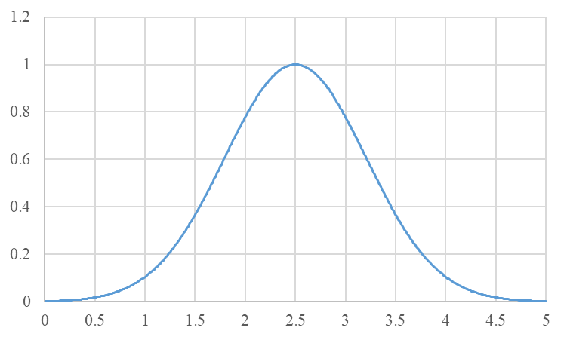
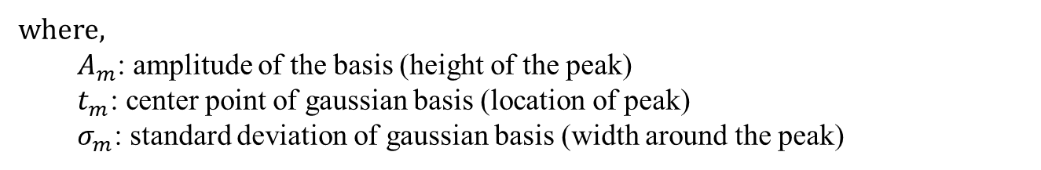
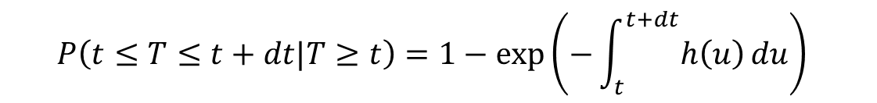

Seasonality
Hazard function-based formulation:
$$P\left(t≤T≤t+dt|T≥t\right)=1−exp\left(−\int_{t}^{t+dt}{h\left(u\right)}du\right)⁡$$
$$h\left(t\right)=w(t)h_{0}(t)$$
  where $w(t)$ represents the seasonal coefficient corresponding to each day or month.
$w\left(t\right)$: Sum of radial basis function (RBF)
$$w\left(t\right)=\sum_{m=1}^{M}{A_{m}exp⁡(−\frac{{\left\|t_{m}−t\right\|}^{2}}{σ_{m}^{2}})}=\sum_{m=1}^{M}{A_{m}exp⁡(−\frac{{\left\|max⁡(\left|t_{m}−t\right|,T−\left|t_{m}−t\right|\right\|}^{2}}{σ_{m}^{2}})}$$
where,
  $A_{m}$: amplitude of the basis (height of the peak)
  $t_{m}$: center point of gaussian basis (location of peak)
  $σ_{m}$: standard deviation of gaussian basis (width around the peak)
Notes:
This slide shows how to model seasonality.
As discussed in the previous meeting,
we multiply h(t) by the seasonal coefficient corresponding to each day or month.
The key point is how to design this coefficient.
And I propose it as a sum of radial basis functions, or RBF.
As you know, RBF forms a bell-shaped curve.
the coefficient is constructed by summing up multiple RBF.
Each RBF is defined by 3 parameters, A, t and sigma.
Am is amplitude of the basis, meaning the height of peak.
Tm is center point of the basis, meaning the height of peak.
Sigma is standard deviation of the basis, meaning the width around peak.
And by summing up these functions,
we can draw seasonality curve based on each location.

Slide 5
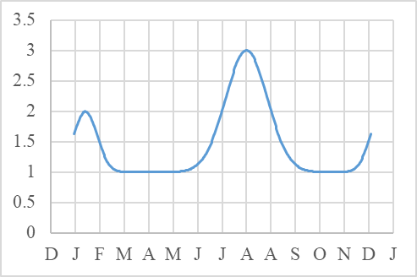
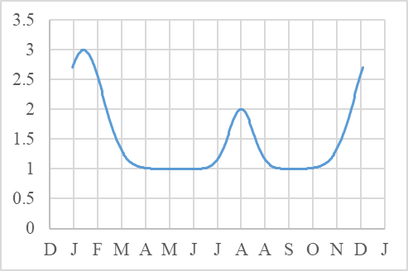
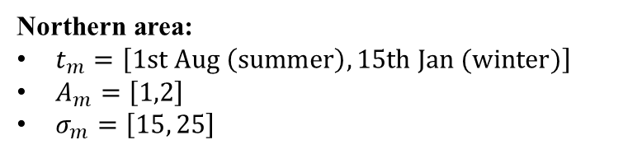
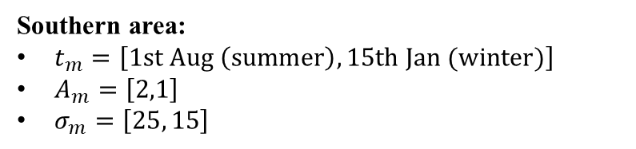
Behavior of $w\left(t\right)$
Southern area:
$t_{m}=\left[1st Aug \left(summer\right), 15th Jan (winter)\right]$
$A_{m}=\left[2,1\right]$
$σ_{m}=\left[25, 15\right]$
Northern area:
$t_{m}=\left[1st Aug \left(summer\right), 15th Jan (winter)\right]$
$A_{m}=\left[1,2\right]$
$σ_{m}=\left[15, 25\right]$
Notes:
In this slide,
I illustrate seasonal curves for the southern and northern area by using RBF-based model.
I placed two center points at specific summer and winter days.
And the amplitude and width were adjusted to represent the intensity and duration of seasonal peaks.
This is how we can moel different seasonality for each location.

Slide 6
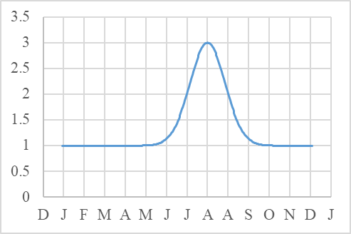
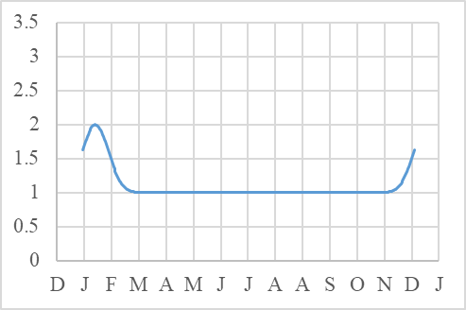
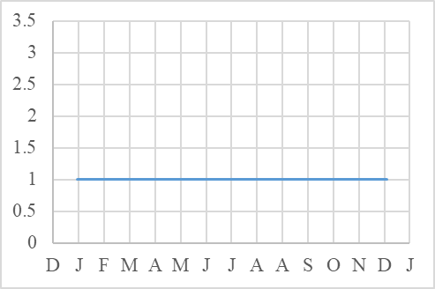
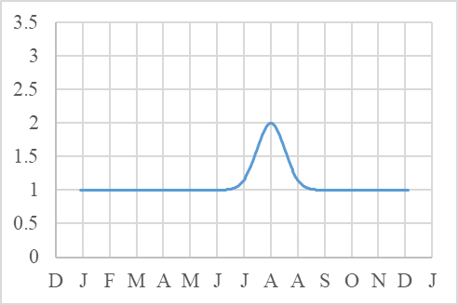
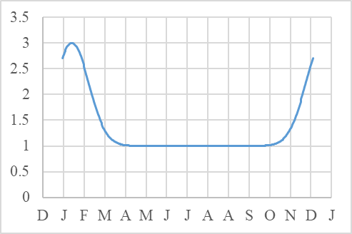
Behavior of $w\left(t\right)$
Southern area: $t_{m}=\left[1st Aug \left(summer\right), 15th Jan (winter)\right],A_{m}=\left[2,1\right],σ_{m}=\left[25, 15\right]$
Both-season
Summer
Winter
No-season
Northern area: $t_{m}=\left[1st Aug \left(summer\right), 15th Jan (winter)\right],A_{m}=\left[1,2\right],σ_{m}=\left[15, 25\right]$
Both-season
Summer
Winter
No-season
Notes:
As well,
Several types of seasonality can be modeled, like this.
It includes both-season, summer-only, winter-only, and no-season patterns.
Then, I simulated one year of demand
using these four types of seasonality for the two locations.

Slide 7
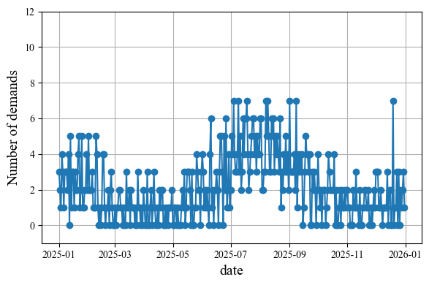
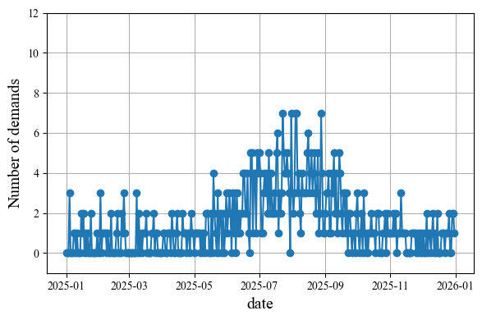
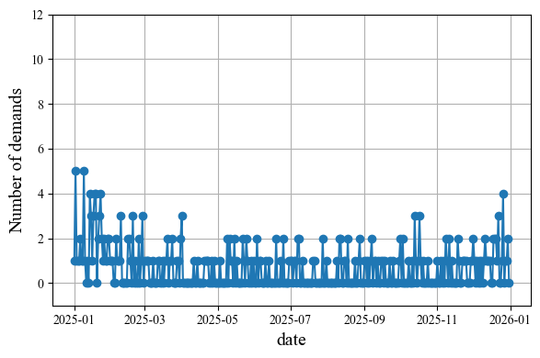
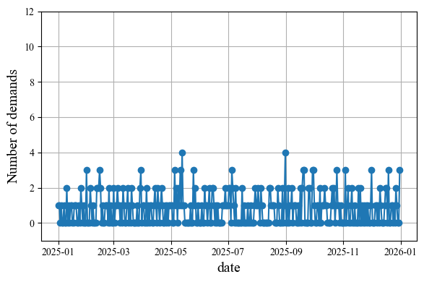
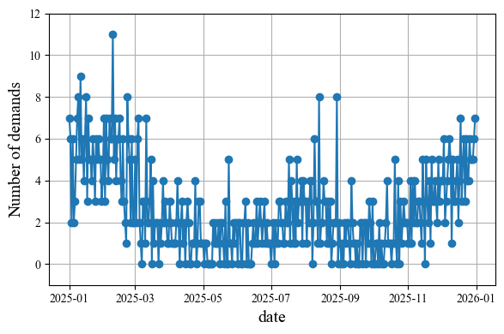
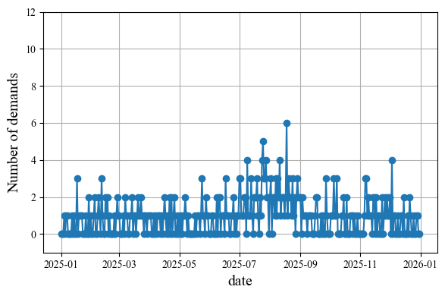
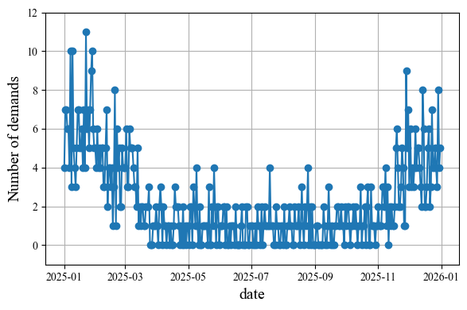
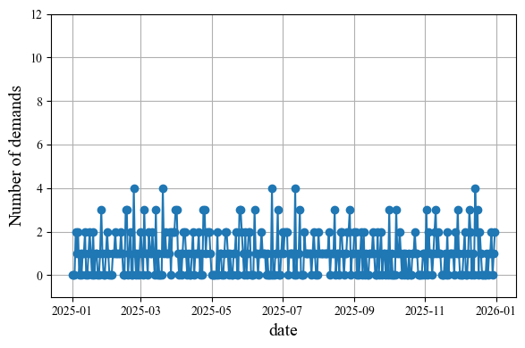
Simulated Demand Data (Daily)
Dealer1 (location: southern area)
Part1 (both-seasons)
Part2 (summer)
Part3 (winter)
Part4 (no-season)
Dealer2 (location: northern area)
Part1 (both-seasons)
Part2 (summer)
Part3 (winter)
Part4 (no-season)
Notes:
This slide shows the simulated daily demand data for each dealer.
Dealer1 is located in the southern(サウザーン) area, and Dealer is in northern(ノーザン) area.
As you can see,
the simulated demand data successfully follow the seasonal patterns defined in the RBF model.

Slide 8
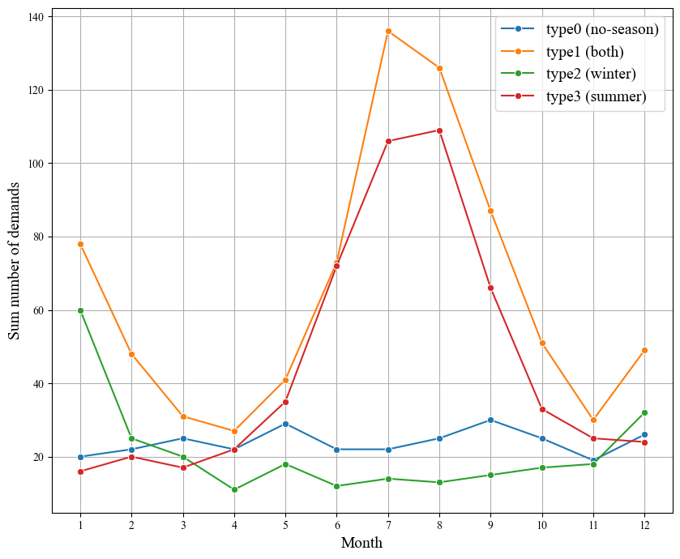
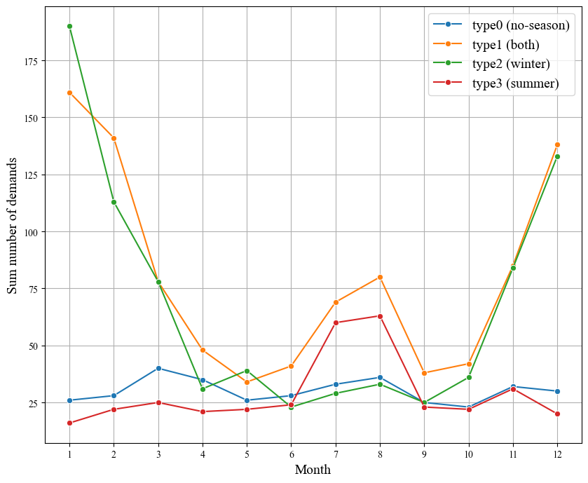
Simulated Demand Data (Monthly)
Dealer1 (location: southern area)
Dealer2 (location: northern area)
Part1 (both)
Part1 (both)
Part2 (summer)
Part2 (summer)
Part3 (winter)
Part3 (winter)
Part4 (no)
Part4 (no)

Slide 9
Demand Prediction
Model: XGBoost
  Trained using 2 years demand data for multiple parts showing different seasonality across all dealers
  Predicts demands for the following year, for each part at each dealer
Target variable: Daily number of demands
Feature datasets: Two types
  Basic features
    Day-of-the-year: sequential day index within a year (1-365)
    Month
    Part ID
    Dealer ID
  Basic + Historical features
    Historical data calculated over past p days: mean, median, standard deviation (std) of demands in the past days
    Zaro-cumulative: number of consecutive days with zero-demand before the current day
    Lag demand: demand values from each of the past n days
Notes:
And I performed demand prediction for the previous simulated data by XGBoost.
Specifically,
I trained model using 2 years demand data for multiple parts showing distinct seasonality across all dealers
And predicts demands for the following year, for each part at each dealer
Namely, The target variable is the daily number of demands.
As the feature datasets, I used 2 types.
The first is the Basic feature set, which includes
the day of the year, month, part ID, and dealer ID.
The second is the Basic plus Historical feature set,
which additionally includes historical data calculated over the past $p$days —
such as mean, standard deviation, and median of demand —
as well as zero-cumulative and lag-based features.
Then, I trained two types of models using these two different feature sets.

Slide 10
Feature Data
time | demand | Part ID | Dealer ID | Day-of-the-year | month | mean | median | std | Zero-cumulative | lag1 | lag2 | …
0 | 0 | Part1 | Dealer1 | 0 | 1 | 0 | 0 | 0 | 0 | 0 | 0
1 | 1 | Part1 | Dealer1 | 1 | 1 | 0 | 0 | 0 | 1 | 0 | 0
2 | 0 | Part1 | Dealer1 | 2 | 1 | 0.5 | 0.5 | 0.25 | 0 | 1 | 0
3 | 2 | Part1 | Dealer1 | 3 | 1 | 0.33 | 0 | 0.15 | 1 | 0 | 1
0 | 0 | Part4 | Dealer2 | 0 | 1 | 0 | 0 | 0 | 0 | 0 | 0
1 | 1 | Part4 | Dealer2 | 1 | 1 | 0 | 0 | 0 | 1 | 0 | 0
2 | 1 | Part4 | Dealer2 | 2 | 1 | 0.5 | 0.5 | 0.25 | 0 | 1 | 0
3 | 1 | Part4 | Dealer2 | 3 | 1 | 0.66 | 1 | 0.15 | 0 | 1 | 1

Slide 11
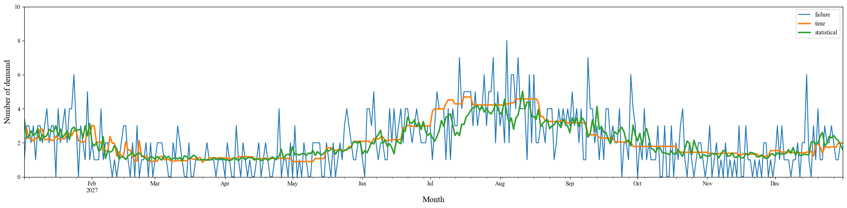
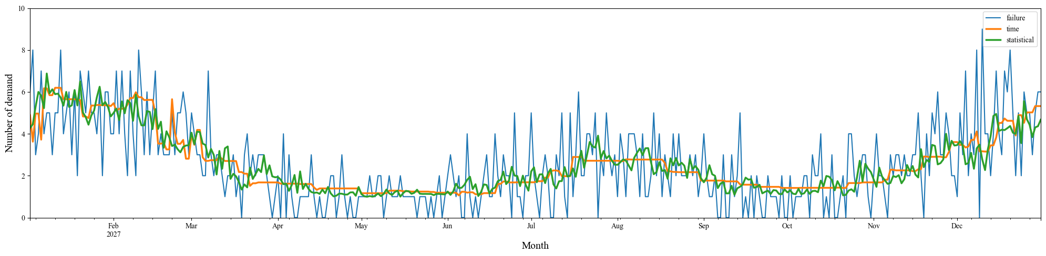
Results (Part1: Both-seasons)
Dealer1 (southern area)
Simulated demand
Basic features
Basic +
Historical features
Dealer2 (northern area)
Simulated demand
Basic features
Basic +
Historical features
Notes:
This slide shows the prediction results for parts with both-season seasonality in each dealer.
Blue curve shows the simulated demand.
Orange curve shows predicted demand by the model using the basic features.
Green curve shows prediction by the model using the basic + historical features.
As you can see, both models successfully captured seasonal trend.
And, compared to the basic-feature model,
the model with historical features shows daily variations.

Slide 12
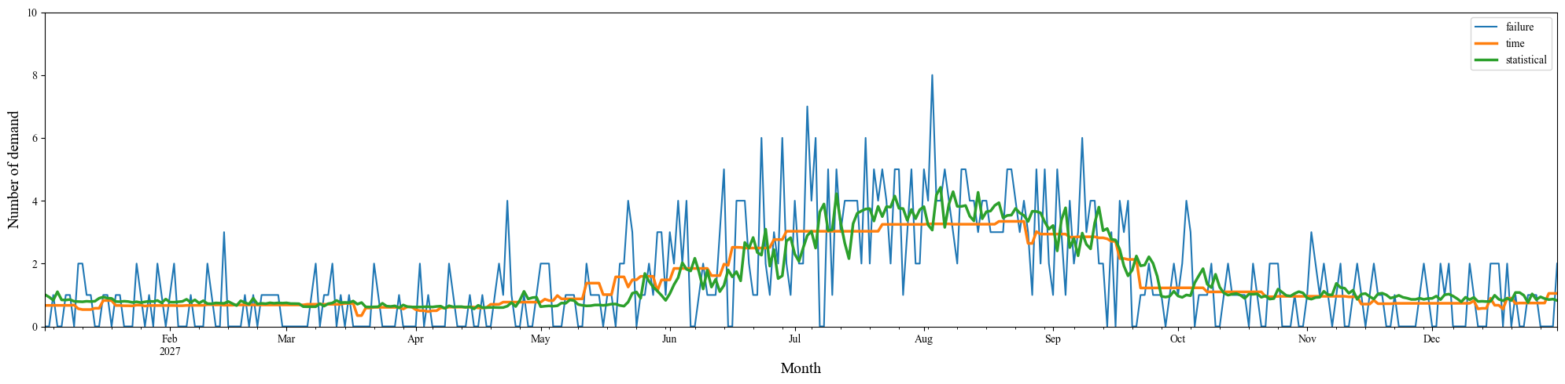
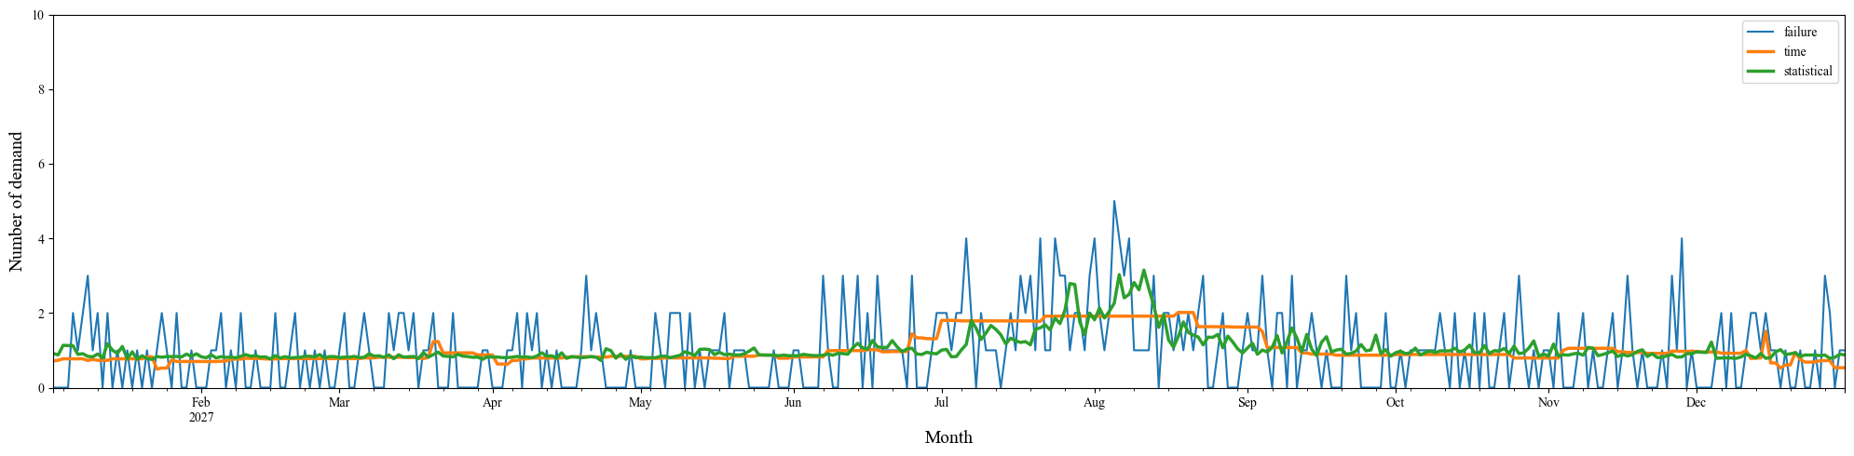
Results (Part2: summer)
Dealer1 (southern area)
Simulated demand
Basic features
Basic +
Historical features
Dealer2 (northern area)
Simulated demand
Basic features
Basic +
Historical features
Notes:
This slide shows the prediction results for parts with summer seasonality in each dealer.
Similarly, both models successfully captured the seasonal trend.

Slide 13
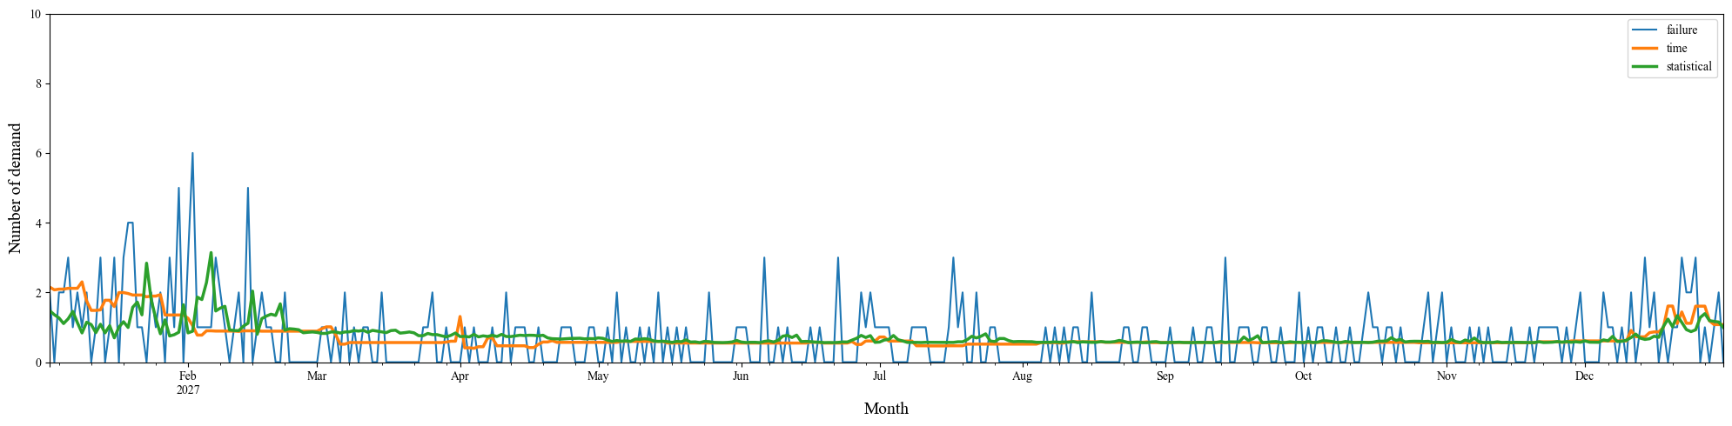
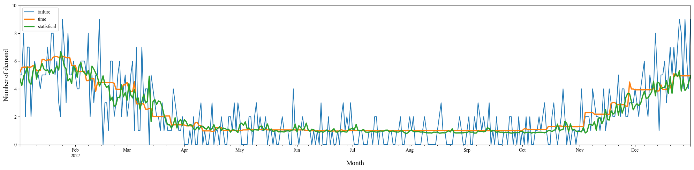
Results (Part3: winter)
Dealer1 (southern area)
Simulated demand
Basic features
Basic +
Historical features
Dealer2 (northern area)
Simulated demand
Basic features
Basic +
Historical features
Notes:
This slide shows the prediction results for parts with winter seasonality in each dealer.
Similarly, both models successfully captured the seasonal trend.

Slide 14
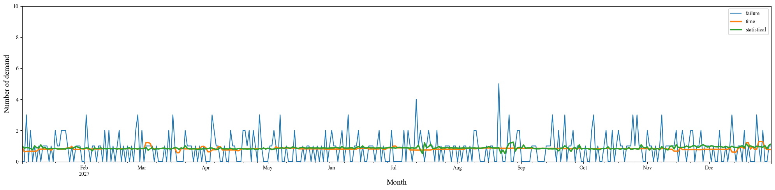
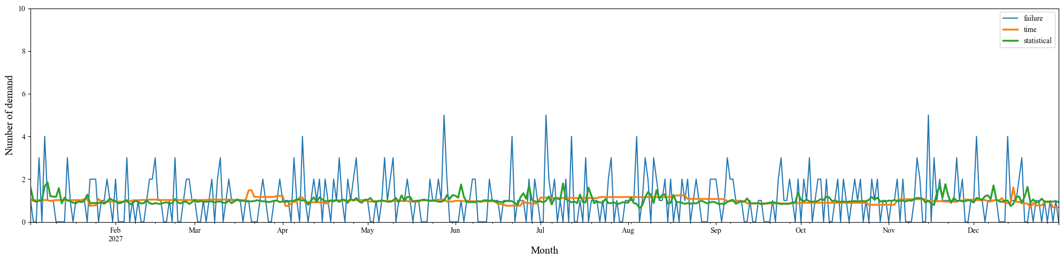
Results (Part4: No-season)
Dealer1 (southern area)
Simulated demand
Basic features
Basic +
Historical features
Dealer2 (northern area)
Simulated demand
Basic features
Basic +
Historical features
Notes:
This slide shows the prediction results for parts with no-season seasonality in each dealer.
both models produce almost constant predictions throughout the yea

Slide 15
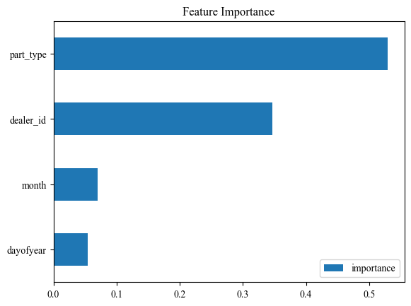
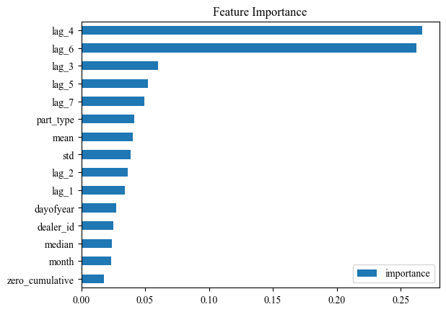
Feature Importance
Basic feature
Basic + Historical features

Slide 16
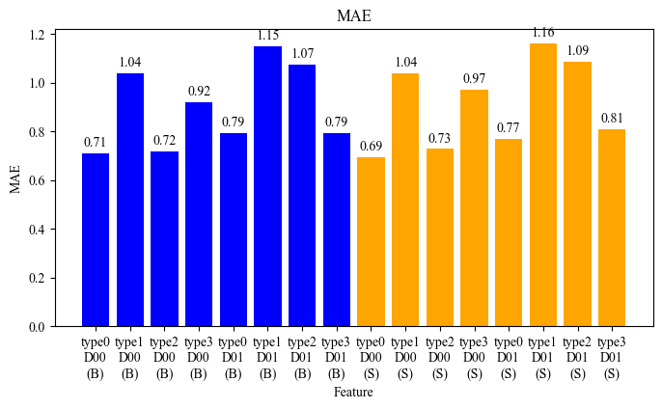
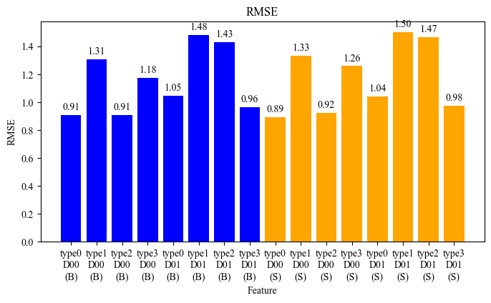
Evaluation metrics
MAE
RSME
Basic feature
Basic + Historical feature
Basic feature
Basic + Historical feature

Slide 17
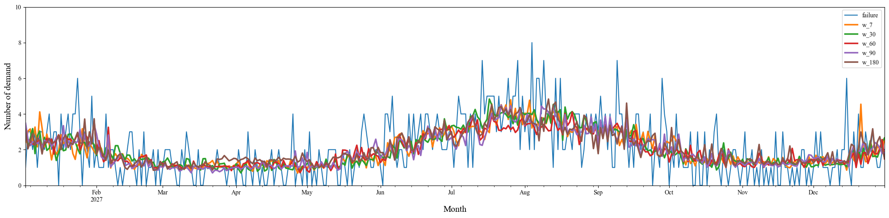
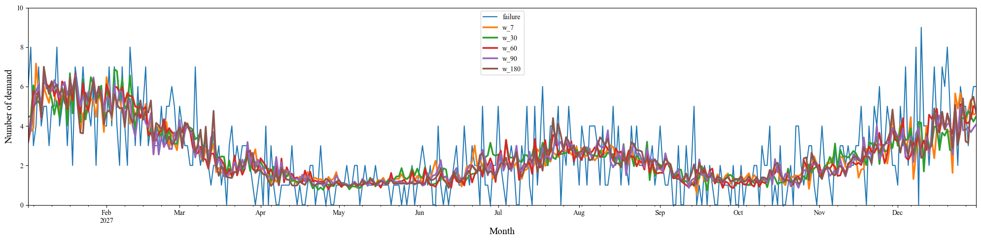
Parameter Survey 1 (past p days)
Dealer1 (southern area)
Dealer2 (northern area)

Slide 18
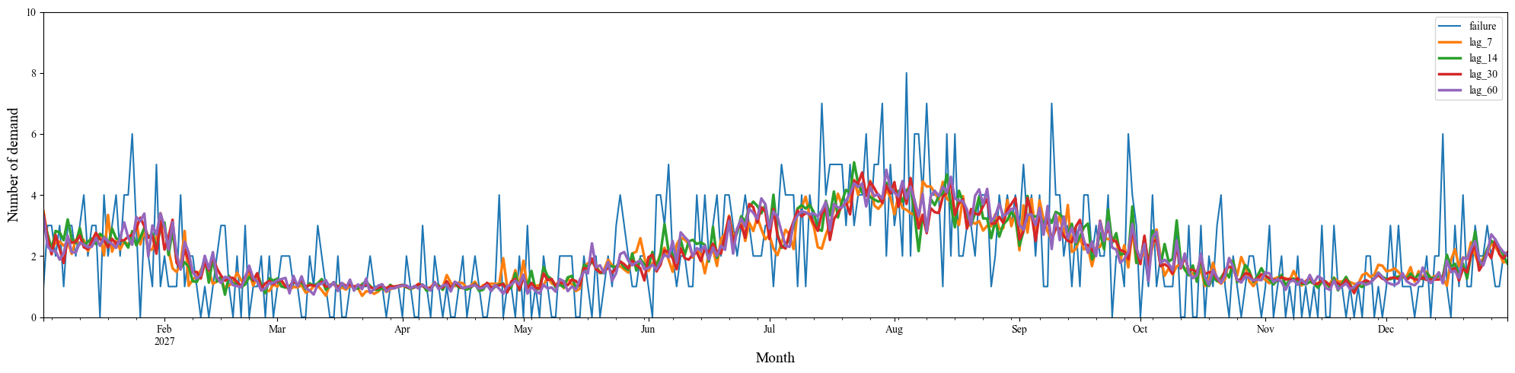
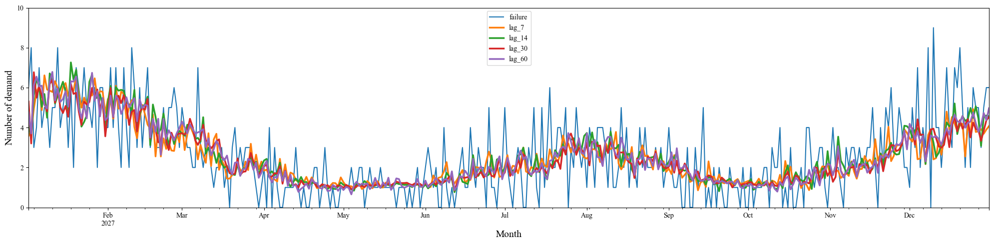
Parameter Survey 2 (lag n days)
Dealer1 (southern area)
Dealer2 (northern area)

