Slide 1
Progress Report
2025-11-12

Slide 2
Contents
Confirm the seasonality behavior of demand in several failure models.
Integrate demand simulator, forecasting model and cost simulator.
Evaluate forecasting model via the integrated simulator.
Notes:
First, I define the location of each dealer.
Next, I introduce a new function that reproduces seasonal demand patterns.
Finally, I predict the simulated demand using the XGBoost model.

Slide 3
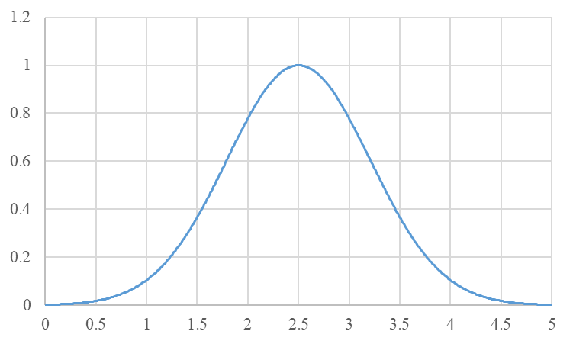
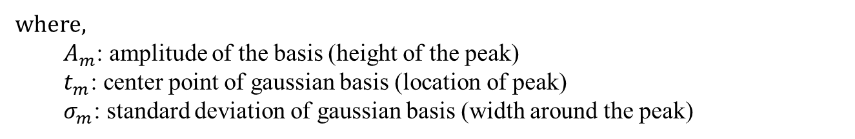
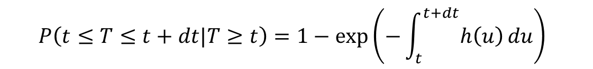

Seasonality
Hazard function-based formulation:
$$P\left(t≤T≤t+dt|T≥t\right)=1−exp\left(−\int_{t}^{t+dt}{h\left(u\right)}du\right)⁡$$
$$h\left(t\right)=w(t)h_{0}(t)$$
  where $w(t)$ represents the seasonal coefficient corresponding to each day or month.
$w\left(t\right)$: Sum of radial basis function (RBF)
$$w\left(t\right)=\sum_{m=1}^{M}{A_{m}exp⁡(−\frac{{\left\|t_{m}−t\right\|}^{2}}{σ_{m}^{2}})}=\sum_{m=1}^{M}{A_{m}exp⁡(−\frac{{\left\|max⁡(\left|t_{m}−t\right|,T−\left|t_{m}−t\right|\right\|}^{2}}{σ_{m}^{2}})}$$
where,
  $A_{m}$: amplitude of the basis (height of the peak)
  $t_{m}$: center point of gaussian basis (location of peak)
  $σ_{m}$: standard deviation of gaussian basis (width around the peak)
Notes:
This slide shows how to model seasonality.
As discussed in the previous meeting,
we multiply h(t) by the seasonal coefficient corresponding to each day or month.
And use the sum of RBF for the coefficient.

Slide 4
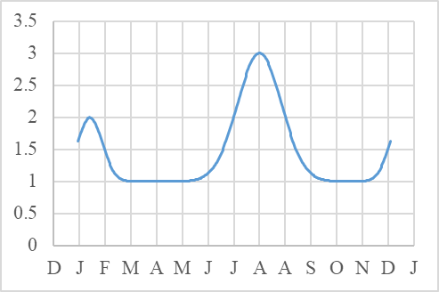
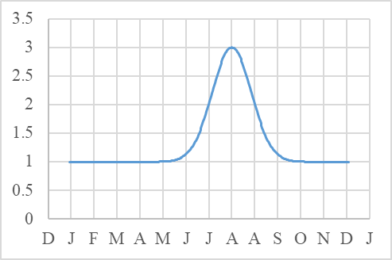
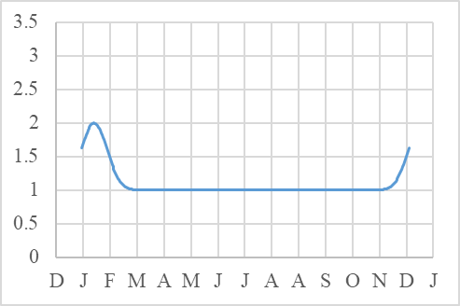
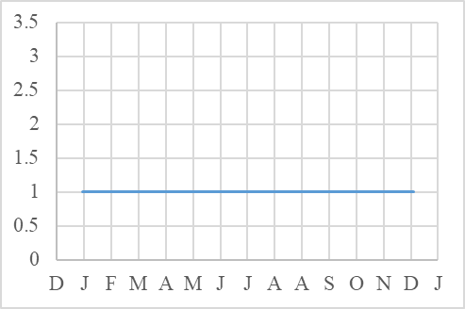
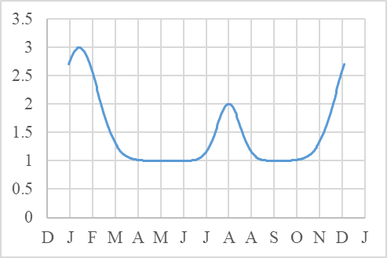
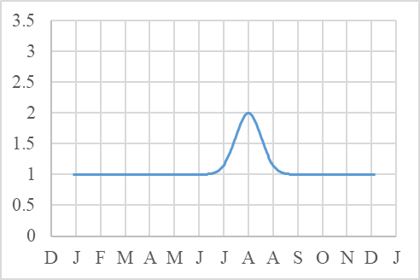
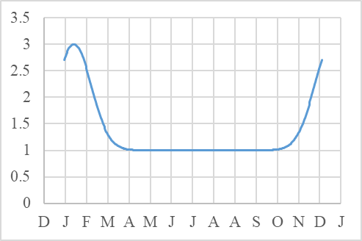
Behavior of $w\left(t\right)$
Southern area: $t_{m}=\left[1st Aug \left(summer\right), 15th Jan (winter)\right],A_{m}=\left[2,1\right],σ_{m}=\left[25, 15\right]$
Both-season
Summer
Winter
No-season
Northern area: $t_{m}=\left[1st Aug \left(summer\right), 15th Jan (winter)\right],A_{m}=\left[1,2\right],σ_{m}=\left[15, 25\right]$
Both-season
Summer
Winter
No-season
Notes:
By using this coefficients, we can model various types of seasonal patterns,
for example, both-season, summer-only, winter-only, and no-season patterns.
Then, I simulated one year of demand
using these seasonality model for the two locations
and several types of failure models.
Specifically, I used
Weibull model, Exponential model, log-logistic model and gompertz model.

Slide 5
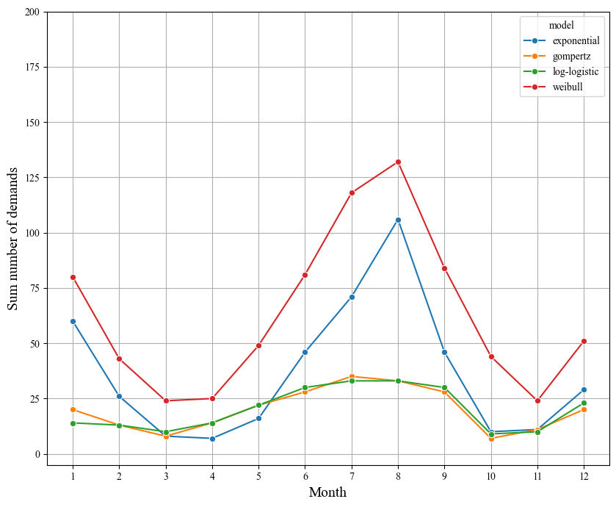
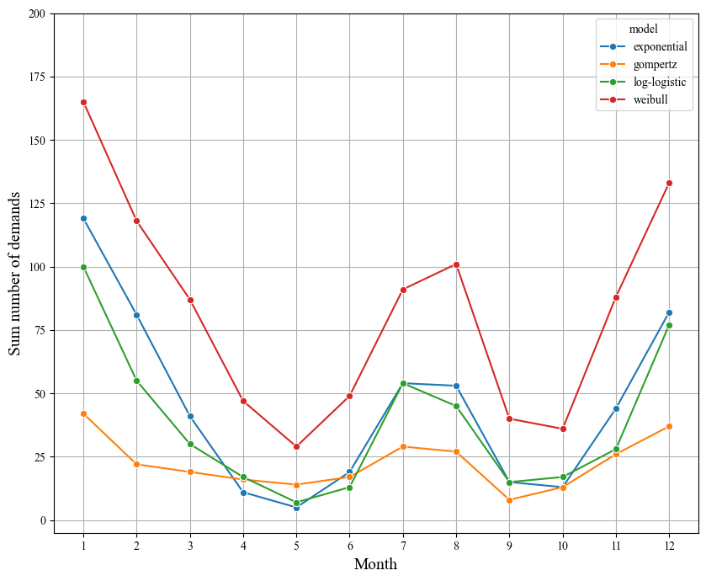
Simulated demand using several models
Part1: Both-seasons parts
Dealer1 (southern area)
Dealer2 (northern area)
exponential
exponential
weibull
weibull
log-logistic
log-logistic
gompertz
gompertz
Notes:
This slide shows the simulated demand of both-seasons part in each dealer location.
The vertical axis indicates the number of demands per month.
Blue, red, green and orange curves indicate
demand by exponential, Weibull, log-logistic and gompertz models.
As you can see, All curves show clear seasonal change.
And the degree and shape of seasonality differ across models.
Why? This is because,
- It depends on distinct hazard rate behavior of each failure model.
-> Log-logistic and Gompertz models show slower growth in failure probability.

Slide 6
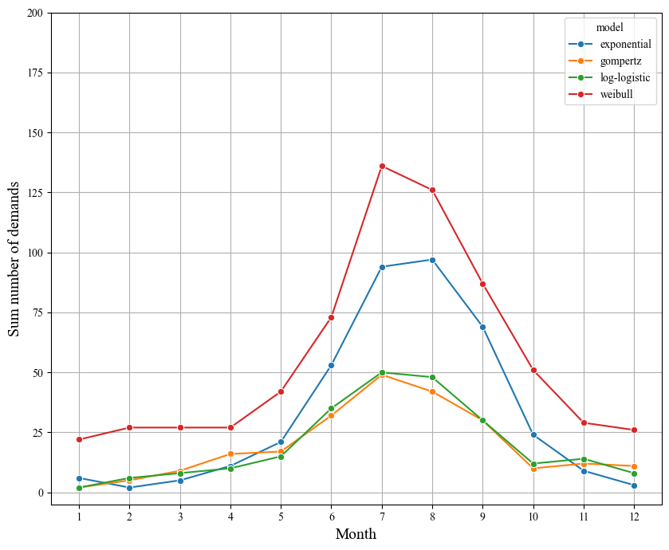
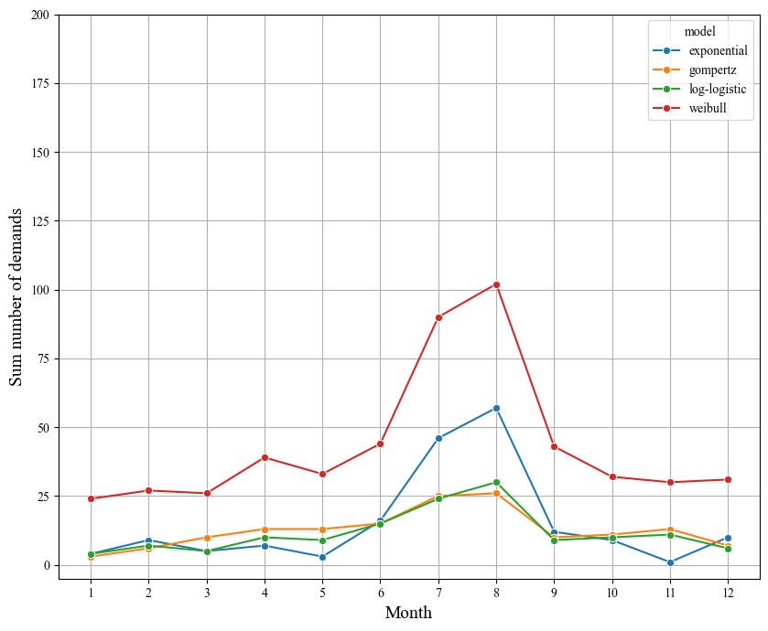
Simulated demand using several models
Part2: Summer-season parts
Dealer1 (southern area)
Dealer2 (northern area)
exponential
exponential
weibull
weibull
log-logistic
log-logistic
gompertz
gompertz
Notes:
These graph shows demand curves of summer-season part.
All curves show clear seasonal change.

Slide 7
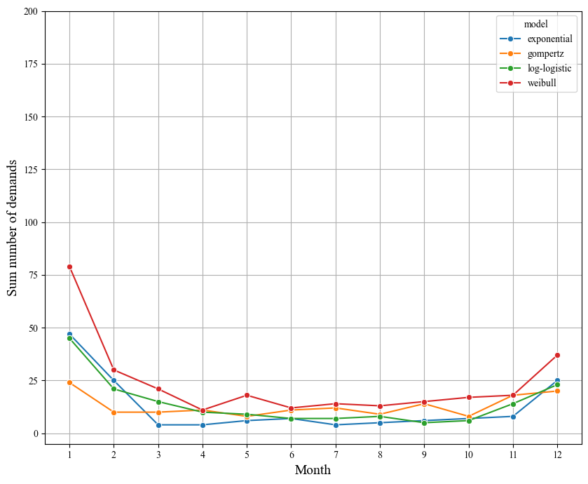
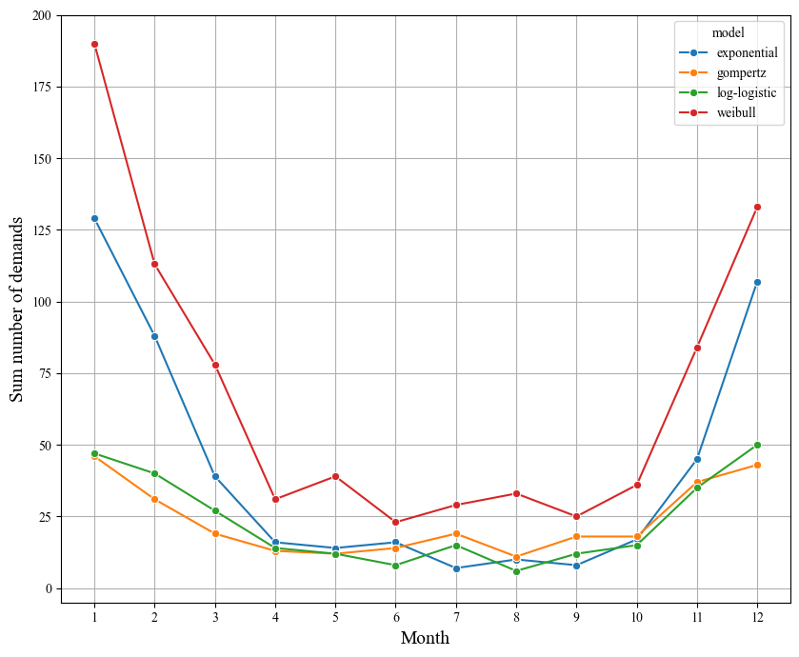
Simulated demand using several models
Part3: Winter-season parts
Dealer1 (southern area)
Dealer2 (northern area)
exponential
exponential
weibull
weibull
log-logistic
log-logistic
gompertz
gompertz
Notes:
These graph shows demand curves of winter-season part.
All curves show clear seasonal change.

Slide 8
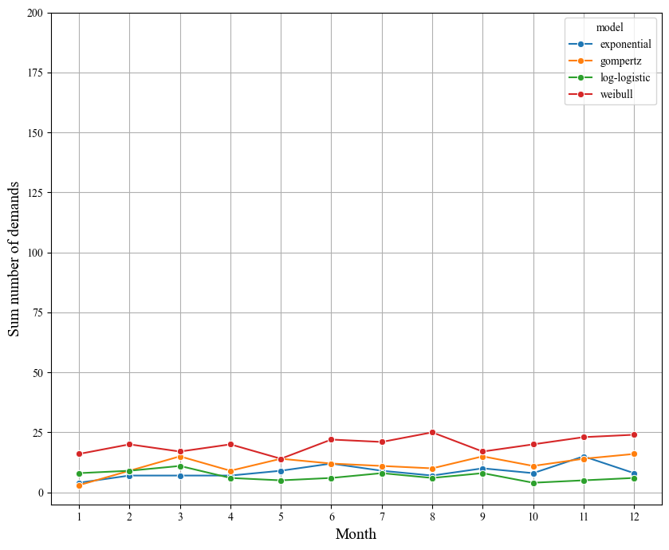
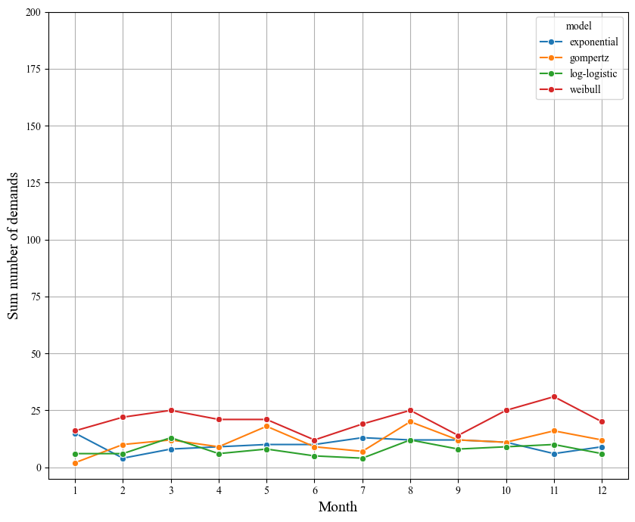
Simulated demand using several models
Part4: No-season parts
Dealer1 (southern area)
Dealer2 (northern area)
exponential
exponential
weibull
weibull
log-logistic
log-logistic
gompertz
gompertz
Notes:
These graph shows demand curves of no-season part.
All curves don’t have significant peaks.
For now, I could have confirmed that
each failure model displays seasonal patterns in the demand, using RBF model.

Slide 9
Demand Prediction
Model: XGBoost
  Trained using 2 years demand data for multiple parts showing different seasonality across all dealers
  Predicts demands for the following year, for each part at each dealer
Target variable: Daily number of demands
Feature datasets: Two types
  Basic features
    Day-of-the-year: sequential day index within a year (1-365)
    Month
    Part ID
    Dealer ID
  Basic + Historical features
    Historical data calculated over past p days: mean, median, standard deviation (std) of demands in the past days
    Zaro-cumulative: number of consecutive days with zero-demand before the current day
    Lag demand: demand values from each of the past n days
Notes:
And I performed demand prediction for the previous simulated data by XGBoost.
Specifically,
I trained model using 2 years demand data for multiple parts showing distinct seasonality across all dealers
And predicts demands for the following year, for each part at each dealer
Namely, The target variable is the daily number of demands.
As the feature datasets, I used 2 types.
The first is the Basic feature set, which includes
the day of the year, month, part ID, and dealer ID.
The second is the Basic plus Historical feature set,
which additionally includes historical data calculated over the past $p$days —
such as mean, standard deviation, and median of demand —
as well as zero-cumulative and lag-based features.
Then, I trained two types of models using these two different feature sets.

Slide 10
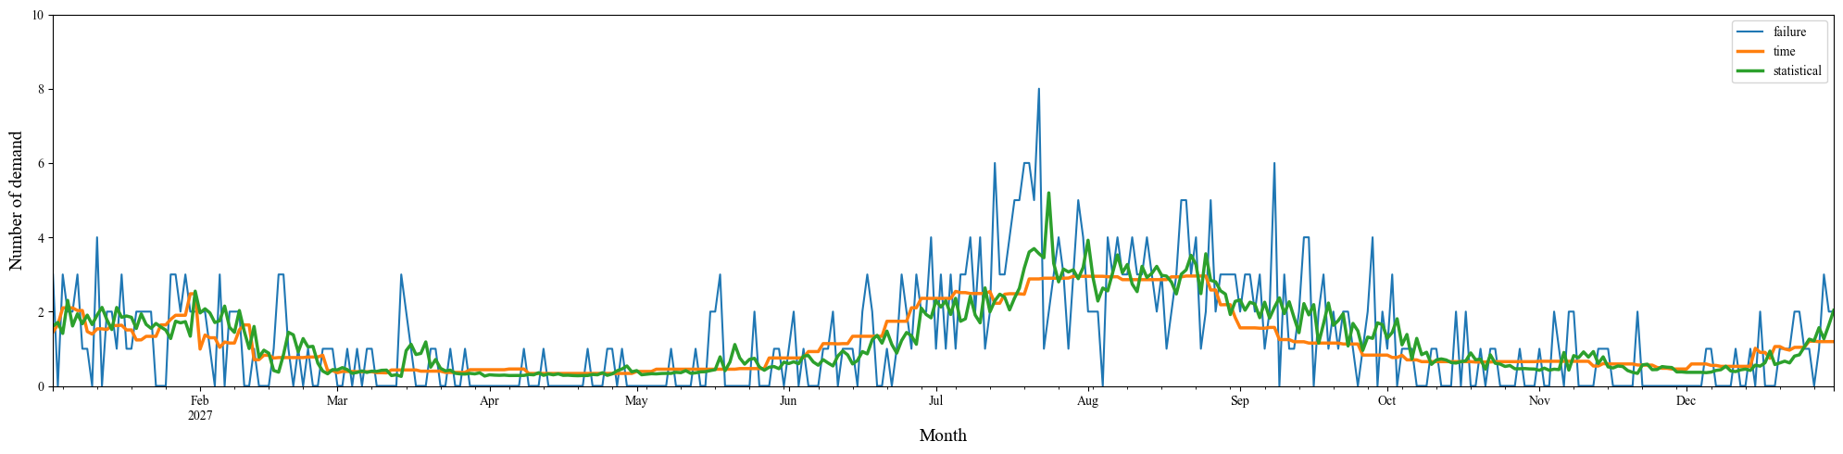
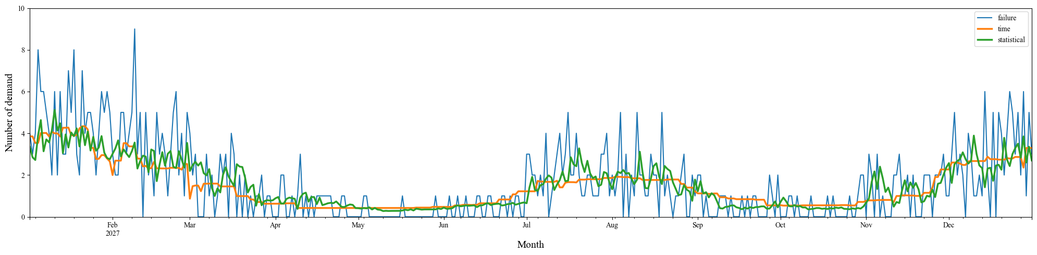
Results (Exponential model, Part1: Both-seasons)
Dealer1 (southern area)
Simulated demand
Basic features
Basic +
Historical features
Dealer2 (northern area)
Simulated demand
Basic features
Basic +
Historical features
Notes:
This slide shows the prediction results for parts with both-season seasonality in each dealer.
Blue curve shows the simulated demand.
Orange curve shows predicted demand by the model using the basic features.
Green curve shows prediction by the model using the basic + historical features.
As you can see, both models successfully captured seasonal trend.
And, compared to the basic-feature model,
the model with historical features shows daily variations.

Slide 11
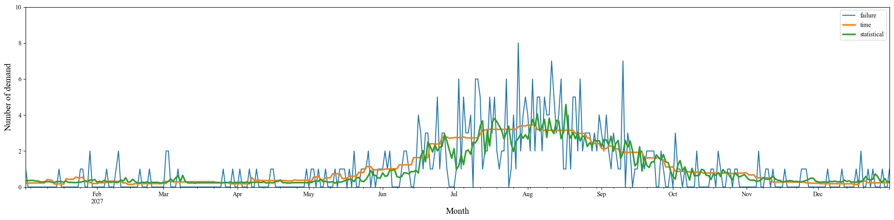
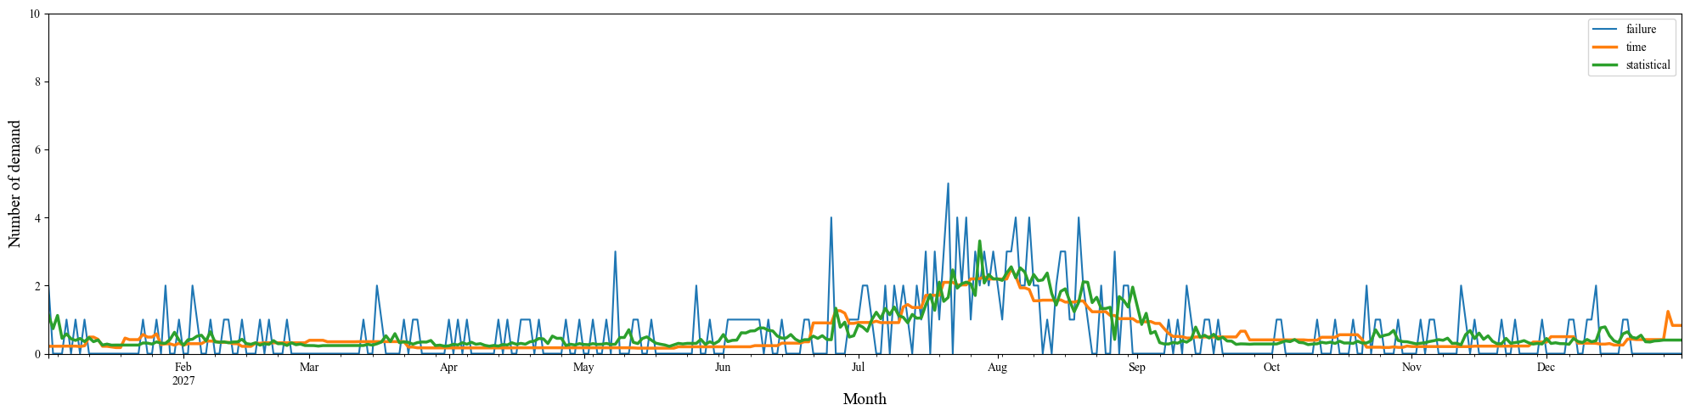
Results (Exponential model, Part2: summer)
Dealer1 (southern area)
Simulated demand
Basic features
Basic +
Historical features
Dealer2 (northern area)
Simulated demand
Basic features
Basic +
Historical features
Notes:
This slide shows the prediction results for parts with summer seasonality in each dealer.
Similarly, both models successfully captured the seasonal trend.

Slide 12
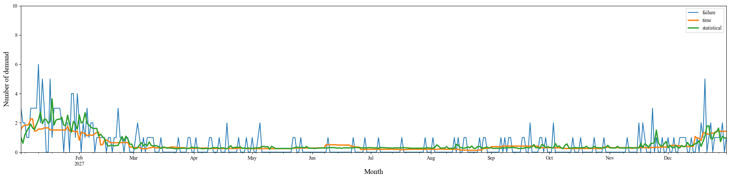
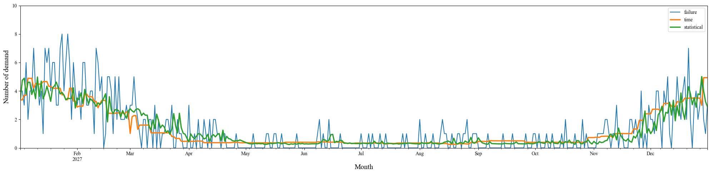
Results (Exponential model, Part3: winter)
Dealer1 (southern area)
Simulated demand
Basic features
Basic +
Historical features
Dealer2 (northern area)
Simulated demand
Basic features
Basic +
Historical features
Notes:
This slide shows the prediction results for parts with winter seasonality in each dealer.
Similarly, both models successfully captured the seasonal trend.

Slide 13
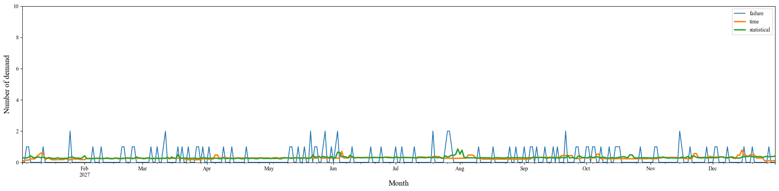
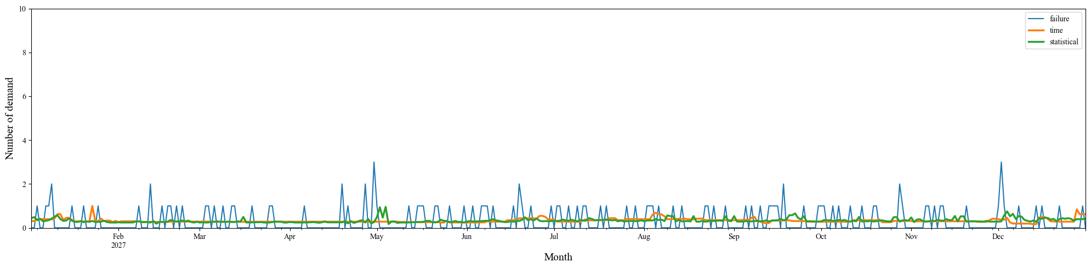
Results (Exponential model, Part4: No-season)
Dealer1 (southern area)
Simulated demand
Basic features
Basic +
Historical features
Dealer2 (northern area)
Simulated demand
Basic features
Basic +
Historical features
Notes:
This slide shows the prediction results for parts with no-season seasonality in each dealer.
both models produce almost constant predictions throughout the yea

Slide 14
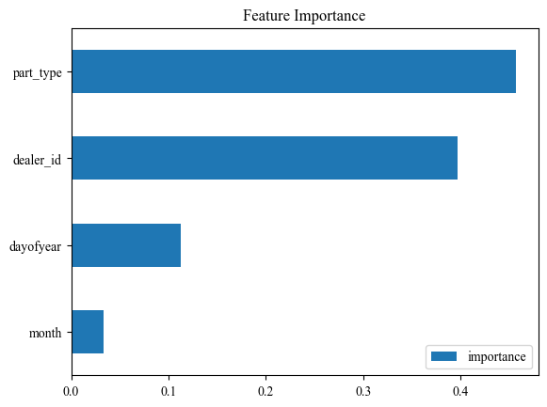
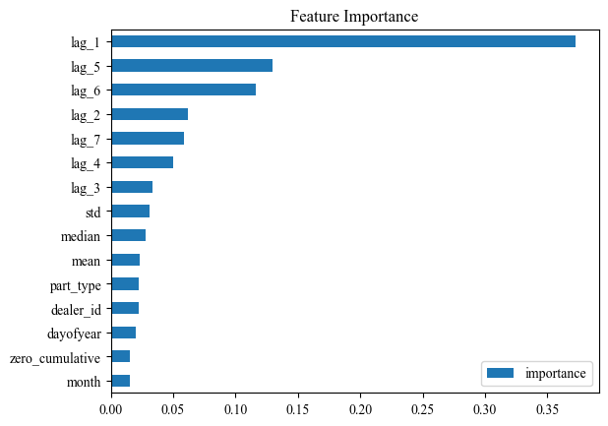
Feature Importance (Exponential model)
Basic feature
Basic + Historical features

Slide 15
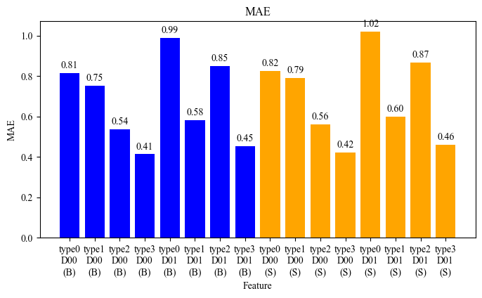
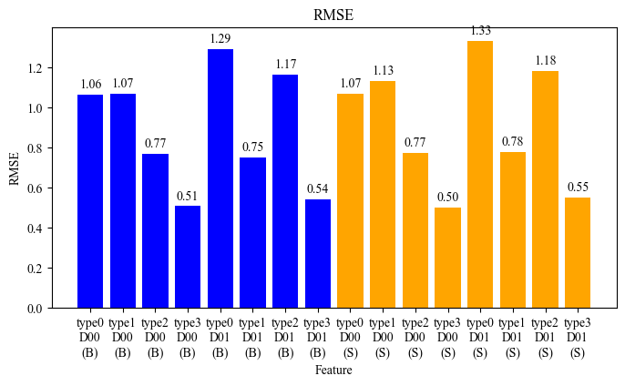
Evaluation metrics (Exponential model)
MAE
RSME
Type
0
(both)
D00
sou.
Type
1
(sum)
D00
sou.
Type
2
(nor)
D00
sou.
Type
3
(no)
D00
sou.
Type
0
(both)
D01
nor.
Type
1
(sum)
D01
nor.
Type
2
(nor)
D01
nor.
Type
3
(no)
D01
nor.
Type
0
(both)
D00
sou.
Type
1
(sum)
D00
sou.
Type
2
(nor)
D00
sou.
Type
3
(no)
D00
sou.
Type
0
(both)
D01
nor.
Type
1
(sum)
D01
nor.
Type
2
(nor)
D01
nor.
Type
3
(no)
D01
nor.
Type
0
(both)
D00
sou.
Type
1
(sum)
D00
sou.
Type
2
(nor)
D00
sou.
Type
3
(no)
D00
sou.
Type
0
(both)
D01
nor.
Type
1
(sum)
D01
nor.
Type
2
(nor)
D01
nor.
Type
3
(no)
D01
nor.
Type
0
(both)
D00
sou.
Type
1
(sum)
D00
sou.
Type
2
(nor)
D00
sou.
Type
3
(no)
D00
sou.
Type
0
(both)
D01
nor.
Type
1
(sum)
D01
nor.
Type
2
(nor)
D01
nor.
Type
3
(no)
D01
nor.
Basic feature
Basic + Historical feature
Basic feature
Basic + Historical feature

Slide 16
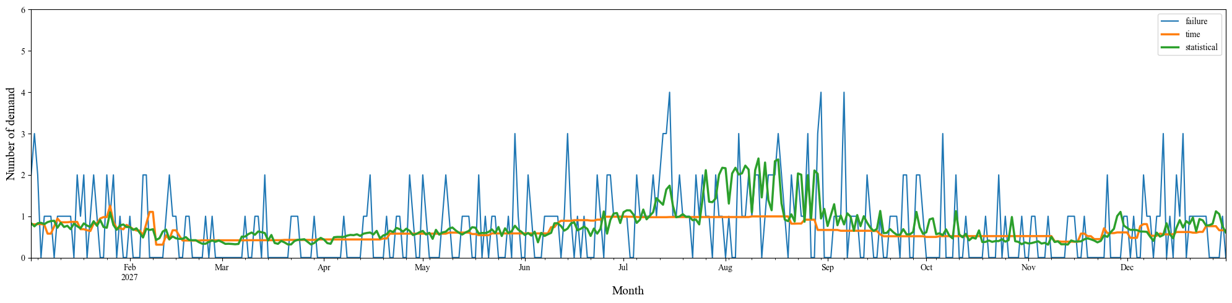
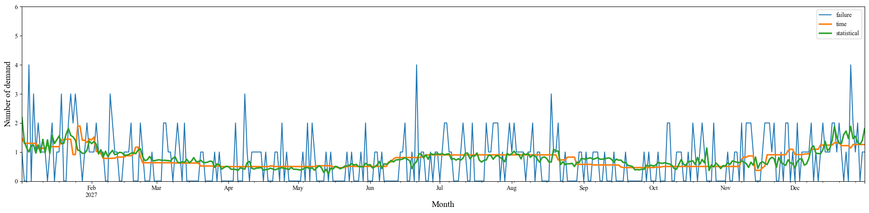
Results (gompertz model, Part1: Both-seasons)
Dealer1 (southern area)
Simulated demand
Basic features
Basic +
Historical features
Dealer2 (northern area)
Simulated demand
Basic features
Basic +
Historical features
Notes:
This slide shows the prediction results for parts with both-season seasonality in each dealer.
Blue curve shows the simulated demand.
Orange curve shows predicted demand by the model using the basic features.
Green curve shows prediction by the model using the basic + historical features.
As you can see, both models successfully captured seasonal trend.
And, compared to the basic-feature model,
the model with historical features shows daily variations.

Slide 17
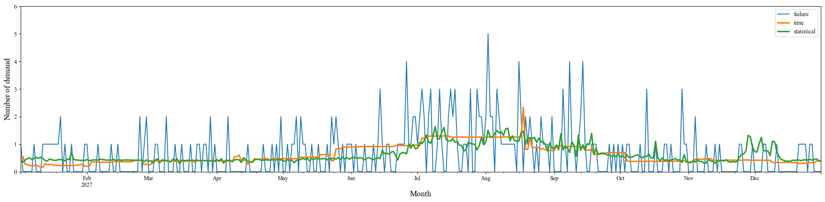
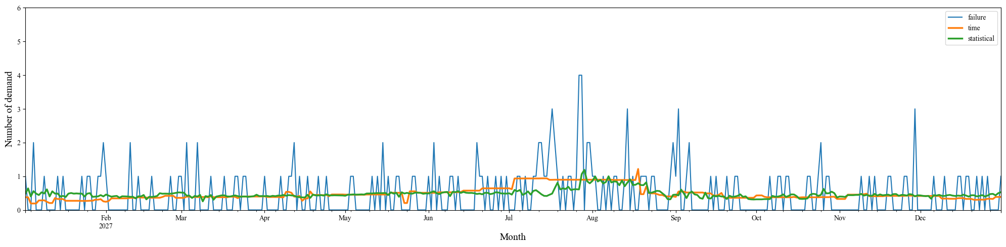
Results (gompertz model, Part2: summer)
Dealer1 (southern area)
Simulated demand
Basic features
Basic +
Historical features
Dealer2 (northern area)
Simulated demand
Basic features
Basic +
Historical features
Notes:
This slide shows the prediction results for parts with summer seasonality in each dealer.
Similarly, both models successfully captured the seasonal trend.

Slide 18
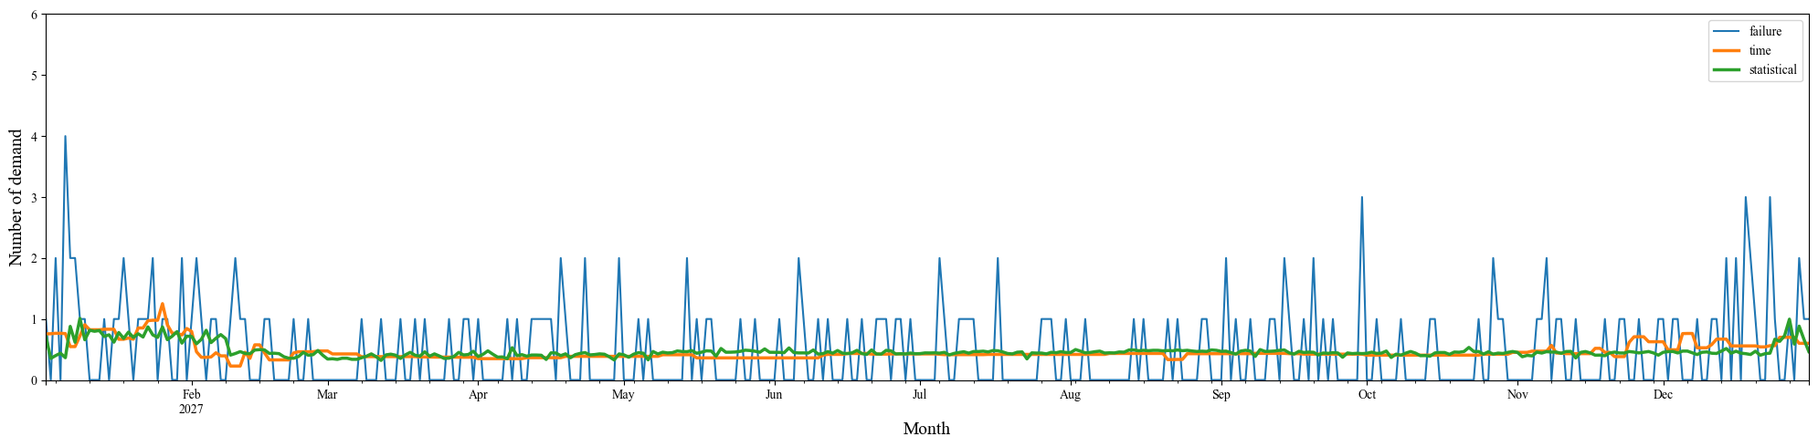
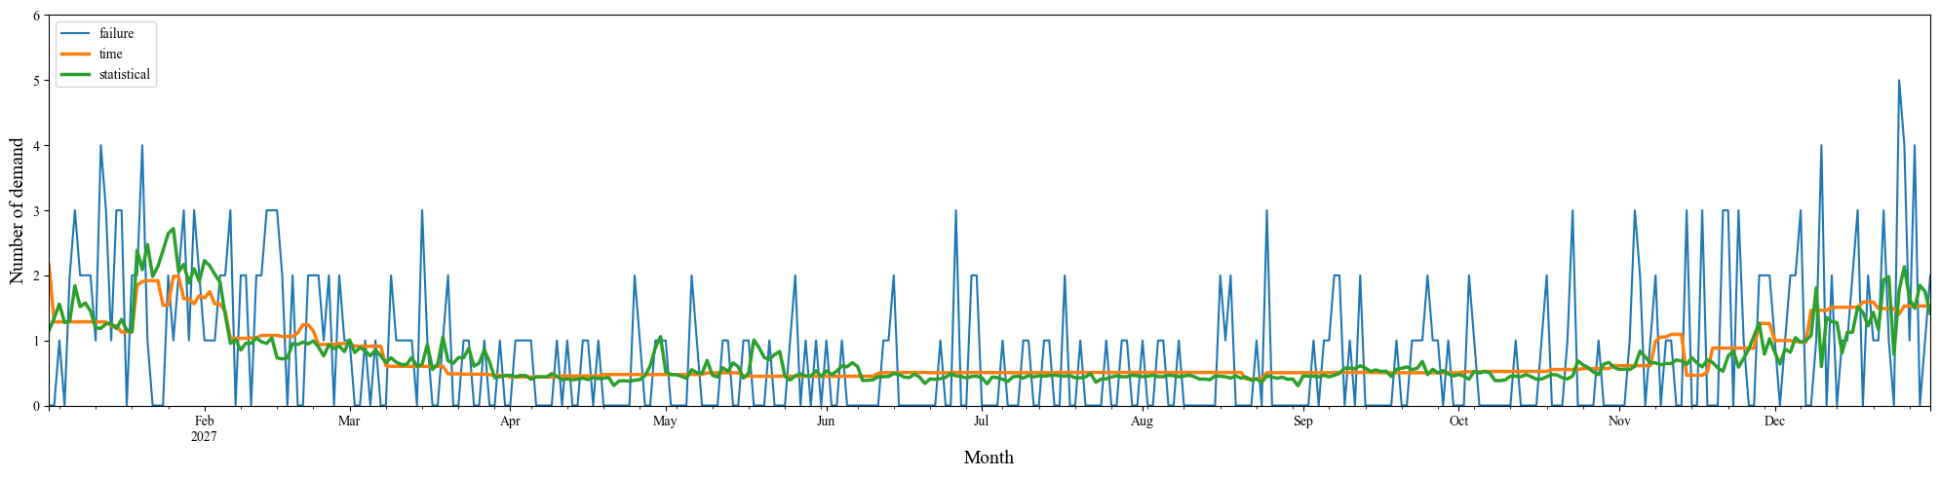
Results (gompertz model, Part3: winter)
Dealer1 (southern area)
Simulated demand
Basic features
Basic +
Historical features
Dealer2 (northern area)
Simulated demand
Basic features
Basic +
Historical features
Notes:
This slide shows the prediction results for parts with winter seasonality in each dealer.
Similarly, both models successfully captured the seasonal trend.

Slide 19
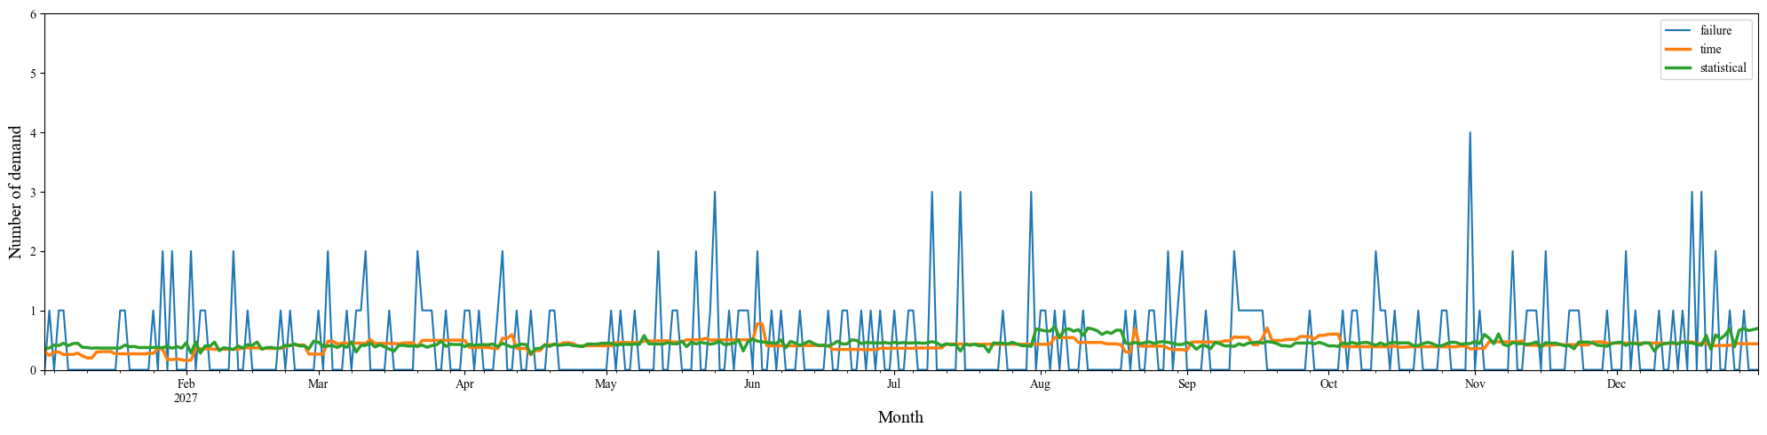
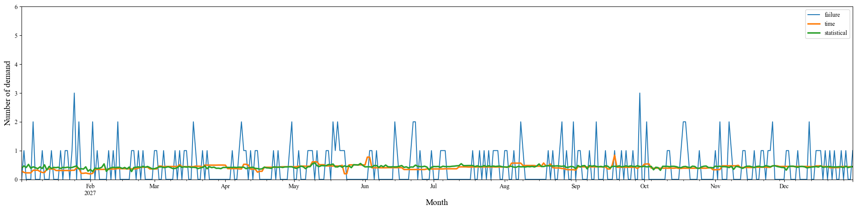
Results (gompertz model, Part4: No-season)
Dealer1 (southern area)
Simulated demand
Basic features
Basic +
Historical features
Dealer2 (northern area)
Simulated demand
Basic features
Basic +
Historical features
Notes:
This slide shows the prediction results for parts with no-season seasonality in each dealer.
both models produce almost constant predictions throughout the yea

Slide 20
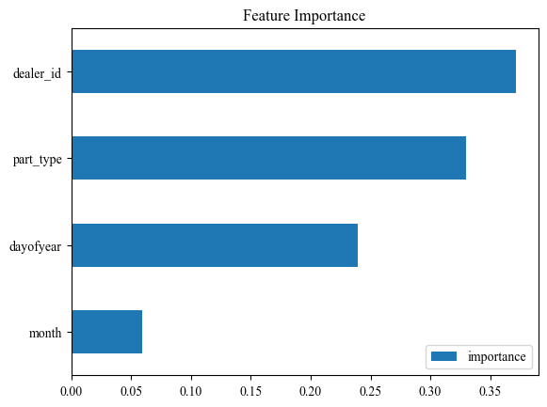
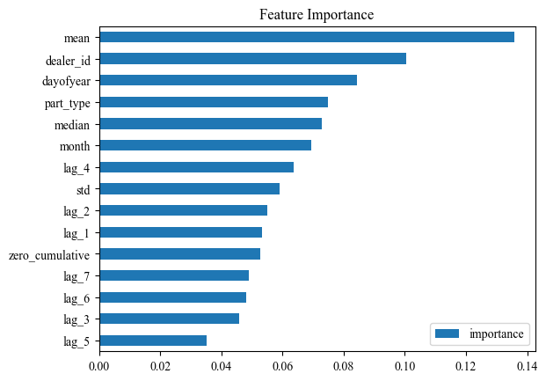
Feature Importance (gompertz model)
Basic feature
Basic + Historical features

Slide 21
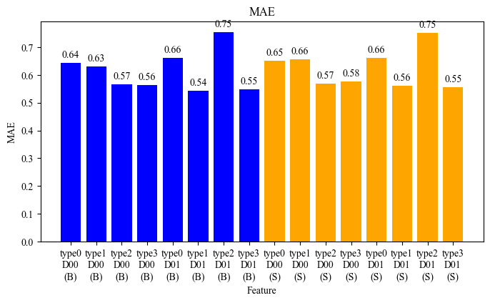
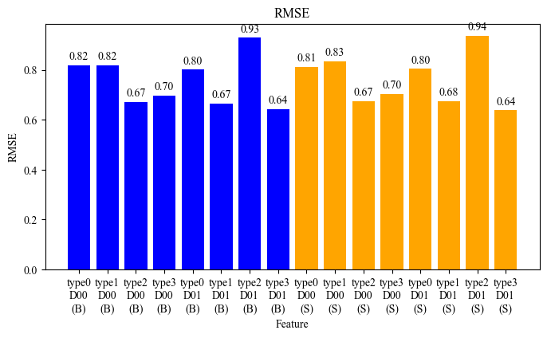
Evaluation metrics (gompertz model)
MAE
RSME
Type
0
(both)
D00
sou.
Type
1
(sum)
D00
sou.
Type
2
(nor)
D00
sou.
Type
3
(no)
D00
sou.
Type
0
(both)
D01
nor.
Type
1
(sum)
D01
nor.
Type
2
(nor)
D01
nor.
Type
3
(no)
D01
nor.
Type
0
(both)
D00
sou.
Type
1
(sum)
D00
sou.
Type
2
(nor)
D00
sou.
Type
3
(no)
D00
sou.
Type
0
(both)
D01
nor.
Type
1
(sum)
D01
nor.
Type
2
(nor)
D01
nor.
Type
3
(no)
D01
nor.
Type
0
(both)
D00
sou.
Type
1
(sum)
D00
sou.
Type
2
(nor)
D00
sou.
Type
3
(no)
D00
sou.
Type
0
(both)
D01
nor.
Type
1
(sum)
D01
nor.
Type
2
(nor)
D01
nor.
Type
3
(no)
D01
nor.
Type
0
(both)
D00
sou.
Type
1
(sum)
D00
sou.
Type
2
(nor)
D00
sou.
Type
3
(no)
D00
sou.
Type
0
(both)
D01
nor.
Type
1
(sum)
D01
nor.
Type
2
(nor)
D01
nor.
Type
3
(no)
D01
nor.
Basic feature
Basic + Historical feature
Basic feature
Basic + Historical feature

Slide 22
Integration of Simulators
Overview
Demand Simulator
  Generates synthetic demand data for truck spare parts.
Forecasting Model
  Predicts future demand based on the historical demand data.
Cost Simulator
  Simulates inventory management based on actual and forecasted demand.
  Calculate key performance indicators (KPIs).
Demand
Simulator
Forecasting
model
Cost
Simulator
Demand
data
Forecasted /
actual
demand
Notes:
Next about the integration of simulators.
I integrated demand simulator, forecasting model and cost simulator.
The process flow is like this:
1: Demand simulator
Generates synthetic demand data for truck spare parts.
Provides these data to the forecasting model
2: Forecasting model
Predicts future demand
passes the forecasted and actual (ground-truth) demand data to Cost simulator
3: Cost simulator
Simulates inventory management based on actual and forecasted demand.
Calculates KPIs.
From the next, I will explain the validation of this overall simulator.
Specifically, I will talk about the detailed settings of each component.

Slide 23
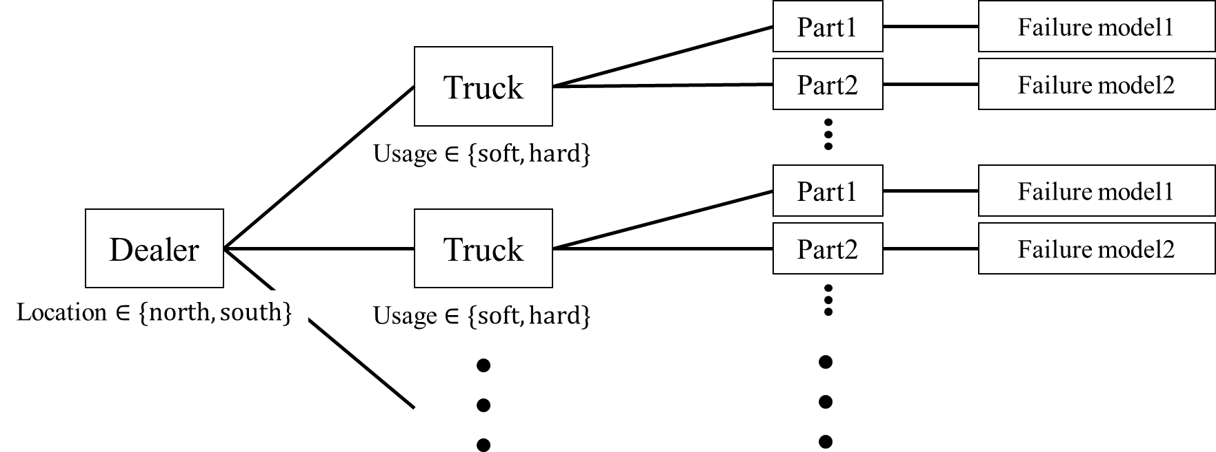
1. Demand Simulator
Diagram
Generates 3 years of demand data for each part type held by each dealer, based on failure models.
No. of dealers = 10
No. of trucks = 50
No. of parts = 100
Notes:
First, about the demand simulator.
In the validation,
It generates 3 years of demand data for each part type held by each dealer, based on failure models.
I define 10 dealers.
Attach 50 trucks to each dealer.
Attach 100 types of parts to each part
And each part has a failure model,
which is selected from 4 different models and commonly shared among parts of same types.

Slide 24
2. Forecasting Model
Train - Predict
Trained using 2 years of demand data, for all parts across all dealers
Predict demands for the following year of each part in each dealer
Model
XGBoost, Random Forest, SVR (2 types of feature dataset: basic and historical)
ARIMA
Noise data (pseudo forecasting data): adds Gaussian noise (sigma=1.0, 2.5, 5.0) to the actual demand.
Prediction Accuracy Evaluation
MAE: the mean of MAE for all parts across all dealers.
RSME: the mean of RSME for all parts across all dealers.
Notes:
Next about forecasting model.
I trained model using 2 years of demand data, for all parts across all dealers.
And predicted demands for the following year of each part in each dealer
As models, I used
3 machine learning models: XGBoost, Random Forest, SVR
I used 2 types of feature datasets which I mentioned at the previous meeting.
1: Basic feature set (time)
2: Basic plus Historical feature set (statistical data such as the mean of demands in the past days)
I used ARIMA
I used noise data as pseudo forecasting data.
> Its generated by adding gaussian noise to the actual demand.
> I made three types of noise data with distinct standard deviations.
I evaluated prediction accuracy by using MAE and RSME.
I use the mean value of each metric for all parts across all dealers.
Because there are a lot of prediction results and

Slide 25
3. Cost Simulator
Overview
Performs inventory management such as shipment, inventory checking, and replenishment, according to actual (simulated) and forecasted demand over one year.
Calculates KPIs:
  Total Cost - the total cost of inventory management for all parts
  Service Level - the mean of the immediate service levels for all parts
Policy: standard inventory policy
Parameters (common to all parts)
  Lead time: 14 days standard, 2 days urgent, Initial stock: 100 units
  Holding costs: rate 15% annually, 0.13 SEK part value
  Ordering cost: 100 SEK per regular order (165 SEK per urgent order)
  Transporting costs: 2 SEK per kilogram, 0.001 kg per unit
  …
Notes:
Finally, about cost simulator.
It performs inventory management such as shipment, inventory checking, and replenishment, according to actual (simulated) and forecasted demand over one year.
Finally, it calculates KPIs:
Total Cost - the total cost of inventory management for all parts
Service Level - the mean of the immediate service levels for all parts
All parameters are set to common value among all parts.
I followed the documents about the cost simulator.
I will proceed to the validation result of this overall simulator.

Slide 26
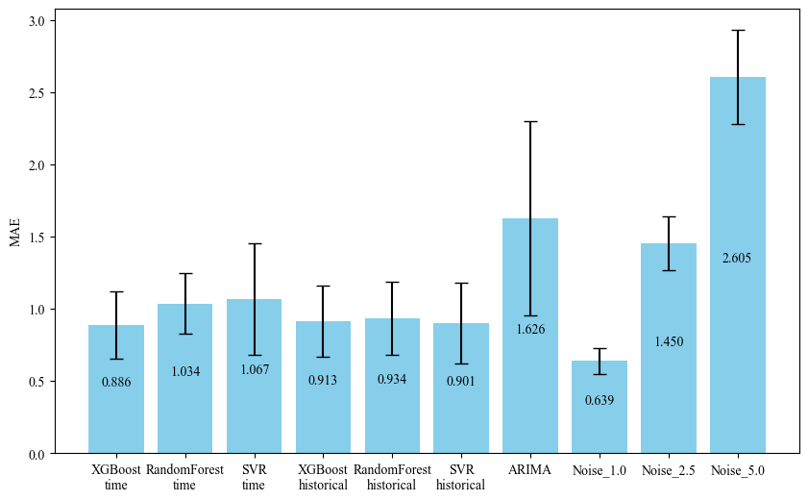



Demand Prediction Accuracy: MAE
MAE
XGBoost
(basic)
R. Forest
(basic)
SVR
(basic)
XGBoost
(hist.)
R. Forest
(hist.)
SVR
(hist.)
ARIMA
noise
($σ=1.0$)
noise
($σ=2.5$)
noise
($σ=5.0$)
Notes:
This slide shows the prediction results MAE in each forecasting model and noise data.

Slide 27
Demand Prediction Accuracy: MAE
MAE
1st
3rd
2nd
XGBoost
(basic)
R. Forest
(basic)
SVR
(basic)
XGBoost
(hist.)
R. Forest
(hist.)
SVR
(hist.)
ARIMA
noise
($σ=1.0$)
noise
($σ=2.5$)
noise
($σ=5.0$)
Notes:
As you can see,
XGBoost with basic feature achieved the best accuracy.
Following that, SVR and XGBoost with historical feature show better accuracy.
About noise data,
The accuracy get worse as the standard deviation increase.
Especially, MAE increases by a corresponding multiple as the noise level

Slide 28
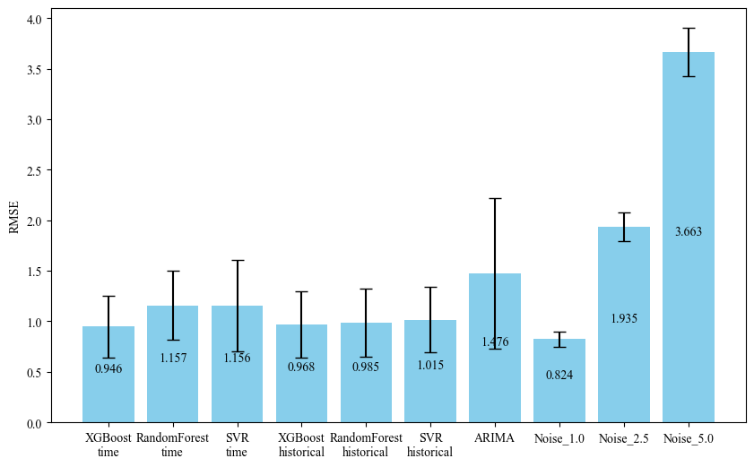
Demand Prediction Accuracy : RMSE
RMSE
XGBoost
(basic)
R. Forest
(basic)
SVR
(basic)
XGBoost
(hist.)
R. Forest
(hist.)
SVR
(hist.)
ARIMA
noise
($σ=1.0$)
noise
($σ=2.5$)
noise
($σ=5.0$)
Notes:
This slide shows the prediction results RSME in each forecasting model and noise data.

Slide 29
Demand Prediction Accuracy : RMSE
RMSE
2nd
3rd
1st
XGBoost
(basic)
R. Forest
(basic)
SVR
(basic)
XGBoost
(hist.)
R. Forest
(hist.)
SVR
(hist.)
ARIMA
noise
($σ=1.0$)
noise
($σ=2.5$)
noise
($σ=5.0$)
Notes:
As you can see,
XGBoost with basic feature achieved the best accuracy.
Following that, SVR and XGBoost with historical feature show better accuracy.
About noise data,
The accuracy get worse as the standard deviation increase.
Especially, MAE increases by a corresponding multiple as the noise level.

Slide 30
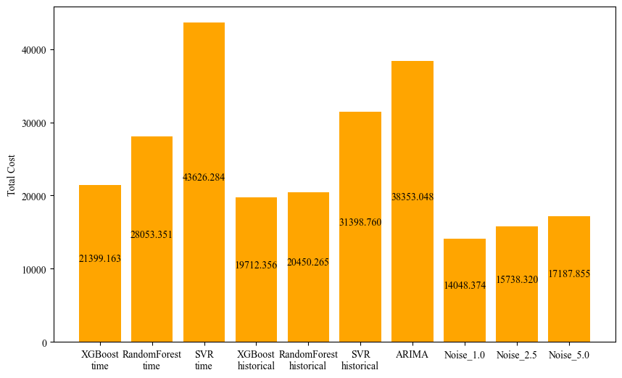
KPI: Total Cost
Total cost
XGBoost
(basic)
R. Forest
(basic)
SVR
(basic)
XGBoost
(hist.)
R. Forest
(hist.)
SVR
(hist.)
ARIMA
noise
($σ=1.0$)
noise
($σ=2.5$)
noise
($σ=5.0$)
Notes:
This slide shows the KPIs calculated by cost simulator
using forecated demand made by each and noise data.

Slide 31

KPI: Total Cost
3rd
Total cost
1st
2nd
XGBoost
(basic)
R. Forest
(basic)
SVR
(basic)
XGBoost
(hist.)
R. Forest
(hist.)
SVR
(hist.)
ARIMA
noise
($σ=1.0$)
noise
($σ=2.5$)
noise
($σ=5.0$)
Notes:
As you can see, in terms of Total cost,
the model with the best prediction accuracy — XGBoost (basic features) — is placed third.
Instead, XGBoost and SVR with historical feature show are placed first and second.
About noise data,
The accuracy get larger as the standard deviation increase.
But, it didn’t significantly increase like MAE.

Slide 32
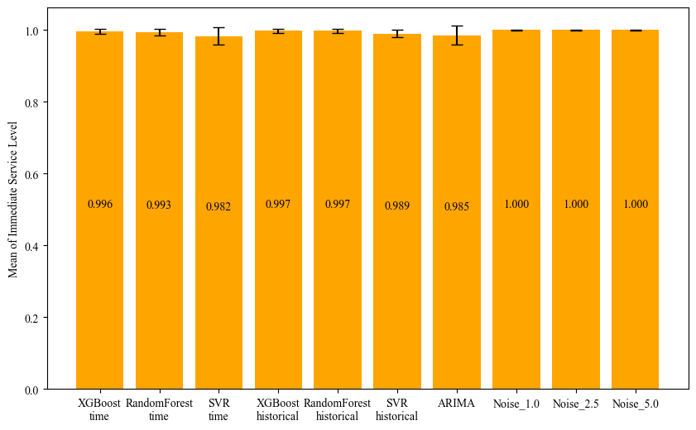
KPI: Service Level
Service level
XGBoost
(basic)
R. Forest
(basic)
SVR
(basic)
XGBoost
(hist.)
R. Forest
(hist.)
SVR
(hist.)
ARIMA
noise
($σ=1.0$)
noise
($σ=2.5$)
noise
($σ=5.0$)
Notes:
This slide shows the service level calculated by cost simulator
using forecated demand made by each and noise data.

Slide 33
KPI: Service Level
3rd
1st
2nd
Service level
XGBoost
(basic)
R. Forest
(basic)
SVR
(basic)
XGBoost
(hist.)
R. Forest
(hist.)
SVR
(hist.)
ARIMA
noise
($σ=1.0$)
noise
($σ=2.5$)
noise
($σ=5.0$)
Notes:
As you can see, the ranking is same as the total cost.
About noise data,
The service level didn’t change if the standard deviation increase.

Slide 34
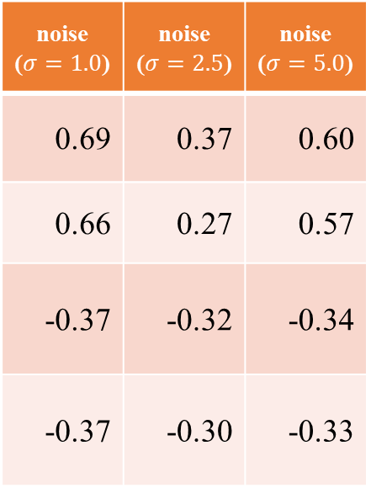
Result: Correlation Coefficient
 | XGBoost (basic) | R. Forest (basic) | SVR (basic) | XGBoost (hist.) | R. Forest (hist.) | SVR (hist.) | ARIMA | Max | Min
MAE vs. Total cost | 0.33 | 0.51 | 0.07 | 0.38 | 0.49 | 0.12 | 0.09 | 0.51 | 0.07
RMSE vs. Total cost | 0.34 | 0.58 | 0.15 | 0.38 | 0.49 | 0.12 | 0.25 | 0.58 | 0.12
MAE vs. Service level | 0.04 | -0.26 | 0.21 | -0.06 | -0.02 | 0.35 | 0.08 | 0.35 | -0.26
RMSE vs. Service level | 0.04 | -0.33 | 0.12 | -0.06 | -0.03 | 0.34 | -0.05 | 0.34 | -0.33
noise ($σ=1.0$) | noise ($σ=2.5$) | noise ($σ=5.0$)
0.69 | 0.37 | 0.60
0.66 | 0.27 | 0.57
-0.37 | -0.32 | -0.34
-0.37 | -0.30 | -0.33
Notes:
This slide shows the correlation coefficient between prediction accuracy metrics and kpis in each model.
In all comparisons, no strong relationship is observed．

Slide 35
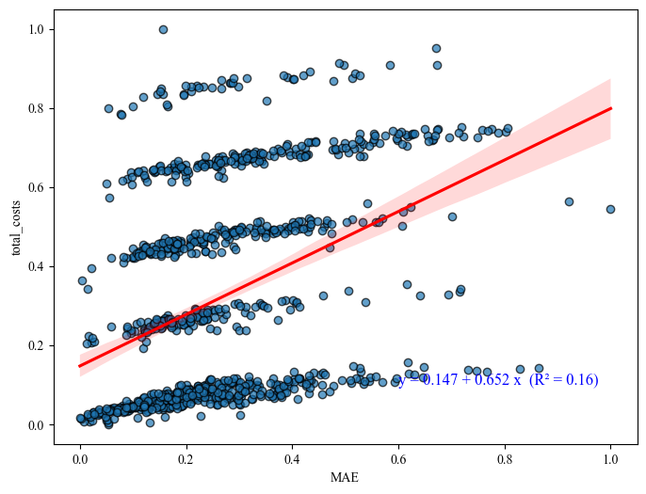
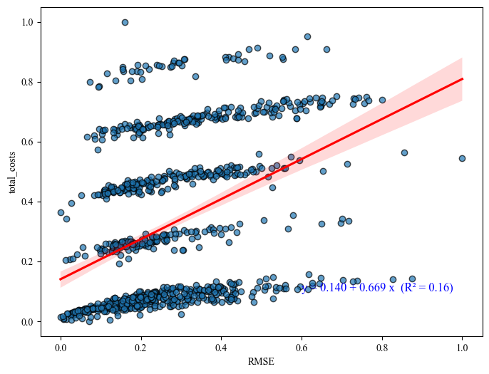
Total Cost vs. MAE, RMSE (XGBoost)
Total cost
Total cost
MAE
RMSE
Notes:
This slide shows the scatter plot of Total Cost versus MAE and RMSE for the XGBoost model.
The red line shows the linear regression result between 2 metrics.
There is no linear relationships.

Slide 36


Service Level vs. MAE, RMSE (XGBoost)
Service Level
Service Level
MAE
RMSE

Slide 37
The Paper Concept for IDA2026
Overview – Practical Forecast Model Evaluation in Inventory Management
Research Question:
  Forecasting model selection, or evaluation, generally relies on prediction accuracy metrics such as MAE and RMSE. However, these metrics do not necessarily reflect the operational impact in inventory management.
  There is no established relationship between prediction accuracy metrics and operational KPIs.
  What is the adequate metric for evaluating or selecting the models in a real operational context?
Objective:
  To reveal the relationship, or gap, between conventional metrics and operational KPIs.
  To demonstrate that KPIs can serve as practical evaluation metrics for models.
Framework
Demand Simulator - generate synthetic demand data.
ML model - predict future demand.
Cost Simulator -

