Slide 1
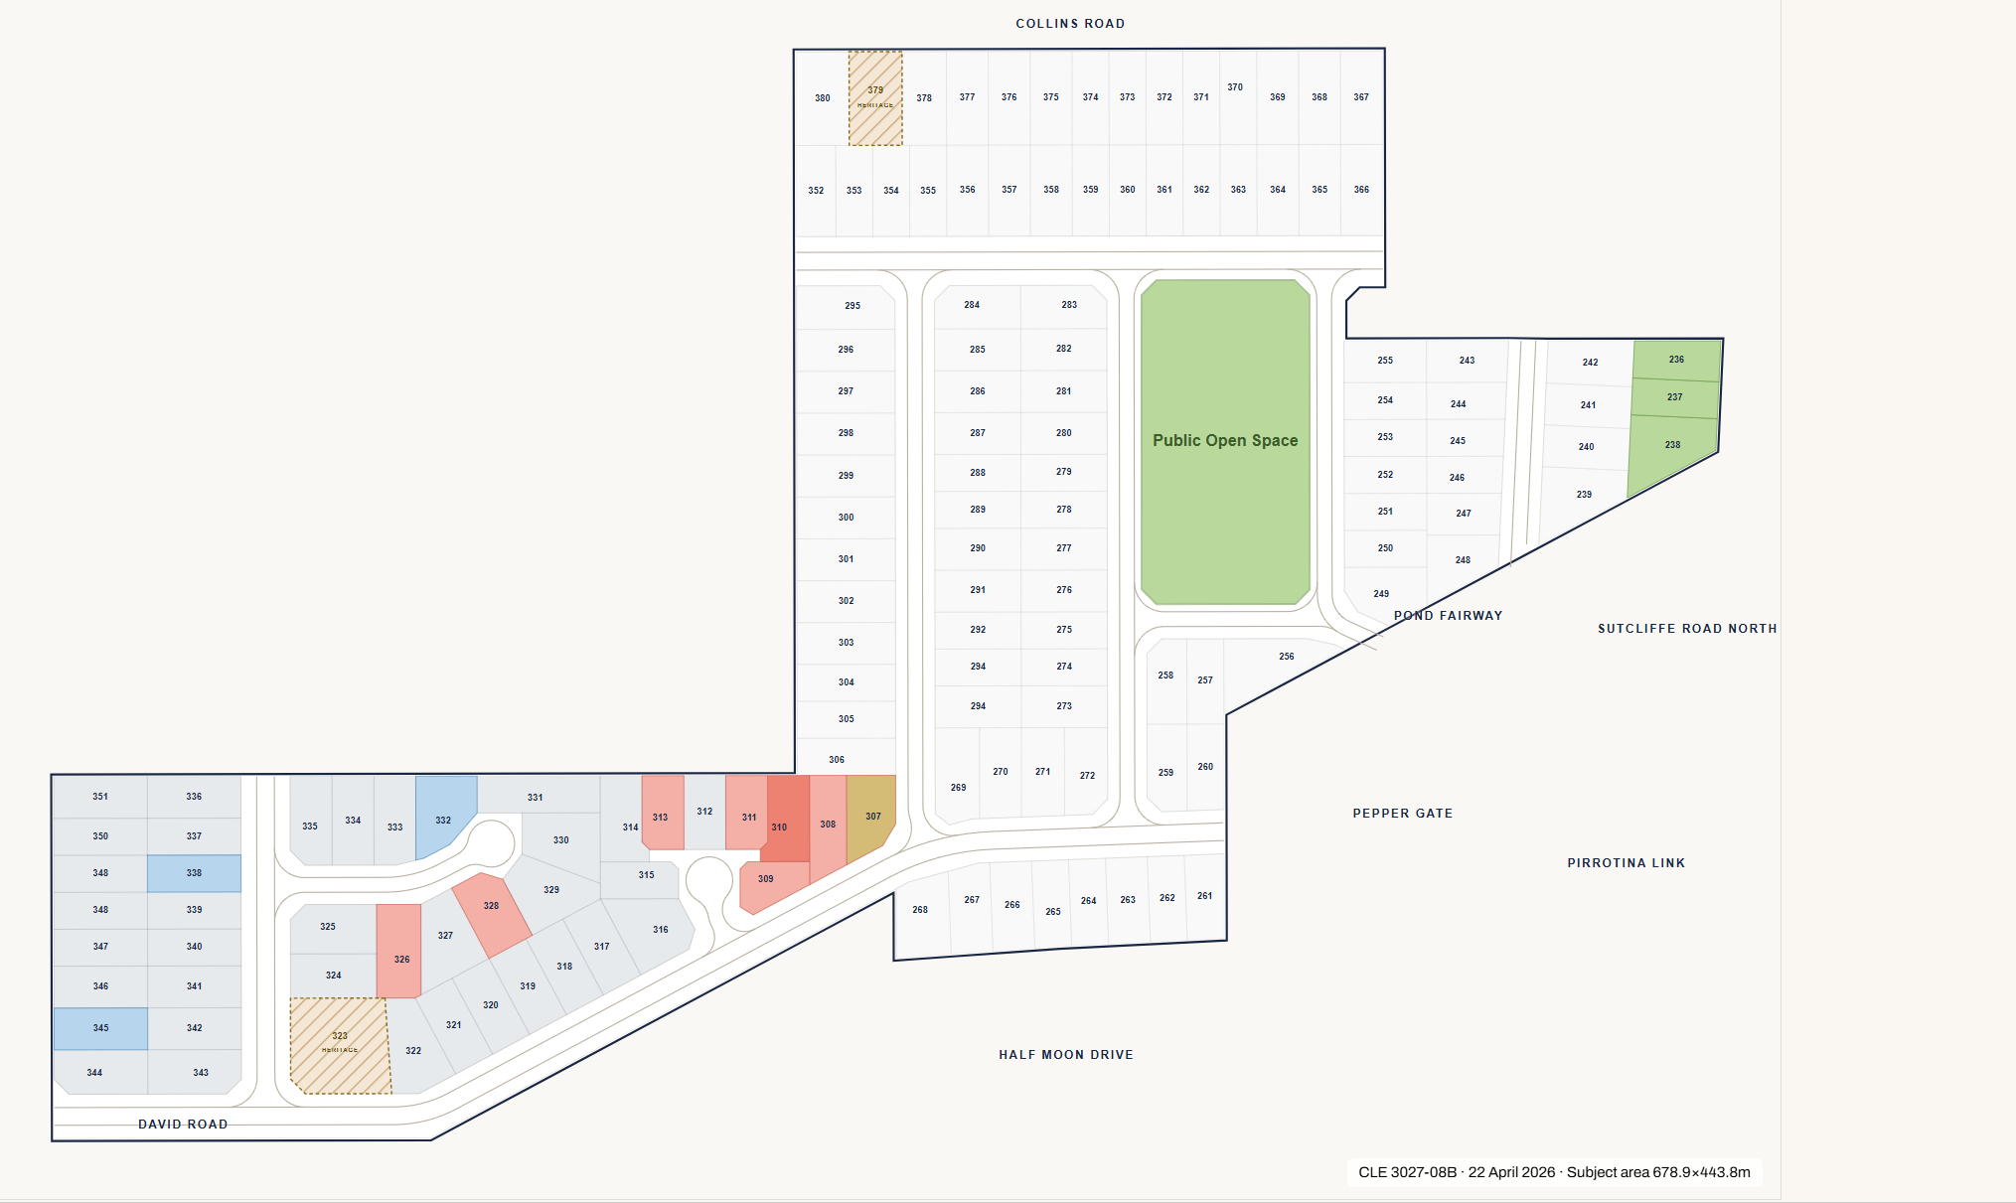
Original from claude

Slide 2
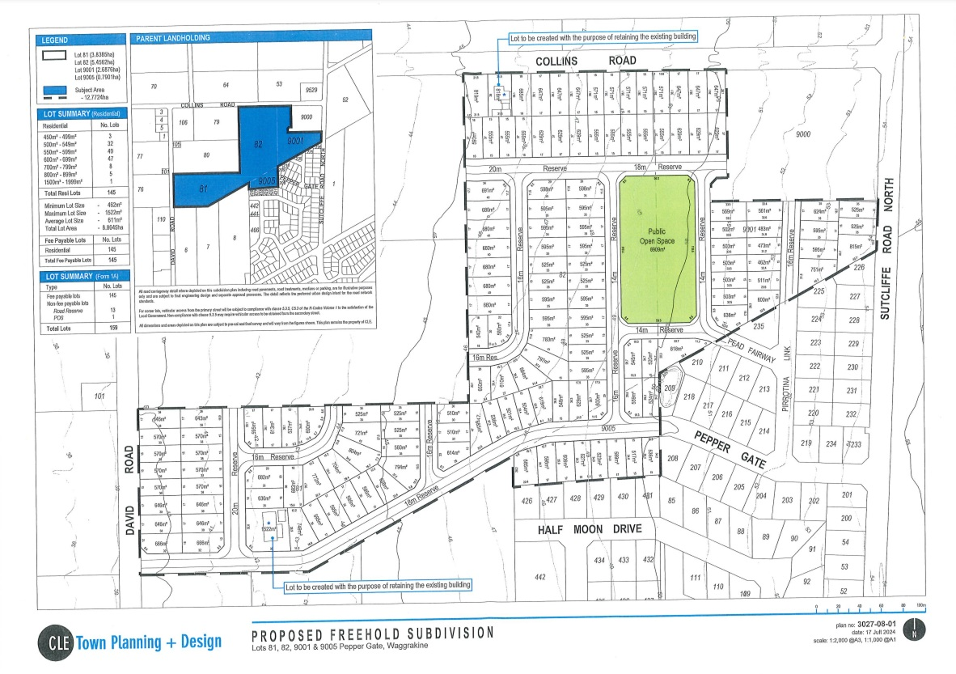

Slide 3
These lines deleted
This line deleted
Updated by dennis
Sutcliffe Road North
Pead Fairway
This line deleted
This deleted
This deleted
David Road
These lines deleted
This line deleted
This deleted
This line deleted

Slide 4
These lines deleted
This line deleted
Updated by dennis
Sutcliffe Road North
Pead Fairway
This line deleted
This deleted
This deleted
David Road
These lines deleted
This line deleted
This deleted
This line deleted

Slide 5
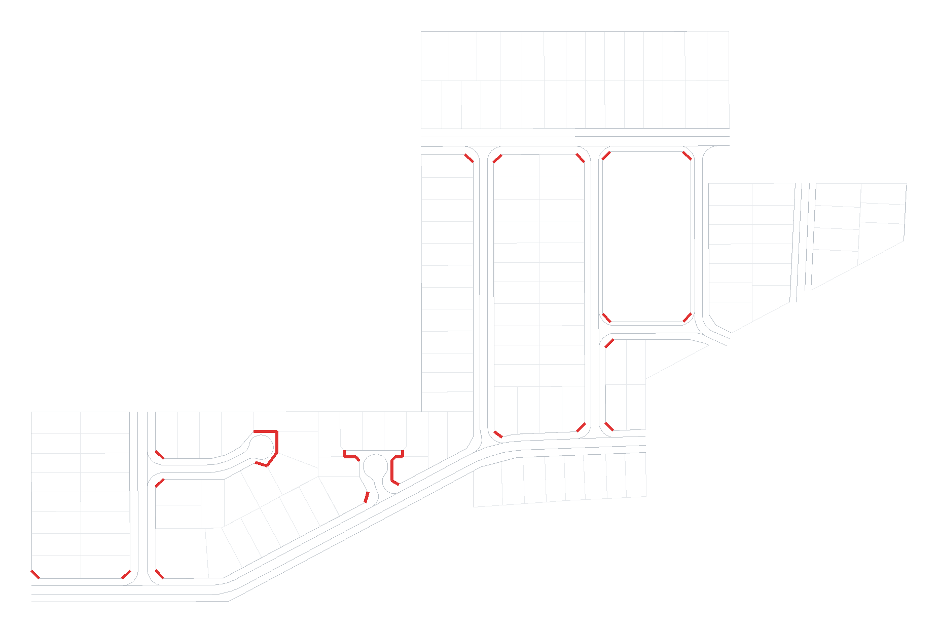
Dennis corrected – red stays, yellow is deleted

Slide 6
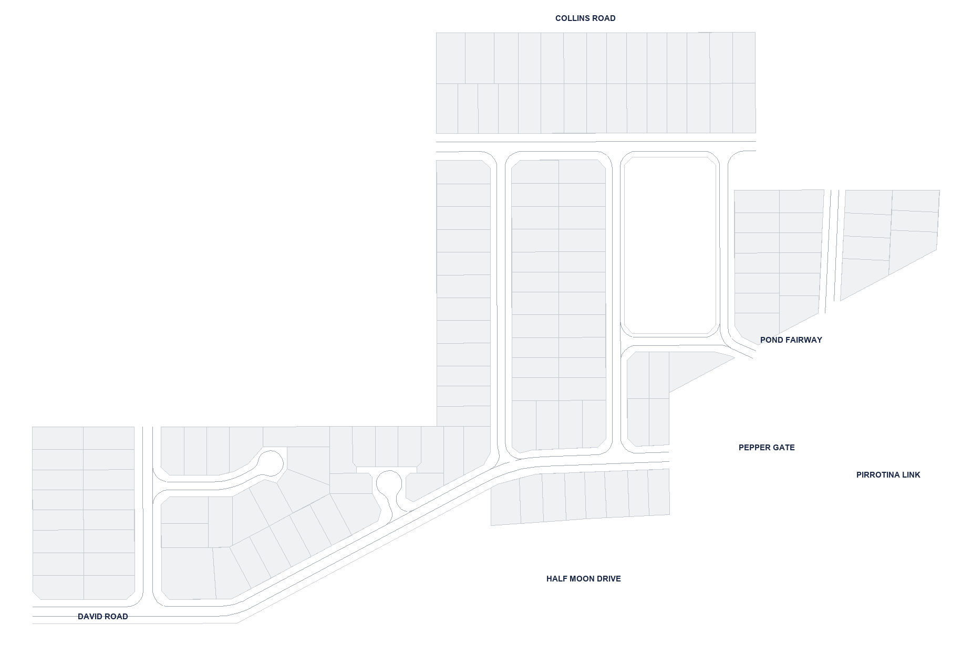

Slide 7


Slide 8


