Slide 2
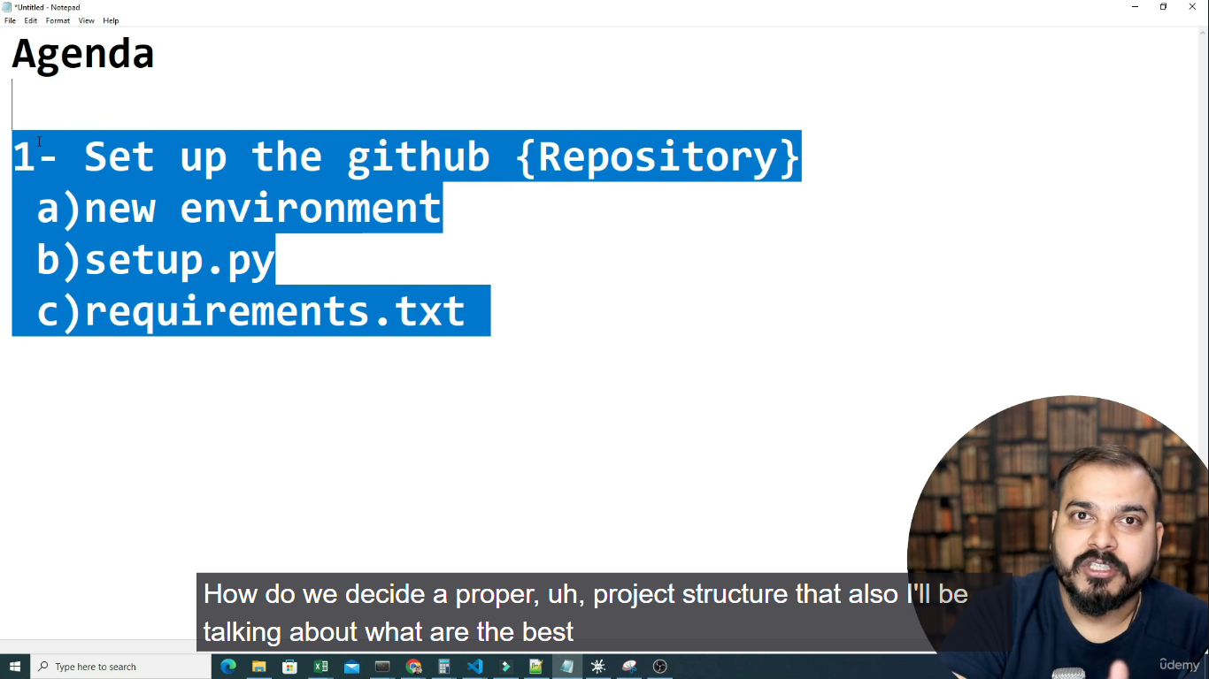

Slide 3
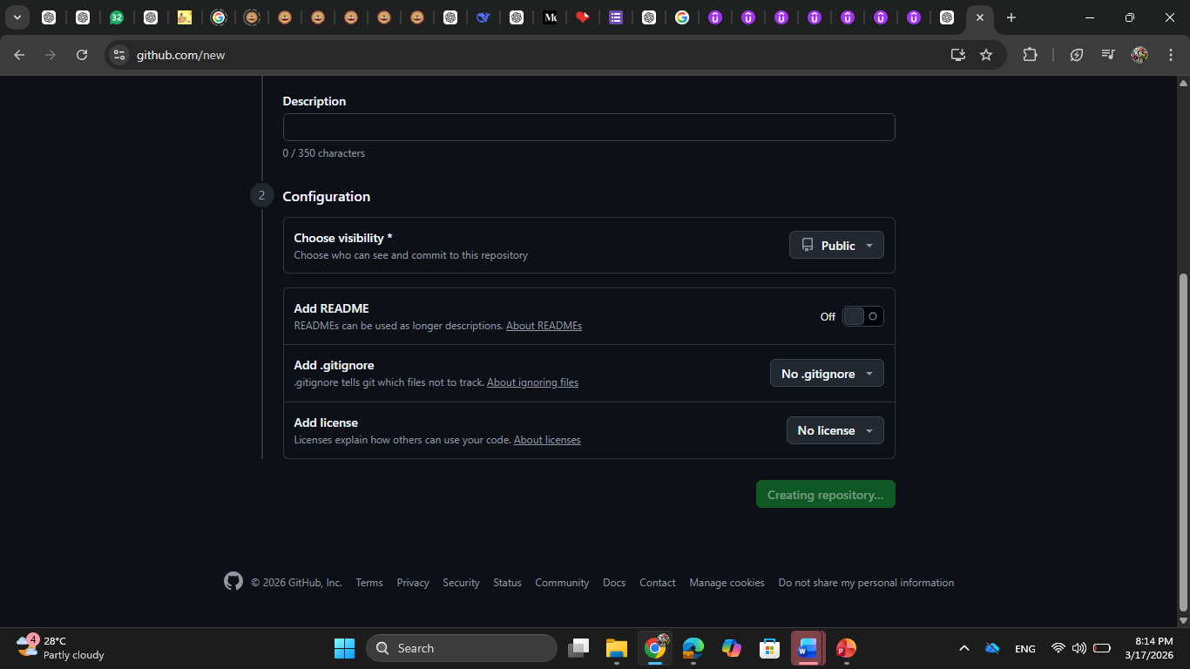

Slide 4
Anaconda prompt - E:\ML project
E:
cd "ML project“
Code . – for opening vs code
Open a terminal.
Create a environment. conda create -p venv python=3.8 -y

Slide 5
conda activate venv
conda activate ./venv
Install git first from website. 👉https://git-scm.com/download/win
Git init
Then create a file readme.md
And then in terminal – write – git add readme.md
git commit -m "first commit"

Slide 6
git config --global user.name "Chaitanya"
(base) PS E:\ML project> git config --global user.email caitanyadesai1008@gmail.com
git commit -m "First commit“
Git status
Git branch –M main
git remote add origin https://github.com/caitanyadesai1008-dev/mlproject.git
Git remote -v
git push -u origin main

Slide 7
And then reload your github.
Create a new file. Gitignore
Git pull in code.
Requirements.txt file create.
Pypi.org for packages.

Slide 8
We will create one folder – in src – that is components

