Slide 1
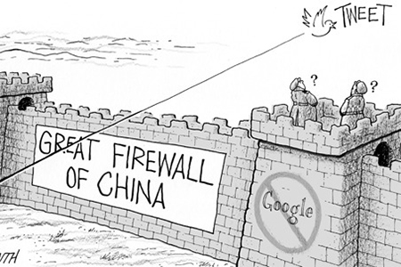
SbuSocks: Break the Great Firewall
CSE534 Project
Xuan Li, Caitao Zhan, Runxiang Huang
Computer Science Department
May10, 2018

Slide 2
Table of Contents
Introduce GFW
What we did to break GFW
Experiments and take-away messages

Slide 3


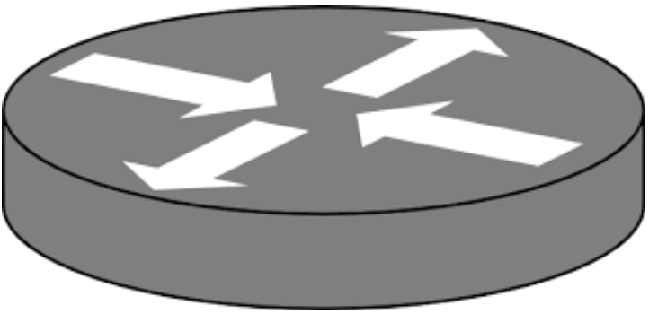

GFW: world’s largest firewall
So… How does it work?
China
Gateway router
wiretap
Deep packet Inspection
Local
resolver
wiretap
Faked
DNS reply
Inject blacklist via BGP (null routing)
DNS Injector
TCP RST
Router with
IP-blacklist
GFW is at international gateways and province-level ISP

Slide 4
Take-away Message
The basic methodology for breaking the GFW is to find some proxy nodes and encrypt the traffic.
We implemented a tool namely SbuSocks, which successfully breaks GFW following the methodology.

Slide 5
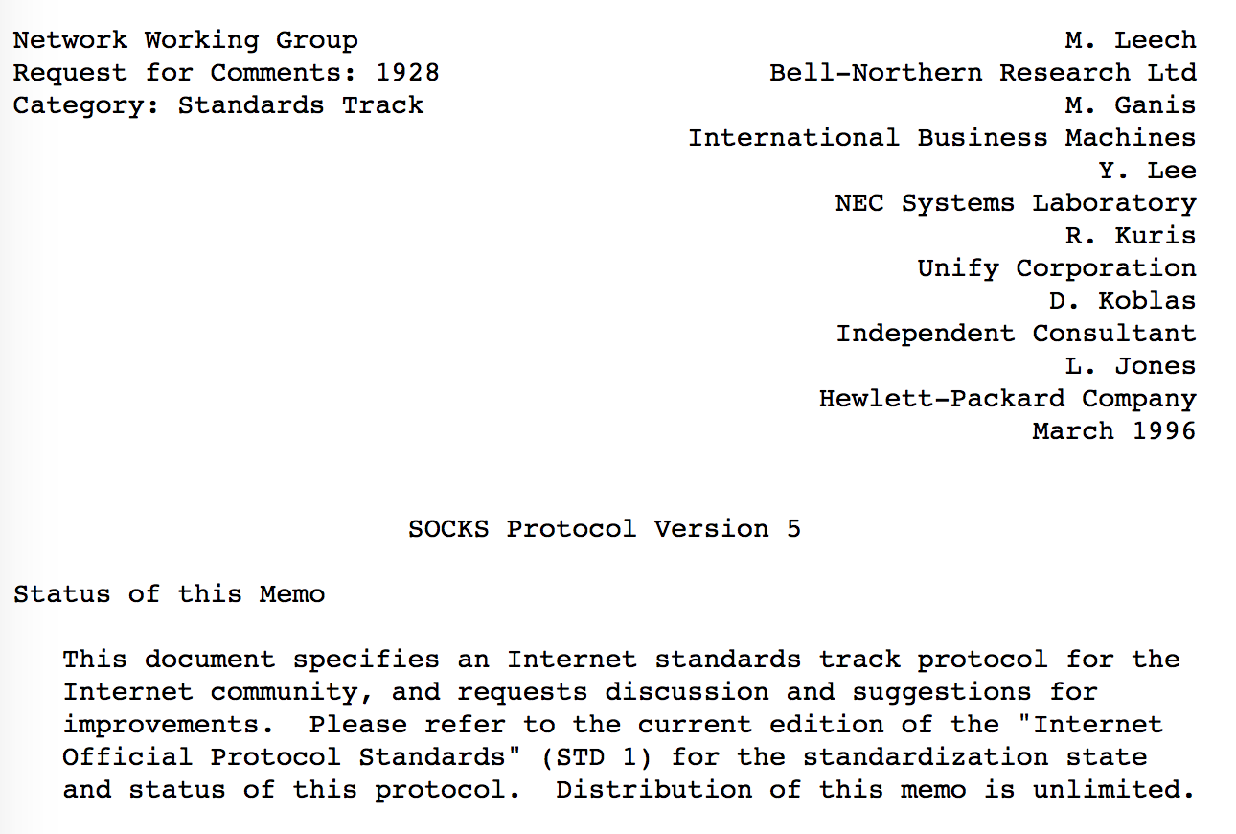
Socks5 (RFC 1928)
https://www.ietf.org/rfc/rfc1928.txt

Slide 6

Socks 5: Handshake + Forwarding Relay
GFW
Free World
Handshake Phase
Forwarding Relay
sbusocks-client
sbusocks-server
1 IP not in blacklist
2 Safe DNS resolver
Notes:
Socket Secure Version 5 (SOCKS5) is an Internet protocol that exchanges network packets between a client and server through a proxy server.
In the handshake phase, the client first send to the proxy server the real destination, and then start to stream data to the proxy server. The proxy then forward it and forward the response to the client.

Slide 7
Socks5 Protocol
IP blacklist
DNS injection
But… How to deal with evil deep packet inspection (DPI) with TCP RST attack?
Encryption to the rescue!

Slide 8
Encryption: Obfuscate the DPI
GFW
Free World
Decrypt
sbusocks-client
Encrypt
Encrypt
sbusocks-server
Decrypt

Slide 9
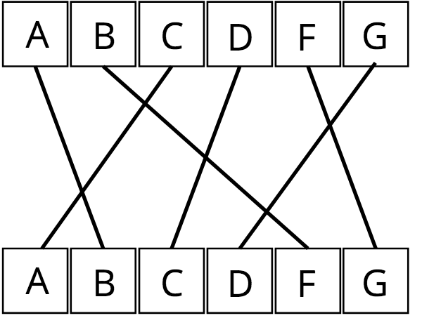
SbuSocks Use: Classic Cryptography
Use out-of-band key to set a random state.
Use a permutation cipher based on the random state.
b'You cannot see me!' --> b'\xb0\xeaB\xde,cff\xea\xc7\xde\x8e\xf4\xf4\xde\x95\xf4x'

Slide 10
Introduce SbuSocks
SbuSocks = Socks 5 + Encryption
https://github.com/caitaozhan/CSE534-Project

Slide 11
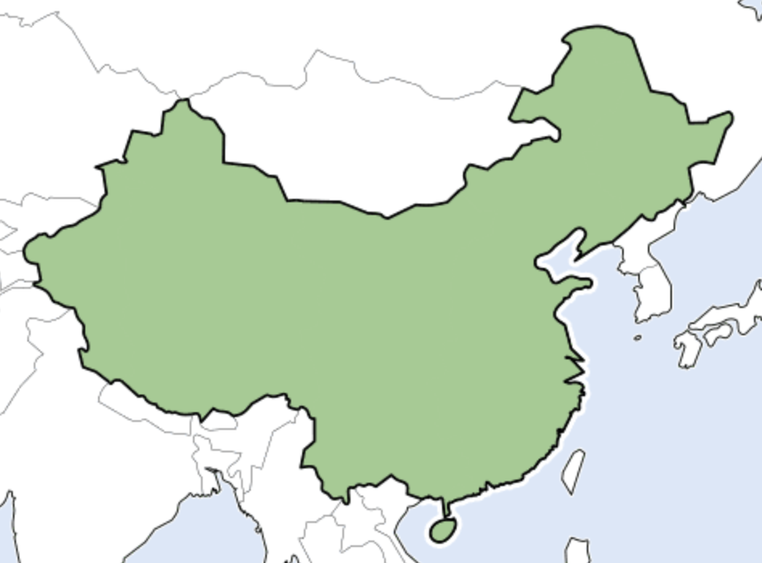
Experiment: 8 People in 5 Cities across China
SbuSocks | Hypothesis | Test
Socks5+Encryption | Break GFW | Break GFW
Socks5 | Blocked | Break GFW

Slide 12
More Take-away Messages
GFW will let very small scale suspicious traffic go, due to economic reasons.

Slide 13


Slide 14
Backup Slides (Not used during presentation)

Slide 15
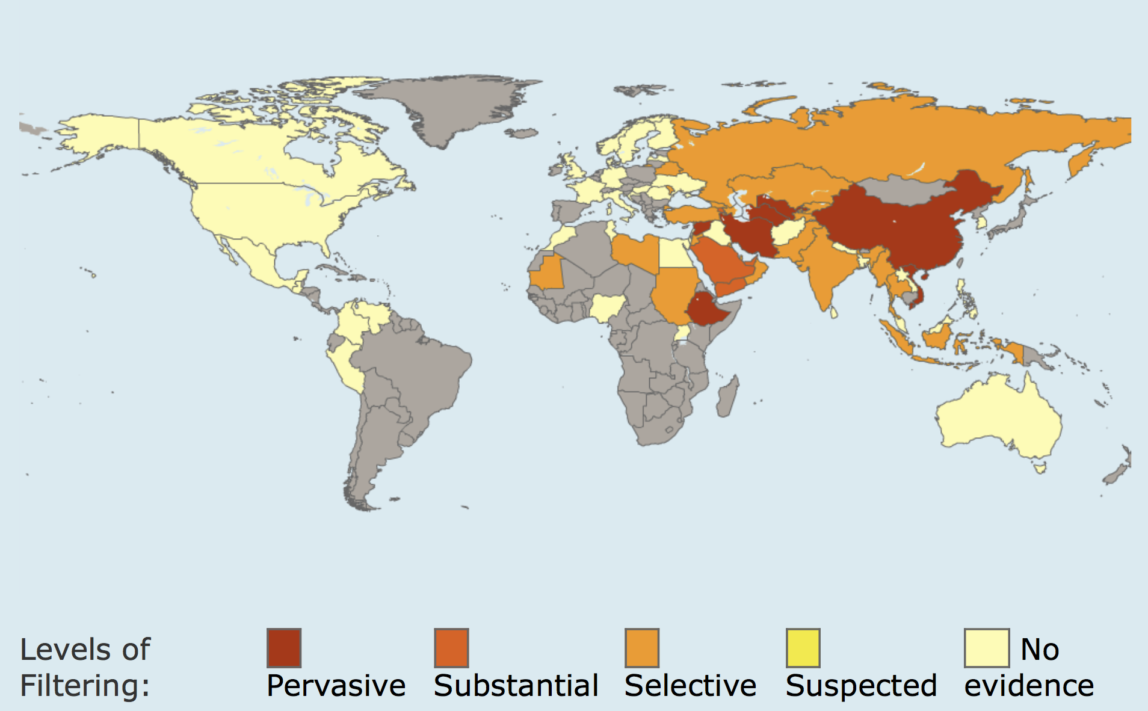
Motivation
China
Ethiopia
Iran
Syria
Turkmenistan
Uzbekistan
Vietnam
http://map.opennet.net/filtering-pol.html

Slide 16
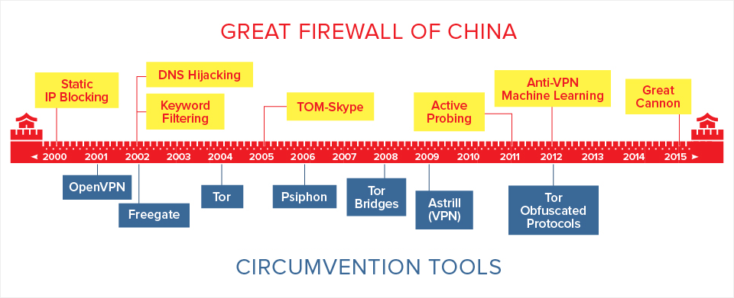
Related Work: the arms race
https://blog.thousandeyes.com/the-war-between-chinas-great-firewall-and-circumvention-tools/

Slide 17
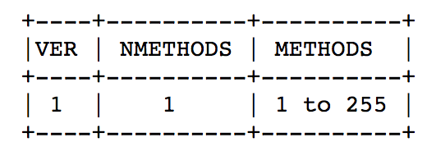
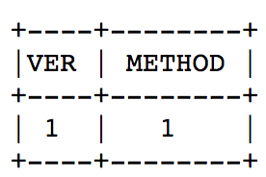
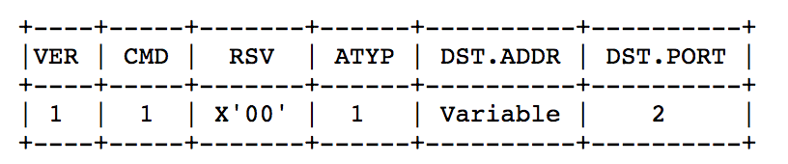
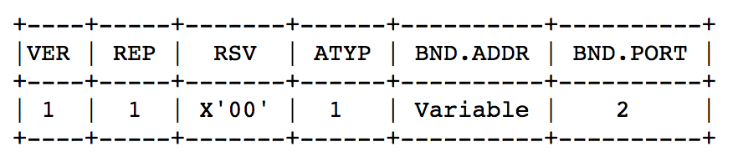
Socks5 Protocol Handshake Details
1. Application → Client
2. Client → Application
3. Client → Server
4. Server → Client
Notes:
Socket Secure Version 5 (SOCKS5) is an Internet protocol that exchanges network packets between a client and server through a proxy server. The protocol performs at Layer 5.
In the handshake phase, the client first send to the proxy server the real destination, and then start to stream data to the proxy server. The proxy then forward

Slide 18
Why Socks5
Elusive.
Easy to deploy.
A lot of applications support socks5 protocol. We only need to implement the responding part.

Slide 19
More on Traffic Encryption Obfuscation
Encryption is a method, the goal is obfuscation!
Randomization: randomize every byte in the packet payload.
Mimicry: masquerade as a whitelisted protocol.
Tunneling: Use a special protocol, such as VPN.

Slide 20
GFW’s New Weapons
Active Probing
Machine learning
DDos attack
The arms race goes on and on...

Slide 21
TCP Relay
Server
Forward streams from the client to the target destination
Forward responses from the target destinations to the client.
Client
Forward streams from the local applications to the server.
Forward streams from the server to local applications

Slide 22
Future Work: Detecting TCP RST Attack
One major way GFW perform blocking is using TCP RST Attack.
TCP RST Attack is triggered by keywords. Once GFW detect that the packet contain such keyword, it will send TCP RST to both end of the TCP connection.
One way to solve this problem is to send an ACK to server/client after receive RST. If RST is send by client/server, then connection ends; if not, RST will be dropped.
Current detecting system need both server and client implementation.

