Slide 1
Coalition(联盟) Formation By 詹才韬
version_0.2.1
联盟的形成——寻找一个最优的“编队”

Slide 2
This week, I finished an excellent
科研立项中期答辩《群体智能游戏开发》
The results will come out soon

Slide 3
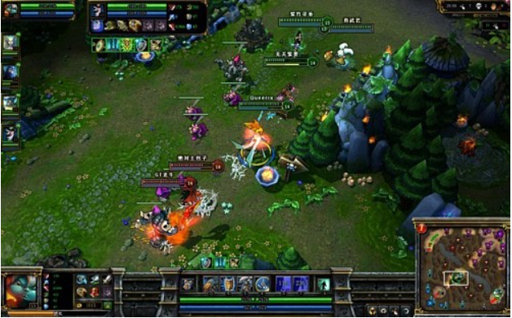
Coalition in LOL
enemy
me

Slide 4
目标：find a coalition, as good as possible
me

Slide 5
评估一个联盟（编队）的好坏
simple algorithm to evaluate the coalitions
bad
good
…
-2
-1
0
1
2
…
评估坐标

Slide 6
4 updates
Only show the best coalition(阵型)
Fixed one bug
Probability 0 → 0.1
Analyze log system

Slide 7
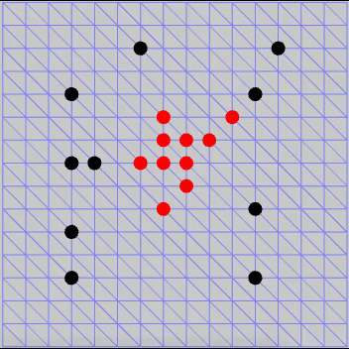
Only show the best Coalition

Slide 8
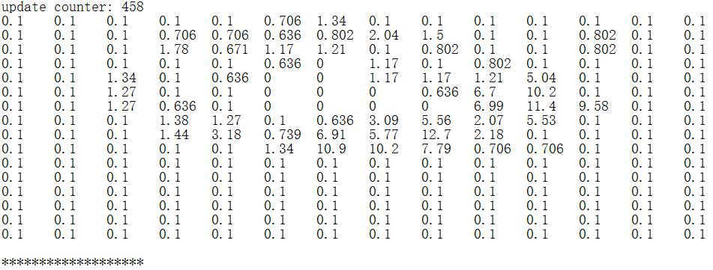
Probability 0 → 0.1

Slide 9
Analyze log system
6(best)
3(best)

Slide 10
Future work
Add local search
Solve the issue when E = 0 stagnation

Slide 11
固定的测试用例

Slide 12
疑问
配置参数化
我现在的测试代码和主程序的代码是混在一起的。可不可以把测试模块的代码和主程序的代码分离？

