Slide 1

NBAnalysts
Ben Winters
Sara Patel
Bismaad Minhas
Rob Matelyan
Caitilin Beatty

Slide 2
Agenda
Machine Learning :
Random Forest rational and output
Linear Regression rational and output
Tableau:
Further insights

Slide 3
Goal
What information can we learn from NBA player databases to understand past and current trends to try to predict future impact ?

Slide 4
Why Machine Learning?
Large amount of data (21,734 rows)
Observe data trends across many years and data points (1950-2017 across multiple sources)
Aim to gain insights on current data (2021 salary)
Develop models to predict future outcomes

Slide 5
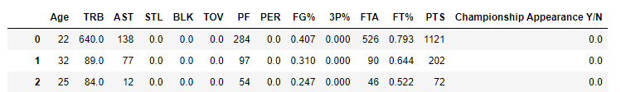
Random Forest
“What are the most important player stats to look at when determining who can bring a team to a championship?”
Categorial
Binary Classification (Championship Appearance Y/N)
Aim to gain insights on most important factors (ie PTS vs AST)
Data set contained a large mixture of numerical values

Slide 6
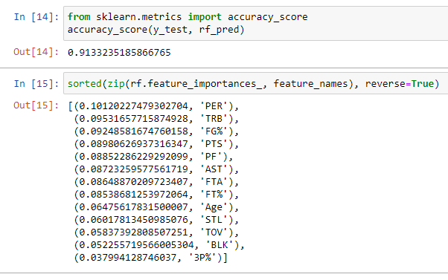
Random Forest
Model 1 – All Data (21734 Records):
All player stats from the 1950-51 season until the 2016-17 season
Possibly included ‘trash’ factors:
STL – Steals
BLK – Blocks
3P% – Three Point Shot Percentage
Accuracy score: 0.91

Slide 7
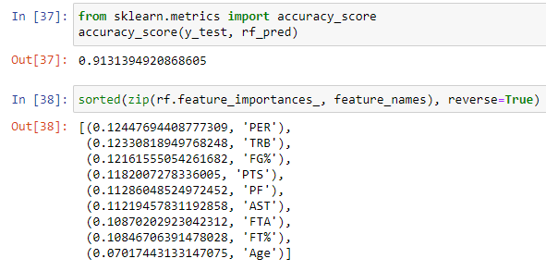
Random Forest
Model 2 – Original NBA Stats only (21734 Records):
Only original stats from the 1950-51 season until the 2016-17 season
Steals, Blocks, 3P% and Turnovers EXCLUDED
Accuracy score: 0.91

Slide 8
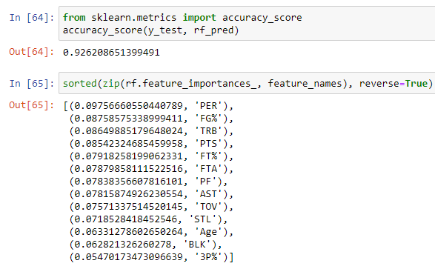
Random Forest
Model 3 – Only Modern NBA Data (17291 Records):
By slicing the data into a post 1980 subset, we have a complete dataset for every stat
Accuracy score: 0.93
What’s Next?
Filling Nulls with Averages
Dropping players with zero 3 point shot attempts

Slide 9
Multiple Linear Regression
“Is player salary based on their contribution to getting to a championship?”
Demonstrates relationship between a scalar response (salary) and multiple explanatory variables (PTS, AST, TRB, etc. )
Does the model predict better based on chosen factors from Random Forest output?

Slide 10
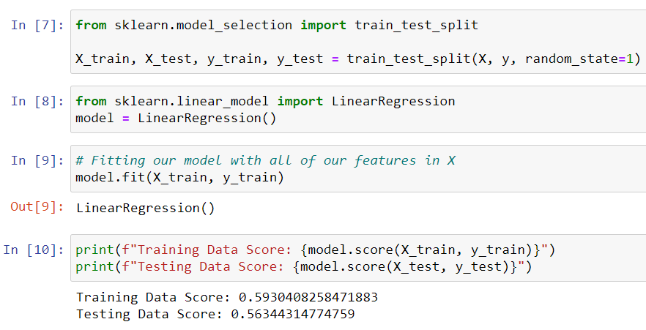
Multiple Linear Regression
Model 1 – All Data (13,805 Records):
Player salary data and performance data (1978-2015)
Independent Variables:
PTS – Points
AST – Assists
TRB – Total Rebounds
Coefficient of determination (R²):
Train dataset = 0.59
Test dataset = 0.56
Drawback: Player salary information does not change every season, but performance varies in the same timeframe.

Slide 11
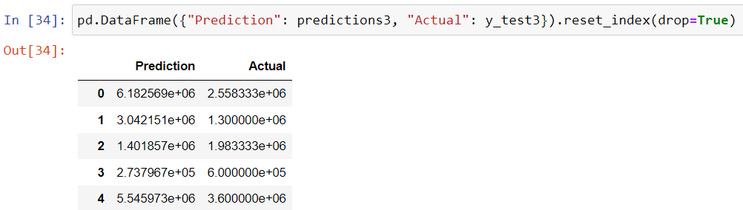
Multiple Linear Regression
Model 2 – Final Season data for every player (1,893 Records):
Coefficient of determination (R²):
Train dataset = 0.44
Test dataset = 0.27
Drawback: Player performance data may be lower their final season
Model 3 – Avg. salary and performance data per player(1,893 Records):
Coefficient of determination (R²):
Train dataset = 0.66
Test dataset = 0.66

Slide 12
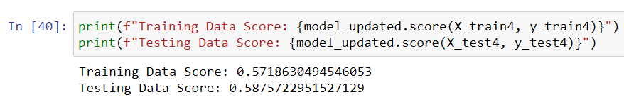
Multiple Linear Regression
Model 4 – Avg. salary and performance data per player(1,893 Records):
Independent Variables:
PER – Player Efficiency Rating
FG% - Field goal percentage (any shot that is not a free throw)
TRB – Total Rebounds
Coefficient of determination (R²):
Train dataset = 0.57
Test dataset = 0.59

Slide 13
Multiple Linear Regression
Summary: It appears that the model that uses average salary and performance data over the timeframe of a player’s career is the best at predicting their average salary
What Next:
Get comprehensive salary information for a larger portion of the player dataset
Rerun models using other performance indicators
Account for inflation and policy changes over time
Explore other machine learning models (ex. Polynomial Regression)

Slide 14
Let’s move to Tableau for further insights

Slide 15
Back-up

Slide 16
Acronyms
TRB - total Rebounds PER - player efficiency rating
sums up all a player's positive accomplishments, subtracts the negative accomplishments, and returns a per-minute rating of a player's performance
AST - Assists PTS - Points scored PF - Personal Fouls Age - Age FG% - Field Goal percentage (any shot that is not a free throw) FTA - Free Throw Attempts FT% - Free Throw percentage TOV - Turnovers (how many times a player lost the ball for their team) STL - Steal BLK - Block 3p% - 3 point shot percentage

Slide 17
NBA PER Calculation
uPER = (1 / MP) *
[ 3P
+ (2/3) * AST
+ (2 - factor * (team_AST / team_FG)) * FG
+ (FT *0.5 * (1 + (1 - (team_AST / team_FG)) + (2/3) * (team_AST / team_FG)))
- VOP * TOV
- VOP * DRB% * (FGA - FG)
- VOP * 0.44 * (0.44 + (0.56 * DRB%)) * (FTA - FT)
+ VOP * (1 - DRB%) * (TRB - ORB)
+ VOP * DRB% * ORB
+ VOP * STL
+ VOP * DRB% * BLK
- PF * ((lg_FT / lg_PF) - 0.44 * (lg_FTA / lg_PF) * VOP) ]

Slide 18
Acronyms Continued
PG Point Guard Any point guard or guard
SG Shooting Guard Any shooting guard, guard, or guard/forward
G Guard Any point guard, shooting guard, guard, or guard/forward
SF Small Forward Any small forward, forward, or guard/forward
PF Power Forward Any power forward, forward, or forward/center
F Forward Any small forward, power forward, forward, guard/forward, or forward/center
C Center Any center or forward/center
Util Utility Any player

