Slide 1
Multiple Linear Regression
“Is player salary based on their contribution to getting to a championship?”
Demonstrates relationship between a scalar response (salary) and multiple explanatory variables (PTS, AST, TRB, etc. )
Does the model predict better based on chosen factors from Random Forest output?

Slide 2
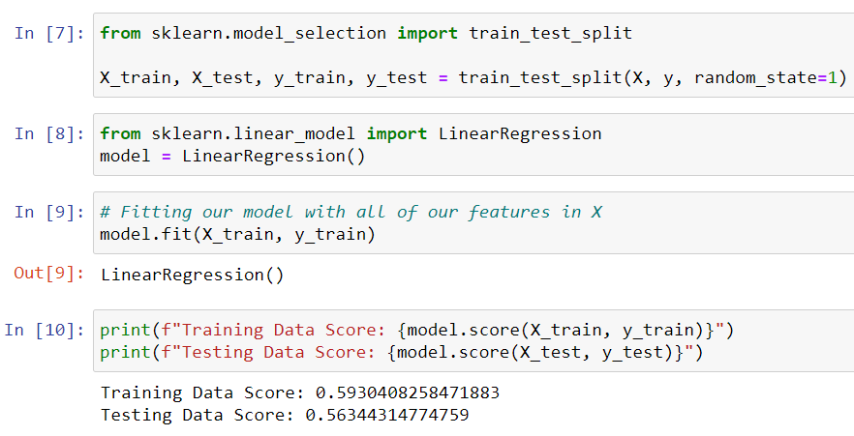
Multiple Linear Regression
Model 1 – All Data (13,805 Records):
Player salary data and performance data (1978-2015)
Independent Variables:
PTS – Points
AST – Assists
TRB – Total Rebounds
Coefficient of determination (R²):
Train dataset = 0.59
Test dataset = 0.56
Drawback: Player salary information does not change every season, but performance varies in the same timeframe.

Slide 3
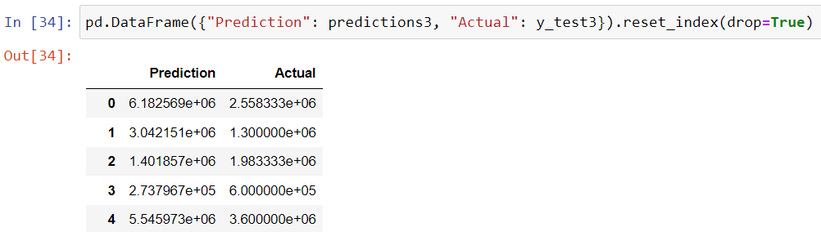
Multiple Linear Regression
Model 2 – Final Season data for every player (1,893 Records):
Coefficient of determination (R²):
Train dataset = 0.44
Test dataset = 0.27
Drawback: Player performance data may be lower their final season
Model 3 – Avg. salary and performance data per player(1,893 Records):
Coefficient of determination (R²):
Train dataset = 0.66
Test dataset = 0.66

Slide 4
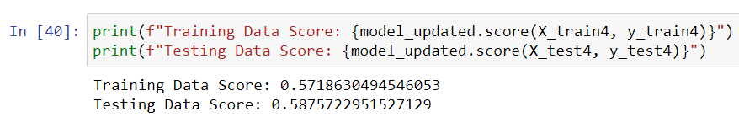
Multiple Linear Regression
Model 4 – Avg. salary and performance data per player(1,893 Records):
Independent Variables:
PER – Player Efficiency Rating
FG% - Field goal percentage (any shot that is not a free throw)
TRB – Total Rebounds
Coefficient of determination (R²):
Train dataset = 0.57
Test dataset = 0.59

Slide 5
Multiple Linear Regression
Summary: It appears that the model that uses average salary and performance data over the timeframe of a player’s career is the best at predicting their average salary
What Next:
Get comprehensive salary information for a larger portion of the player dataset
Rerun models using other performance indicators
Account for inflation and policy changes over time
Explore other machine learning models (ex. Polynomial Regression)

