Slide 1

PHILLY LIVING
TEAM REACT
Alannah Fleet
Bismaad Minhas
Caitilin Beatty
Sara Patel
Notes:
Alannah

Slide 2





Agenda
Introduction
Technologies Used/Coding Approach
Data sources and Transformation
Overview of visualizations
Conclusions
Notes:
Alannah

Slide 3
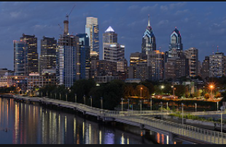
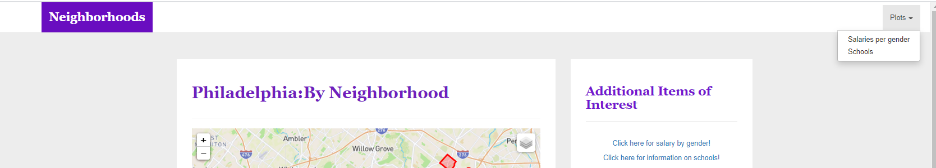
Introduction
Philadelphia is a city of 100 neighborhoods each bringing a rich history, culture, and way of living. The city boasts some of the best academic and medical institutions in the world.
We wanted to build a website, designed to provide key information, by neighborhood, for someone looking to move to Philadelphia. The site is geared to women and young families with factors including information on equal pay, cost of living, and school ratings.
Notes:
Caitilin

Slide 4




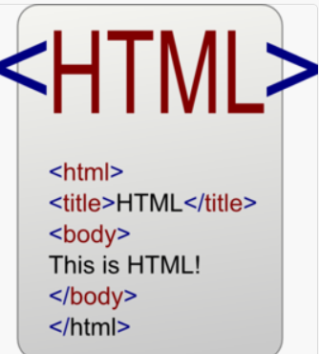

Technologies Used and Coding Approach
Flask
To connect DB to web
Visualizations
Plotly (bar chart)
GeoJson (map points)
Leaflet (map markers)
API calls
Opendataphilly.org
Data.usa.io
Jupyter Notebook
read API and push to SQLite
Relational Database
Data could be connected on Philadelphia GeoId’s
Web development
css/bootstrap
Notes:
Sara

Slide 5
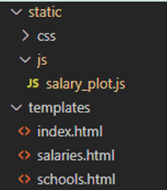
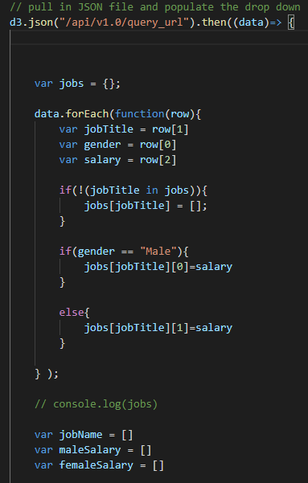
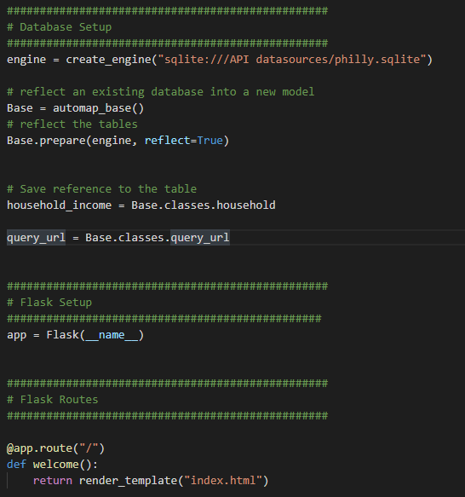
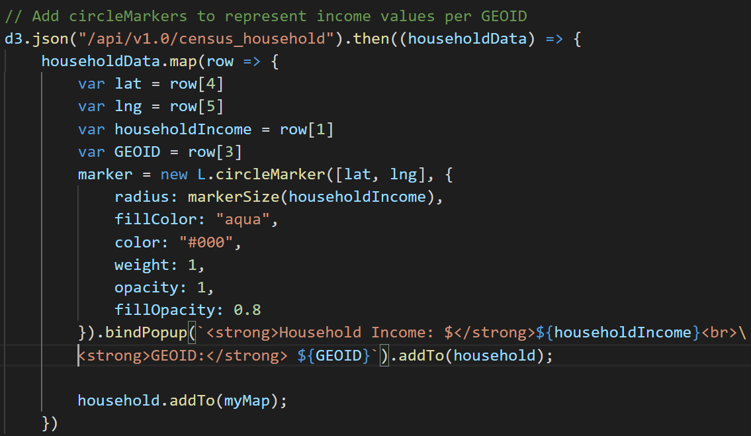
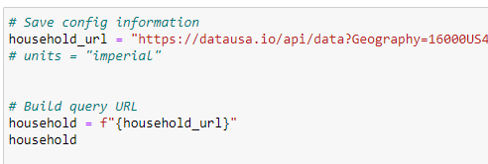
Data Sources and Transformations
Client
Server (Flask)
Database (SQLite)
Index.html
Plotly
Insert screenshot of Alannah’s cool app with all db’s
Leaflet
External Data
Opendataphilly.org
Data.usa.io
Notes:
Bismaad

Slide 6
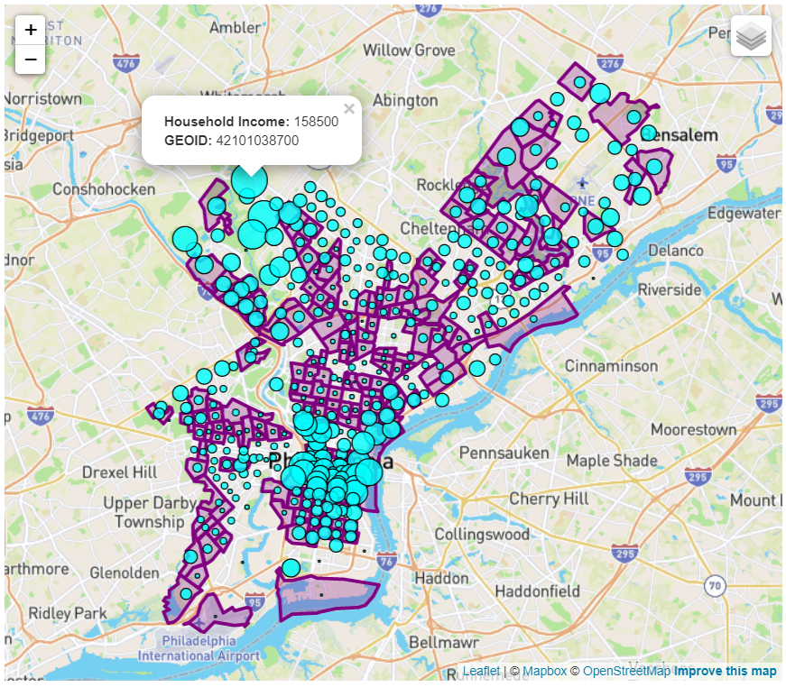
Average Income by Neighborhood
Income range:
$11,000 to $160,000
Census Tracts (2010):
384 distinct census tracts
Enter summary here
Notes:
Bismaad/Sara

Slide 7

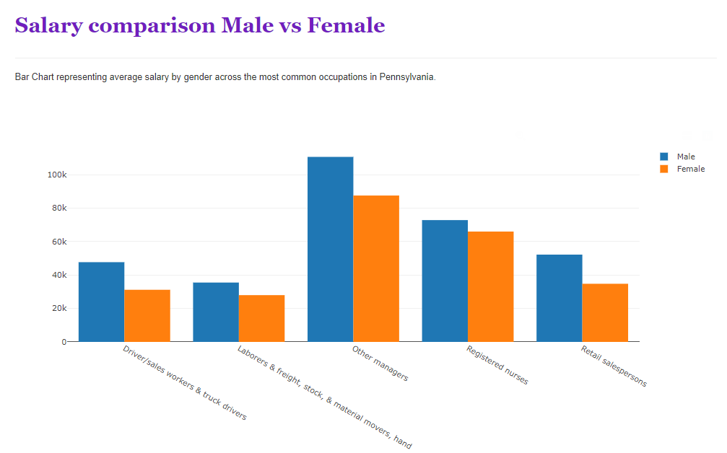
Salary by Gender
Salary of most common jobs in Pennsylvania
Trend across most common jobs:
On average, females are making less than their male counterparts, with sometimes as much as 20% less
Sept 2000 Philadelphia Wage Equity Ordinance enforced
Notes:
Caitilin

Slide 8
Local School Information
Title of visual
Screenshot of visual
Enter summary here
Notes:
Alannah

Slide 9




Conclusion
Neighborhood
Salary by Gender
Schools
Income varies depending on the areas
Ranges $11,000 to $160,000
Know your worth!!
Research pay scales prior to offer acceptance
Add conclusion
Notes:
Alannah

Slide 10
Thank You!

Slide 11
Any Questions?
Notes:
All

