Slide 1
Interpolation for the alignment of Clock Frequency Data
Suzanne Thornton, NIST PREP Associate, SED
January, 16, 2026

Slide 2
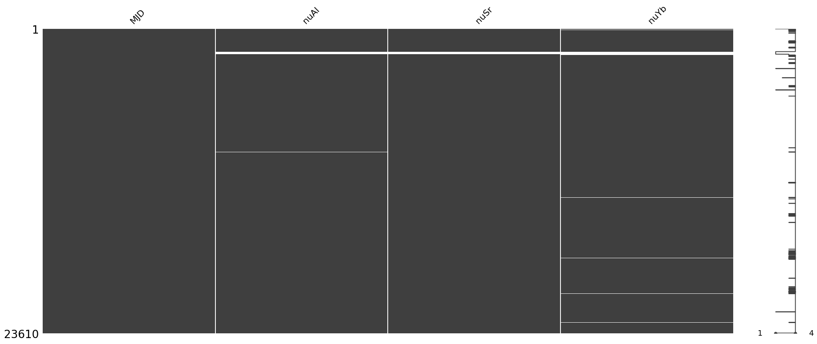
Missingness in comb data
Missing Al comb nu: 233
Missing Sr comb nu: 203
Missing Yb comb nu: 417
©Robert Rathe
©Nicholas McIntosh Photography

Slide 3
Summary of “not good” shift data
The following summaries represent how many shift data points were deemed “not good” based on the IS_GOOD indicator for each clock.
NA Al shift values: 81164
NA Sr shift values: 0
NA Yb shift values: 515
©Robert Rathe
©Nicholas McIntosh Photography

Slide 4
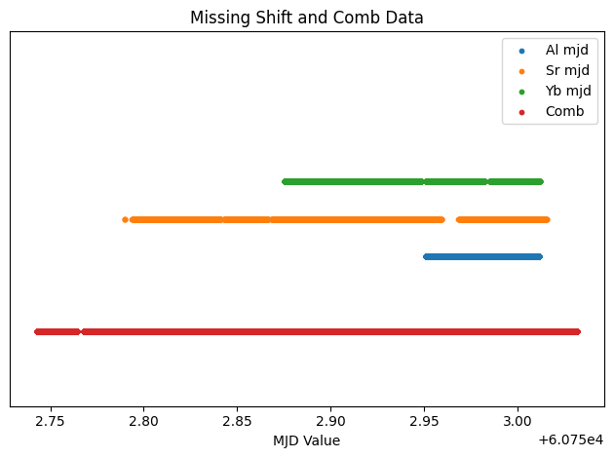
Visualizing all shift data
©Robert Rathe
©Nicholas McIntosh Photography

Slide 5
Determining an overlapping window of observations
Comb start and end MJD: [ 60752.742818 , 60753.031848 ]
Al good shift start and end MJD: [ 60752.9509491 , 60753.0115278 ]
Sr good shift start and end MJD: [ 60752.78983432031 , 60753.01555496421 ]
Yb good shift start and end MJD: [ 60752.87540139 , 60753.01171893 ]
Last start time: 60752.9509491
First end time: 60753.0115278
©Robert Rathe
©Nicholas McIntosh Photography

Slide 6
Overlapping window of observations
In this example, the results of filtering only the data that lie between the last start time and first end time are as follows.
nuAl, nuSr, and nuYb start and end MJD: [ 60752.950939 , 60753.011522 ]
Al good shift start and end MJD: [ 60752.9509491 , 60753.0115162 ]
Sr good shift start and end MJD: [ 60752.95094887931 , 60753.01144822278 ]
Yb good shift start and end MJD: [ 60752.94844731 , 60753.01152291 ]
©Robert Rathe
©Nicholas McIntosh Photography

Slide 7
Comparing MDJ for comb and shift data
Can see the need for interpolation due to misalignment in order to derive a ratio time series
Clarify distinction between missing data and misaligned data.
Can incorporate an interpolation limit
©Robert Rathe
©Nicholas McIntosh Photography

Slide 8
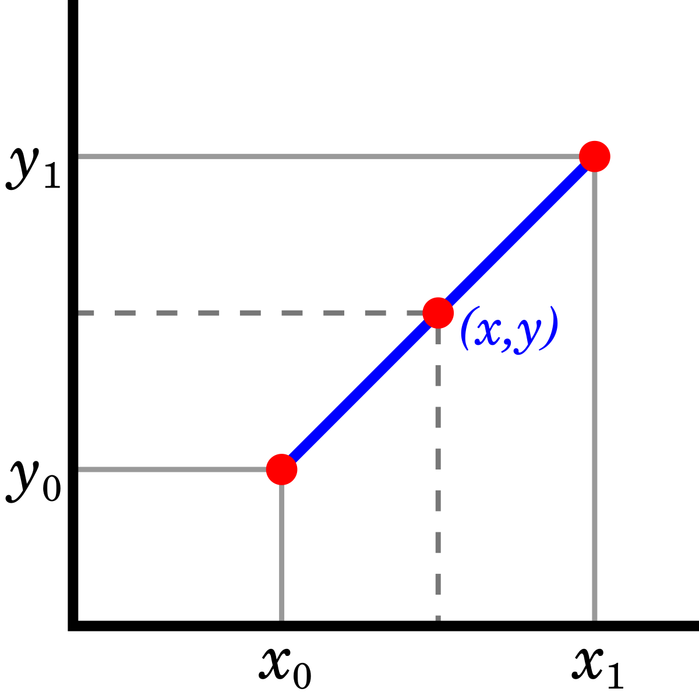
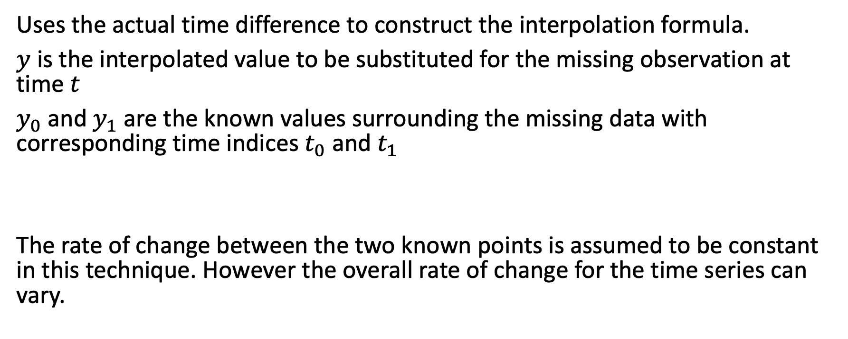
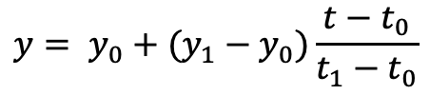
Time-based linear interpolation
Uses the actual time difference to construct the interpolation formula.
$y$ is the interpolated value to be substituted for the missing observation at time $t$
$y_{0}$ and $y_{1}$ are the known values surrounding the missing data with corresponding time indices $t_{0}$ and $t_{1}$
The rate of change between the two known points is assumed to be constant in this technique. However the overall rate of change for the time series can vary.
$$y= y_{0}+(y_{1}−y_{0})\frac{t−t_{0}}{t_{1}−t_{0}}$$
©Robert Rathe
©Nicholas McIntosh Photography

Slide 9
Interpolation via Kalman filter smoothing
TEXT
©Robert Rathe
©Nicholas McIntosh Photography

Slide 10
Other interpolation techniques
TEXT
©Robert Rathe
©Nicholas McIntosh Photography

Slide 11
TITLE
TEXT
©Robert Rathe
©Nicholas McIntosh Photography

Slide 12
TITLE
TEXT
©Robert Rathe
©Nicholas McIntosh Photography

