Slide 1
Active Learning for
Molecular Property Prediction
TYK2 DDG — Finding Better Binders, Faster
Deliverable for Lindsey • HERMES Agent

Slide 2



The Challenge
Expensive Experiments
Vast Chemical Space
Rare Good Binders
Binding assays cost time
and resources per compound.
Testing millions is infeasible.
Virtual libraries contain
640,000+ candidates.
Which ones do we test first?
Only ~5% of compounds are
strong binders. Finding them
is like a needle in a haystack.

Slide 3

What is Active Learning?
1
2
3
4
→
→
→
1. Train Model
2. Predict All
3. Score & Pick
4. Measure & Add
GP / Chemprop / RF
on labeled data so far
Predict DDG + uncertainty
for every unlabeled molecule
UCB = mean + beta × std
Pick top-30 most promising
Run binding assay on picks
Add results to labeled set
After 10 cycles (360 measurements), we find 80%+ of the top binders —
vs. only 35% with random sampling. Same budget, 2.3× better results.

Slide 4
The TYK2 Dataset
Why TYK2?
Well-characterized kinase target
TYK2 is a validated drug target for autoimmune diseases
Diverse chemical space
Compounds span broad range of scaffolds and potencies
Clean benchmark
Open dataset for reproducible comparison across methods
1,010 compounds
Measured TYK2 binding free energy (DDG)
640,000+ virtual library
1sub pool — untested candidates
DDG: lower = better
Strongest binders have most negative DDG
Goal: Use active learning to find the best binders (lowest DDG)
from the 640K virtual library using only ~360 measurements

Slide 5



Three Models Compared
Gaussian Process
Chemprop MVE
CheMeleon + RF
ECFP4 fingerprints (Morgan, radius 4)
Tanimoto kernel (Jaccard similarity)
UCB acquisition: mean + β · std
Fast: ~2 min for full AL run
Best for: interpretable exploration
Message-passing neural network
Deep ensemble + MVE loss
Learns mean AND variance directly
~16 min for full AL run
Best for: predictive accuracy
Foundation model (Chemprop v2.2+)
2048-dim learned fingerprints
Random Forest with tree-variance UCB
R²=0.575 — best overall predictor
Best for: library screening accuracy

Slide 6
The Active Learning Protocol
Random
Init
Cycle 1:
Explore
Cycle 2:
Exploit
… ×8 more
cycles
Final:
360 total
→
→
→
→
60
+30
+30
+240
360
7 Acquisition Strategies Tested
Protocol | Strategy | Verdict
random | Pure random | Baseline
ucb-balanced | 50% explore / 50% exploit | Balanced
ucb-alternate | Alternating explore/exploit | Best performer
ucb-sandwich | Explore → exploit → explore | Strong runner-up
ucb-explore-heavy | 70% explore / 30% exploit | Maximum diversity
ucb-exploit-heavy | 30% explore / 70% exploit | Maximum exploitation
ucb-gradual | Explore → UCB → exploit | Smooth transition

Slide 7
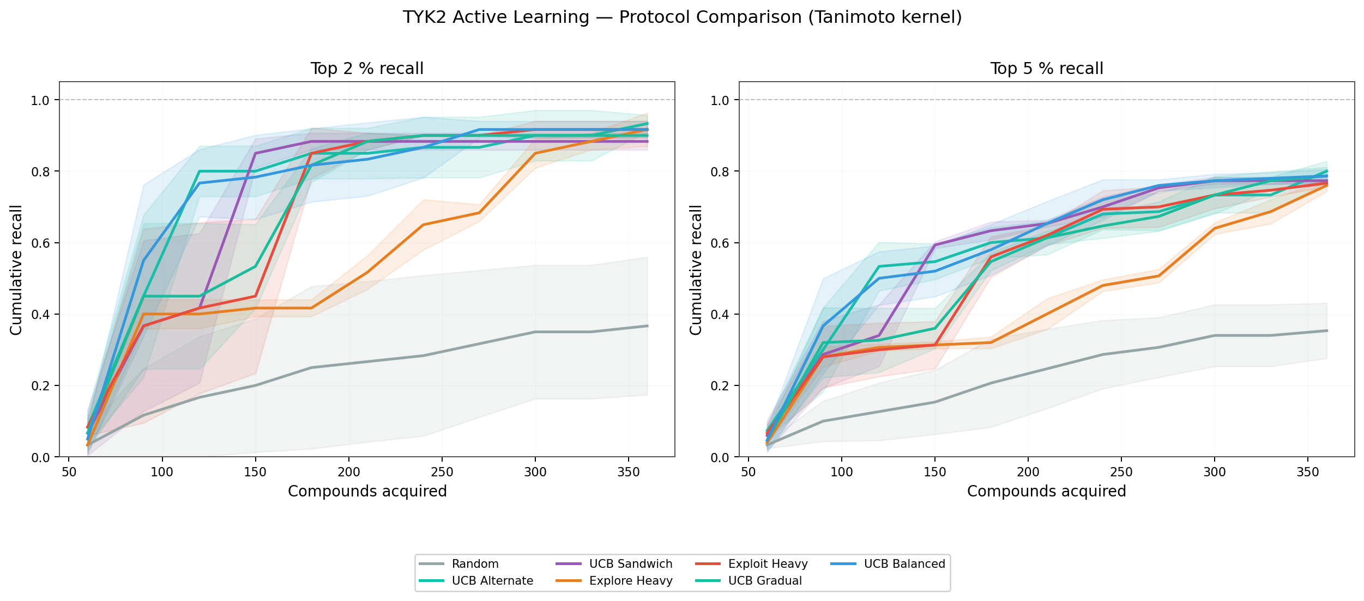

Best Protocol: UCB-Alternate
ucb-alternate
Tanimoto kernel
0.49
R²
0.62
Spearman ρ
1.64
RMSE
40/50
Top-5% recall
UCB-Alternate finds 40/50 top binders — 2.3× more than random (18/50)
with the same 360 measurements. Alternating explore/exploit is key.

Slide 8
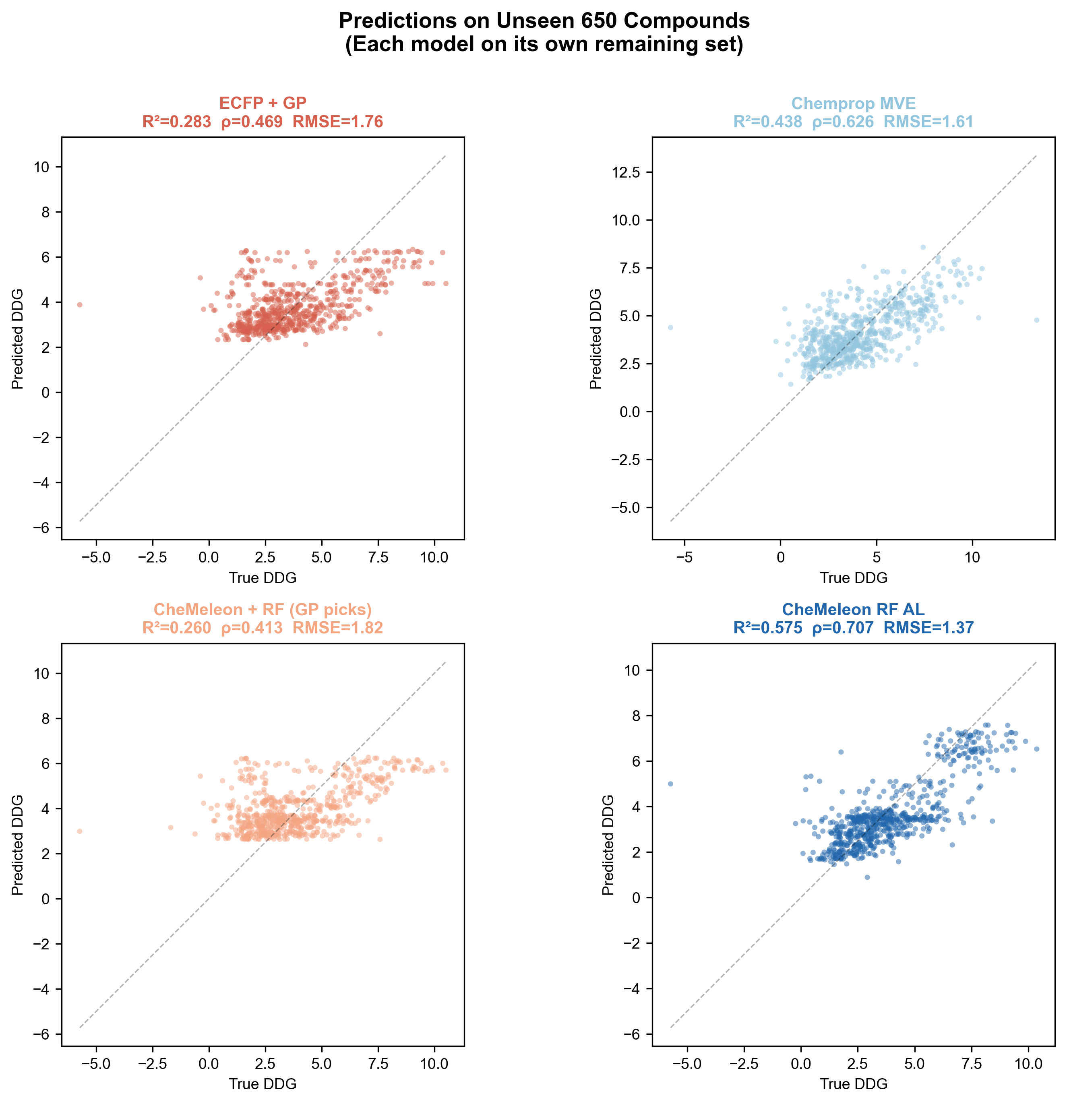
Model Leaderboard
Performance on 650 truly unseen compounds after 10 AL cycles
Model | R² ↑ | Spearman ↑ | RMSE ↓ | Top-5% ↑ | Wall Time
CheMeleon + RF | 0.575 | 0.707 | 1.37 | 39 / 50 | ~3 min
Chemprop MVE | 0.438 | 0.626 | 1.61 | 42 / 50 | ~16 min
GP (Tanimoto) | 0.283 | 0.469 | 1.76 | 41 / 50 | ~2 min
Random baseline | — | — | — | ~18 / 50 | —

Slide 9
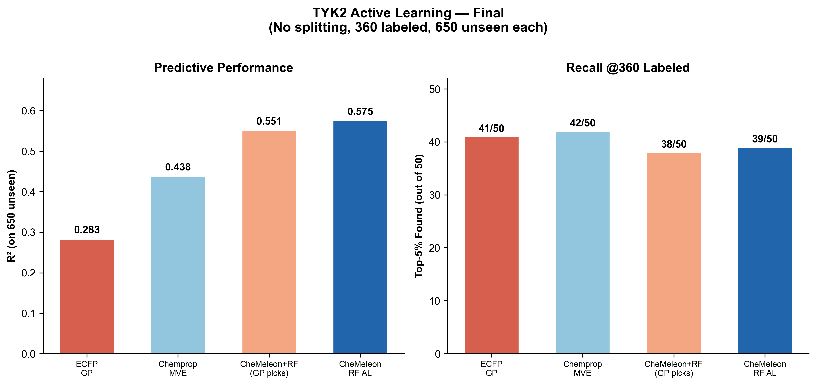
CheMeleon + RF: Best Overall
What makes it special?
Foundation model pretrained on ~8M molecules
Generates 2048-dim learned fingerprints
Captures subtle chemical patterns ECFP misses
Random Forest with tree-variance UCB
R²=0.575 — best generalization by far
R² = 0.575 · Spearman ρ = 0.707 · RMSE = 1.37 · Top-5% recall: 39/50

Slide 10


Key Insight: Selector ≠ Predictor
GP is the better SELECTOR
RF is the better PREDICTOR
GP's Tanimoto + RBF kernel explores diverse chemical space effectively
Uncertainty (std) is well-calibrated — high in unexplored regions
RBF picks: RF trains to R²=0.55 on 650 unseen
RF on CheMeleon fingerprints: R²=0.575 — best model overall
RF's own AL (tree-variance UCB): only R²=0.28 (poor explorer)
Best combo: GP picks → RF predicts
The model that explores best is NOT the same as the model that predicts best.
GP's well-calibrated uncertainty makes it the ideal exploration engine. Feed GP's picks to
RF for the most accurate predictions. This decoupling is a publishable finding.

Slide 11

Using the Pipeline
One file. Your data. Three models. Seven protocols.
# Quick start:
python al_for_everyone.py --model gp \
--protocol ucb-alternate \
--data my_data.csv --library virtual.csv
# Or use a config file:
python al_for_everyone.py --config config.txt
3 models: gp, rf, chemeleon
7 protocols: random → ucb-*
3 GP kernels: tanimoto, rbf, matern
Library screening built-in
Plots: recall curves + scatter
CSV export: selected + predictions
github.com/caithmac/al-for-everyone
Fully self-contained. Zero imports from external codebase.
Chemists can download and run immediately.

Slide 12

Recommendations
Best Accuracy
Best Explorer
Quick Start
CheMeleon + RF
R²=0.575, recall 39/50
Use for library screening
Requires chemprop >= 2.2.0
Install: conda create -n chemeleon
GP + Tanimoto + ucb-alt
R²=0.283, recall 41/50
Best uncertainty calibration
Fast: ~2 min full run
Use when interpretability matters
Default config (GP defaults)
Just provide your CSV
pip install torch gpytorch rdkit
python al_for_everyone.py \
--data my_data.csv

Slide 13
Thank You
Questions? Let's find better binders.
github.com/caithmac/al-for-everyone
al_for_everyone.py · CheMeleon + RF · GP + Tanimoto
Built with HERMES Agent

