Slide 1
Caitlan Nichols
January 06 2025
Module 1.2 - Assignment: The Technology Value Stream

Slide 2
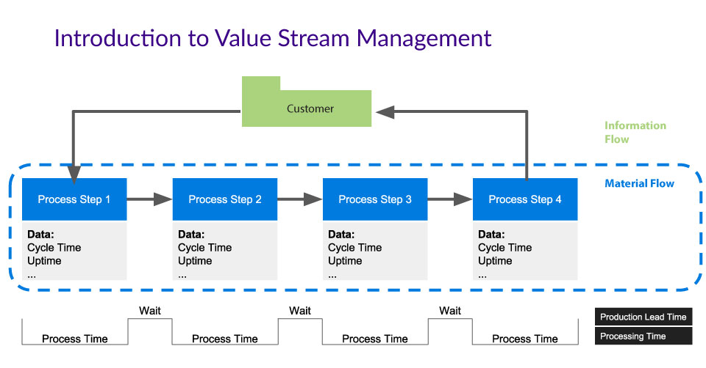
Introduction to the Technology Value Stream!
Simply put, it's a framework to map/optimize the flow of work and value.
Importance of streamlining processes to enhance efficiency and reduce waste.
Source: https://www.cloudbees.com/blog/value-stream-management-software-delivery-visibility-and-insight

Slide 3
Understanding Lead Time vs. Processing Time
Lead Time: The total time taken from the start of a work item (idea, request) to its completion (deployment).
Processing Time: The actual time spent working on a task during its lifecycle, excluding waiting times.
(source: The textbook)

Slide 4
Common Scenario - Deployment Lead Times Requiring Months
Describe the typical scenario where software deployment can take months.
For example: Imagine a financial services company deploying a new trading platform. The software needs to integrate with existing legacy systems. It must comply with law and take into account others.
Discuss reasons for this extended lead time: manual processes (Ex: Human Error and Inconsistencies) , inefficiencies in handoffs (Communication Gaps), bottlenecks in approval or testing (Overloaded Approvers like lack of WIP control).
Extended lead times in software deployment can pose several challenges to businesses, particularly when it comes to their responsiveness to market demands and their ability to innovate.

Slide 5
Our DevOps Ideal - Deployment Lead Times of Minutes
The DevOps ideal of drastically reducing deployment lead times. This allows businesses to transform their software development and deployment processes. Turning them into an agile, automated, and collaborative effort for a company rather than a guessing game.
Benefits: Faster release cycles, more frequent updates, quicker user feedback.
Highlight key strategies used in DevOps, such as automation, CI/CD pipelines, and collaborative culture.
Source: DevOps Handbook.

Slide 6
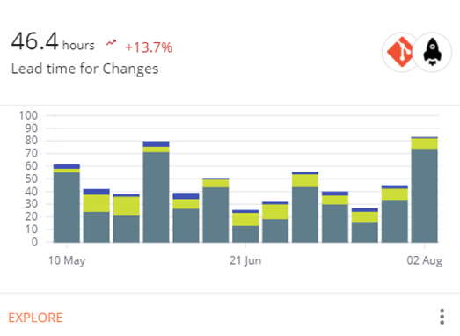
Deployment Lead Times Comparison
Source: https://plandek.com/blog/lead-time-for-changes/

Slide 7
The Role of Continuous Integration & Delivery (CI/CD)
Continuous Integration ensures that developers frequently integrate their code into a shared repository (multiple times a day). Each integration triggers an automated build and test process, allowing teams to detect errors early.
Continuous Delivery extends this by automating the deployment pipeline, so that code that passes through CI is automatically prepared for deployment to production or other environments. This ensures that the software is always in a deployable state and that releases can happen with minimal manual intervention.

Slide 8
Challenges in Achieving Fast Deployment Lead Times
Challenges:
Outdated Architecture: Legacy systems often have tight coupling between components, making it difficult to update or deploy new features without risking system stability.
Manual Processes: Many legacy systems require manual intervention for deployment, testing, and configuration, which adds significant lead time.
Technical Debt: Over time, legacy systems accumulate technical debt that complicates efforts to automate processes, making it difficult to implement modern DevOps practices.

Slide 9
Solutions in Achieving Fast Deployment Lead Times
Incremental Modernization: Instead of attempting to overhaul legacy systems entirely, organizations can incrementally modernize their systems. For example, moving to microservices architectures allows parts of the application to be updated or replaced without impacting the entire system.
Containerization: Using tools like Docker can help encapsulate legacy applications in containers, making them more portable and manageable in modern environments. This enables more automated deployments and reduces the impact of manual processes.
API Wrappers: Wrapping legacy systems with APIs can provide a way to modernize functionality without requiring a complete rewrite. APIs allow newer systems to integrate with older infrastructure more seamlessly, reducing deployment bottlenecks.

Slide 10
Sources:
Our textbook, chapters 1-4
ChatGPT (to help lessen my words and organize things)
https://plandek.com/blog/lead-time-for-changes/
https://www.cloudbees.com/blog/value-stream-management-software-delivery-visibility-and-insight
0-09[=pppppppppppppppppppp

