Slide 1
Case Study 2
6306
Caitlin Endler

Slide 2
Introduction
DDSAnalytics is looking for insight on attrition and job role-specific trends.
As well, we have been asked to create a model that predicts monthly salary.
We will create a model to predict attrition using Naïve Bayes.
We will create a model to predict salary using multiple linear regression.
We will also provide additional insight on job role trends.

Slide 3
Predicting Attrition with Naïve Bayes
Naïve Bayes classifiers are based on Bayes’ Law:
  P(A|B) = P(B|A)P(A)/P(B)
  They’re called naïve because they assume independence between the predictor variables.
Our model uses the following variables as predictors:
  Age
  Job Involvement
  Job Level
  Job Role
  Job Satisfaction
  Marital Status
  Monthly Income
  Number of Companies Worked
  Over Time
  Stock Option Level
  Total Working Years
  Work-Life Balance
  Years At Company
  Years with Current Manager

Slide 4
Predicting Attrition with Naïve Bayes
Our attrition model has:
90.04% accuracy
94.27% sensitivity (percent of retained employees classified correctly)
61.76% specificity (percent of turned-over employees classified correctly)

Slide 5
Predicting Attrition with Naïve Bayes
To determine the top three contributors to attrition, we took the predictors from our model and constructed a new model with each combination of three predictors. Of these combinations, that from the model best able to predict attrition (turned-over employees) was deemed the top three contributors.
The top three contributors were Job Level, Monthly Income, and Over Time.

Slide 6
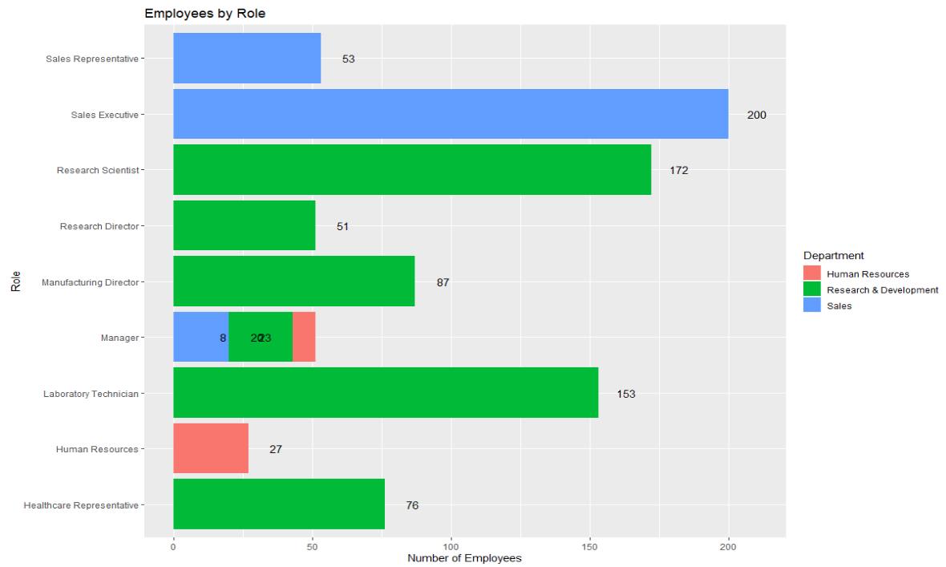
Job Role Insights

Slide 7
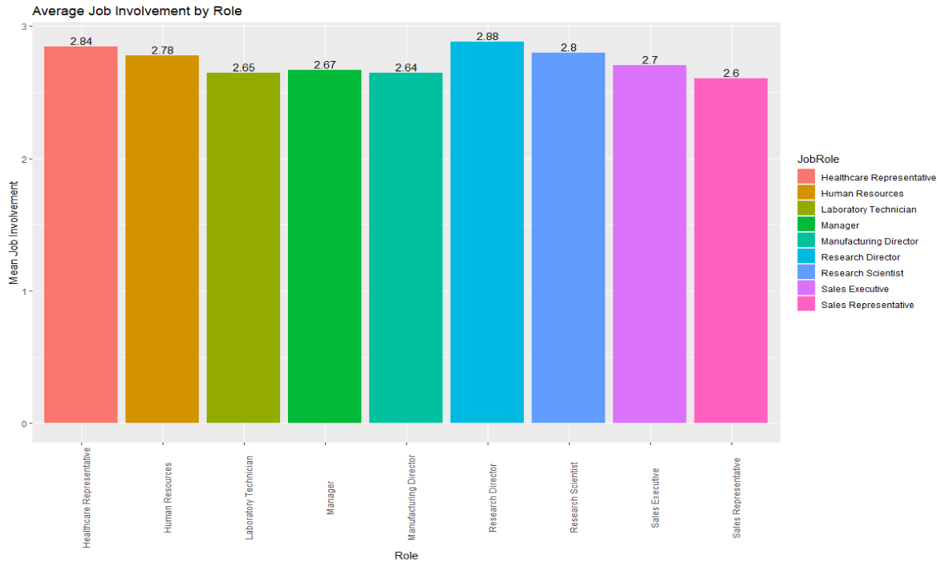
Job Involvement

Slide 8
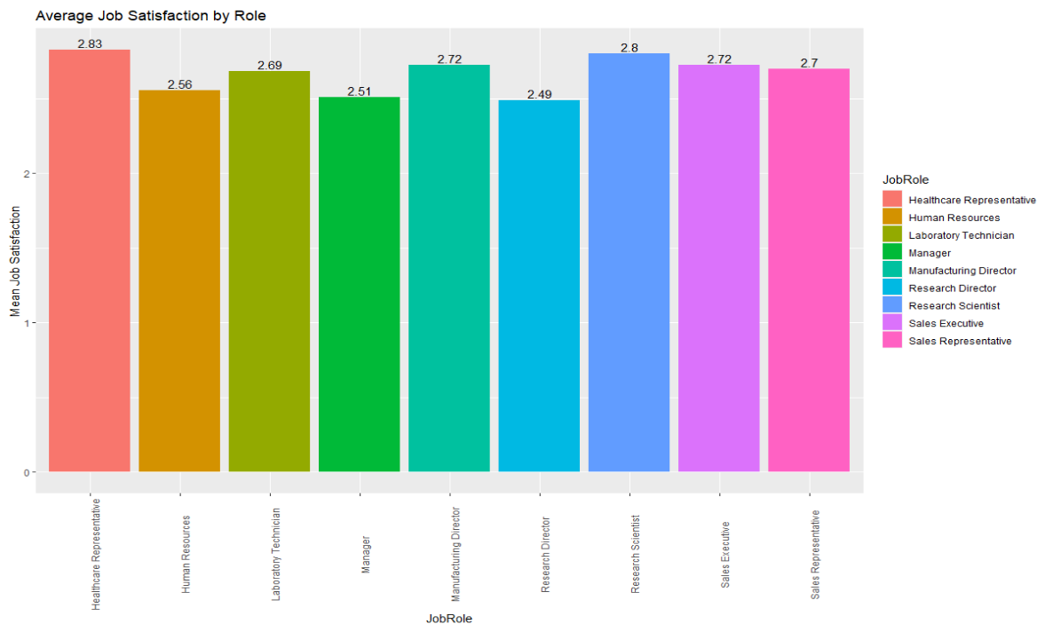
Job Satisfaction

Slide 9
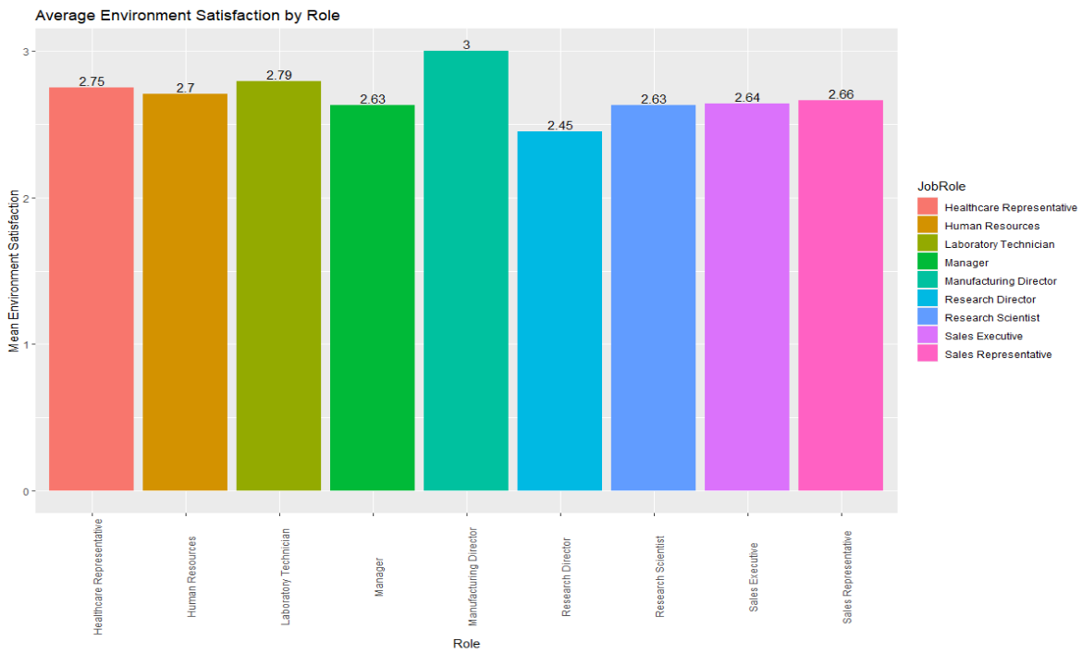
Environment Satisfaction

Slide 10
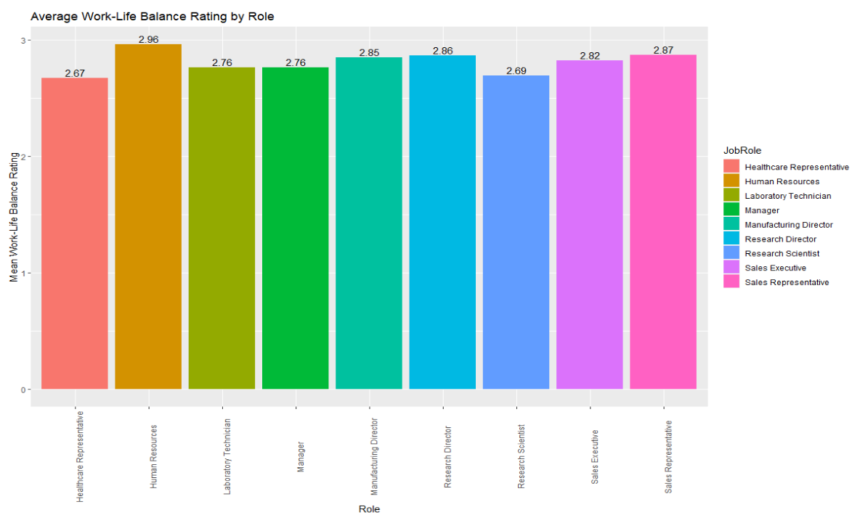
Work-Life Balance Rating

Slide 11
Predicting Salary with MLR
Multiple linear regression (MLR) is a technique in which several explanatory variables are used to predict the outcome of a single response variable. This is done by fitting a linear equation to the observed data.
The assumptions of multiple linear regression are as follows:
  There should be a linear relationship between the response variable and each explanatory variable.
  For each value of the explanatory variables, the distribution of residuals should have the same variance.
  The residuals should be normally distributed.
  There should be independence between observations.

Slide 12
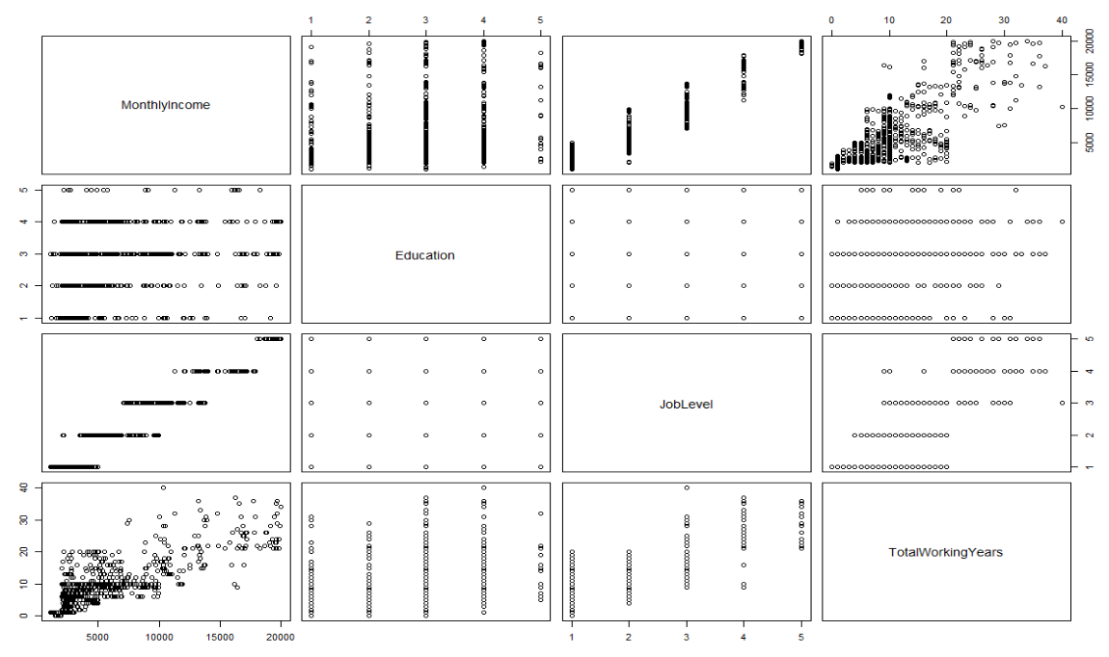
Predicting Salary with MLR
From the scatterplot matrix on the right, we can see that the first assumption is satisfied by looking at the top row.

Slide 13
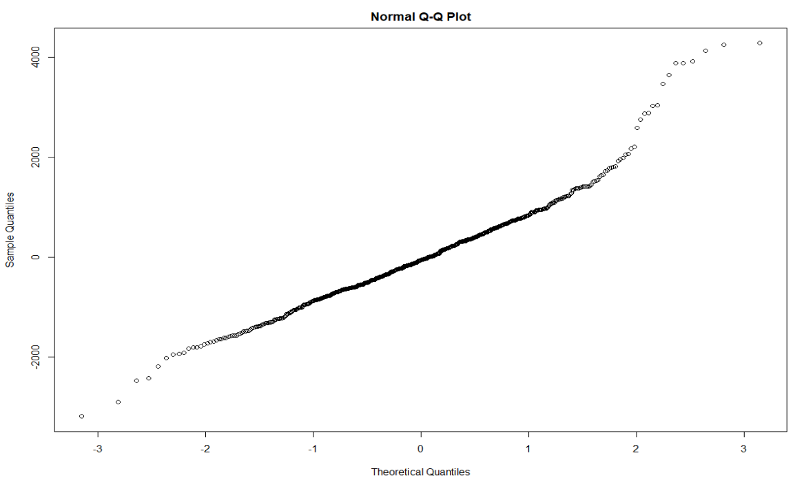
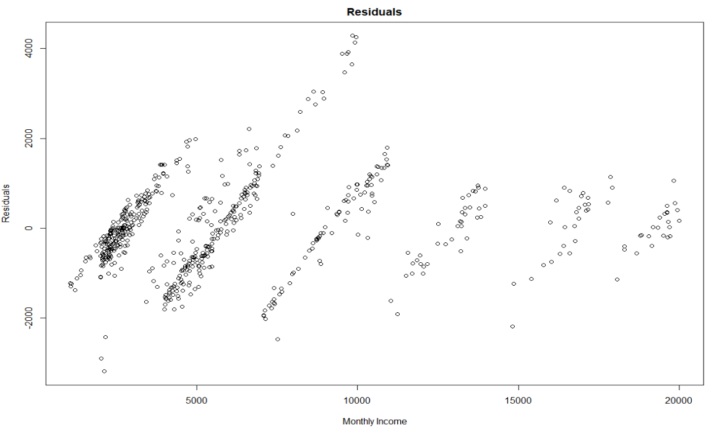
Predicting Salary with MLR
From the Q-Q plot and the scatterplot, we can see that the residuals have a mostly normal distribution and the variance is staying constant.
We will assume independence between observations.

Slide 14
Predicting Salary with MLR
Our model uses the following variables as predictors:
  Department
  Education
  Job Level
  Job Role
  Total Working Years
Our model contained several categorical variables, for which each level gets a coefficient in the equation. Though not all of these indicator coefficients were statistically significant, we chose to keep them in the model because removing them resulted in a higher RMSE.
The RMSE of our model was $981.16.

Slide 15
Conclusion
We were tasked with finding a model to predict attrition, a model to predict monthly salary, and insights on job role trends. A Naive Bayes Model performed the best in regards to predicting attrition. The multiple linear regression model was used to predict monthly salary. Most notably, we found that research directors are least satisfied with their jobs and environments and most involved with their jobs, and healthcare representatives have the lowest work-life balance but highest job satisfaction.

