Slide 1
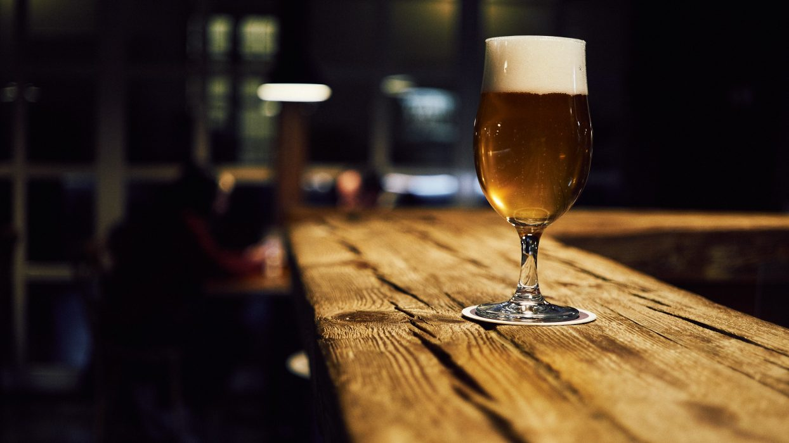
MSDS 6306: Case Study 1
Beer and Breweries Across United States
By-Rashmi Patel-Caitlin Endler

Slide 2
Executive Summary
Budweiser is exploring the craft brewery market. We will review current trends for beer in this industry and provide insight for growth opportunities in the market.
Notes:
The ceo and cfo of budweiser company have hired us to do some analysis on beers and breweries to know the useful insights and current trends in united states market

Slide 3
Agenda
Existing craft breweries in United States
Types of Craft Beers
Addressing missing values
Median of Alcohol by volume(ABV) and Median International Bitterness Unit(IBU) of each state
Most Alcohol by volume(ABV) and Most International Bitterness Unit(IBU) Beer
Summary of Alcohol by Volume(ABV) distribution
Investigate the difference with respect to IBU and ABV between IPAs and Ale using KNN classifier.
Extra insights that can be useful

Slide 4
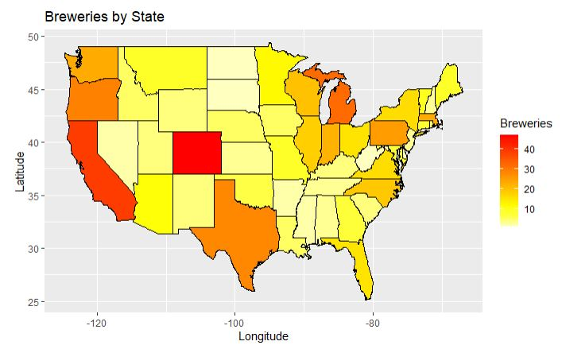
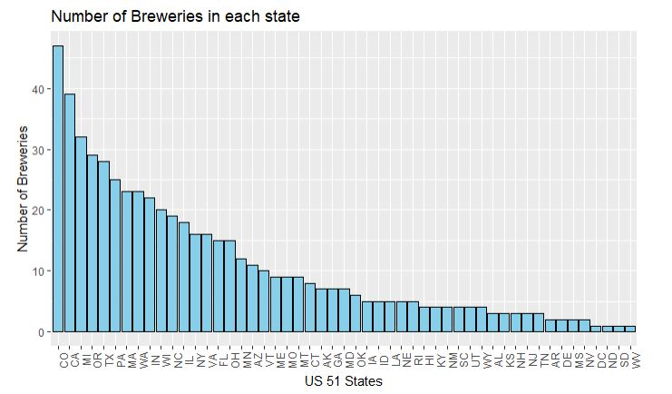
Existing craft breweries in United States
Top 5 States | Bottom 4 States
Colorado | DC
California | South Dakota
Michigan | North Dakota
Oregon | West Virginia
Texas
Colorado has the most breweries in United States with 47.
Other than Colorado, the states having most breweries are clustered along US border and coasts.
**Each of these bottom 4 states have only 1
brewery in the entire state
Notes:
every state has atleast one brewery but some states dominates the craft breweries. colorado has highest number of breweries with count of 47 and dc sd nd wv are in bottom 4 because they have only 1 in entire state. other states with high number of breweries are located in coasts and border of US

Slide 5
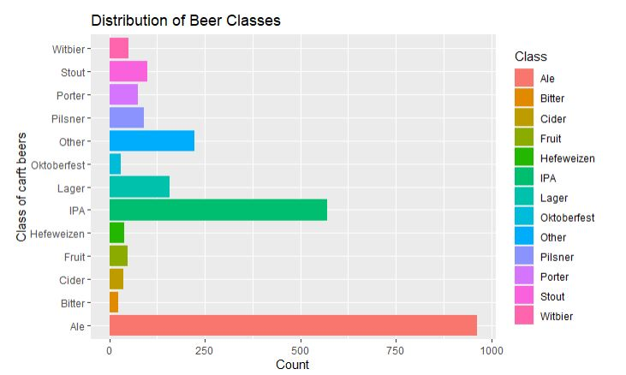
Types of Craft Beers
There are 100 different style of craft beers brewed in the United States.
Classes of Beer have style variants, i.e., Ales include English Pale, Irish Red, etc.
When grouped into classes, IPA’s And Ales account for 64% of all craft beers.
Notes:
we saw that data contained 100 styles of beer so we decided to classify them in classes. we found that ipa and ale alone account for 64% of all beers

Slide 6
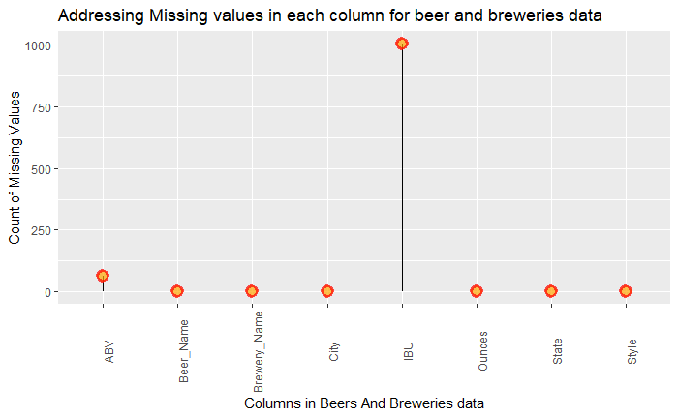
Addressing missing values
IBU information has 1005 of 2410 missing entries approximately 42%.
ABV information has 62 of 2410 missing entries approximately 2.6%.
We replaced the NA values with the imputed mean for each class of beer.
Note: Bitterness data is not available for South Dakota.
Notes:
talking about missing values, visually it seems that ibu has a lot missing values. ibu had 1005 missing values which 42% of ibu data provided and abv has 62 missing values which 2.6% of abv data provided. thinking of to get better results we replaced null values with imputed mean. note that no bitterness dat was given for sd knowing that only 1 brewery is there in entire sd.

Slide 7
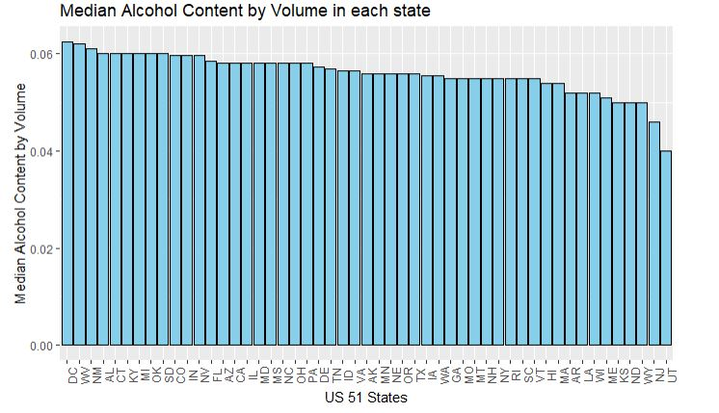
Median ABV by each state
Top 5 States | ABV values | Bottom 5 States | ABV values
DC | 6.25% | Kansas | 5.00%
West Virginia | 6.20% | North Dakota | 5.00%
New Mexico | 6.21% | Wyoming | 5.00%
Alabama | 6.00% | New Jersey | 4.60%
Connecticut | 6.00% | Utah | 4.00%
For almost all the states, we found median Alcohol by volume in between 5% to 6%
Notes:
when looking at median abv by each state washington dc has highest median abv with 6.25% and utah had lowest with 4% and all other states has median abv in between 5 to 6%

Slide 8
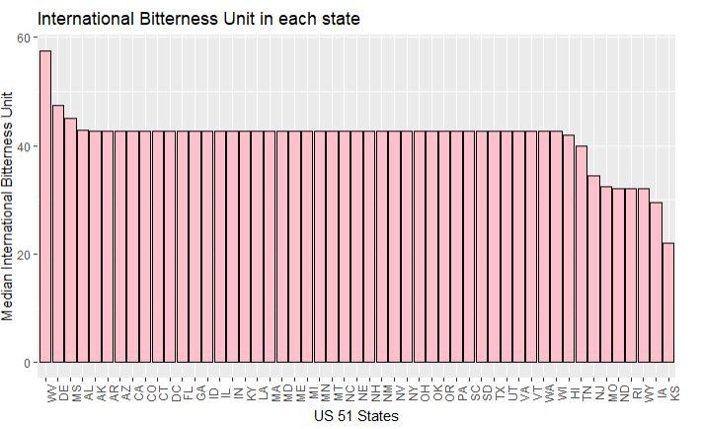
Median IBU by each state
Top 5 States | IBU values | Bottom 5 States | IBU values
West Virginia | 57.50 | North Dakota | 32.00
Delaware | 47.35 | Rhode Island | 32.00
Mississippi | 45.00 | Wyoming | 32.00
Alabama | 42.71 | Iowa | 29.50
Arkansas | 42.71 | Kansas | 22.00
For most of the states having sufficient large samples, the median of International Bitterness Unit(IBU) is in mid 40’s
Notes:
when looking at median ibu by each state west virginia has highest median ibu with 57.5 and kansas had lowest with 22.0 and all other states has median ibu in mid 40s

Slide 9
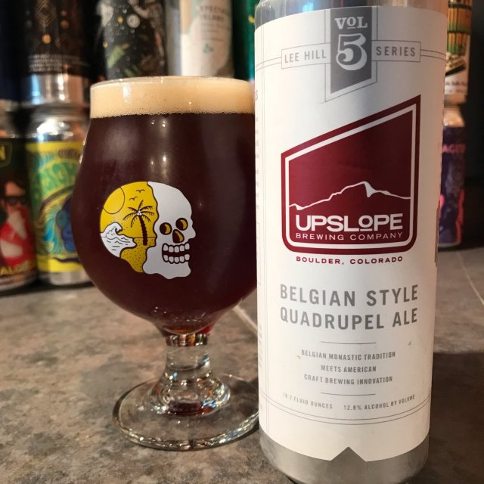
Most Alcoholic Beer in United States
Upslope Brewing Company (Colorado) has the most Alcohol by volume beer named “Lee Hill Series Vol. 5 - Belgian Style Quadrupel Ale” of 19.2 Oz with ABV=12.8% and no IBU score is given.

Slide 10
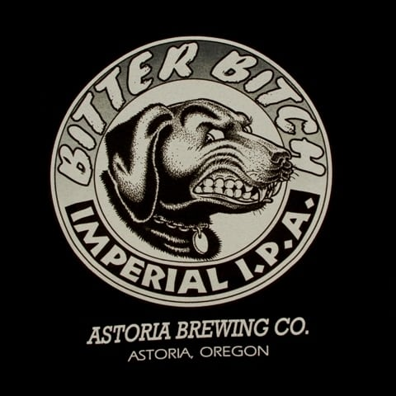
Most Bitter Beer In United States
Astoria Brewing Company (Oregon) has the most bitter beer named “Bitter Bitch Imperial IPA” of 12 Oz with IBU=138 and ABV=8.2%.

Slide 11
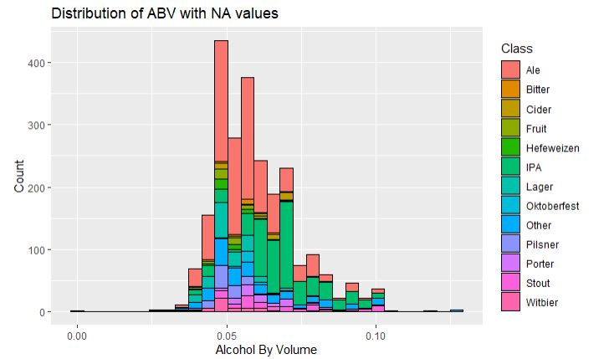
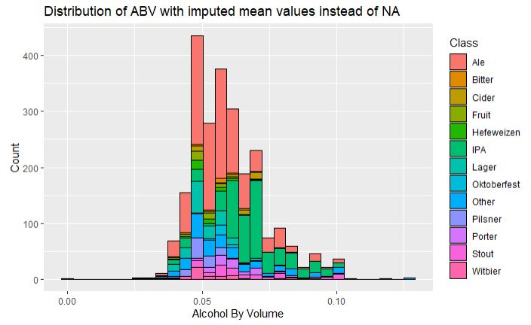
Summary of Alcohol by volume (ABV) distribution
ABV distribution is relatively normal with a right skewness.
Looking at the graph, it seems IPA is contributing mostly to the right.
By imputing the mean the median changes to 0.0570 with other statistics being same.
Parameter | Values(Total=2410)
Minimum | 0.01000
1st Quantile | 0.05000
Median | 0.05600
Mean | 0.05977
3rd Quantile | 0.06700
Maximum | 0.12800
NA’s | 62(2.6%)
Notes:
looking at summary of abv distribution, visually the data seems to be approximately normal with some right skewness. it also seems that ipa mostly contribute to right which indiacate higher alcohol content in it. when the null values was replaced by mean the median increased from 0.056 to 0.057 being other statistics same

Slide 12
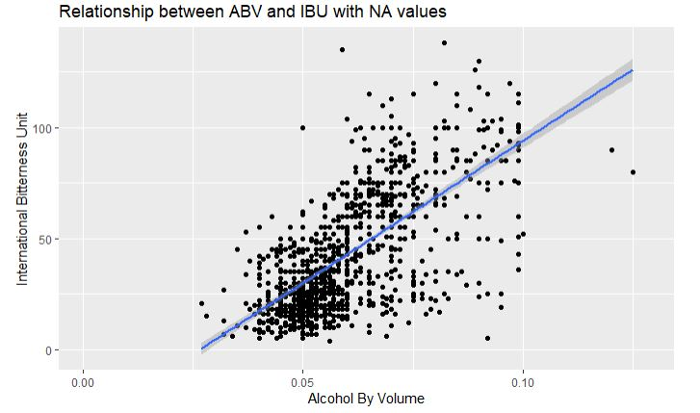
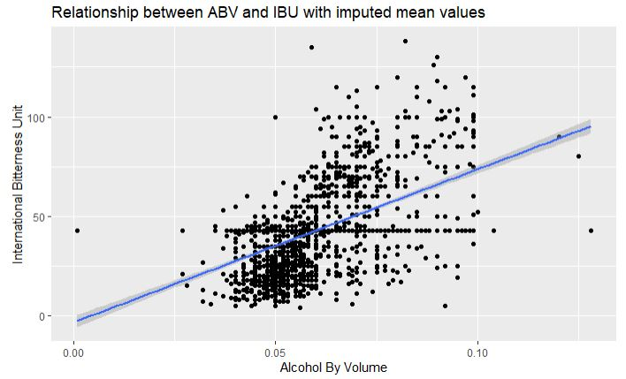
Relationship between ABV and IBU
There is a positive relationship between ABV and IBU that means more is the alcohol content in the beer, more the bitter will be the beer.
The graph with null values account for a variation of approximately 45% estimated that the bitterness of a particular beer can be accounted by its alcohol content.
The graph with imputed mean values shows a decrease in variation from 45% to 27%. This decrease can be related to many other factors, some of the reason being the non-alcoholic beer, sugar used for fermentation, etc.
Notes:
there seems to be positive relationship between ibu and abv indicating that more is the alcohol content, more is the bitterness of the beer. when ull values was replaced with mean the variation seems to have a decease from 45% to 27%. there may be many reasons for this decrease but one reason is non alcoholic beer present in the data.

Slide 13
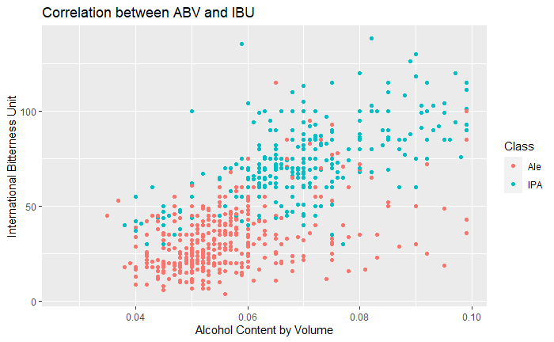
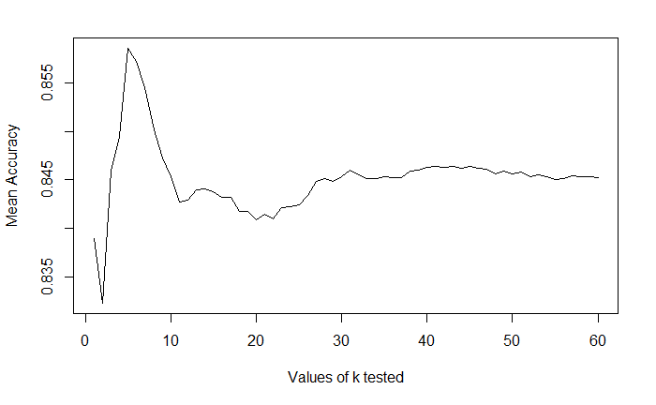
KNN model for ABV versus IBU
We trained the data with 100 iterations and then tested the model for highest accuracy.
A k-nearest model (with NA’s omitted) gives an accuracy of 85% at k=5 which means the number of beers correctly classified as either IPA or other Ale..
The model has a sensitivity of over 88%--which means over 88% of the Ales were identified correctly.
The model has a specificity of over 81%--which means over 81% of the IPA's were identified correctly.
Notes:
based the ibu abv relationship we built a machine learning model using knn classifier that has 85 % accuracy at k=5 which means the ability of model to classify the beer as an ipa or as an ale. the model has sensitivity of 88% and specificity of 81%

Slide 14
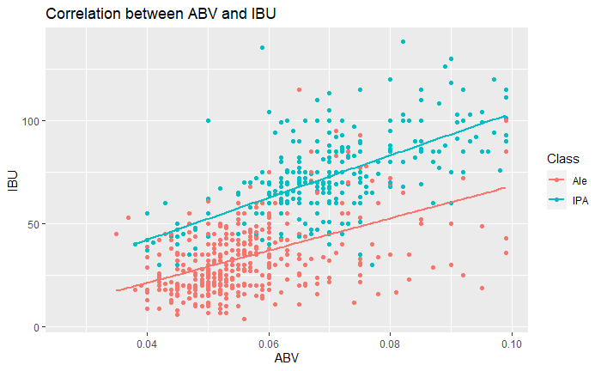
ABV and IBU relationship for IPA and Ale
IPA has positive relationship with a variation of approximately 41% estimated that the bitterness(IBU) of a particular beer can be accounted by its alcohol content(ABV).
Ale has a positive relationship lower than IPA with a variation of approximately 24% estimated that the bitterness(IBU) of a particular beer can be accounted by its alcohol content(ABV).
IPAs are more bitter than Ales.
Notes:
now looking at some extra insights. the relationship betwwen ibu and abv specifically for ipa and ale. visually we can see that ipa wins the race.it has 41% variatio expalined while ale has only 24% variation explained. the graph suggests that ipa are surely bitter than ale

Slide 15
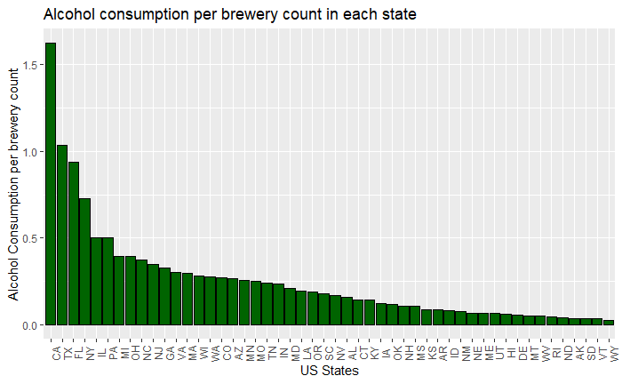
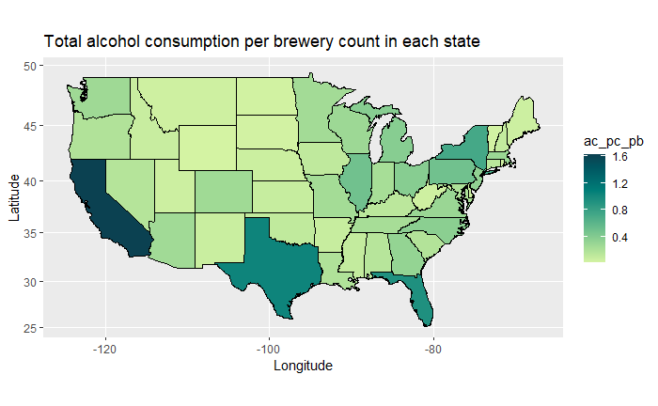
Further studies and recommendations
Top 5 States | Alcohol consumption per brewery count(in million gallons) | Bottom 5 States | Alcohol consumption per brewery count(in million gallons)
California | 1.624 | Wyoming | 0.026
Texas | 1.036 | Vermont | 0.034
Florida | 0.940 | South Dakota | 0.034
New York | 0.726 | Arkansas | 0.034
Illinois | 0.504 | North Dakota | 0.040
California has the highest alcohol consumption per brewery of 1.624 million gallons whereas Colorado with maximum number of breweries in United States have alcohol consumption per brewery of 0.272 million gallons.
Most of the states have alcohol consumption per brewery count is in between 0.026 to 0.5 million gallons.
Notes:
then we took some external data and did some analysis and found that california has the highest alcohol consumption per brewery count which is 1.624 million gallons and wyoming having the lowest alcohol consumption though colorado have the highest number of breweries but the alcohol consumption per brewery count is just 0.272 million gallon. the other states seems to have alcohol consumption in between 0.026 to 0.5 million gallons per brewery count

Slide 16
Further studies and recommendations
The top 5 states account for 42% of all the alcohol consumed per brewery count.
The bottom 5 states account for 1.32% of all the alcohol consumed per brewery count.
Minimum | 1st Quantile | Median | Mean | 3rd Quantile | Maximum
0.0260 | 0.0705 | 0.1760 | 0.2539 | 0.2960 | 1.6240
Notes:
the top 5 states account 42% alcohol consumption per brewery and bottom 5 with just 1.32%

Slide 17
Conclusion
In conclusion, we found that IPAs and other ales make up 64% of all craft beers. There's a linear relationship between alcohol content and bitterness within a beer,
and the relationship is stronger for IPAs than for other ales.
Given alcohol content and international bitterness rating, we can identify a beer as an IPA or as an Ale with over 85% accuracy.
Finally, the five states with the greatest alcohol consumption per brewery makeup over 40% of total alcohol consumption per brewery. If Budweiser wants to increase their market share by tapping into the craft brew market, they should focus on these states, and they should focus on IPAs or other ales. Despite the market saturation, these seem to be the states with the most demand.

Slide 18
Further studies and recommendations
Review various sales data on top craft beers.
Review the brewery and alcohol laws for the state.

Slide 19
Thank you
Notes:
thank you for watching my presentation. stay safe stay healthy in this pandemic. thank you bye bye

