Slide 1
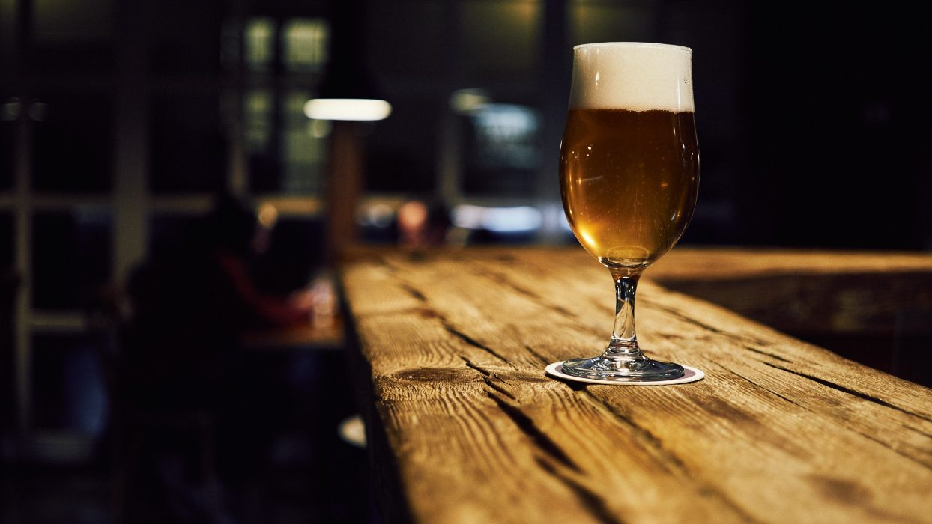
MSDS 6306: Case Study 1
Beer and Breweries Across United States
By Rashmi Patel and Caitlin Endler

Slide 2
Executive Summary
Budweiser is exploring the craft brewery market. We will review current trends for beer in this industry and provide insight for growth opportunities in the market.

Slide 3
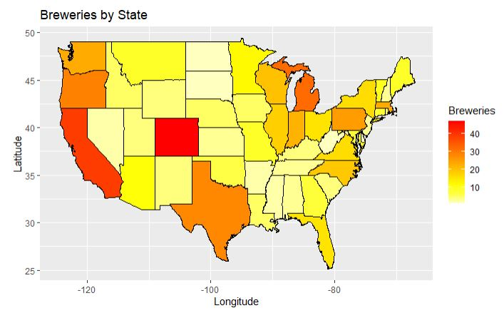
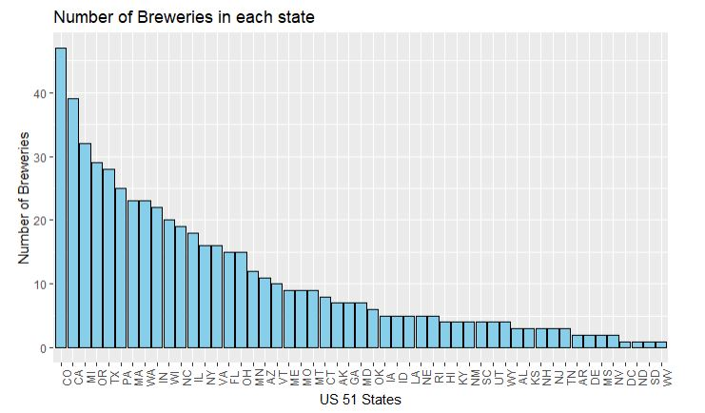
Existing craft breweries in United States
Top 5 States | Bottom 4 States
Colorado | DC
California | South Dakota
Michigan | North Dakota
Oregon | West Virginia
Texas
Colorado has the most breweries in United States with 47.
Other than Colorado, the states having most breweries are clustered along US border and coasts.
**Each of these bottom
Bottom 4 states have only 1
brewery in the entire state

Slide 4
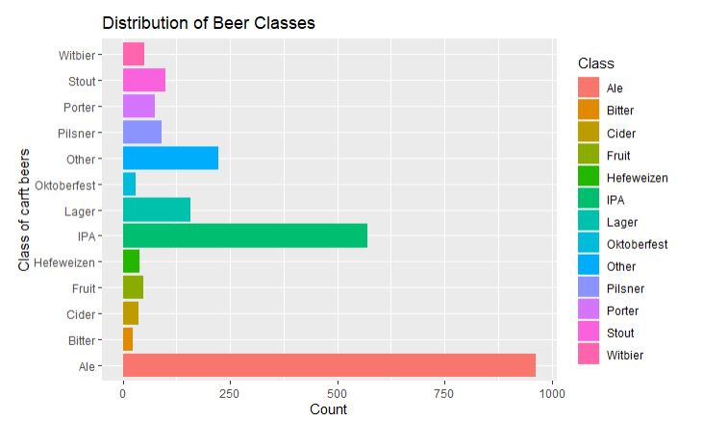
Types of Craft Beers
There are 100 different style of craft beers brewed in the United States.
Classes of Beer have style variants, i.e., Ales include English Pale, Irish Red, etc.
When grouped into classes, IPA’s And Ales account for 64% of all craft beers.

Slide 5
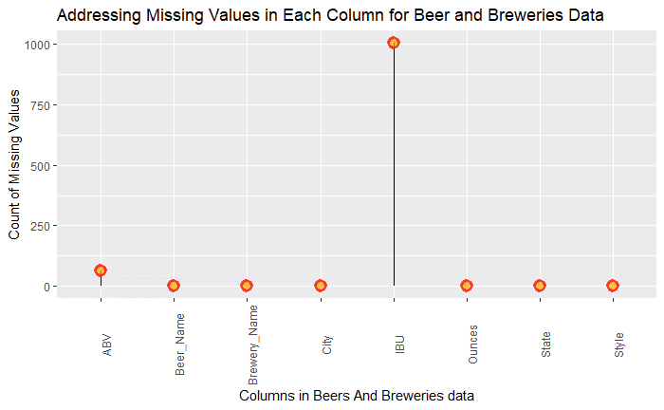
Addressing missing values
ABV information has 62 of 2410 missing entries, approximately 2.6%.
IBU information has 1005 of 2410 missing entries, approximately 42%.
We replaced the NA values with the imputed mean for each class of beer.
Note: Bitterness data is not available for South Dakota.

Slide 6
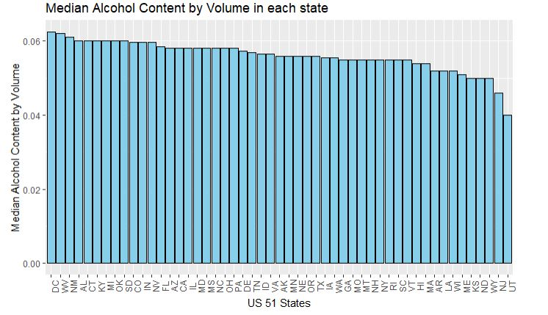
ABV by each state
Top 5 States | ABV values | Bottom 5 States | ABV values
DC | 6.25% | Kansas | 5.00%
West Virginia | 6.20% | North Dakota | 5.00%
New Mexico | 6.21% | Wyoming | 5.00%
Alabama | 6.00% | New Jersey | 4.60%
Connecticut | 6.00% | Utah | 4.00%
For almost all states, we found the median Alcohol by volume to be in between 5% to 6%

Slide 7
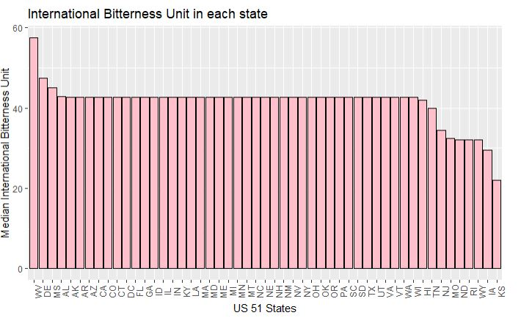
IBU by each state
Top 5 States | IBU values | Bottom 5 States | IBU values
West Virginia | 57.50 | North Dakota | 32.00
Delaware | 47.35 | Rhode Island | 32.00
Mississippi | 45.00 | Wyoming | 32.00
Alabama | 42.71 | Iowa | 29.50
Arkansas | 42.71 | Kansas | 22.00
For most states, the median of International Bitterness Units (IBU) rating is in the low 40’s
Note we replaced 42% of the data with the mean.

Slide 8
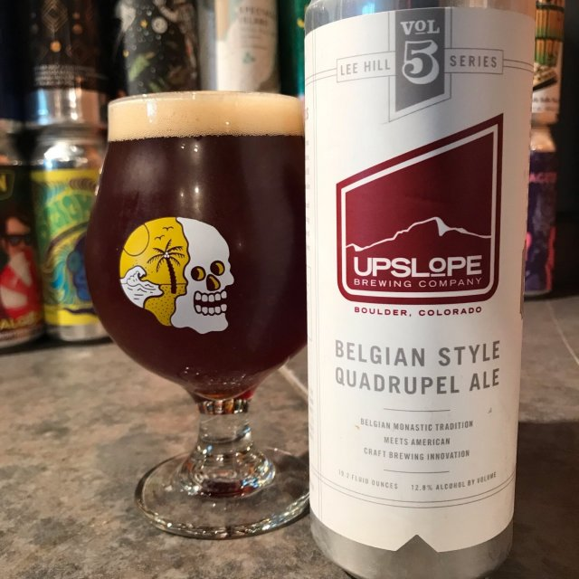
Maximum ABV and IBU Beers
Upslope Brewing Company in Colorado has the most alcoholic beer, named “Lee Hill Series Vol. 5 - Belgian Style Quadrupel Ale,” of 19.2 Oz, with ABV =12.8%.

Slide 9
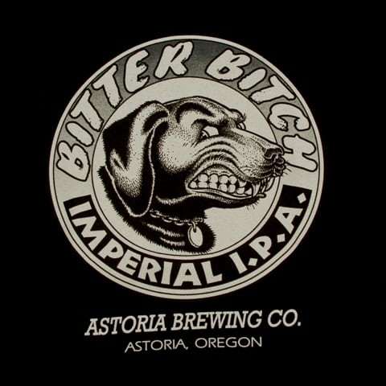
Maximum ABV and IBU Beers
Astoria Brewing Company in Oregon has the most bitter beer, named “Bitter Bitch Imperial IPA,” of 12 Oz, with IBU=138 and ABV=8.2%.

Slide 10
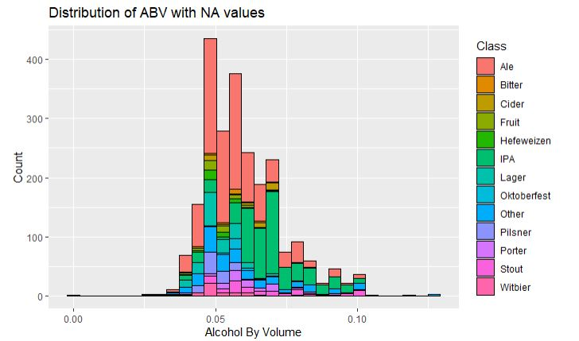
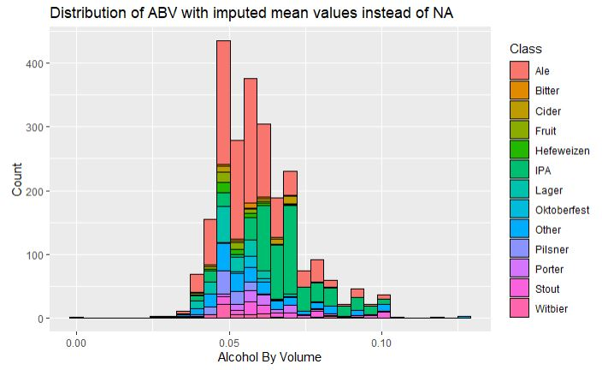
Summary of Alcohol by volume (ABV) distribution
ABV distribution is relatively normal with a right skewness.
The visual evidence suggests the IPAs, which are generally somewhat more alcoholic, contribute to the right skewness.
Parameter | Values(Total=2410)
Minimum | 0.01000
1st Quantile | 0.05000
Median | 0.05600
Mean | 0.05977
3rd Quantile | 0.06700
Maximum | 0.12800
NA’s | 62(2.6%)

Slide 11
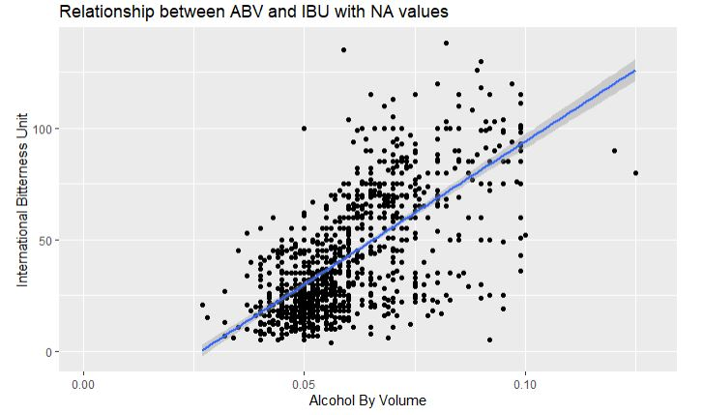
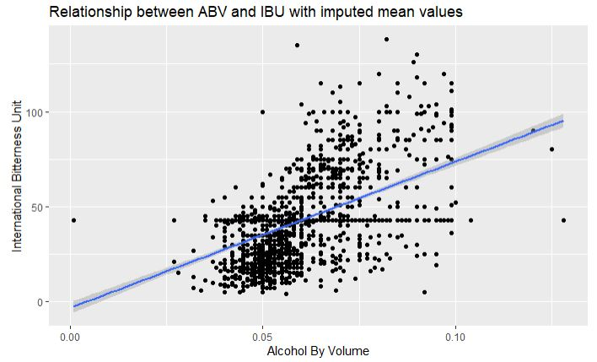
Relationship between ABV and IBU
There is a positive relationship between ABV and IBU rating.
Without imputing the nulls, it is estimated that 45% of the variation in IBU can be attributed to the linear relationship.
With the imputed nulls, it is estimated that 27% of the variation in IBU can be attributed to the linear relationship.
This may be due to breweries wishing to balance the amount of sugar in fermentation (which makes a beer more alcoholic) with the amount of hops used in the process (which can make a beer more bitter).

Slide 12
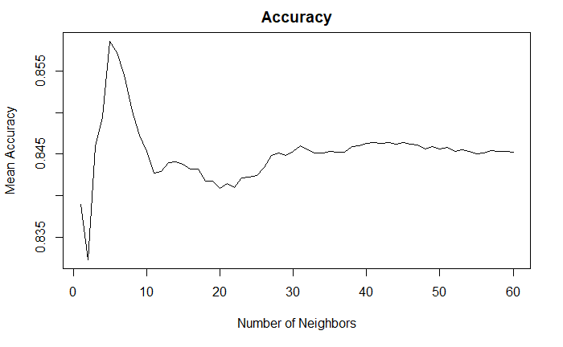
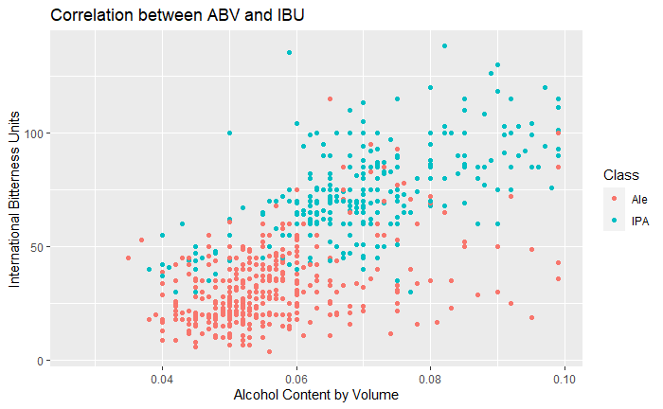
Classifying Ales with KNN
We trained a K-Nearest Neighbors model with 100 iterations to find the number of neighbors with the highest accuracy.
Given ABV and IBU, our KNN model has over an 85% accuracy rate—the percentage of beers correctly classified as either IPA or other Ale.
The model has a sensitivity of over 88%—that is of the Ales, over 88% were identified correctly.
The model has a specificity of over 81%—that is, of the IPAs, over 81% were identified correctly.

Slide 13
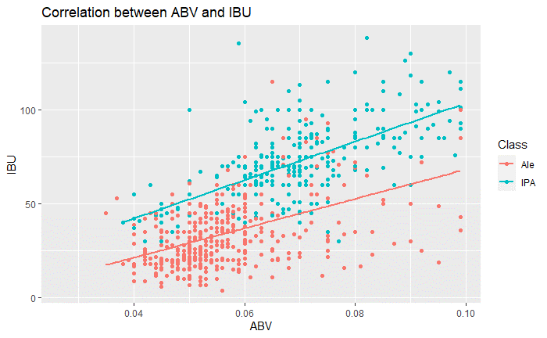
Additional Insights
For IPAs, the relationship between ABV and IBU is once again positive, with an estimated 41% of variation in IBU attributed to ABV.
For other ales, a positive relationship, with an estimated 24% of variation in IBU attributed to ABV.
We can also see from the graph that IPAs are generally more bitter than other ales.

Slide 14
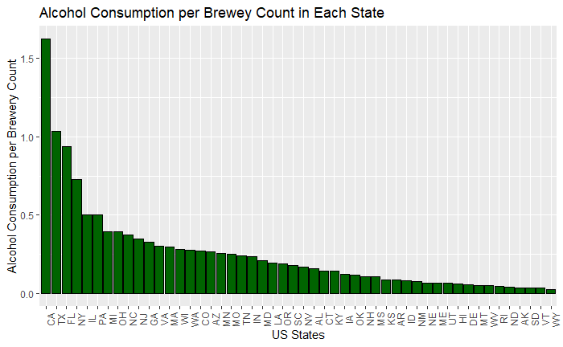
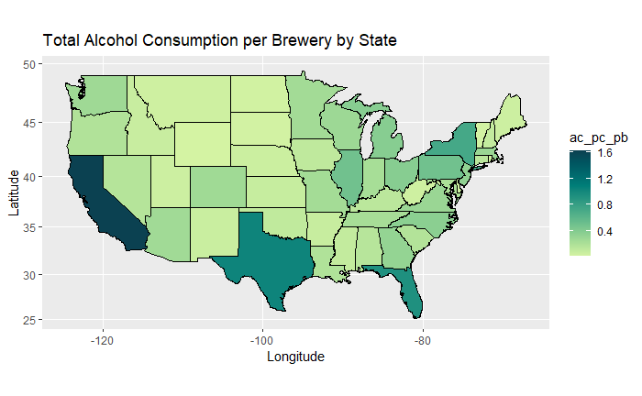
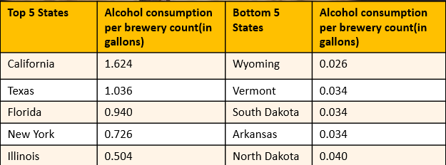
Additional Insights
The top 5 states (California, Texas, Florida, New York and Illinois) account for 42% of all the alcohol consumed per brewery count.
The bottom 5 states (North Dakota, Alaska, South Dakota, Vermont, and Wyoming) account for 1.32% of all the alcohol consumed per brewery count.

Slide 15
Conclusion
In conclusion, we found that IPAs and other ales make up 64% of all craft beers. There's a linear relationship between alcohol content and bitterness within a beer, and the relationship is stronger for IPAs than for other ales. Given alcohol content and international bitterness rating, we can identify a beer as an IPA or as an other ale with over 85% accuracy. Finally, the five states with the greatest alcohol consumption per brewery make up over 40% of total alcohol consumption per brewery. If Budweiser wants to increase their market share by tapping into the craft brew market, they should focus on these states, and they should focus on IPAs or other ales. Despite the market saturation, these seem to be the states with the most demand. Additional research could include reviewing sales data on top craft beers and reviewing brewery and alcohol laws for different states.

Slide 16
Thank you

Slide 17
YouTube: https://www.youtube.com/watch?v=dliZp8-Yfaw&ab_channel=CaitlinEndler

