Slide 1

-JSR 14- Adding generics to java
Principals of Programing Languages
Heather L. Dykstra
Caitlin E. Hickey
Michael D. Williams

Slide 2
What is it?

Slide 3
Generics in general

Slide 4
When was it proposed?

Slide 5
When did it get its final release?

Slide 6
How the community worked to make the dream come true

Slide 7
What the community struggled with

Slide 8
The general anger of other language communities

Slide 9
Why c# users were so upset

Slide 10
What went really well

Slide 11
How the java community was happy with the results

Slide 12
What happens next

Slide 13
Other info

Slide 14
The paper is 1500 words without code

Slide 15
He is crazy

Slide 16
I have no clue what else to add to these slides…

Slide 17
I need 3 more…

Slide 18
Some graphs of angry men

Slide 19
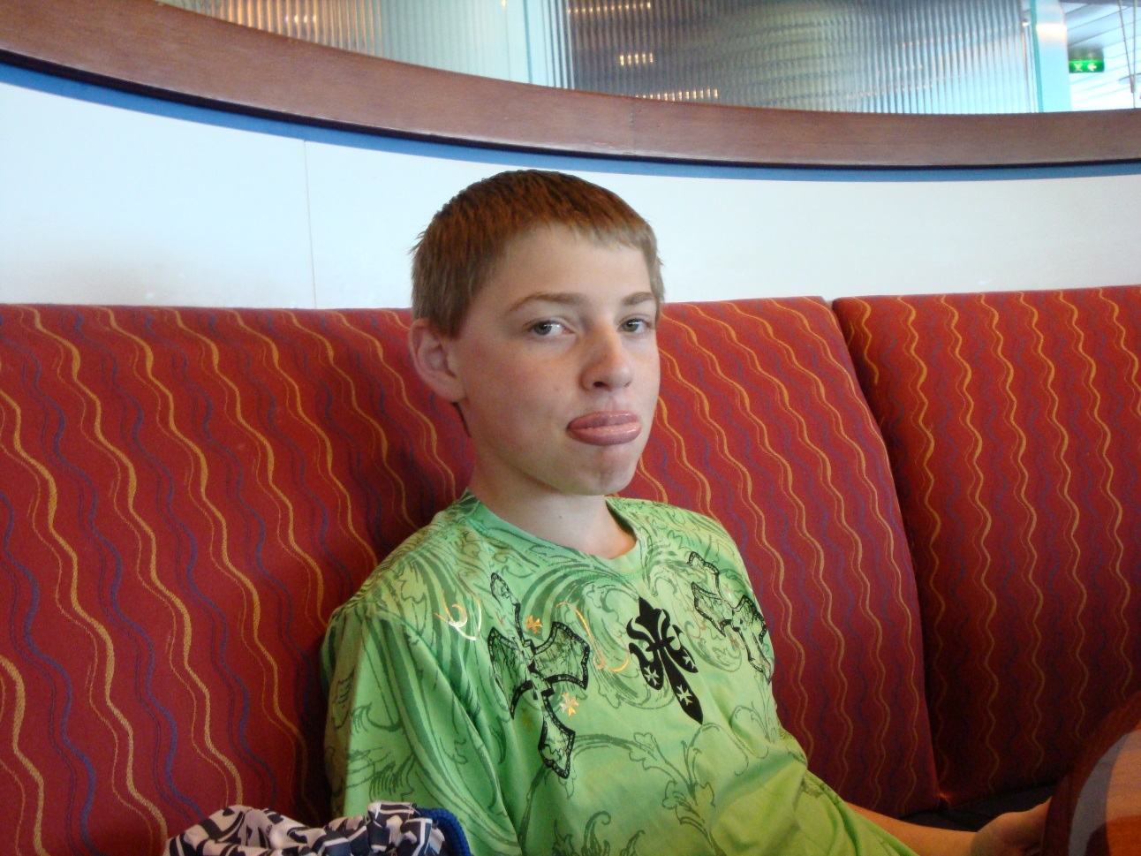
Pictures of upset community members

Slide 20
Any Questions?
Thank you!

