Slide 1
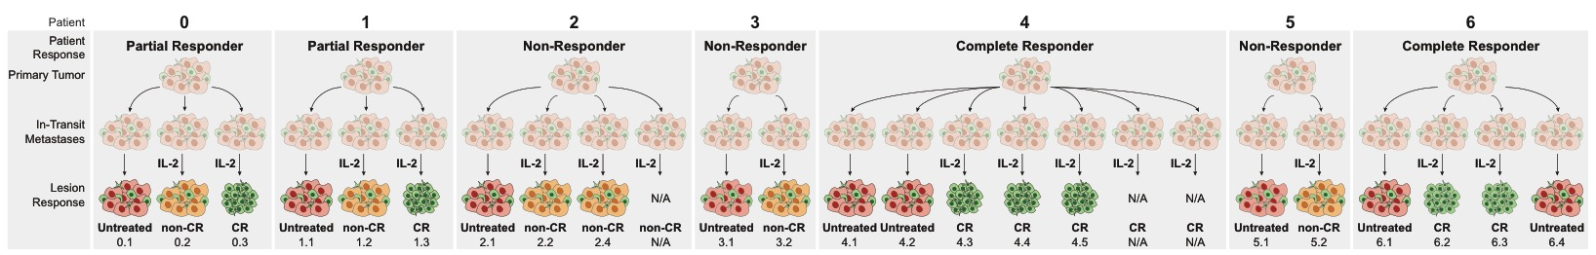
Patient Summary
Patient | Overall Response | Analyzed lesions | Untreated lesions | IL-2 Injected lesions | Lesion response: CR | Lesion response: non-CR
0 | Partial Responder | 3 | 1 | 2 | 1 | 1
1 | Partial Responder | 3 | 1 | 2 | 1 | 1*
2 | Non-Responder | 3 | 1 | 3 | 0 | 3
3 | Non-Responder | 2 | 1 | 1 | 0 | 1*
4 | Complete Responder | 5 | 2 | 5 | 5 | 0
5 | Non-Responder | 2 | 1 | 1 | 0 | 1*
6 | Complete Responder | 4 | 2 | 2 | 2 | 0
Sum |  | 22 | 9 | 16 | 9 | 7
Sum of FOVs |  | 333 | 112 | 221 | 101 | 120
IL-2 Lesion Response: 56.3% CR, 43.8% non-CR
IL-2 Patient Response: 28.6% Complete Responder, 28.6% Partial Responder, 42.9% Non-Responder
*IL-2 injection followed by TVEC injection
Notes:
NOTE: Lesion counts includes non-analyzed lesions

Slide 2
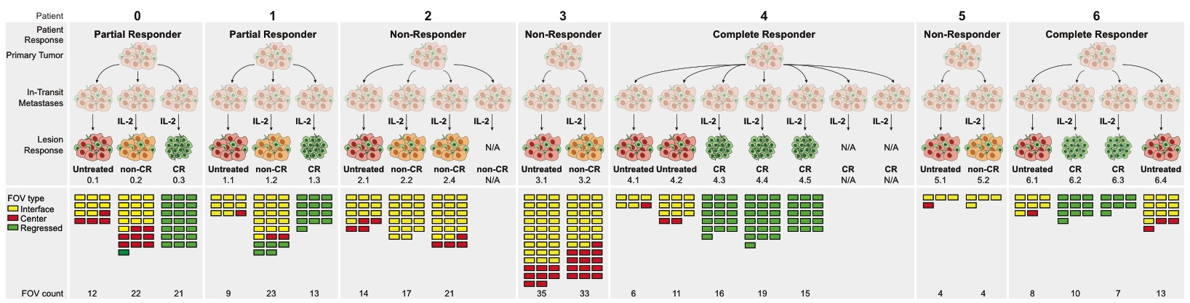
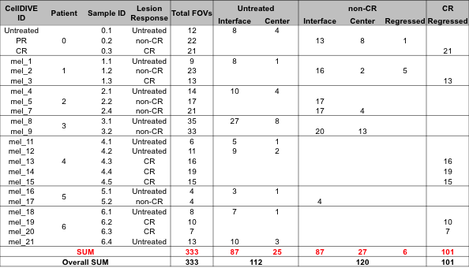
FOV Summary

Slide 3
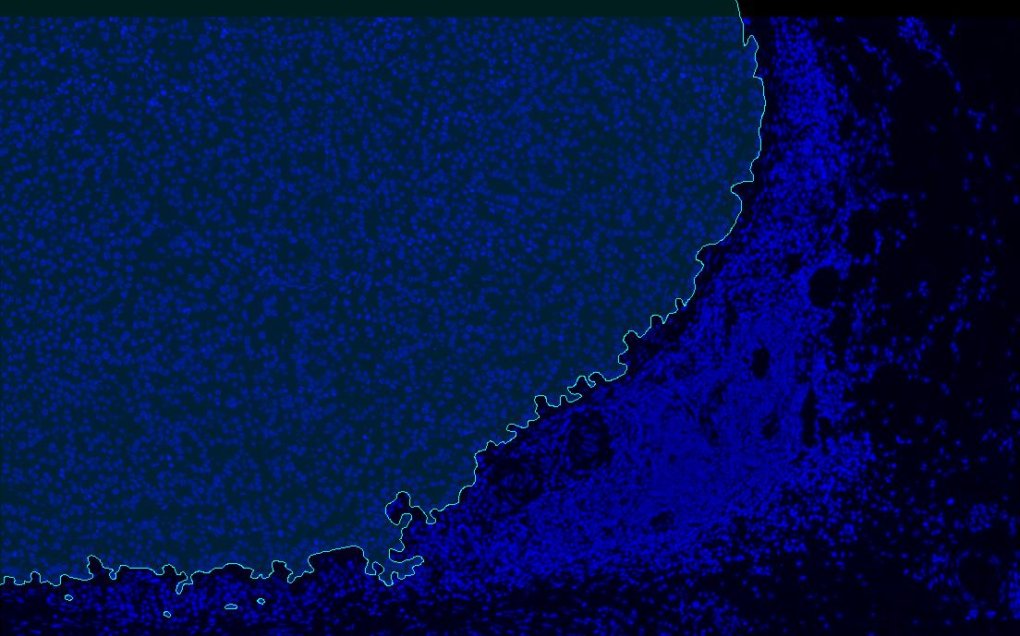
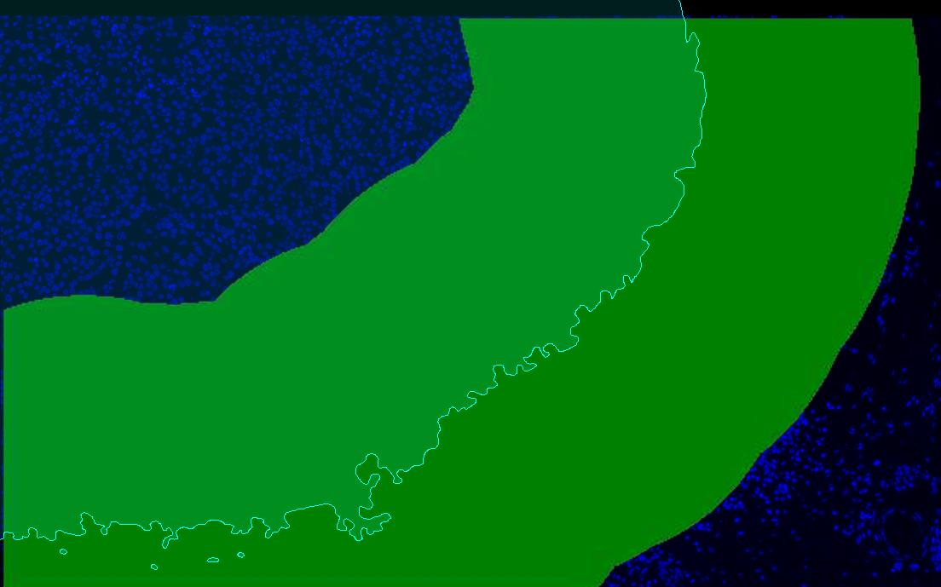
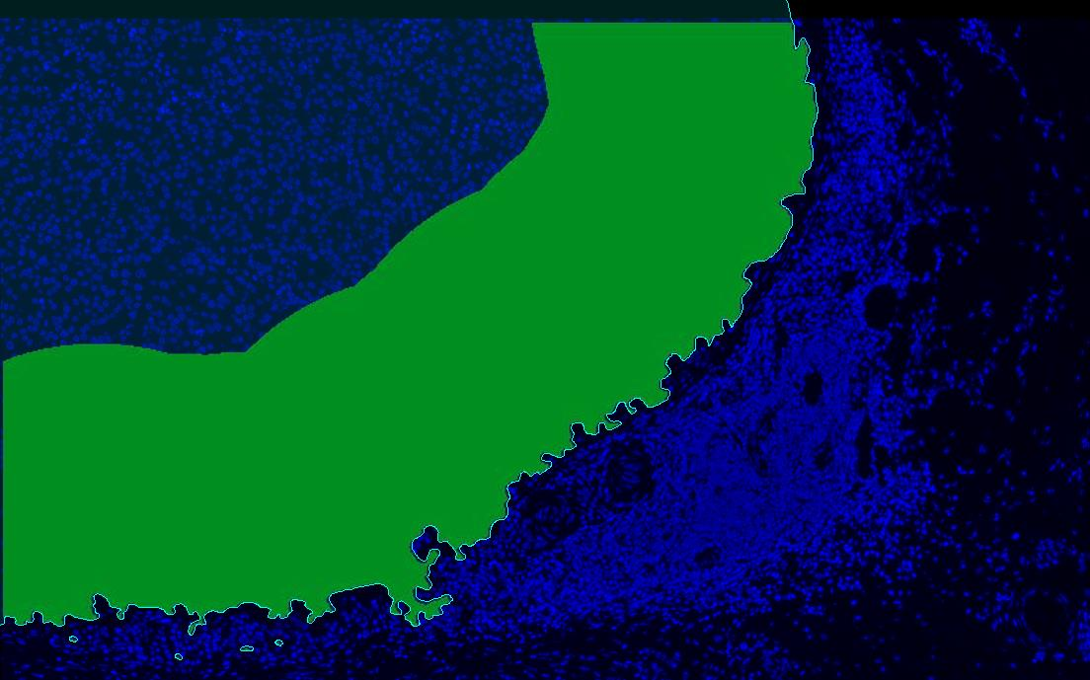
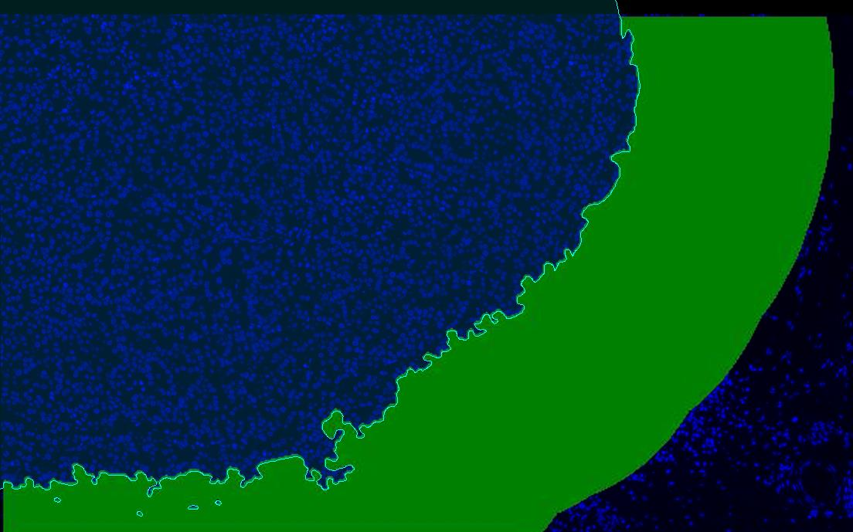
Interface FOV analyses
Interface
-360:360 µm
All
Inside
-360:0 µm
Outside
0:360 µm

Slide 4
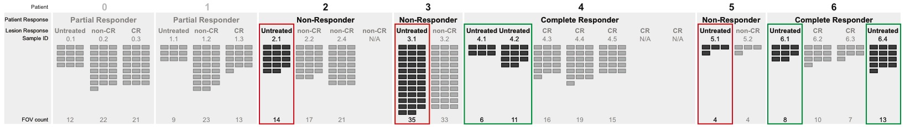
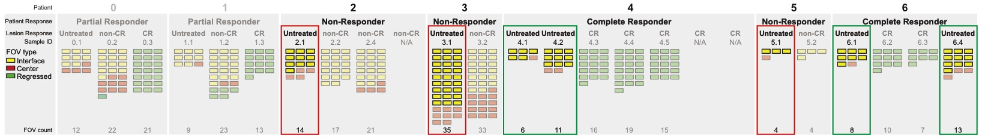
Question 1a: How does the tumor microenvironment of untreated “IL-2 Complete Responders” versus “IL-2 non-Responders” differ?
Overall
FOV Count
IL-2 non-Responder: 53
IL-2 Complete Responder: 38
At the interface: all interface -360:360, inside -360:0, outside 0:360
FOV Count
IL-2 non-Responder: 40
IL-2 Complete Responder: 31
Notes:
This analysis can also be completed for center FOVs:
Untreated Center FOVs “IL-2 complete responder n=7” vs “IL-2 non-responder n=13”

Slide 5
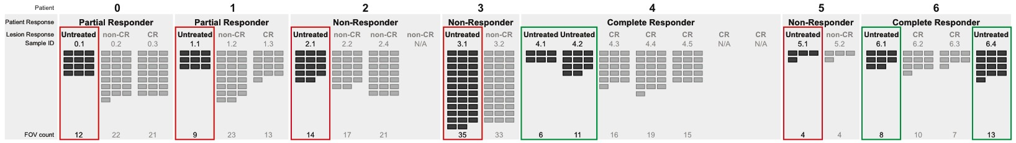
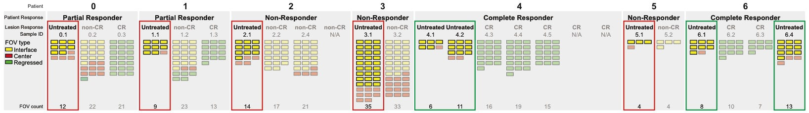
Question 1b: How does the tumor microenvironment of untreated “IL-2 Complete Responders” versus “IL-2 non/Partial Responders” differ?
Overall
FOV Count
IL-2 non/Partial Responder: 74
IL-2 Complete Responder: 38
At the interface: all interface -360:360, inside -360:0, outside 0:360
FOV Count
IL-2 non/Partial Responder: 56
IL-2 Complete Responder: 31
Notes:
This analysis can also be completed for center FOVs:
Untreated Center FOVs “IL-2 complete responder n=7” vs “Il-2 non/partial responder n=18”

Slide 6
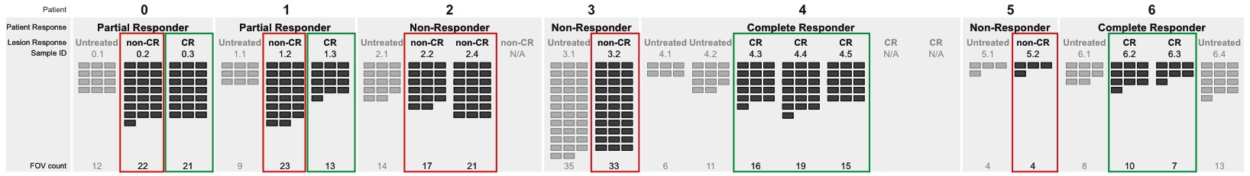
Question 2a: How does the type and function of immune cells in IL-2 treated CR versus non-CR lesions differ?
FOV Count
non-CR: 120
CR: 101
Notes:
Other option:
4-way comparison between: IL-2 treated CR n=101; IL-2 treated non-CR Interface FOVs n= 87; IL-2 treated non-CR Center FOVs n=27; IL-2 treated non-CR Regressed FOVs n=6

Slide 7
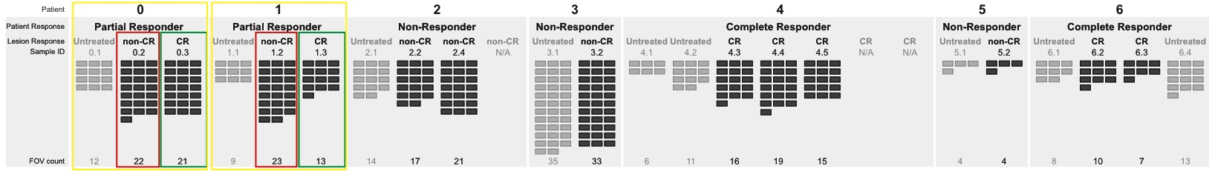
Question 2b: How does the type and function of immune cells in IL-2 treated CR versus non-CR lesions differ in Partial Responders?
FOV Count
non-CR versus CR by patient
Pt 0: 22, 21
Pt 1: 23, 13

Slide 8
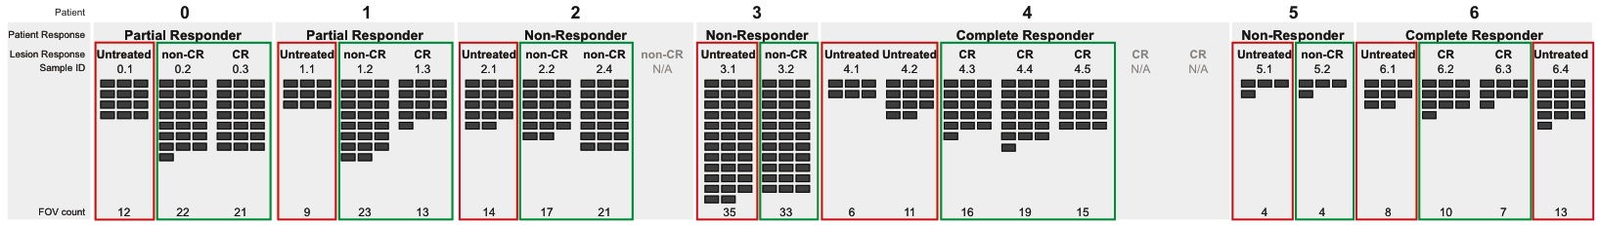
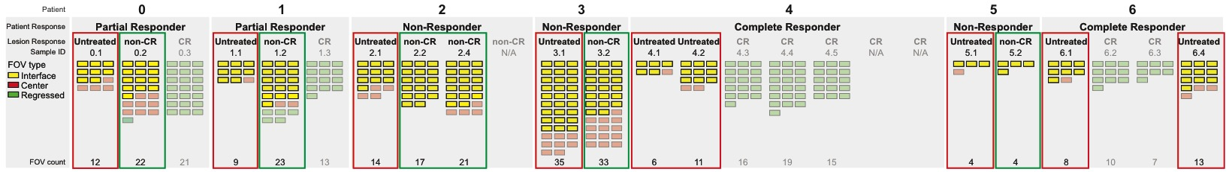
Question 3a: How do untreated and IL-2 treated lesions differ? (effects of IL-2)
Overall
FOV Count
Untreated: 112
IL-2 treated (CR & non-CR): 221
At the interface: all interface -360:360, inside -360:0, outside 0:360
FOV Count
Untreated: 87
IL-2 treated non-CR: 87
Notes:
Other option:
3-way comparison between untreated, non-CR, CR

Slide 9
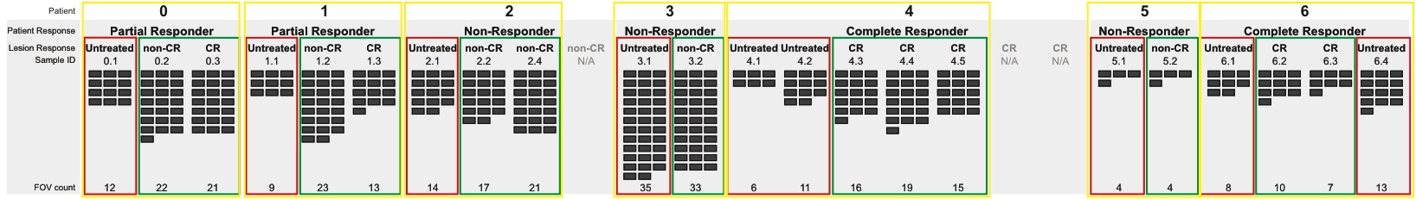
Question 3b: How do untreated and IL-2 treated lesions differ by patient? (effects of IL-2)
Overall
FOV Count
Untreated versus IL-2 treated (CR & non-CR) by patient
Pt 0: 12, 43
Pt 1: 9, 36
Pt 2: 14, 38
Pt 3: 35, 33
Pt 4: 17, 50
Pt 5: 4, 4
Pt 6: 21, 17
Notes:
NOTE: Color each patient’s spreadsheet with a different color and merge into one spreadsheet -> resort OR compare significant differences between each patient
Other option:
3-way comparison between untreated, non-CR, CR

Slide 10
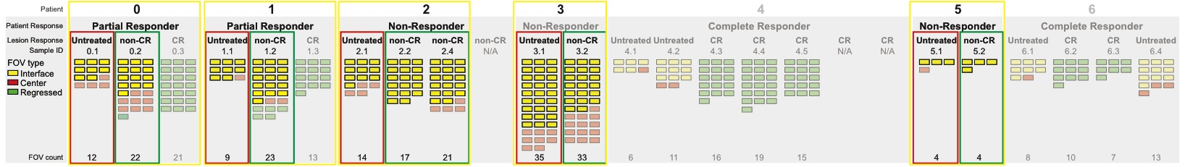
Question 3b: How do untreated and IL-2 treated lesions differ by patient? (effects of IL-2)
At the interface: all interface -360:360, inside -360:0, outside 0:360
FOV Count
Untreated versus IL-2 treated non-CR by patient
Pt 0: 8, 13
Pt 1: 8, 16
Pt 2: 10, 34
Pt 3: 27, 20
Pt 5: 3, 4
Notes:
NOTE: Color each patient’s spreadsheet with a different color and merge into one spreadsheet -> resort OR compare significant differences between each patient
Other option:
3-way comparison between untreated, non-CR, CR

Slide 11
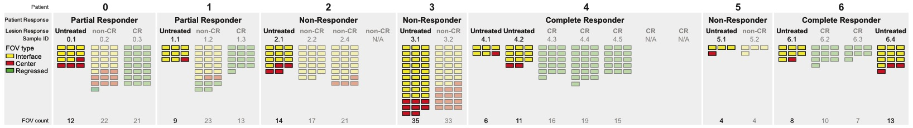
Question 4a: How does the tumor microenvironment of untreated tumors differ at the interface versus center of tumor?
FOV Count
Untreated Center: 25
Untreated Interface: 87
Being completed as:
Total interface vs. center
Interface -360:360 vs. center
Notes:
This analysis can also be completed at the patient level

Slide 12
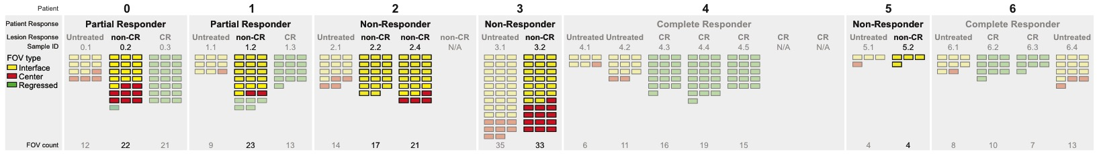
Question 4b: How does the tumor microenvironment of non-CR tumors differ at the interface versus center of tumor?
FOV Count
non-CR Center: 27
non-CR Interface: 87
Being completed as:
Total interface vs. center
Interface -360:360 vs. center
Notes:
This analysis can also be completed at the patient level

Slide 13
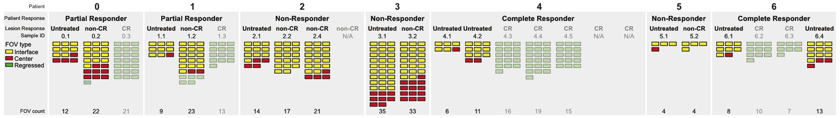
Question 4c: How does the tumor microenvironment of untreated and non-CR tumors differ at the interface versus center of tumor?
FOV Count
Untreated & non-CR Center: 52
Untreated & non-CR Interface: 174
Being completed as:
Total interface vs. center
Interface -360:360 vs. center
Notes:
This analysis can also be completed at the patient level

